Slide 1
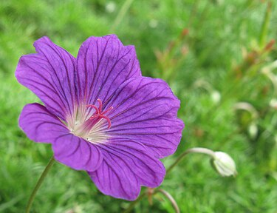
Welcmoe

Slide 2
Md. Rajib Ahamed Raju
Assistant Teacher (English)
Chand Mia Secondary School
Nesrabad, Pirojpur
Introduction:
Class: 6
Subject: English
Experience Name:The Missing Tenth Man
Time: 1 Hour
Date: 26-04-2024

Slide 3
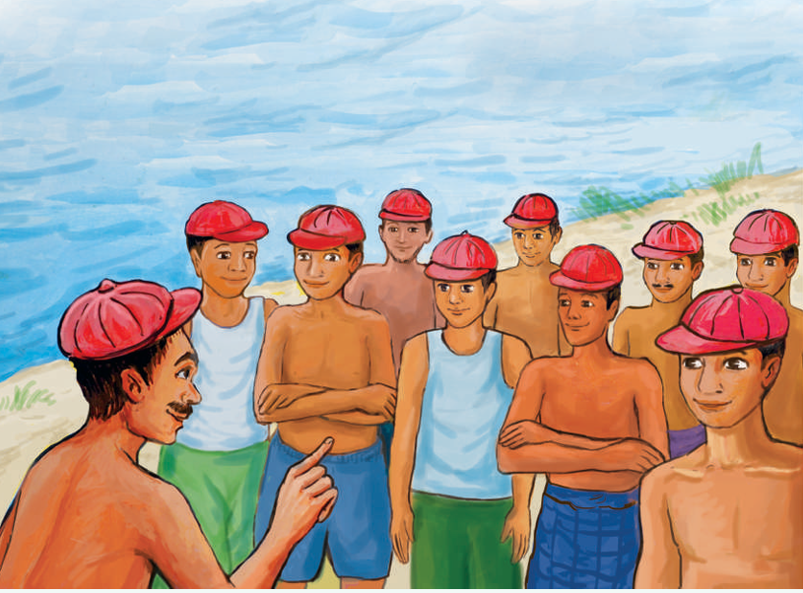
What can yu osee?

Slide 4
The Missing Tenth Man

Slide 5
One day, a group of ten men went to the river Padma to take a dip. They held each other’s hand while taking the dip. But they somehow forgot to hold hands while coming out of the water. After returning to the shore, Rothin Babu, one of the senior men asked, “Have we all crossed the river safely?” All the men in the group started looking at each other. They were confused. Then the senior man asked everyone to lift their hands up to take a count. He started counting each person and the count stopped at nine. Thinking that one man was missing all the men started screaming. They even started looking for the missing tenth man. That went on with each person counting men up to nine and missing the tenth man. Seeing this, a cap seller told, “I can help you”. He gave a cap to each man and asked them to wear it. The men were confused as to what was happening. The seller asked the senior man to gather all the caps, including his own, and count them all. Everyone was happy to see ten caps, that means no one was missing at all. The silly men thanked the seller for his help to find their missing member and believed it to be a magic!

Slide 8
Home work:

Slide 12
The End
Thank You

