Slide 1
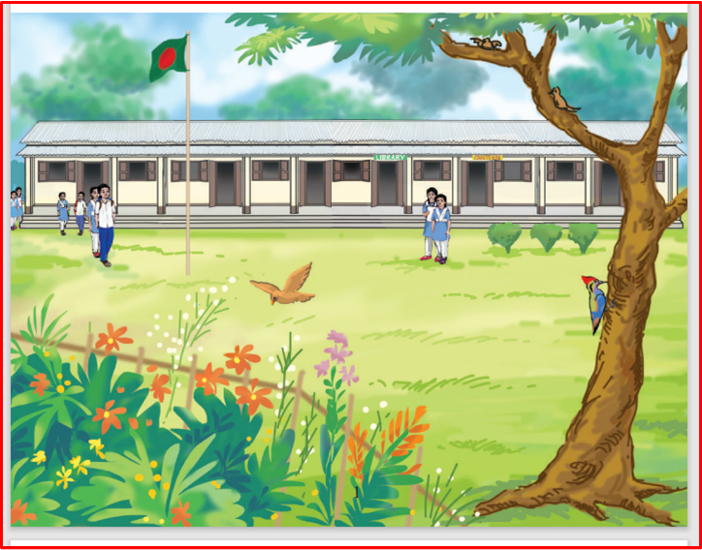

Slide 2
GRATEFUL TO ALL

Slide 3
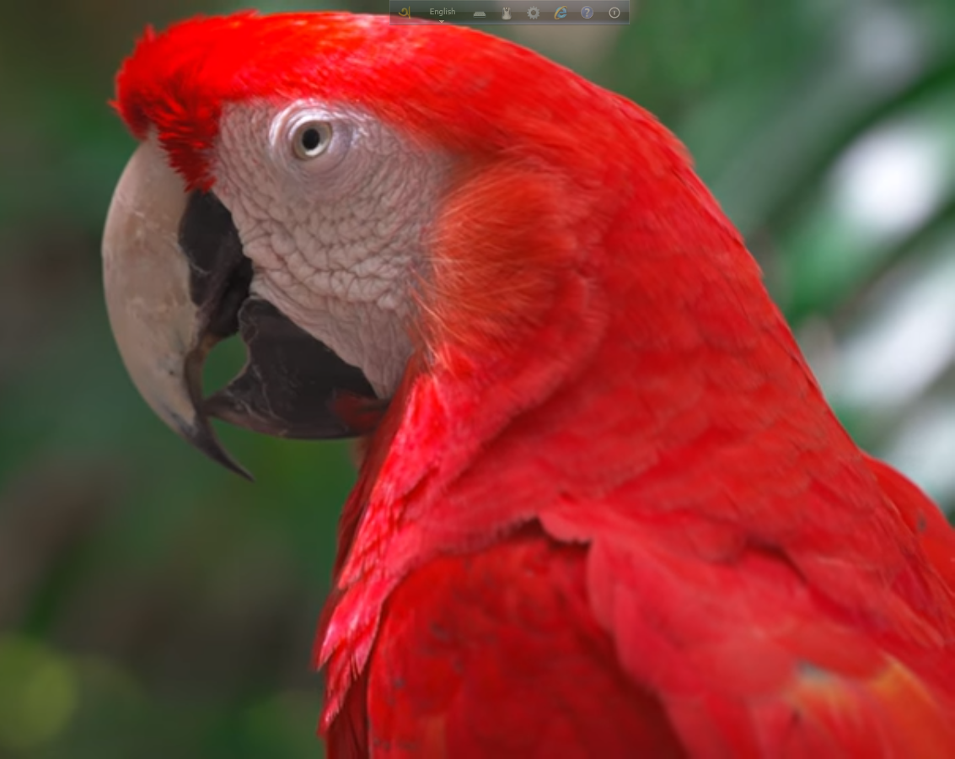
welcome

Slide 4
Introduction
Palash Biswas
Assistant Teacher English
Auria Islamia Hosseinia Dakhil Madrasah
Necharabad,Pirojpur.
01737872249

Slide 5
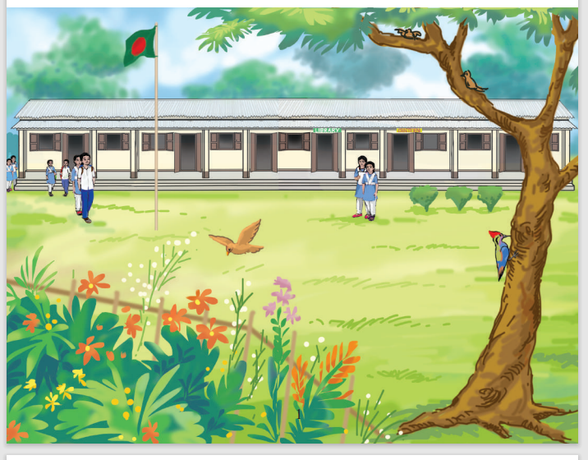
What do you see?
School Campus

Slide 6
Do You like your school? Why?
What do you have in your school?

Slide 7
Today’s Topic
Dream School

Slide 8
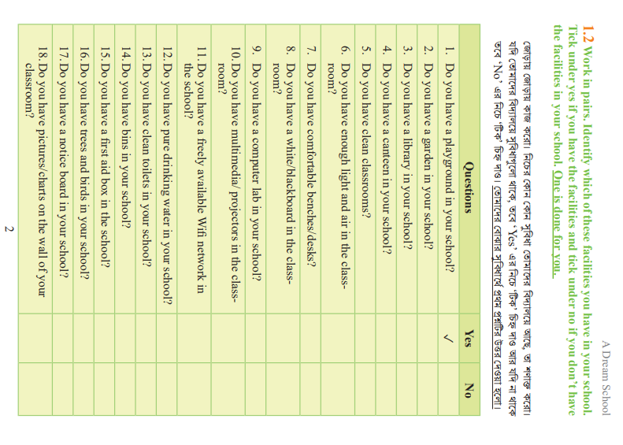

Slide 9
Improve
উন্নত করা
Rise
Ant.
Worsen

Slide 10
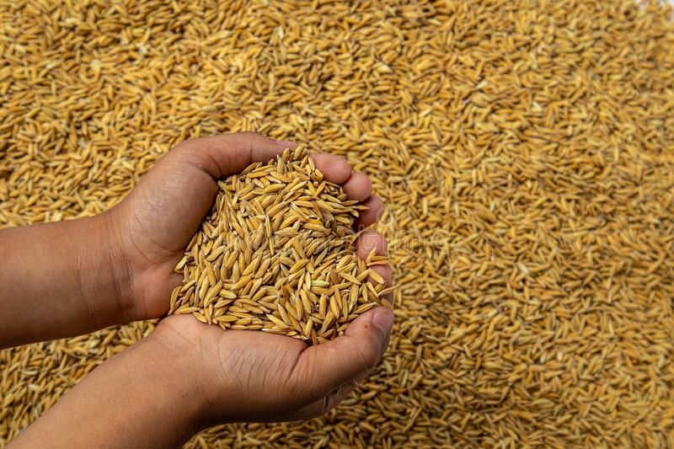
Available
সহজল্ভ্য
Accessible
Ant. Unavailable

Slide 11
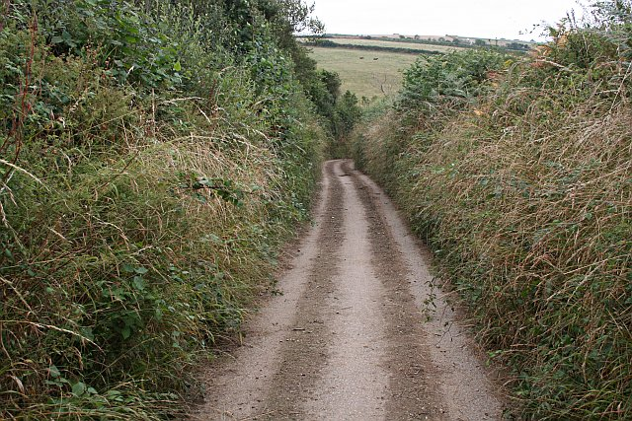
Tiny
ক্ষুদ্র
Mini
Ant. Enormous

Slide 12
Bin
আবর্জনা জড়ো করে রাখার পাত্র
A receptacle for storing
a specified substance.
Ant. Recycle

Slide 13
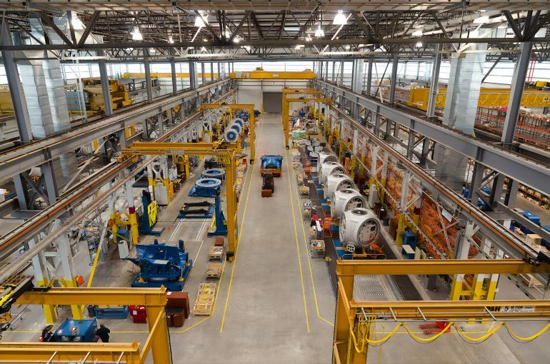
Facility
সুবিধা
Ant.Difficult
Easiness

Slide 14
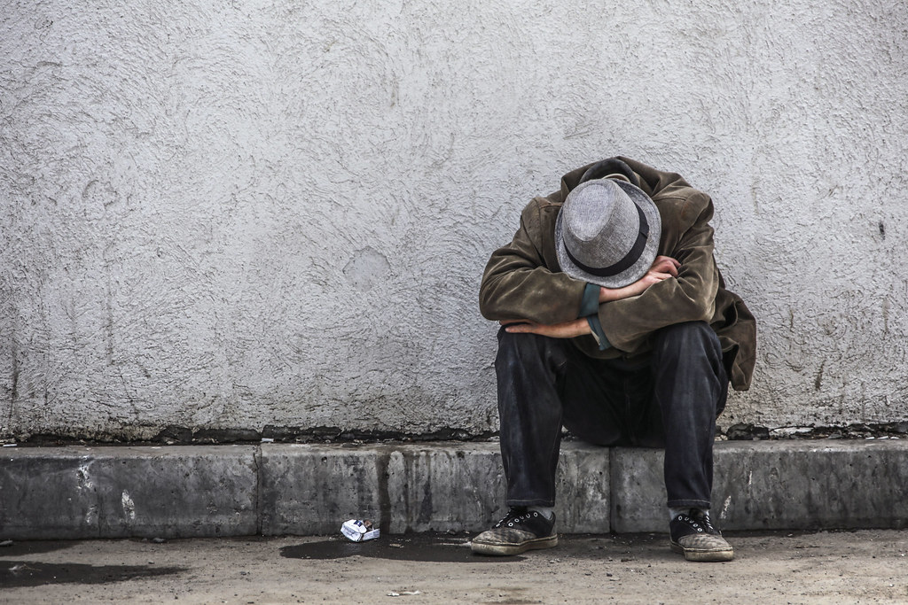
unfortunate
দূর্ভাগ্য
Unlucky
Ant.Fortunate

Slide 15
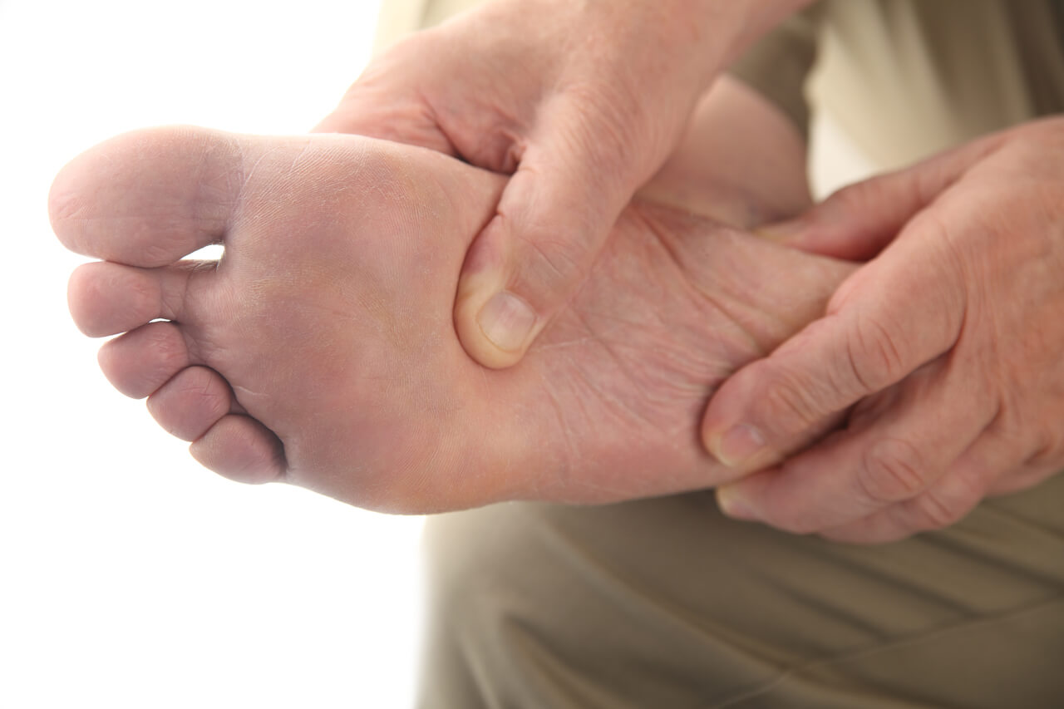
Remove
অপসারণ
Carry away
Ant.Insert

Slide 16
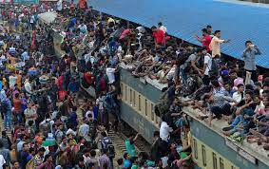
Vacation
অবকাশ
Leisure
Ant.Duty

Slide 17
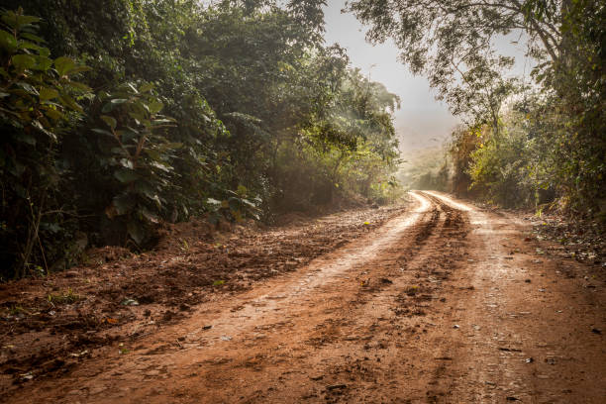
Muddy Road
মাটির রাস্তা
Muddy Pathway
Ant.Pavement

Slide 18
Pre-reading Activities
Who are Faria &Raihan?
Where does Raihan visit?
How does the garden of Faria’s school?

Slide 19
While-readingActivities
Raihan: That’s great! I’ll ……… that.
Faria: This’s our school garden (……………), we all love it.
Faria: That’s a “Dighi”, my dear cousin. ……… you have one in yours?
Raihan: Let’s …….. inside, will that be all right?
Faria: Here is my school.
Faria: It will be just fine.
Raihan: Look at that!! So nice, I ………..
Raihan: We have a small one, a pond you can say and it is ………… by a multistoried school building.

Slide 20
Post-reading Activities
Do you have a library here?
what do you like most about your school?
How does Faria’s School Librar?
How does Raihan’s school garden?
How does Raihan’s school Playground?

Slide 21
Thank You

