Slide 1
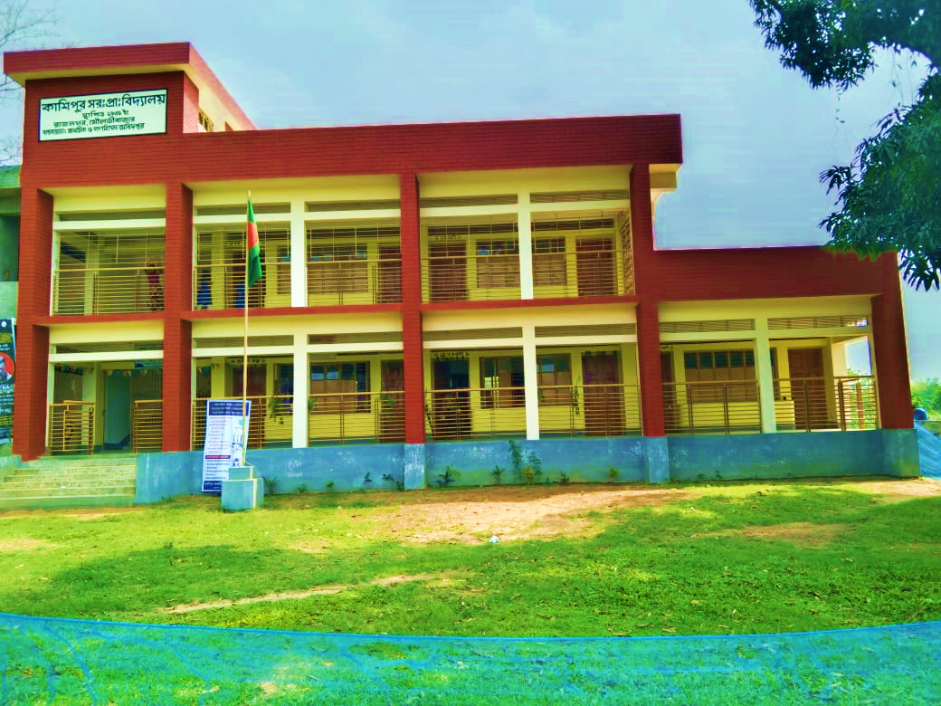








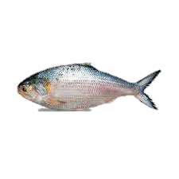


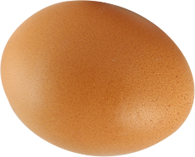
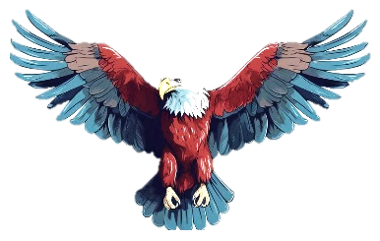




H
O
E
L
L

Slide 2

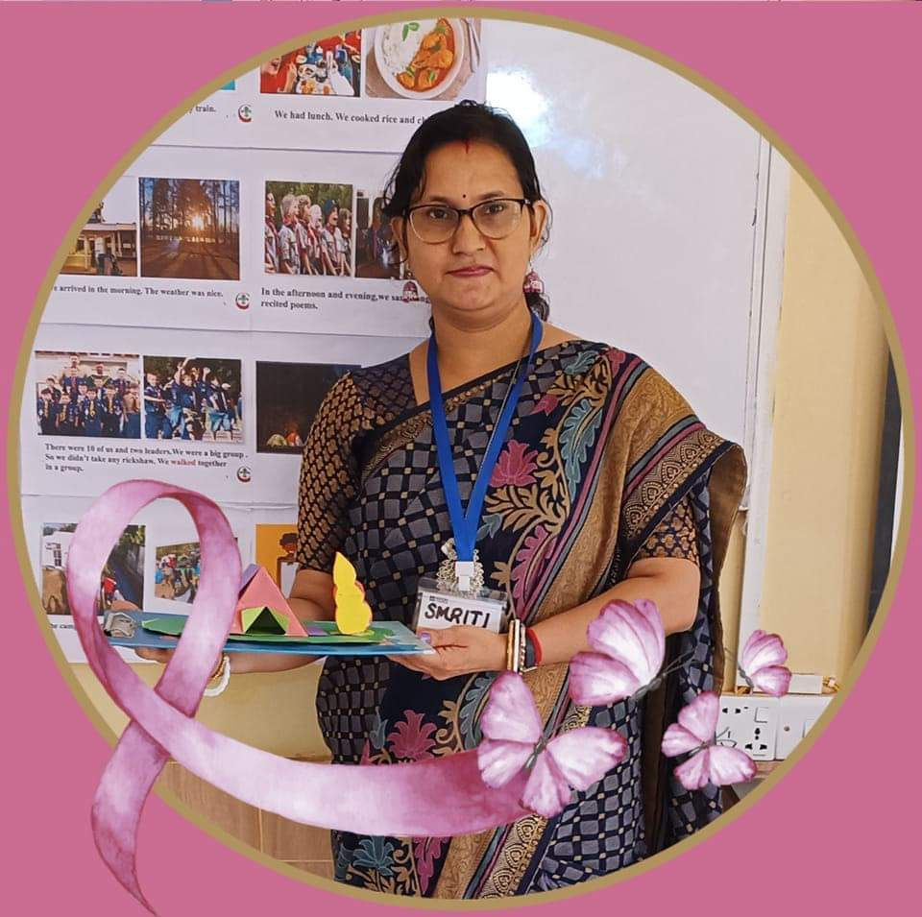


Presented by ,,
Smriti Rani Dey
Head Teacher
Kashipur GPS.
Rajnagar ,Moulvibazar
smritidey2011@gmail.com

Slide 3


Introduction
Class one
Unit 2
Lesson 2(Ee,Ff)
Page 23

Slide 4
LISTENING:
1.1.1 recognize the sounds of the alphabet in familiar words .
1
SPEAKING:
3.1.1 say proper sounds of the letters in familiar words .
2
READING:
4.1.1 read the pictures of familiar objects and events.
3

Slide 5
Let’s sing.

Slide 6

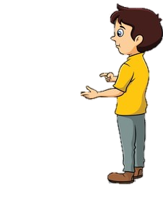
What did we learn yesterday ?
Cc
Dd

Slide 7
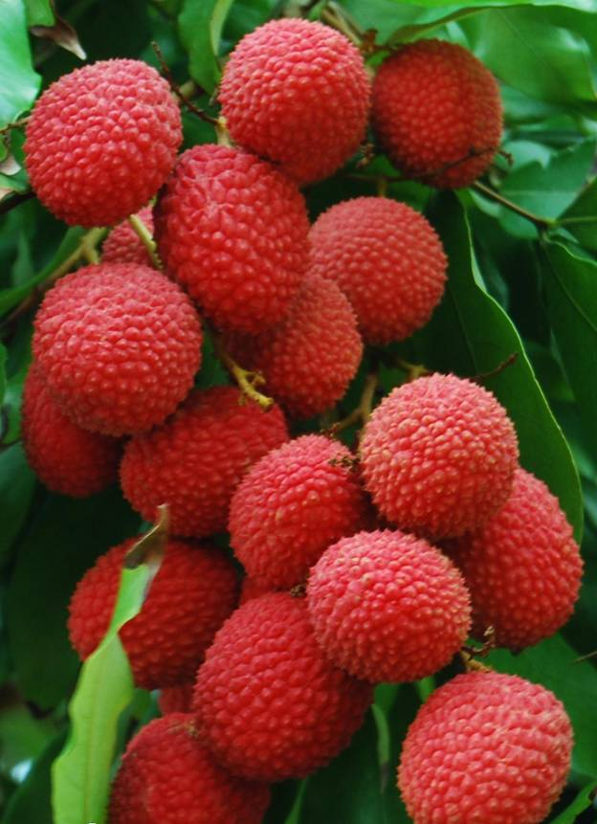


We are going to learn some English letters today ,
Ee,Ff

Slide 8

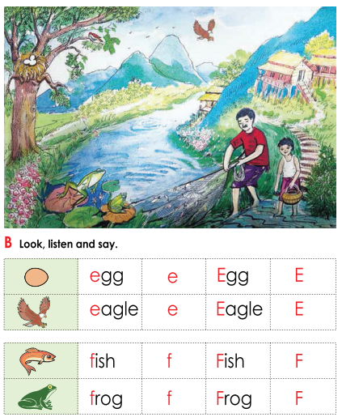
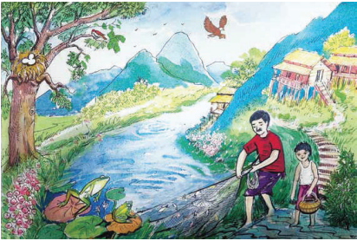
Open your book at page : 23
What can you see in the picture?

Slide 9
What can you see in the picture?
fish
frog
eagle
egg
bird
boy

Slide 10
What’s this?
How do we say that in English?

Slide 11
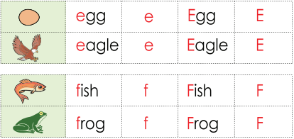
Listen to me and repeat after me
egg
e
Egg
E

Slide 12

What’s this?
How do we say that in English?

Slide 13
Listen to me and repeat after me
eagle
e
Eagle
E

Slide 14
Listen to me and repeat after me
e
E
capital E
Small e

Slide 15
The letter name of E is /i/

Slide 16
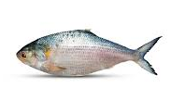
What’s this?
How do we say that in English?

Slide 17
Listen to me and repeat after me
fish
f
Fish
F

Slide 18

What’s this?
How do we say that in English?

Slide 19
Listen to me and repeat after me
frog
f
Frog
F

Slide 20
Listen to me and repeat after me
f
F
capital F
Small f

Slide 21
The letter name of F is /ef/

Slide 22
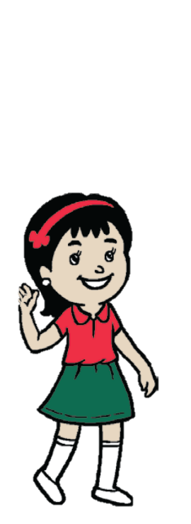






What’s this?
PW
egg
fish
eagle
frog

Slide 23
Say the sound of letter
PW
e
f
/i/
E
/ef/
F

Slide 24
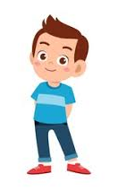

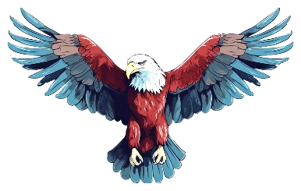
When I say the word(fish.frog,egg,eagle)you will touch the picture .
Whoever touches first get 1 Point
Group 1
Group 2
1+1+ | 1+1+
Group 1
Group 2
Let’s play touch the board.

Slide 25

Matching letter with picture.
GW
Group 1
Group 2
f
e
f
e

Slide 26


Lets play a game (kims game).
Close your eyes
Open your eyes
Which word have I covered

Slide 27

Assessing learning
What’s this?
fish
frog
egg
eagle

Slide 28
Assessing learning
Listen to the audio and round the correct letter.
/di/
/i/
c
e
g
a
f
b
d

Slide 29
Assessing learning
e
eagle
egg
frog
fish
f
f
Say the first letter ..
e

Slide 30

Draw and colour a fish.

Slide 31

Thank you

