Slide 1
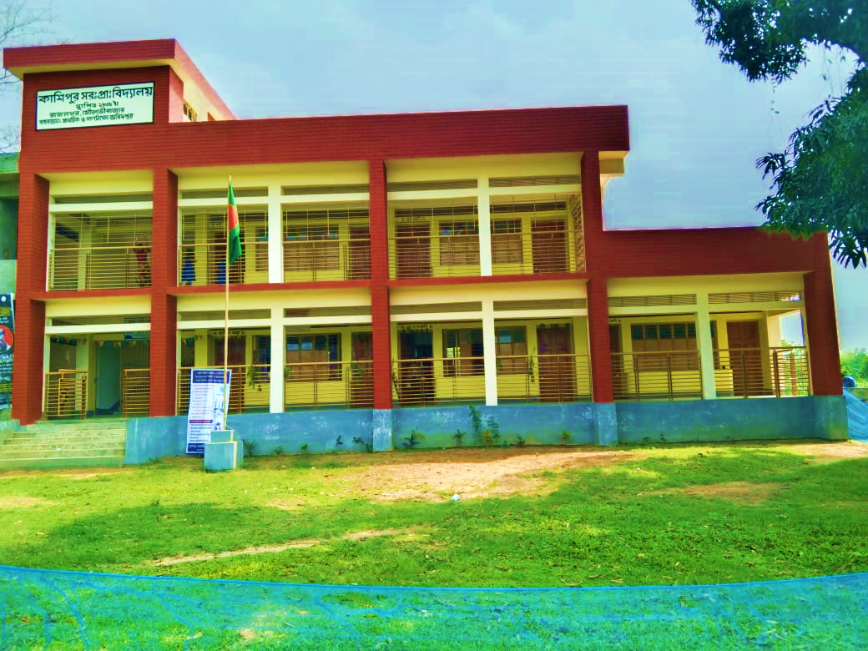











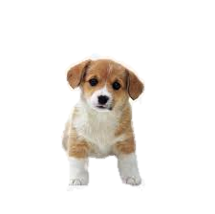
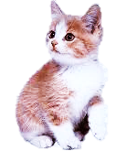
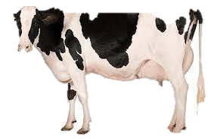

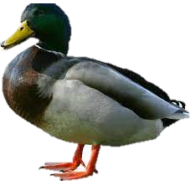

H
O
E
L
L

Slide 2

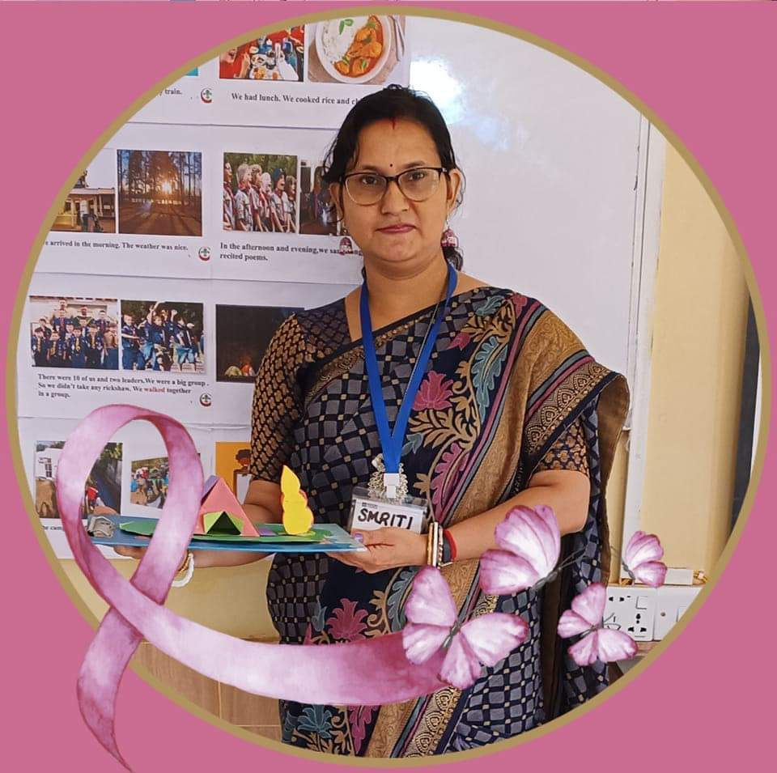


Presented by ,,
Smriti Rani Dey
Head Teacher
Kashipur GPS.
Rajnagar ,Moulvibazar
smritidey2011@gmail.com

Slide 3


Introduction
Class one
Unit 2
Lesson 2(Cc,Dd)
Page 17

Slide 4
LISTENING:
1.1.1 recognize the sounds of the alphabet in familiar words .
1
SPEAKING:
3.1.1 say proper sounds of the letters in familiar words .
2
READING:
4.1.1 read the pictures of familiar objects and events.
3

Slide 5
Let’s sing.

Slide 6

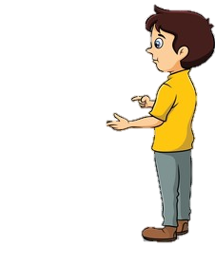
What did we learn yesterday ?
Aa
Bb

Slide 7
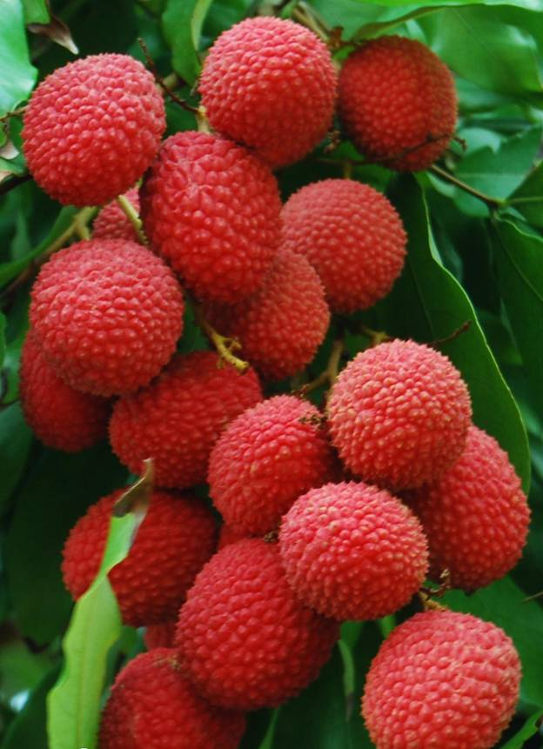


We are going to learn some English letters today ,
Cc,Dd

Slide 8

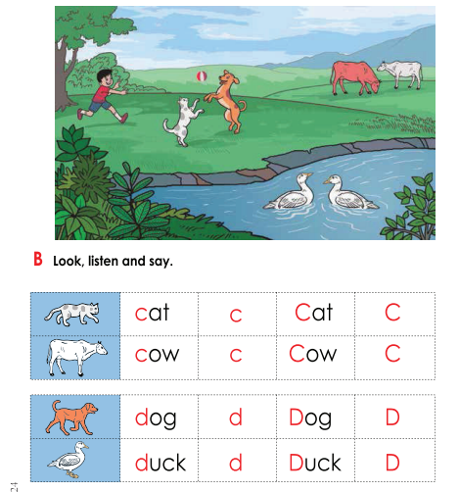
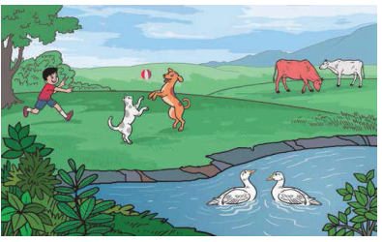
Open your book at page : 17
What can you see in the picture?

Slide 9
What can you see in the picture?
ball
boy
cow
duck
dog
cat

Slide 10
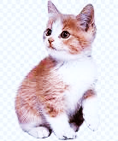
What’s this?
How do we say that in English?

Slide 11
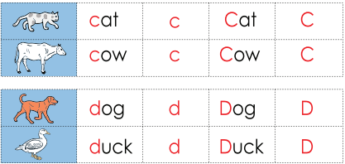
Listen to me and repeat after me
cat
c
Cat
C

Slide 12
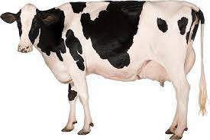
What’s this?
How do we say that in English?

Slide 13
Listen to me and repeat after me
cow
c
Cow
C

Slide 14
Listen to me and repeat after me
c
C
capital C
Small c

Slide 15
The letter name of C is /si/

Slide 16
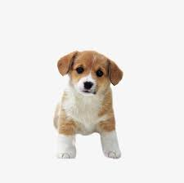
What’s this?
How do we say that in English?

Slide 17
Listen to me and repeat after me
dog
d
Dog
D

Slide 18
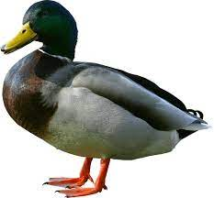
What’s this?
How do we say that in English?

Slide 19
Listen to me and repeat after me
duck
d
Duck
D

Slide 20
Listen to me and repeat after me
d
D
capital D
Small d

Slide 21
The letter name of D is /di/

Slide 22




What’s this?
PW
cat
duck
cow
dog

Slide 23
Say the sound of letter
PW
c
d
/si/
C
/di/
D

Slide 24
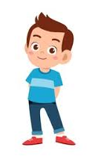

When I say the word(cat,cow,dog,duck)you will touch the picture .
Whoever touches first get 1 Point
Group 1
Group 2
1+1+ | 1+1+
Group 1
Group 2
Let’s play touch the board.

Slide 25
Matching letter with picture.
GW
Group 1
Group 2
d
c
d
c

Slide 26

Lets play a game (kims game).
Close your eyes
Open your eyes
Which word have I covered

Slide 27
Assessing learning
What’s this?
dog
cat
cow
duck

Slide 28
Assessing learning
Listen to the audio and round the correct letter.
/di/
/si/
f
e
c
a
g
d
b

Slide 29
Assessing learning
d
cow
cat
duck
dog
c
d
Say the first letter ..
c

Slide 30

Draw and colour a cat.

Slide 31
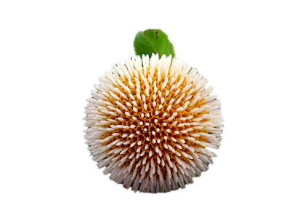
A
K
T
H
N
O
Y
U

