Slide 1




Slide 2

TEACHER’S IDENTITY
Md. Farid Uddin
Lecturer in English
Chipatali J.G.M Kamil(M.A) Madrasah
Hathazari, Chattogram.

Slide 3
LESSON DECLARATION
He is too black_________________
She is too weak _________________
He is too black to love.
She is too weak to walk.
What are these?
So, today we will discuss about
COMPLETING SENTENCES

Slide 4
LEARNING OUTCOMES
BY THE END OF THE LESSON
Students will be able to learn the completing rules.
Students will be able to complete the sentence.

Slide 5
COMPLETING SENTENCE
Rule -01 : Too ------to এতই-------যে
Structure: Sub +a.v+too+adj+ to +verb+obj
Structure 2: Subject + verb+ too+ adjective→ for
ব্যাক্তি বাচক subject এর objective form+ to+ V1+ obj/ext.
She is too weak to speak.
At times it creates too many problems for
me to solve.

Slide 6
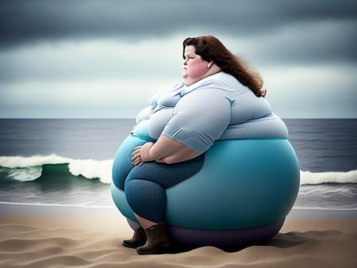
Let ‘s practice the rule( individual)
She is too fat--------------
The sum is too hard for me---------
The load is too heavy for her………
Rana is too strong-------------
He has too much money------------
It is too interesting a matter for us---------

Slide 7
Probable Answer
She is too fat to run.
The sum is too hard for me to solve.
The load is too heavy for her to carry.
Rana is too strong to defeat anybody.
He has too much money to purchase anything anytime.
It is too interesting a matter for us to enjoy

Slide 8
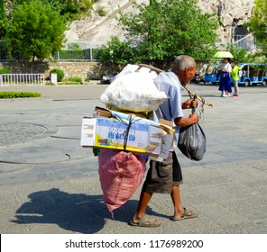
Rule -02: So ------that (এতই-------যে )
Structure : Sub +a.v+so+adj+ that+sub+can/could+not +v1+obj
He is so old that he can not carry the load.
Their throats were so dry that they couldn’t speak.

Slide 9
Let ‘s practice the rule( Pair Work)
He is so expert …………………………………….
She is so intelligent ……………………………..
The man is so weak …………………………….
The man was so mad ----------------------
He is so ill that ----------------------------
The man was so old that ---------------------

Slide 10
Probable Answer
He is so expert that he can solve it easily.
She is so intelligent that she can understand it quickly.
The man is so weak that he cannot move his body.
The man was so mad that he could not recognize anybody.
He is so ill that he can not move an inch.
The man was too old that he could not work.
Note: বাক্যের আগের Verb টি বর্তমানকালের হলে can বসবে আর অতীতকালের হলে could বসবে।

Slide 11
Rule: 03. So that/ In order that (যাতে)
Structure: 1. Subject+ Verb + so that/in order that+ Subject+ can/could+ V1+ Extension.
Structure 2: Present Tense → that/so that/in order that → subject +can/will/may + V1 + obj/ext.
Structure 3: Past Tense→ that/so that/in order that → subject + could/would/might + V1 + obj/ext.
We ate so that we could survive.
She saved money in order that she could buy a gift.
I closed the door so that he might not enter the room.

Slide 12
Let ‘s practice the rule( Group Work)
The farmers sow seeds that ------------
The workers work hard so that ------------
We ate so that --------------------------------
She saved money in order that ---------------------
The farmers sow seeds so that -------------
We build house so that --------------
We drink water so that ------------

Slide 13
Probable Answer
The farmers sow seeds that they may get a harvest.
We ate so that we could survive.
She saved money in order that she could buy a gift.
The workers work hard so that they may/can earn a decent salary.
The farmers sow seeds so that they may get a harvest.
We build house so that we may live in.
We drink water so that we can satisfy our thrist.

Slide 14
Rule: 04. Lest/In case (যাতে.. না/ নতুবা)
Structure: Any Tense→ Lest→ subject + should/might + V1 + object.
অথবা Sub +verb+obj+lest+ +sub+should/might +v1+obj
Read attentively lest You should fail in the exam.
Walk fast lest you should miss the train.
We drink pure water lest we should suffer in the long run.
Take your umbrella lest you should get wet.

Slide 15

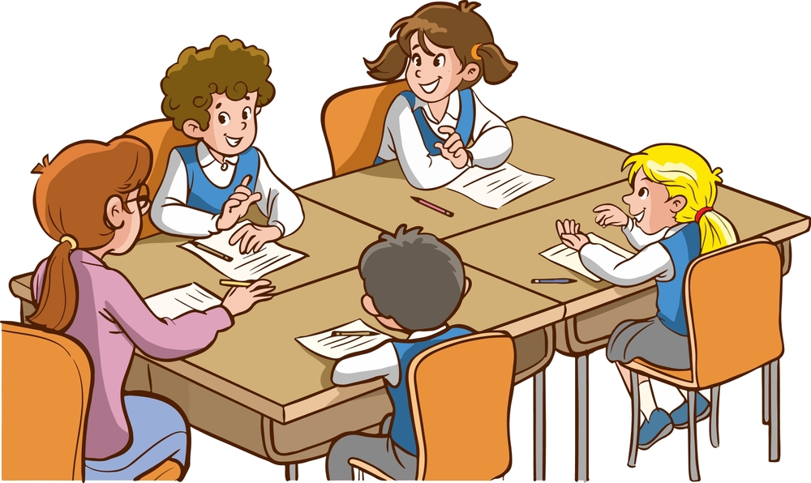
They kept watching all night lest ------------------------
I’ve bought a chicken in case ----------------------------.
I wrote down her address in case ----------------------
We must take care lest ------------------------------------
We must take immediate action lest ------------------
Take your umbrella lest -----------------------------------
He hide in the woods lest --------------------------------
Walk fast lest ------------------------------------------------
Walk carefully lest ------------------------------------------
Read attentively lest ---------------------------------------

Slide 16
Probable Answer
They kept watching all night lest robbers should come.
I’ve bought a chicken in case Raj should stay for lunch.
I wrote down her address in case I should forget it.
We must take care lest evil thoughts enter our hearts.
We must take immediate action lest it grew worse.
Take your umbrella lest you should get wet.
He hide in the woods lest the soldiers would find him
Walk fast lest you should miss the train.
Walk carefully lest you should fall down.
Read attentively lest You should fail in the exam.

Slide 17

Home Work
Take your umbrella lest ------------------
We build house so that --------------
The load is too heavy for her………
I’ve bought a chicken in case ----------------
She is so intelligent ……………
He has too much money------------
She saved money in order that -------------------
I wrote down her address in case ------------
We must take immediate action lest ---------
We drink water so that ------------
He hide in the woods lest ----------------
He is so expert …………………………………….
The farmers sow seeds that ------------
Walk fast lest ------------------------------
Read attentively lest ----------------------

Slide 18


