Slide 1


Paragraph
Uses and abuses of mobile phone

Slide 2
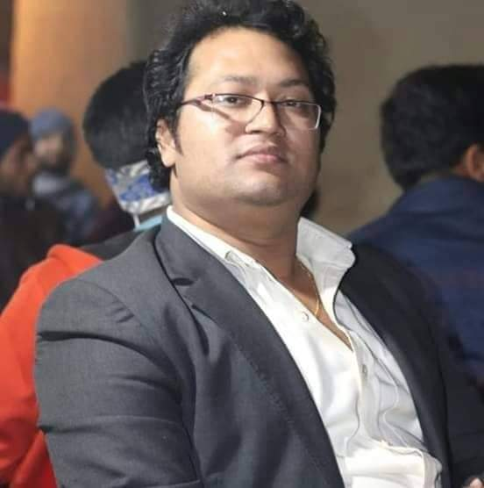
ANUPAM SARKAR
Assistant Teacher
G.G.K.H. Kanailal High School
Satkhira Sadar, Satkhira

Slide 3
Uses and abuses of mobile phone
Mobile phones have become an essential part of our daily lives, offering many benefits and some drawbacks. On the positive side, they help us stay connected with family and friends, access information quickly, and use various apps for education and entertainment. Mobile phones also allow for convenient online shopping and banking, making everyday tasks easier.However, there are also many abuses associated with mobile phone use. Excessive screen time can lead to addiction, affecting our health and social interactions. Some people use phones to engage in cyberbullying or spread misinformation, which can harm others. Additionally, using a mobile phone while driving can be dangerous and lead to accidents. While mobile phones are incredibly useful tools that enhance our lives, it’s important to use them responsibly and be aware of their potential negative effects. Balancing their use can help us enjoy the benefits while minimizing the harms.

Slide 4
Thanks all

