Slide 2
Nahidal Arjin
Class : One
Subject : English
Numbers 9 10
Lesson: 15
Unit : 2. Page : 46
Assistant Teacher
Boddipur Govt. Primary School
Satkhira Sadar, Satkhira.

Slide 3
Learning outcomes
Students will able to
4.1.4
Read aloud cardinal numbers in figures properly.

Slide 4


Greetings
Good morning, students.
Good morning, teacher.
How are you, my dear students?
Fine, thank you, teacher.

Slide 5

Let’s see a video song

Slide 6



Review of the previous session:
‘What did we learn yesterday?’
What is it ?
1
2
3
4
5
6
7
8

Slide 7


Todays lesson
is
Todays lesson
is
Numbers 5 6
Numbers

Slide 8
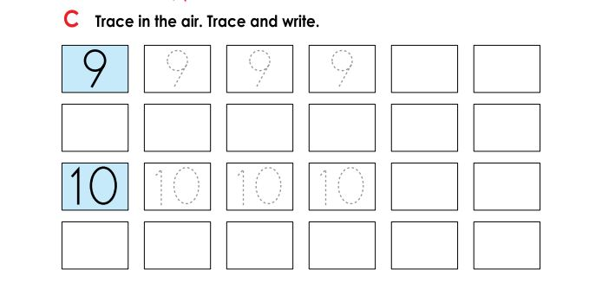
Presentation of the session:
Trace in the air. Trace and write.

Slide 9


Trace in the air. Trace and write.
9
9
9
9
9
9
9
9
10
10
10
10
10
10
10
10

Slide 10
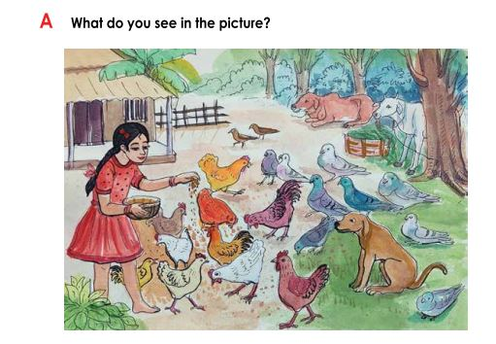
What do you see in the picture?
These are 9 pegon, 10 hens

Slide 11
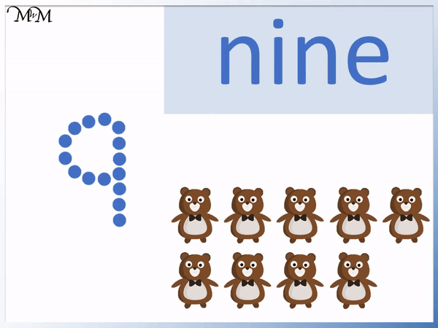
Today we are going to learn how to write 9

Slide 12

Today we are going to learn how to write 10

Slide 13
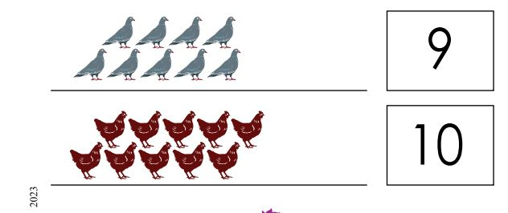
Look, listen and say.
9
What is this, dear students?
Yes, this is pigon.
How many pigons are there?

Slide 14
Look, listen and say.
10
What is this, dear students?
Yes, this is hen.
How many hens are there?

Slide 15
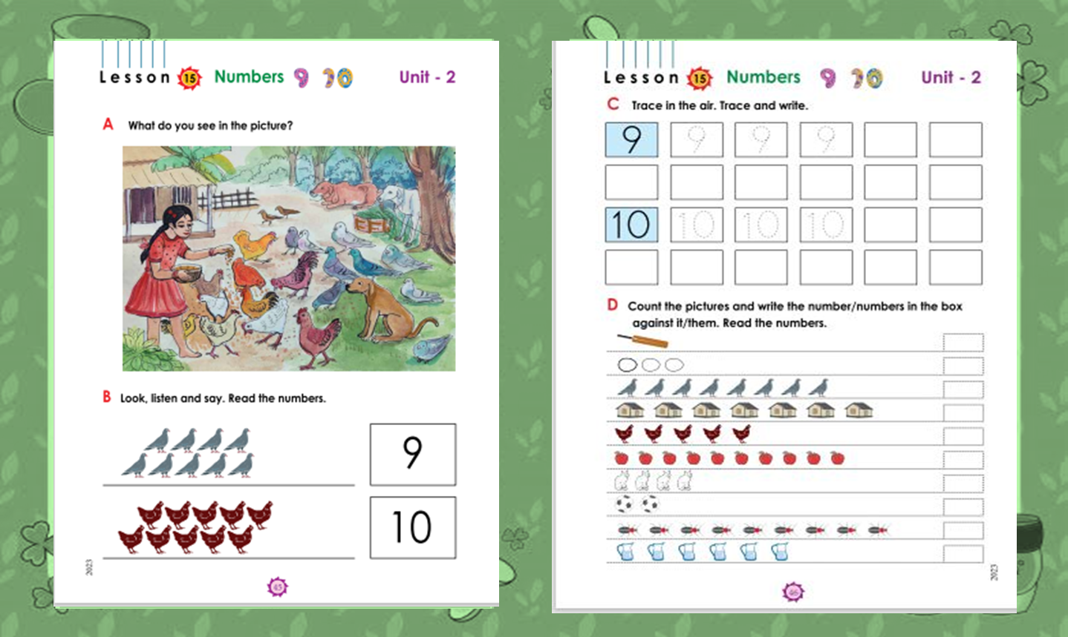

Open at page 45

Slide 16
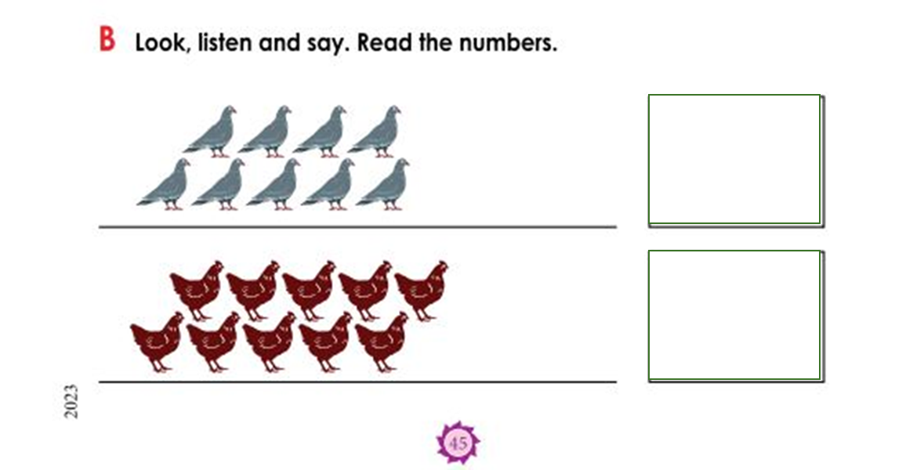
Look, listen and say. Read the numbers.
9
10

Slide 17
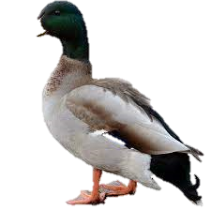

Count and write the number.
9
10

Slide 18
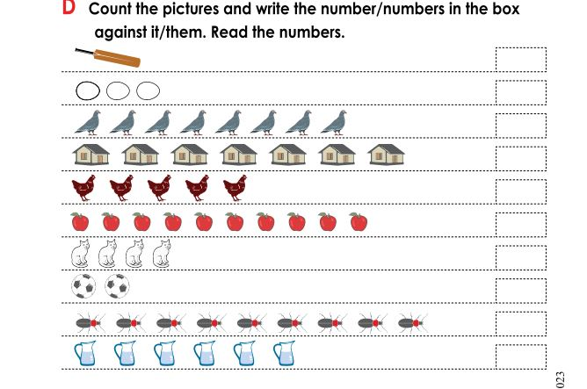
Fill in the blanks.
1
3
8
7
5
10
4
2
9
6

Slide 19


Evaluation
Match the picture.
9
10

Slide 20
Write numbers “ 9,10 ”.

Slide 21
Write numbers “ 9,10 ”

