Slide 1



ASSALAMUALAIKUM
CLASS.
HOW ARE YOU?
ALL.

Slide 2

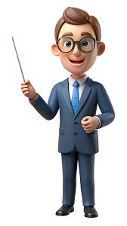
KAMRAN AHMED
LECTURE,ENGLISH
SREEPUR JALALIA KAMIL MADRASAH
֍֍
֍֍
TEACHER’S INTRODUCTION

Slide 3
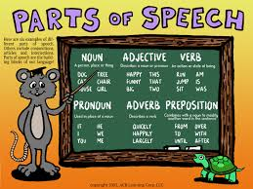
LESSON INTRODUCTION
HEY CLASS!
LET’S CRUSH PARTS OF SPEECH
WELCOME
TO
MY CLASSS

Slide 4

◊TODAY WE WILL LEARN AN IMPORTANT TOPIC.
THE TOPIC IS
LESSON DECLARATION
Parts of
Speech
<PARTS OF SPEECH>

Slide 5






QUICK TEST
●◊ DO YOU KNOW ABOUT PARTS OF SPEECH?
** IF YOU KNOW PLEASE, RAISE YOUR HAND.
∆Look at the pictures ,,
A RED APPLE BALL AN OPEN BOOOK A BOY

Slide 6

After completing the class,We will be able to learn:
*∆ What is parts of speech?
* ∆ How many kinds of parts of speech in English?
∆ *IdentificaItion of parts of speech?
∆*Uses of Parts of speech?
LEARNING OUTCOMES

Slide 7
LESSON PRESENTATION
MY NAME IS RIMA.I HAVE A BOOK.MY TEACHERS ARE VERY GOOD IN TEACHING.
THEY TEACH US VERY SMOOTHLY,BUT WE CAN NOT IDENTIFY PARTS OF SPEECH .TODAY,WE WILL LEARN ABOUT PARTS OF SPEECH.
HURRAH!WE WILL LEARN PARTS OF SPEECH.
DEAR STUDNTS, READ THE PASSAGE BELOW ALOUD
THE MARKED WORDS IN COLOUR ARE PARTS OF SPEECH.

Slide 8
1)What is parts of speech?
*Parts of speech can be defined as words that perform different roles in a sentence .
*Parts of speech work together to build a sentence by performing different roles ,such as ::
@Noun and Pronouns acts as a subject..
@Verbs showing action.
@Adjectives and Adverbs adding detail.
@Conjuctions connect ideas
@Prepositions show relationships between words.
@Interjections express sudden expression.

Slide 9

2)How many parts of speech in english?
8
There are parts of speech in English.
ADJECTIVE
PREPOSITION
CONJUNCTION
NOUN
PRONOUN
VERB
ADVERB
INTERJECTION
HE
NICE
RAHI
PLAY
and
Wow!
Slowly
of

Slide 10
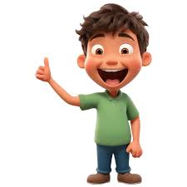



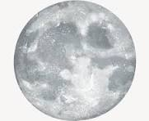

LEARN
WITH
FUN
NOUN
NOUN Refers ,person/place/things name……..
Examples of noun:
*RAHIM
*BALL
*PEN
*LAPTOP
*Moon
*MOBILE PHONE*
ACTION OF A NOUN
*Acting as the subject
*Direct object
*Indirect object
*Subject complementcs

Slide 11

LET’S TALK ABOUT PRONOUN:
*Pronoun is a word that replaces noun.
*Let’s go for searching pronoun in a sentences….
1)HE IS A BOY.
2)IT IS A CAT.
3)THEY ARE STUDENTS.
4)THIS IS NICE FLOWER.
All the words marked in red above are pronoun
(HE,IT,THEY,THIS)

Slide 12

LET’S PLAY WITH VERBS AND ADVERBS :
VERB:A WORD THAT DESCRIBE AN ACTION
ADVERB:A WORD THAT MODIFIES A VERB,ADJECTIVE OR AN OTHER ADVERB .
LET’S SEE HOW THEY WORK…….
1)KARIM PLAYS SLOWLY.
2)A CAT RUN VERY QUICKLY
3)HE READS A BOOK .
4)THIS PC WORKS VERY SMOOTHLY.

Slide 13


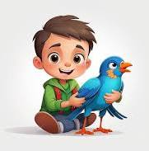

ADJECTIVE
ADJECTIVE IS A WORD THAT DESCRIBES A NOUN OR PRONOUN…
EXAMPLES
*It is a nice flower.
*It is a beautiful bird.
*It was a dark night.

Slide 14

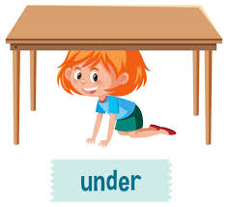

PREPOSITION:<<A PREPOSITION IS AWORD THAT CONNECTS OTHER WORDS IN A SENTENCE.>>.
EXAMPLE:*)THE BOOK IS ON THE TABLE
*)A GIRL UNDER A TABLE
CONJUNCTION :A CONJUCTION IS A WORD CONNECTS WORDS,PHRASES,OR CLAUSES.
EXAMPLE:*)I LIKE SWIMMING AND SHE LIKES PLAYING.

Slide 15



INTERJECTION
INTERJECTION IS A WORD USED TO EXPRESS A SUDDEN ,EMOTION OR REACTION.
,WOW!
OUCH!
HEY!
OH!

Slide 16
HOME WORK FOR THE NEXT CLASS:
Write down the answers to the questions below:
1)What is parts of speech?
2)How many parts of speech in English?
3)Identify the parts of speeches in the sentences:
*Salma is a girl.
*He is a boy.
*I play football.

Slide 17



A BIG THANK YOU TO EVERYONE
BY

