Slide 1
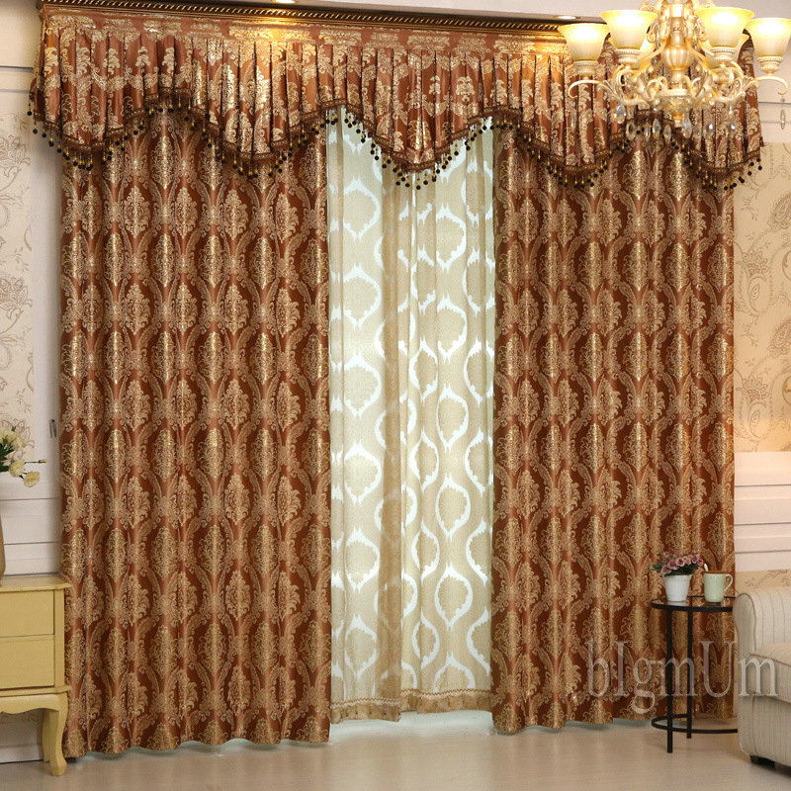

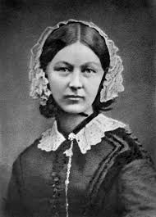

WELCOME

Slide 2
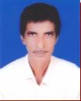
KNOWN :
MD. Rabiul Islam (B. A. B. Ed)
Dhalsa Payari Hazrat Omar Faruque Dakhil madrasah, Khayorpur , Mirpur, Kushtia, Bangladesh
Class : 07
Subject : English1st paper
Special Sub: Florence Nightingale
Students: 48
Time : 50 Minutes
Date: 2026-04-02

Slide 3
Lesson Outcomes:
By the end of the lesson SS will be able to
1.speak the born of Florence Nightingale
2. tell her studied & first job
3. speak her went to Turkey
4. explain her serving worked day & night
5.tell her set up Nightingale School for nurses in London & her death

Slide 4
Look at the picture & ask & answer these questions
1.Who is the woman ?
2.What do you know about her ?

Slide 5
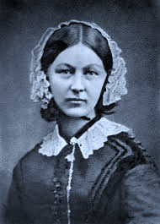
1.The woman is Florence Nightingale.
2.She is the pioneer of modern nursing. In fact, she is the greatest inspiration of this great profession. This great woman was a daughter of rich British parents. Her father was a landlord .

Slide 6
Reading Title :
Today our lesson is
Florence Nightingale

Slide 7
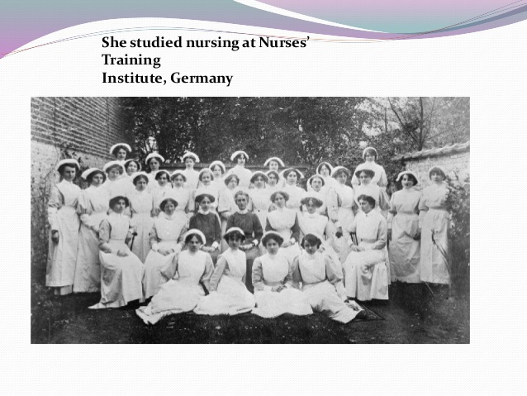
Born :1820, Florence, Italy
Parents –rich- father landlord
studied nursing at Nurses’ Training Institute, Germany

Slide 8
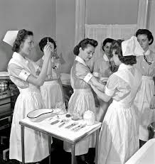

First job – in a London hospital

Slide 9
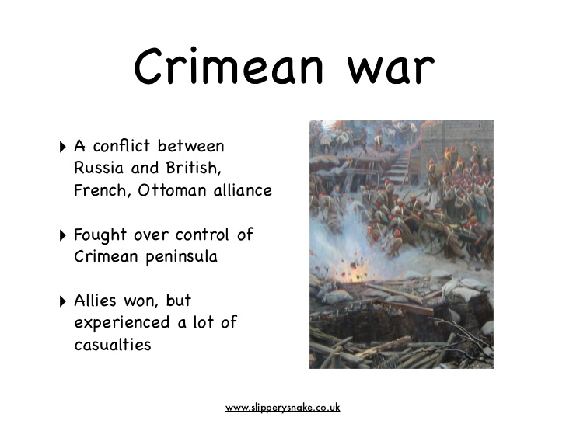
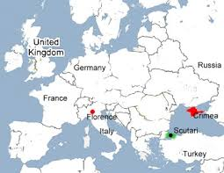
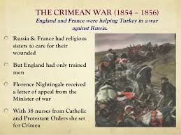
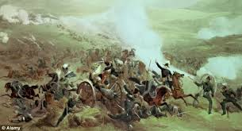
went to Turkey with a group of 38 nurses to work for
the sick British soldiers during the Crimean War (1853-56)

Slide 10
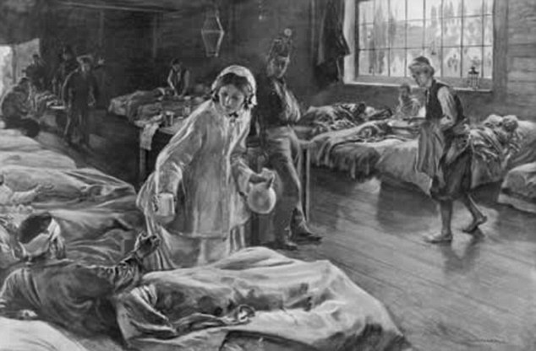
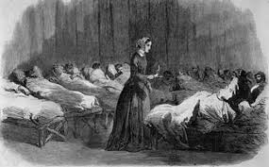
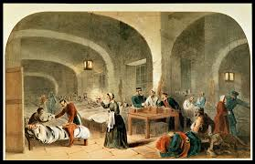
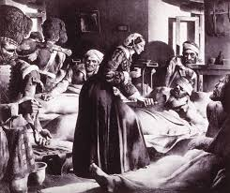
worked day & night to help the wounded soldiers

Slide 11
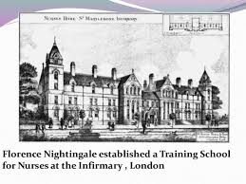
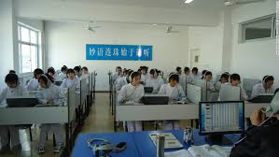
returned to England –the Lady with
the Lamp- famous in nursing

Slide 12
set up Nightingale School for nurses in London

Slide 13
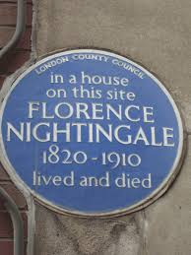
died 13 August 1910

Slide 14
Groupwork : (A, B, C, D, E, F, G )
Use the information / facts about Florence Nightingale & write a composition about her
Born—1820,Florence, Italy
Parents – rich- father landlord
Studied nursing at Nurses’ Training Institute, Germany
First job – in a London hospital
Went to Turkey with a group of 38 nurses to work for the sick British soldiers during the Crimean War (1853-56)
Worked day & night to help the wounded soldiers
Returned to England –the Lady with
the Lamp- famous in nursing
Set up Nightingale School for nurses in London
Died 13 August 1910
Conclusion

Slide 15
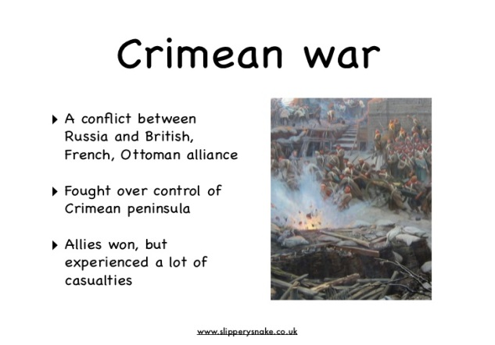

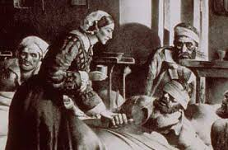
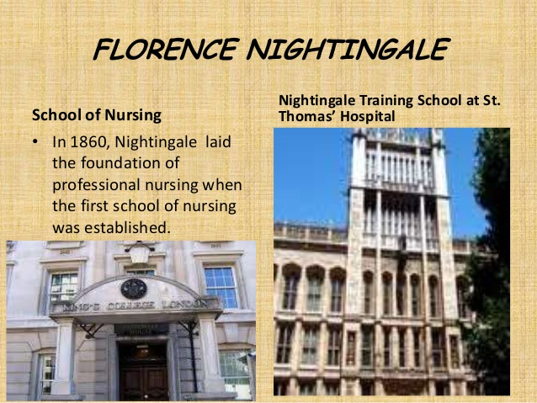

Slide 16
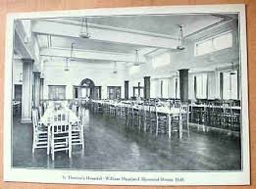
EVALUATION :
1. Who is she ?
2. When she was born ?
3.Who set up Nightingale School for nurses in London ?

Slide 17
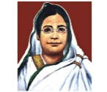
Home work :
Use the information / facts about Begum Rokeya & write a composition about her
Born—1880
Parents – rich- father landlord
Nationality
Family
Physical condition
Education
Aim in life
Achievements
Death
Conclusion

Slide 18

THE
END
THANKS

