Slide 1



Slide 2


Slide 3

Introduction to the Lesson
Unit-12
Activity-1.1,1.2,1.3
Lesson Title-Making Friends
Class-Four
Sub-English

Slide 4
Learning Outcomes
Students will be able to-
8.1.1 Recognise a range of words in communication.
8.1.2 Use a range of words in communication.
4.2.1 Read aloud short and simple texts with proper stress and intonation.

Slide 5
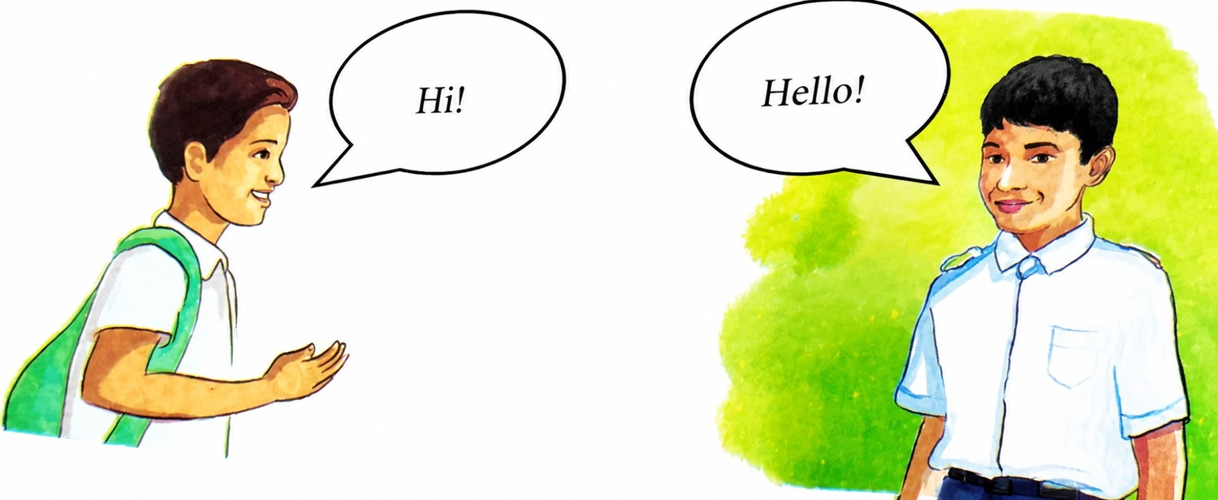
Look at the picture
a.What do you see in the picture?

Slide 6
Can you guess what may be our today’s lesson?

Slide 7

Our Today’s Lesson
Making
Friends

Slide 8
Ask and answer the following questions in pairs.
a)How do you greet your friend?
b) What expressions do you use to agree on something?
c)How do you usually end your conversation?

Slide 9
*When we greet our friends,we
Say “Good morning/Good evening/AS-salamu-alikum or according to their religion.”
*When we agree on something with our friends,we say “Sure/It’s OK/That’s fine,etc.”
*When we end our conversation,we say
“See you later/Take care/Bye,etc.”

Slide 10
Write the words in the boxes that describe the qualities of your friend.
Smart
Honest
Kind
MY Friend
Helpful
Caring
Polite

Slide 11
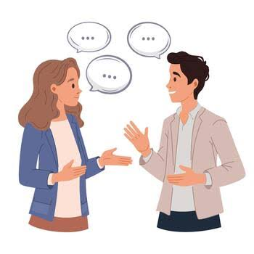
New words
Conversation
Dialogue

Slide 12
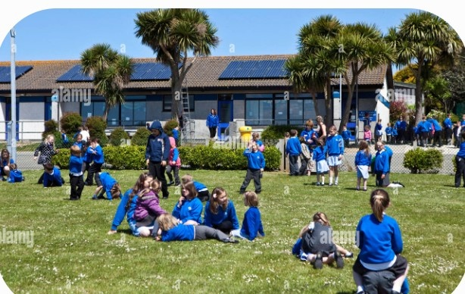
Playground
Play area

Slide 13

Team
Group

Slide 14
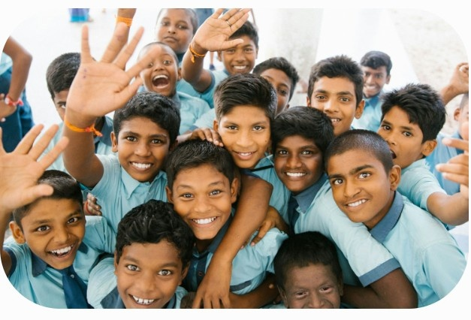
Friendly
Amicable

Slide 15
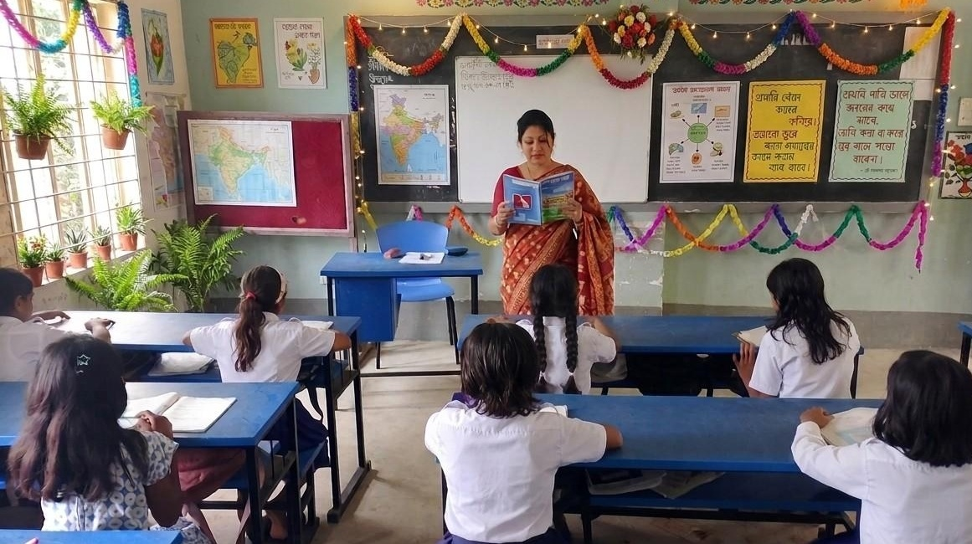
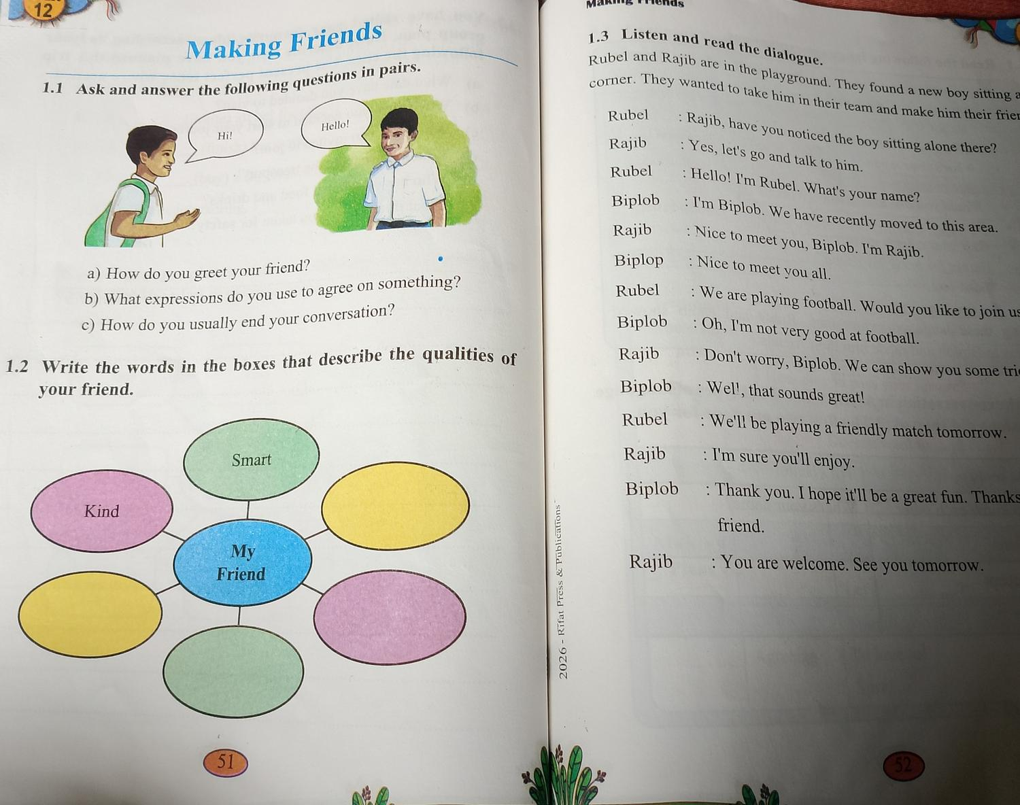
Teacher’s Model Reading

Slide 16
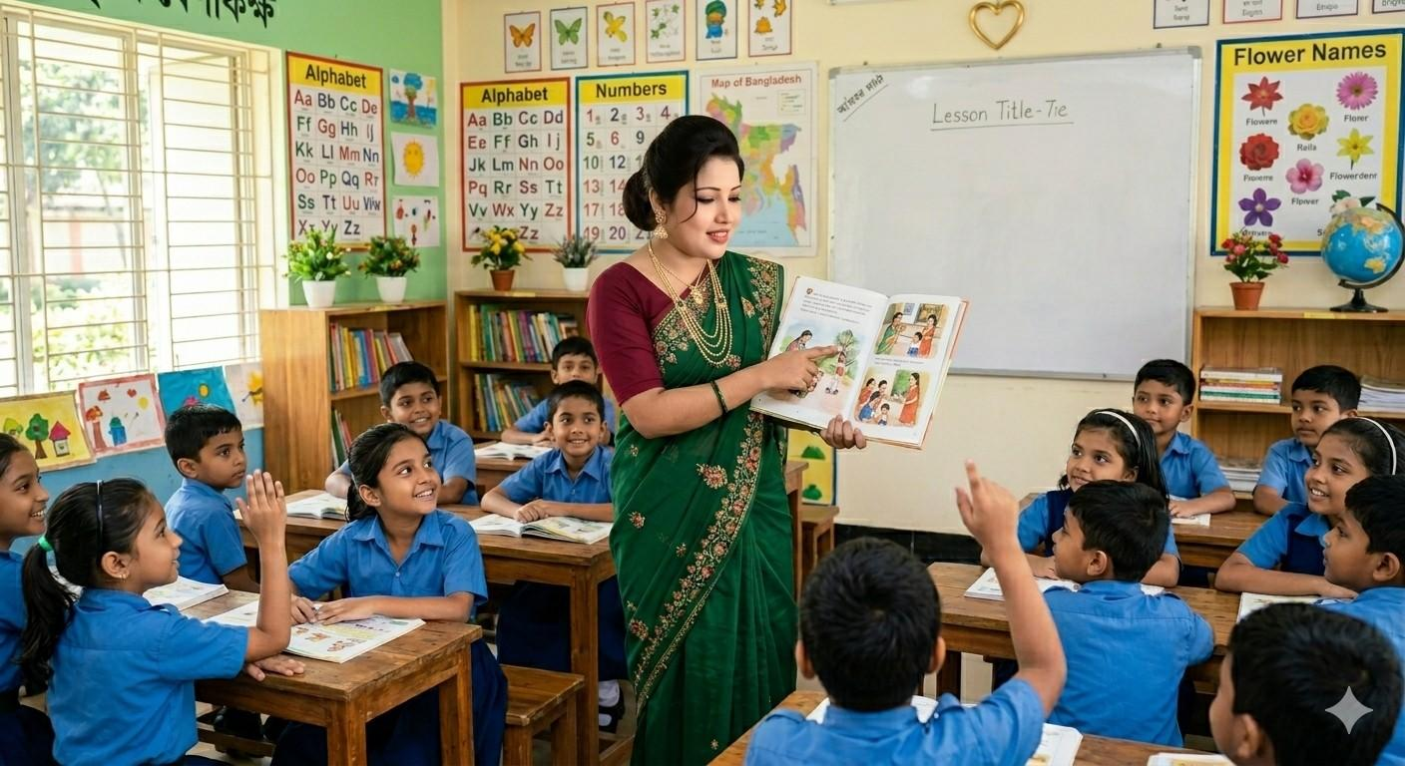
Choral Reading

Slide 17

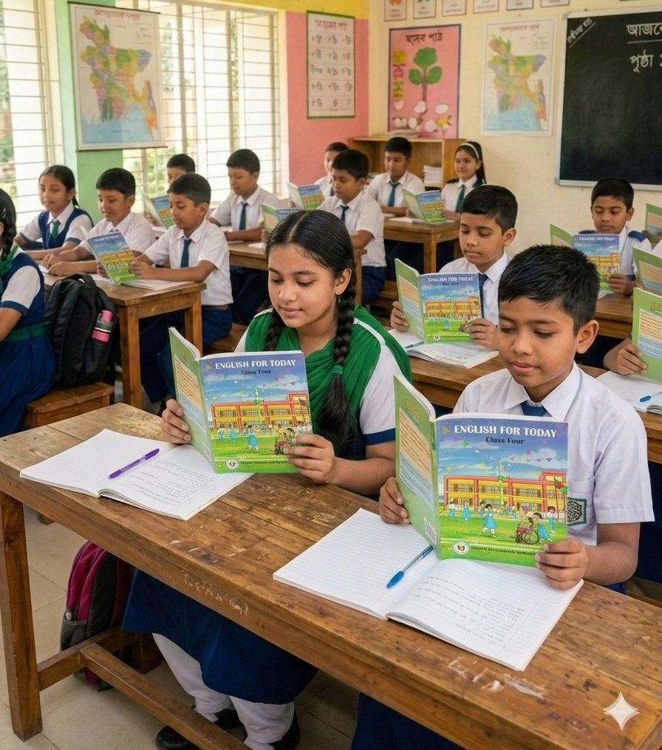
Student’s Reading

Slide 18
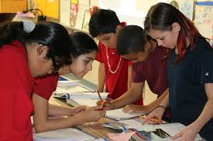
Group Work
Read the text in groups and role-play the characters-Rubel,Rajib and Biplob.
Answer the following questions.
* Where are Rubel and Rajib?
*What did they want?

Slide 19
One day one word
Tomorrow
আগামীকাল
See you tomorrow.

Slide 20

Assessment
Read the dialogue individually from activity 1.3 at textbook page 52.

Slide 21
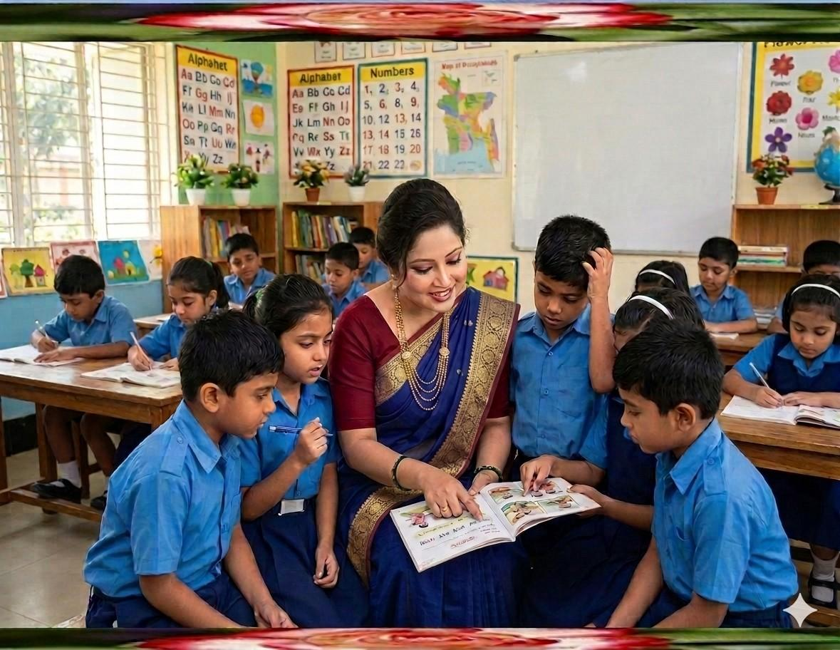
Feedback
Support the students throughout the class,especially those
who cannot read or role-play the dialogue properly.

Slide 22
Summary of the session
“What have you learnt today?”
We have learnt some words that describe the qualities of a friend.

Slide 23

Home Work
Write five qualities of your best friend and make three sentences about him/her.

Slide 24


