Slide 1
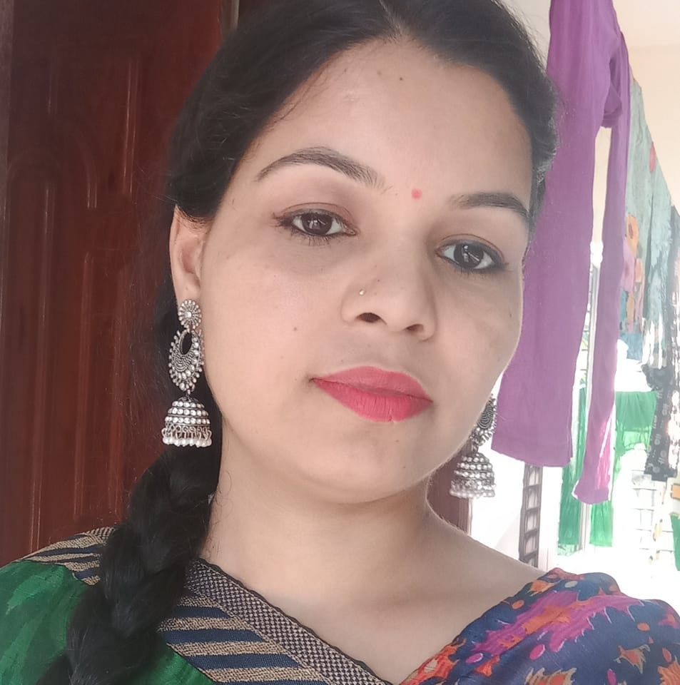

Teachers Name:Fouzia yesmin,
Asistant Teacher,
53 no.Batikamary Govt.Primary School.
Subject: English
Class;2
Unit:7
Lesson:1
Topic:.Colours.
Class Time:40 min.

Slide 2
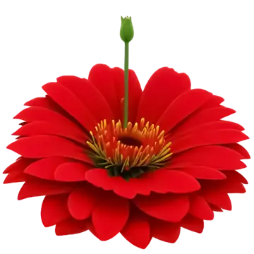
WELCOME

Slide 3
Learning Objective
By the end of todays lesson ,students will be able to …
1-identyfy colours.
2-Say the names of colours.
3-Use this colours is ..correctly.
4-Answer simolequestions about colours.

Slide 4
Warm up Activities-
Good morning student
Good morning teacher
How are you all today?
We are fine.thank tou.And you?
Ok Let ‘s sing a song now.

Slide 5
Previous Knoweldge
What colours is your bag?
What colours is your dress?

Slide 6
Lesson announcement
Todays lesson
Colours.
.

Slide 7
Vocabulary-
Red -লাল
Green -সবুজ
Blue-নীল
Yellow-হলুদ
Orange-কমলা
Violet-বেগুনী
Indigo-আসমানী

Slide 8

Listen and say
Red Red Red
The Rose is red.

Slide 9
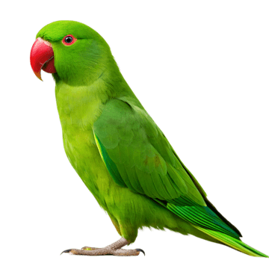
Green Green, green
The parrot is green.

Slide 10

Blue ,blue blue
The sky is blue

Slide 11
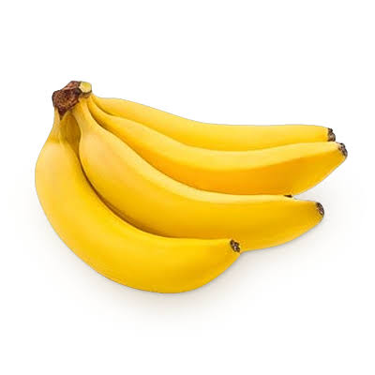
Yellow,yellow,yellow
The banana is

Slide 12

Voilet,violet,violet
The ballon is violet.

Slide 13
Look,Listen and say

Slide 14

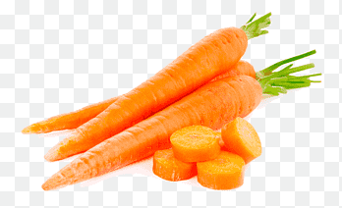

.
This clours is Red
This clours is green
This clours is Orange
This colours is violet
This colours is indigo

Slide 15

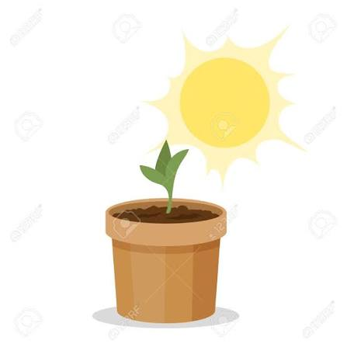
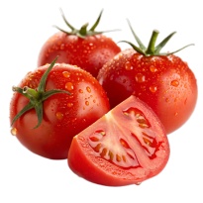
Shorts Questions
Write on your exercise book
What is the colour?
What is the colour?
What is the colour?

Slide 16
ছবি দেখিয়ে এক দল অন্য দলকে প্রশ্ন করবে।
Group 1
Group 2
Group 3
Group 4

Slide 17

Matching
Red
Green
Blue
Violet

Slide 18
Teacher ask
What colour is the rose?
What colours is the parrot?
What colour is the banana?
Red
Green
Yellow

Slide 19
Homework
Draw five objects.
Write their colours.
Example..
Apple-Red
Leaf-Green
Sky-Blue

Slide 20
Summary
Today we have learn –
Red
Green
Blue
Yellow
Orange
Violet
Indigo
.

Slide 21
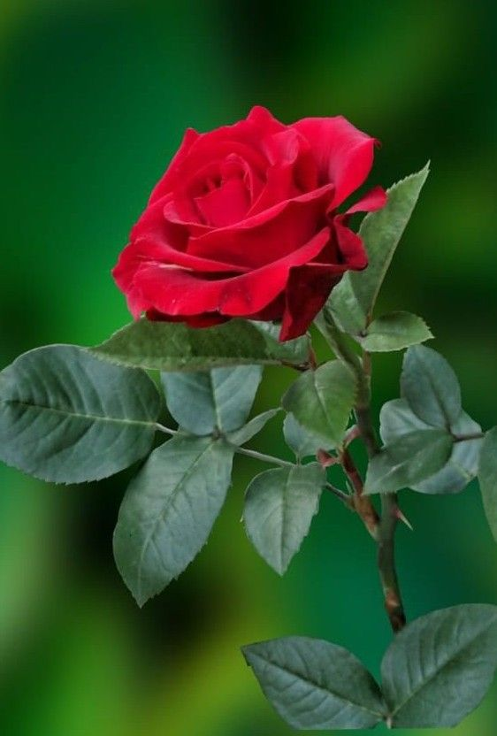
The end
Thank you

