Slide 1
English For Today
Class 10
By
Md. Monzurul Hoque
Senior Teacher
Khilbarirtek Islamia High School
Gulshan, Vatara, Dhaka -1212.
Cell Number: 01712 693 113

Slide 2
Welcome dear students.
Now look at the pictures and answer the questions that follow.

Slide 3
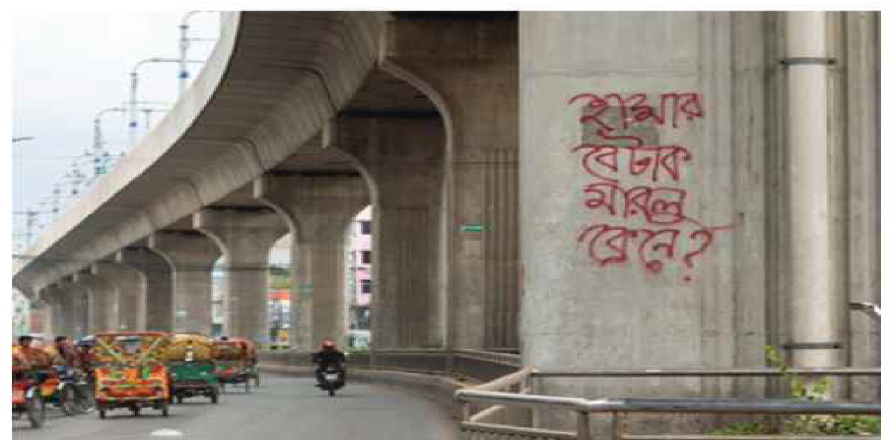
Graffiti

Slide 4
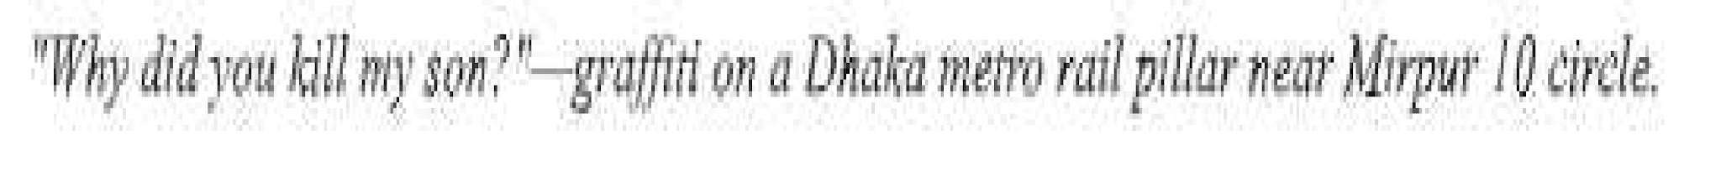

Slide 5
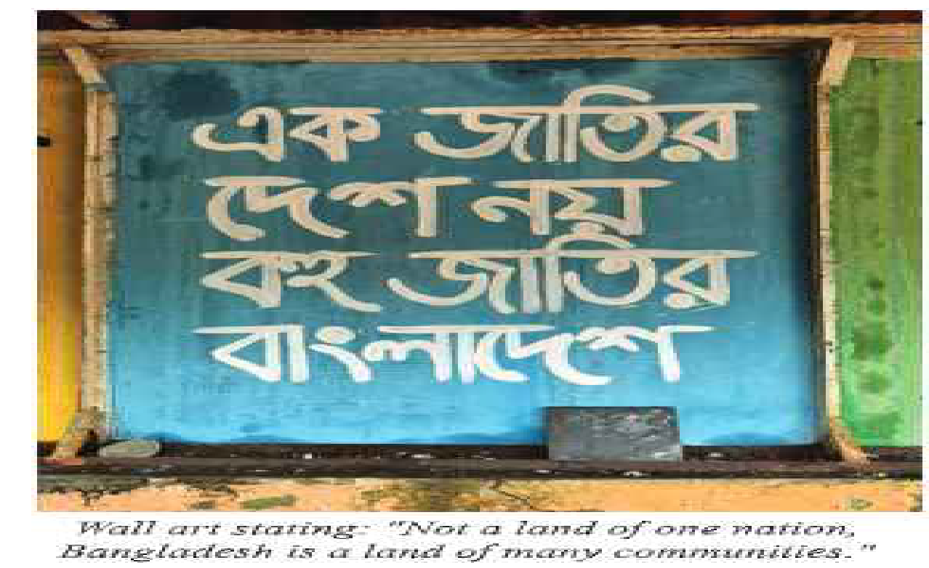
Graffiti

Slide 6
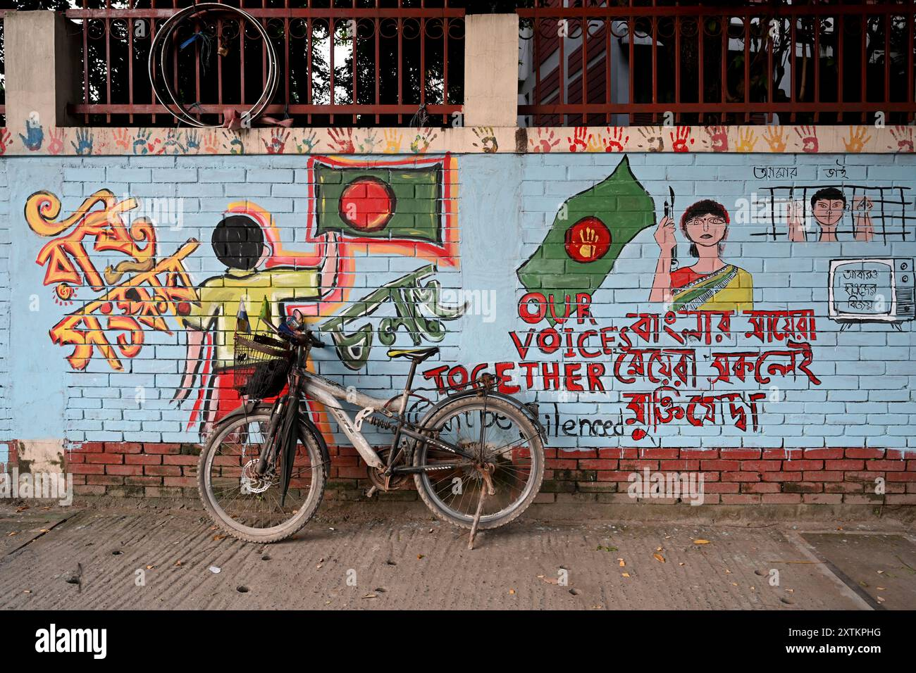
Graffiti

Slide 7
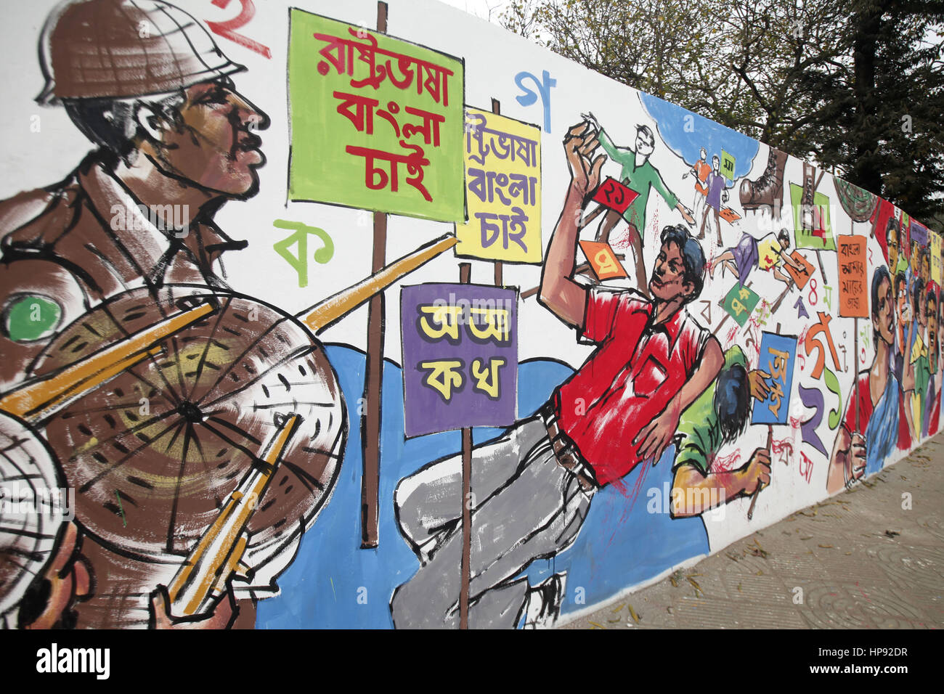
Graffiti

Slide 8
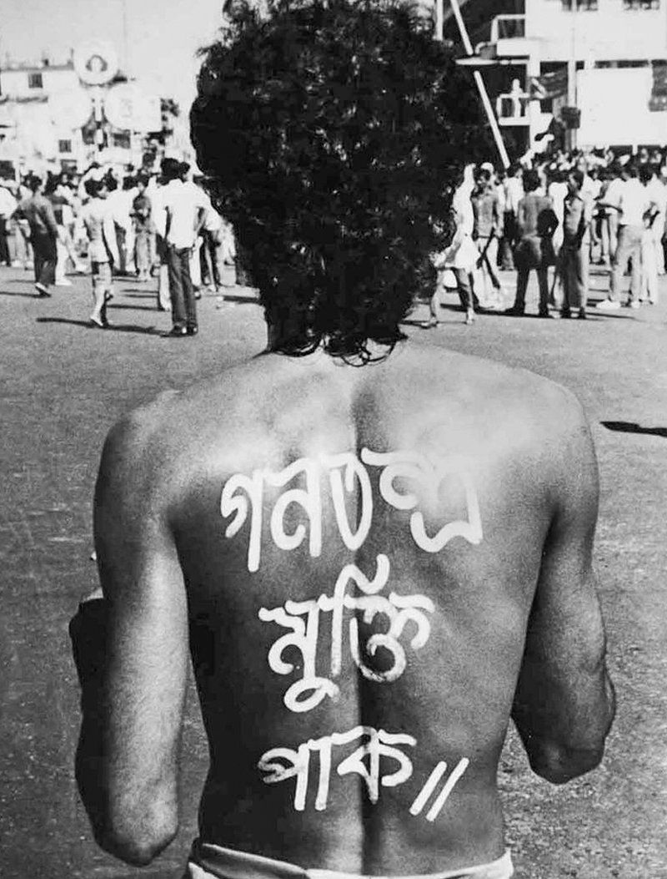
Graffiti

Slide 9
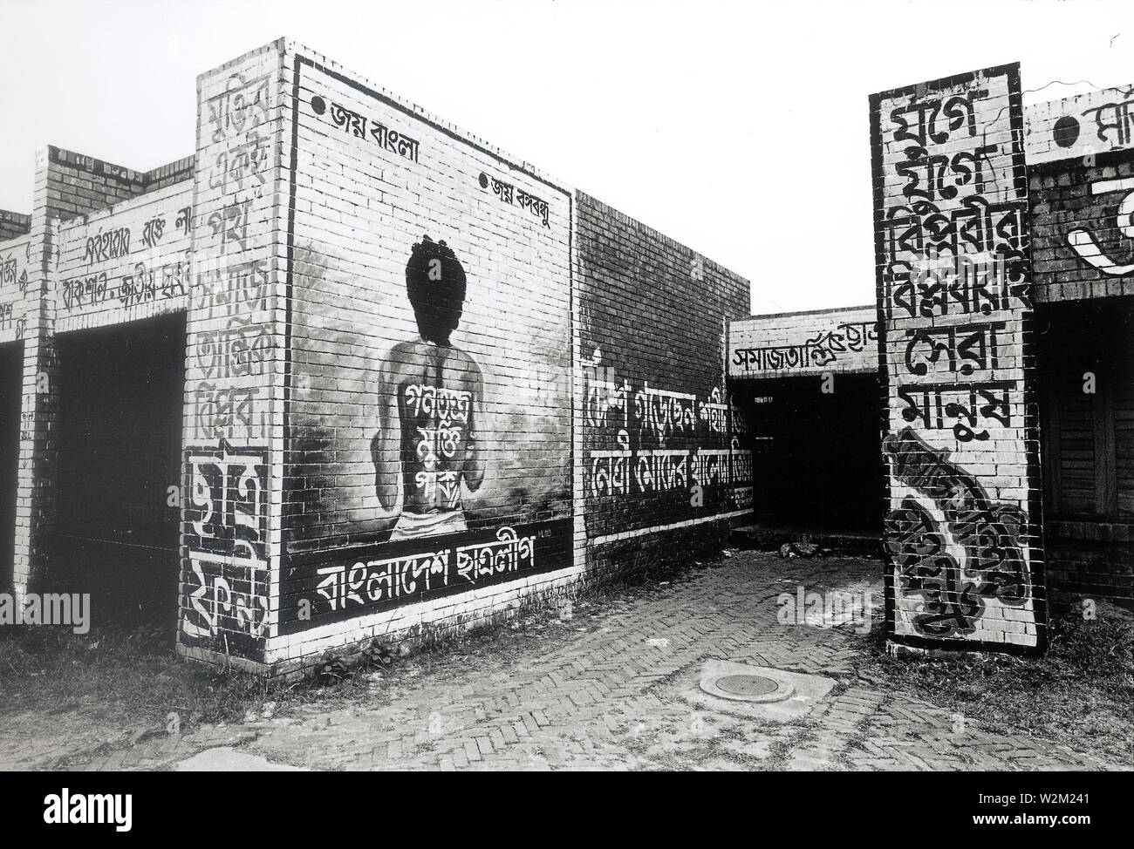
Graffiti

Slide 10
Now it is your term to say something about what you have seen.

Slide 11
Now open at page 196:
Unit 16:
Title: Graffiti

Slide 12
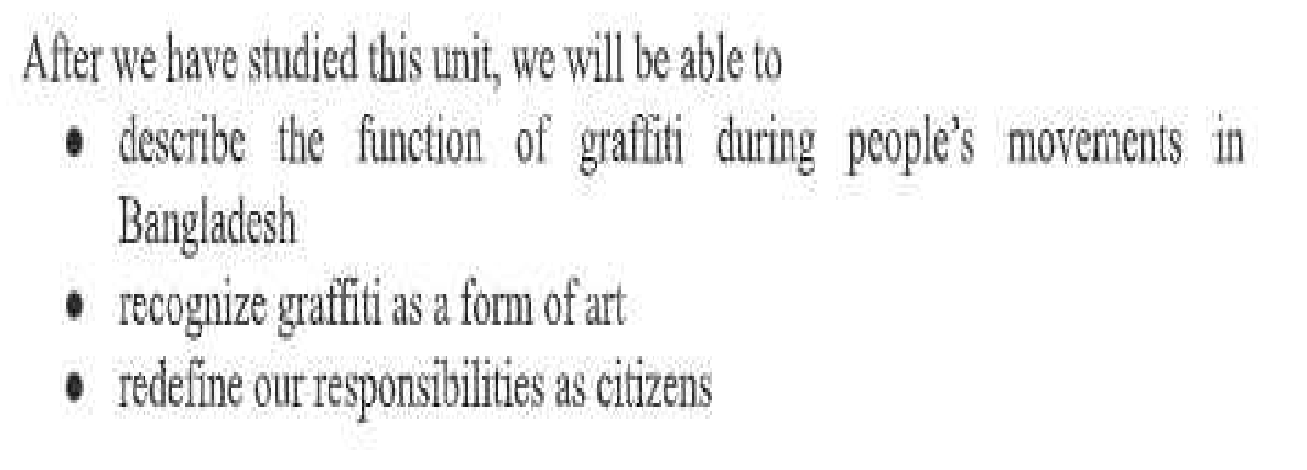
Learning outcomes :

Slide 13
WOULD you TELL ME WHAT IS GRAFFITI?
graf·fi·ti [ɡrəˈfēdē] : noun
writing or drawings scribbled, scratched, or sprayed illicitly on a wall or other surface in a public place:
"the walls were covered with graffiti" · "a graffiti artist"
verb
write or draw graffiti on (something):
"he and another artist graffitied an entire train"

Slide 14
graffiti, form of visual communication, usually illegal, involving the unauthorized marking of public space by an individual or group. Although the common image of graffiti is a stylistic symbol or phrase spray-painted on a wall by a member of a street gang, some graffiti is not gang-related. Graffiti can be understood as antisocial behaviour performed in order to gain attention or as a form of thrill seeking, but it also can be understood as an expressive art form.

Slide 15
Derived from the Italian word graffio (“scratch”), graffiti (“incised inscriptions,” plural but often used as singular) has a long history. For example, markings have been found in ancient Roman ruins, in the remains of the Mayan city of Tikal in Central America, on rocks in Spain dating to the 16th century, and in medieval English churches. During the 20th century, graffiti in the United States and Europe was closely associated with gangs, who used it for a variety of purposes: for identifying or claiming territory, for memorializing dead gang members in an informal “obituary,” for boasting about acts (e.g., crimes) committed by gang members,

Slide 16
and for challenging rival gangs as a prelude to violent confrontations. Graffiti was particularly prominent in major urban centres throughout the world, especially in the United States and Europe; common targets were subways, billboards, and walls. In the 1990s there emerged a new form of graffiti, known as “tagging,” which entailed the repeated use of a single symbol or series of symbols to mark territory. In order to attract the most attention possible, this type of graffiti usually appeared in strategically or centrally located neighbourhoods.

Slide 17
Guess the meanings
Graffiti- (pl. n) writing or drawings scribbled, scratched, or sprayed illicitly on a wall or other surface in a public place Graffito – (sing. N)
Pseudonymous- (a) writing or written under a false name:
Sentiment- (n) a view or opinion that is held or expressed:
Encapsulate- (v) to express the most important parts of something in a few words, a small space or a single object
Spirit-the non-physical part of a person which is the seat of emotions and character; the soul:
Quota- A quota is a predetermined limit or target on something, typically referring to a specific quantity or amount that can be produced, imported, acquired, or needed. This system is often used in international trade to limit the quantity of a particular commodity that can be imported or exported within a given period,
Stretch out- expanded widely

Slide 18
Shell-shocked - mentally confused, upset, or exhausted as a result of a highly stressful or disturbing and often unexpected event or experience
Resistance – refusal to accept
Activists – worker , a person who campaigns to bring about political or social change
Slogans – speech, a short and striking or memorable phrase used in advertising, a motto associated with a political party or movement or other group.
Spray-painted - decorated with spray
Covert - not openly acknowledged or displayed
Repressive - (especially of a social or political system) inhibiting or restraining the freedom of a person or group of people:
Regime – a government, a system or planned way of doing things, especially one imposed from above:
Rodent - a gnawing mammal of an order that includes rats, mice, squirrels, hamsters, porcupines, and their relatives, distinguished by strong constantly growing incisors and no canine teeth.
Disguise – a means of altering one's appearance or concealing one's identity
Dissent –having or expressing an opinion that differs from the prevailing or official position
Guerrilla - a member of a small independent group taking part in irregular fighting, typically against larger regular forces

Slide 19
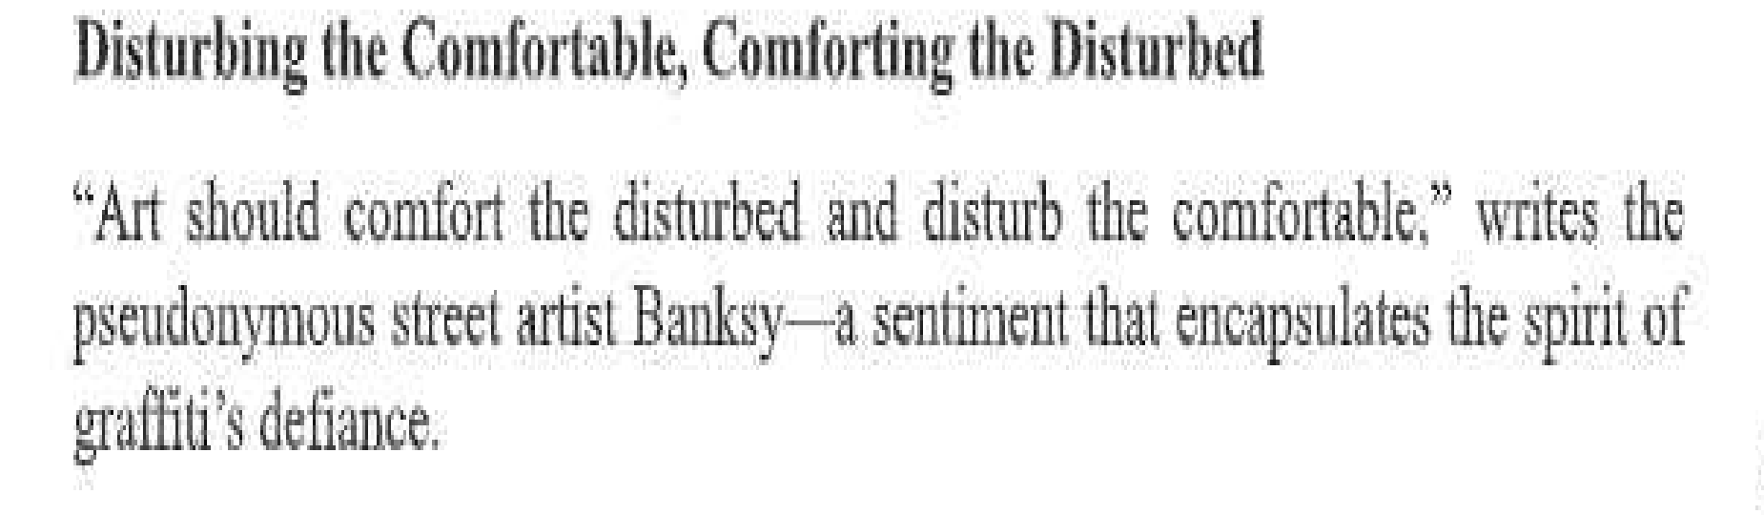

Slide 20
On 16. uly10-4J bu Sayeed an unarmed orgarli:Zer afthe studentsr movement for quom reform at Begum Rokeya University in Rangpur. was shot .and killed by p li e as he stood. \;Vi , his,arms s • etched out, leaving his moilier, Mouo,wara Begum, sh.e1L sho k d and.c1-y,ing .11 · y son only wamcd a job if you dont want ro give mm a job. lhen don't-but why did you kill]tim?11

Slide 21
' ince the 1960s. graffiti in
B rulglad;::::..!fh has served as 1iL
_powerful voi e for re i!;!tlin ce. In J 966 student activists spray-painted slogans like ''Down with .,A.yub Khru'.:t' on walls) u:sil1g graffiti as•a oov rt me:aos of protest against a repressive regime. Wn .1 mil.it ·rorcecs approaclte they :sh:cmted chika!
·.chik:a.''-i word rueatllll, mo! or m1Jskrat- prntenrlino: they were killing rodei· t rn wsguis th.ei.r actions.

Slide 22
This
gu rrilla: tactic marlrnd the begililuing of graffiti as a tooI of dissc.n;t in. Ban ladecl1; and it played a cn1eial roJe in die Libemtjon W in l97J.
No:ar Hossm'·n, 1-liith the word$ 'ZJuwn with Autocracy'' (Òˆ¯^ivPvi bxcvZ hvKÓ;
I' awm er-: the .Bangla spelling for 'VI f s 'R - th,r mis-spelling 1mde:rac(jring raw·. "J)t.mkuudfJ of' ,r:·h expre · ion$) hulilly pafott:d {n lnghtwhite un h}s hate eh.e; l,, was photQgraph:ed by; inu Alam mi J() No h?mbe:i 1987. during .a Jll·o-d,emocracy protest fr Dhaka. Shortly fr/fei he was shot imd killed·b Bangladesh Police.

Slide 24
Home Work:
Word meaning : Learning and writing
Thank you

