Slide 1


WELCOME
TO THE
ENGLISH
CLASS
Learning
Is
FUN

Slide 2

TEACHER
Aysha Siddika Auntara
Assistant Teacher
Kolapara Government Primary School
Sreenagar, Munshiganj

Slide 3



Lession
Title-A Field Trip To Remember
Class- Five
Subject- English
Unit-8 , Activity-3.1-3.2.1
Time-40 minutes
Date: /06/2026

Slide 4

Learning Outcomes:
Students will be able to –
7.2.1 write fractions for expressing time correctly
4.1.1 read aloud fractions for telling time clearly.

Slide 5

TELLING THE TIME

Slide 6

Let’s watch a video, shall we?

Slide 7
Turn to page 42

Slide 8
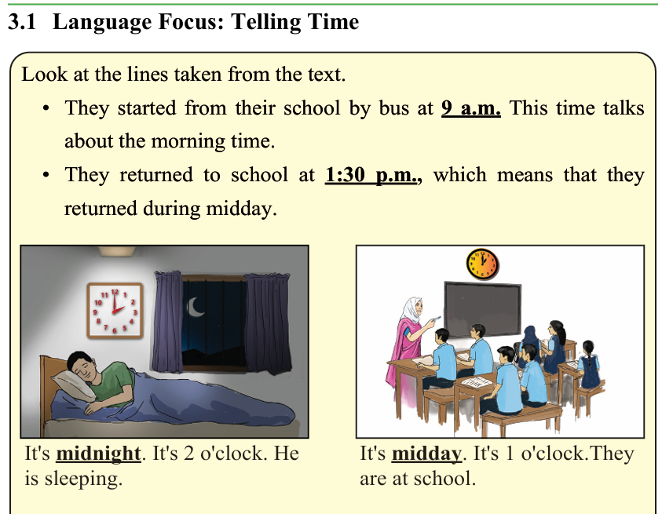
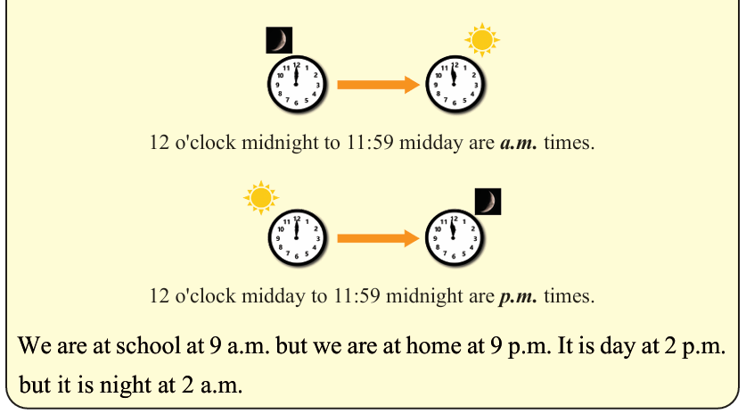

Slide 9
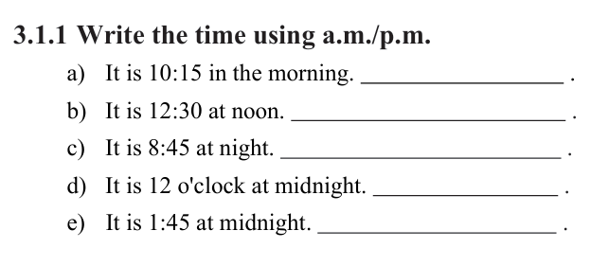

Slide 10
Let’s watch another video

Slide 11
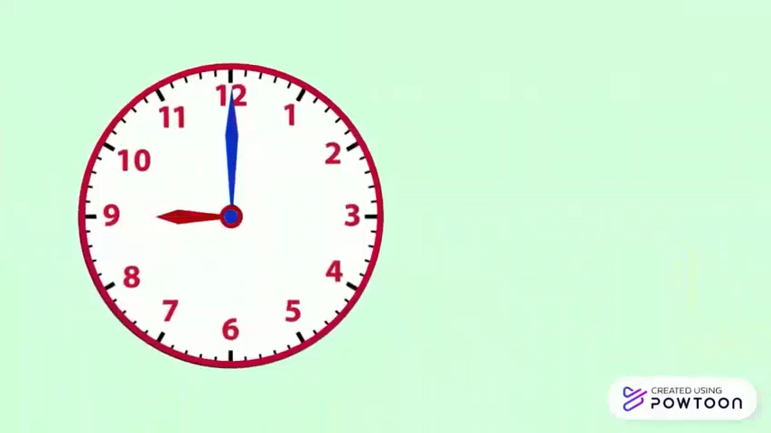

Slide 12
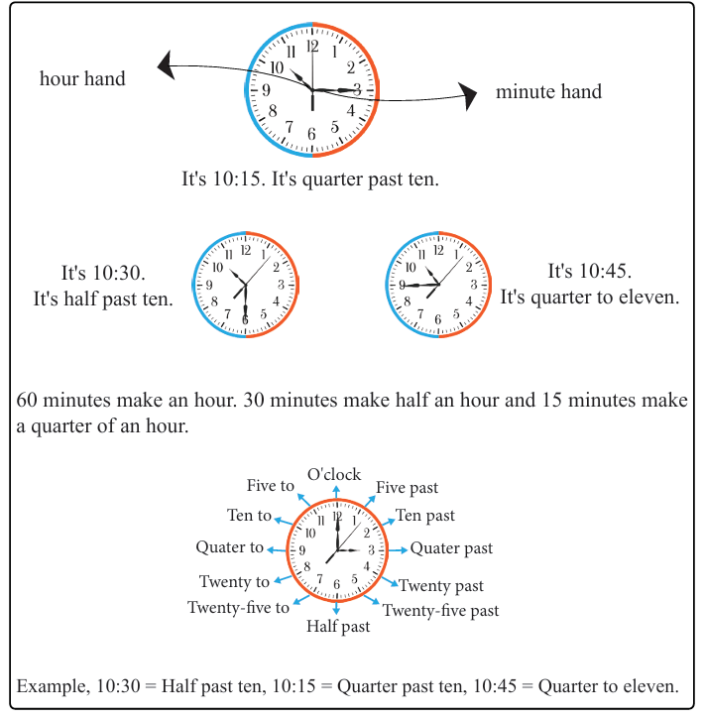

Slide 13
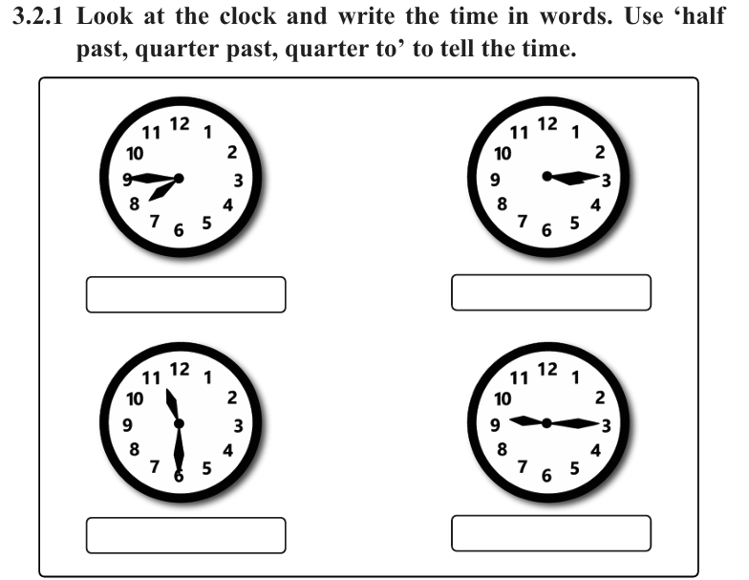

Slide 14
Write about a field trip you enjoyed. The following questions will help you to write about the topic. Use a.m. and p.m. in your writing.
a)When did you start your journey?
b)When did you reach the place?
c) How did you go there?
d)What did you see there?
e) How long did you visit the place?

Slide 15

Thank you so much

