Slide 1
English With Anisur Rahman
Cover
Add your lesson content here...
Class: 5
Subject: English
Unit 11: Making Requests
Pages: 57–60
Activities: 3.1, 3.1.1, 3.2, 3.3, 4.1 & 4.3
📚 English With Anisur Rahman | Learn English with Bangla Explanation

Slide 2
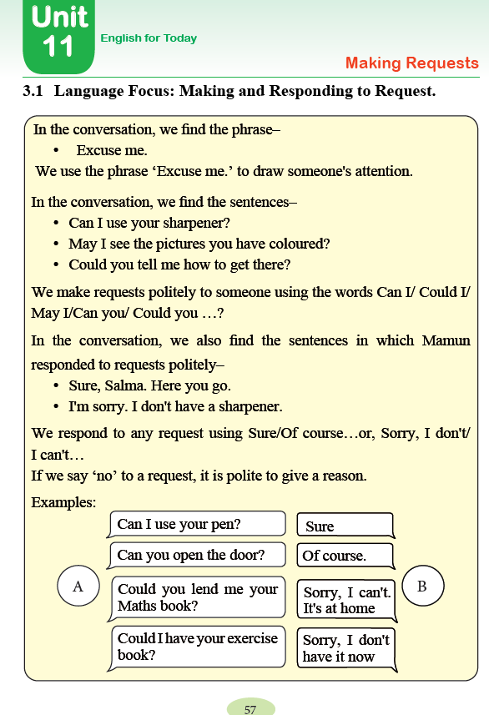
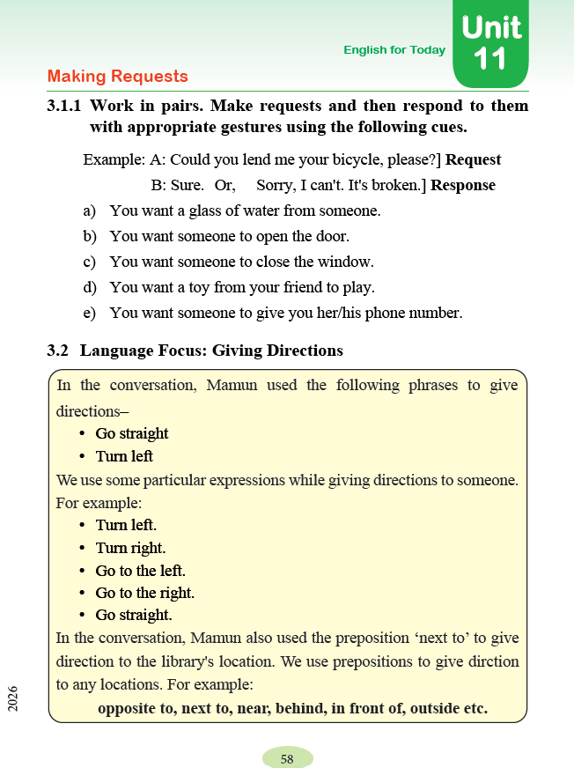
English With Anisur Rahman
Cover
Add your lesson content here...
📚 English With Anisur Rahman | Learn English with Bangla Explanation

Slide 3
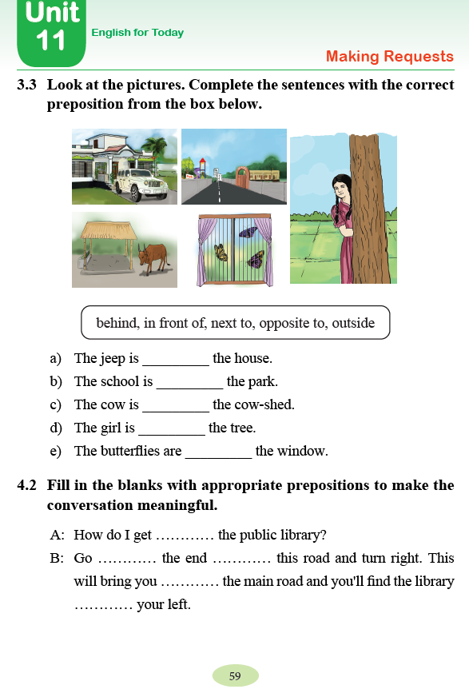
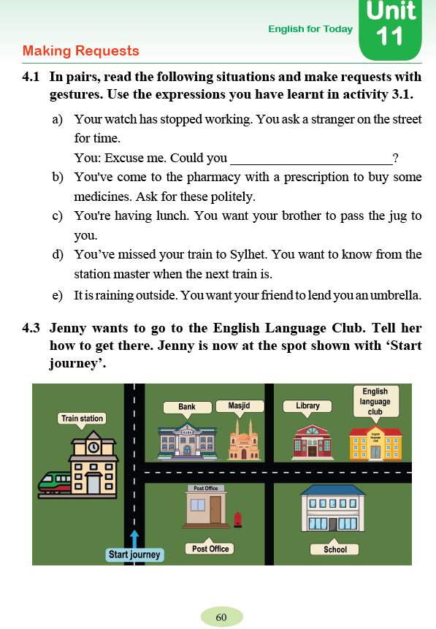
English With Anisur Rahman
Cover
Add your lesson content here...
📚 English With Anisur Rahman | Learn English with Bangla Explanation

Slide 4
English With Anisur Rahman
Learning Outcomes
Add your lesson content here...
Students will be able to—
✅ make polite requests
✅ respond politely
✅ give directions
✅ use prepositions correctly
📚 English With Anisur Rahman | Learn English with Bangla Explanation

Slide 5
English With Anisur Rahman
Warm-up
Add your lesson content here...
Do you ask people politely?
Possible Answer: Yes, I do.
How do you ask your teacher for help?
Possible Answer: I say, “May I ask a question, please?”
Have you ever asked someone for directions?
Yes, I have.
📚 English With Anisur Rahman | Learn English with Bangla Explanation

Slide 6
English With Anisur Rahman
Revision
Add your lesson content here...
📚 English With Anisur Rahman | Learn English with Bangla Explanation

Slide 7
English With Anisur Rahman
Vocabulary
Add your lesson content here...
📚 English With Anisur Rahman | Learn English with Bangla Explanation

Slide 8
English With Anisur Rahman
Activity 3.1
Add your lesson content here...
Excuse me.
বাংলা
মাফ করবেন।
We use Excuse me to get someone's attention.
📚 English With Anisur Rahman | Learn English with Bangla Explanation

Slide 9
English With Anisur Rahman
Activity 3.1
Add your lesson content here...
Polite Request Sentences:
Can I use your sharpener?
আমি কি তোমার শার্পনার ব্যবহার করতে পারি?
📚 English With Anisur Rahman | Learn English with Bangla Explanation

Slide 10
English With Anisur Rahman
Activity 3.1
Add your lesson content here...
Polite Request Sentences:
May I see the pictures?
আমি কি ছবিগুলো দেখতে পারি?
📚 English With Anisur Rahman | Learn English with Bangla Explanation

Slide 11
English With Anisur Rahman
Activity 3.1
Add your lesson content here...
Polite Request Sentences:
Could you tell me how to get there?
আপনি কি আমাকে সেখানে যাওয়ার পথ বলতে পারেন?
📚 English With Anisur Rahman | Learn English with Bangla Explanation

Slide 12
English With Anisur Rahman
Activity 3.1
Add your lesson content here...
Polite Request Sentences:
Can I...
May I...
Could you...
These are polite expressions.
📚 English With Anisur Rahman | Learn English with Bangla Explanation

Slide 13
English With Anisur Rahman
Activity 3.1
Add your lesson content here...
Polite Request Sentences:
In the conversation, we also find the sentences in which Mamun
responded to requests politely...
Sure, Salma. Here you go.
I’m sorry. I don’t have a sharpner.
📚 English With Anisur Rahman | Learn English with Bangla Explanation

Slide 14
English With Anisur Rahman
Activity 3.1
Add your lesson content here...
Responding to Requests
Sure.
অবশ্যই।
Here you are.
এই নাও।
Of course.
অবশ্যই।
Here you go.
এই নাও।
📚 English With Anisur Rahman | Learn English with Bangla Explanation

Slide 15
English With Anisur Rahman
Activity 3.1
Add your lesson content here...
Responding to Requests
Sorry, I can't.
দুঃখিত, আমি পারব না।
📚 English With Anisur Rahman | Learn English with Bangla Explanation

Slide 16
English With Anisur Rahman
Activity 3.1
Add your lesson content here...
Polite Request Sentences:
Can I use your pen?
Sure.
📚 English With Anisur Rahman | Learn English with Bangla Explanation

Slide 17
English With Anisur Rahman
Activity 3.1
Add your lesson content here...
Polite Request Sentences:
Could you help me?
Of course.
📚 English With Anisur Rahman | Learn English with Bangla Explanation

Slide 18
English With Anisur Rahman
Activity 3.1
Add your lesson content here...
Polite Request Sentences:
May I borrow your book?
Here you are.
📚 English With Anisur Rahman | Learn English with Bangla Explanation

Slide 19
English With Anisur Rahman
Activity 3.1
Add your lesson content here...
Responding to Requests
If we say, ‘no’ to a request, it is polite to give a reason.
📚 English With Anisur Rahman | Learn English with Bangla Explanation

Slide 20
English With Anisur Rahman
Activity 3.1
Add your lesson content here...
Polite Request Sentences:
Could you lend me your Maths book?
Sorry. I can’t. it’s at home.
📚 English With Anisur Rahman | Learn English with Bangla Explanation

Slide 21
English With Anisur Rahman
Activity 3.1
Add your lesson content here...
Polite Request Sentences:
Could I have your exercise book?
Sorry. I don’t have it now.
📚 English With Anisur Rahman | Learn English with Bangla Explanation

Slide 22
English With Anisur Rahman
Activity 3.1.1
Add your lesson content here...
Could you give me a glass of water?
Could you open the door?
Could you close the window?
Could I have your toy to play with?
Could I have your phone number, please?
📚 English With Anisur Rahman | Learn English with Bangla Explanation

Slide 23
English With Anisur Rahman
Activity 3.1.1
Add your lesson content here...
Role Play
Student A
Could you give me a glass of water?
Student B
Sure.
📚 English With Anisur Rahman | Learn English with Bangla Explanation

Slide 24
English With Anisur Rahman
Activity 3.1.1
Add your lesson content here...
Role Play
Student A
Could you open the door?
Student B
Of course.
📚 English With Anisur Rahman | Learn English with Bangla Explanation

Slide 25
English With Anisur Rahman
Activity 3.1.1
Add your lesson content here...
Role Play
Student A
Could you close the window?
Student B
Of course.
📚 English With Anisur Rahman | Learn English with Bangla Explanation

Slide 26
English With Anisur Rahman
Activity 3.1.1
Add your lesson content here...
Role Play
Student A
Could I have your toy to play with?
Student B
Sure. Here you are.
📚 English With Anisur Rahman | Learn English with Bangla Explanation

Slide 27
English With Anisur Rahman
Activity 3.1.1
Add your lesson content here...
Role Play
Student A
Could I have your toy to play with?
Student B
Sure. Here you are.
📚 English With Anisur Rahman | Learn English with Bangla Explanation

Slide 28
English With Anisur Rahman
Activity 3.1.1
Add your lesson content here...
Role Play
Student A
Could I have your phone number, please?
Student B
Of course. Here you are.
📚 English With Anisur Rahman | Learn English with Bangla Explanation

Slide 29
English With Anisur Rahman
Activity 3.2
Add your lesson content here...
Giving Directions
Go straight.
সোজা যাও।
Turn left.
বাম দিকে মোড় নাও।
📚 English With Anisur Rahman | Learn English with Bangla Explanation

Slide 30
English With Anisur Rahman
Activity 3.2
Add your lesson content here...
Giving Directions
Turn right.
ডান দিকে মোড় নাও।
Go to the right.
ডান দিকে যাও।
Go to the left.
বাম দিকে যাও।
📚 English With Anisur Rahman | Learn English with Bangla Explanation

Slide 31
English With Anisur Rahman
Activity 3.2
Add your lesson content here...
Prepositions
next to
পাশে
behind
পিছনে
opposite to
বিপরীতে
in front of
সামনে
📚 English With Anisur Rahman | Learn English with Bangla Explanation

Slide 32
English With Anisur Rahman
Activity 3.2
Add your lesson content here...
Prepositions
outside
বাইরে
near
কাছে
📚 English With Anisur Rahman | Learn English with Bangla Explanation

Slide 33
English With Anisur Rahman
Activity 3.3
in front of
opposite to
outside
behind
next to
📚 English With Anisur Rahman | Learn English with Bangla Explanation

Slide 34
English With Anisur Rahman
Activity 4.2
Add your lesson content here...
to
along
of
to
on
📚 English With Anisur Rahman | Learn English with Bangla Explanation

Slide 35
English With Anisur Rahman
Activity 4.1
tell me the time?
Excuse me. Could I have these medicines, please?
Could you pass me the jug, please?
Could you tell me when the next train is?
Could you lend me your umbrella, please?
📚 English With Anisur Rahman | Learn English with Bangla Explanation

Slide 36
English With Anisur Rahman
Activity 4.3
Add your lesson content here...
Go straight.
Turn right.
Walk past the bank and the Masjid.
The English Language Club is next to the library.
📚 English With Anisur Rahman | Learn English with Bangla Explanation

Slide 37
English With Anisur Rahman
Pair Work
Add your lesson content here...
📚 English With Anisur Rahman | Learn English with Bangla Explanation

Slide 38
English With Anisur Rahman
Practice
Add your lesson content here...
📚 English With Anisur Rahman | Learn English with Bangla Explanation

Slide 39
English With Anisur Rahman
Quiz
Add your lesson content here...
📚 English With Anisur Rahman | Learn English with Bangla Explanation

Slide 40
English With Anisur Rahman
Assessment
Add your lesson content here...
📚 English With Anisur Rahman | Learn English with Bangla Explanation

Slide 41
English With Anisur Rahman
Homework
Add your lesson content here...
Write
✔ Three polite requests.
✔ Three polite responses.
✔ Five direction sentences.
✔ Five sentences using prepositions.
📚 English With Anisur Rahman | Learn English with Bangla Explanation

Slide 42
English With Anisur Rahman
Thank You
Add your lesson content here...
Thank You
See you in the next class.
📚 English With Anisur Rahman | Learn English with Bangla Explanation

