Slide 1


Slide 2

Presented by
Mohammad Babul Hossen
Assistant Teacher
Noagoan west GPS
Sarail,Brahmonbaria.
E-mail-mbabul307@gmail.com

Slide 3

Lesson information
Class-Five
Sub-English
Unit-10
Activity-1.1,1.2
Title- :The Swing
Page-52

Slide 4
Learning Outcomes
Students will be able to-
6.1.1 Read rhymes and poems and recite with joy.
6.1.2 Comprehend and express the main ideas of rhymes and poems through reading.

Slide 5
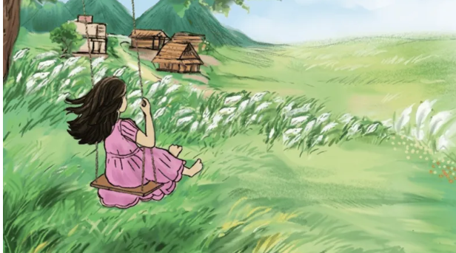
1.What can you see in the picture?
2. Do you like to swing on a swing?

Slide 6
Can you guess what may be our today’s Lesson?

Slide 7
Our Today’s Lesson
The Swing

Slide 8

New words
Swing
A hanging seat

Slide 9

Fly
Go or move through the air

Slide 10

Child
Baby

Slide 11

Roof
A Ceiling of a building

Slide 12

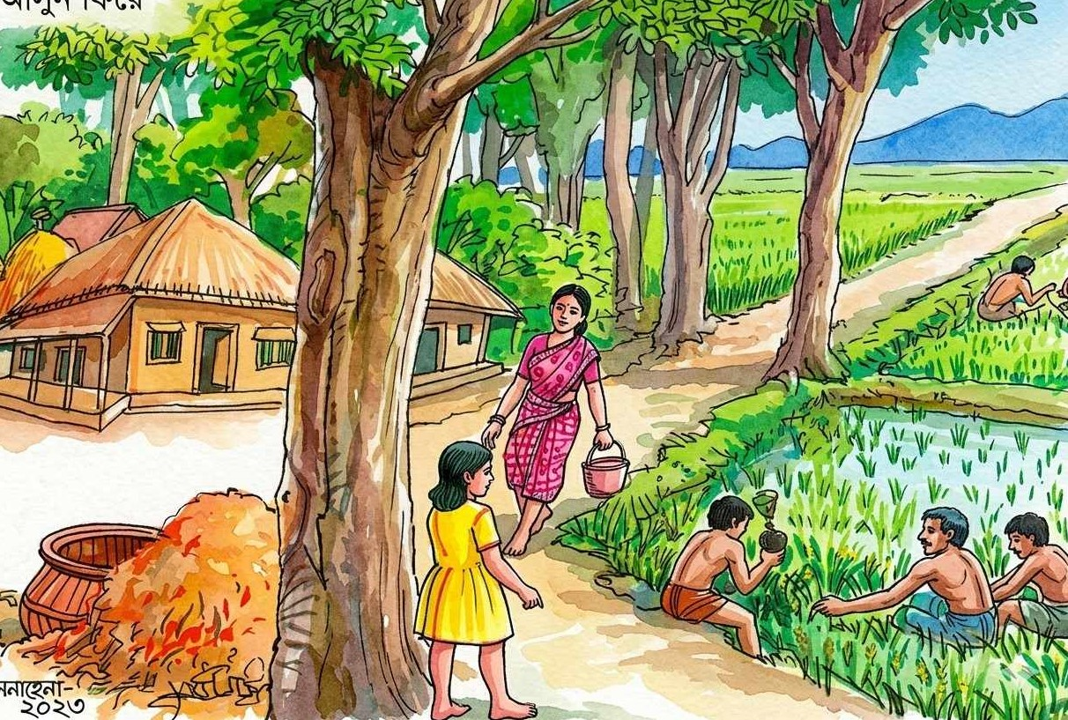
Countryside
Hamlet ,Rural

Slide 13
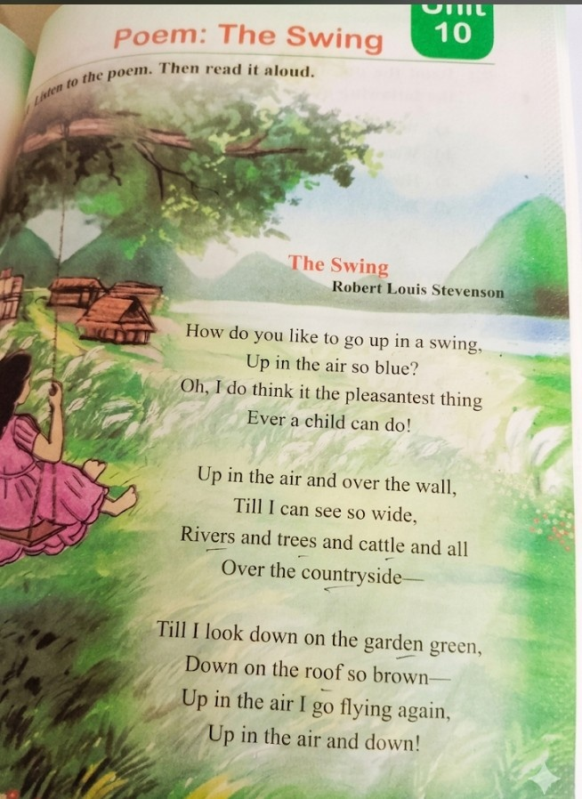
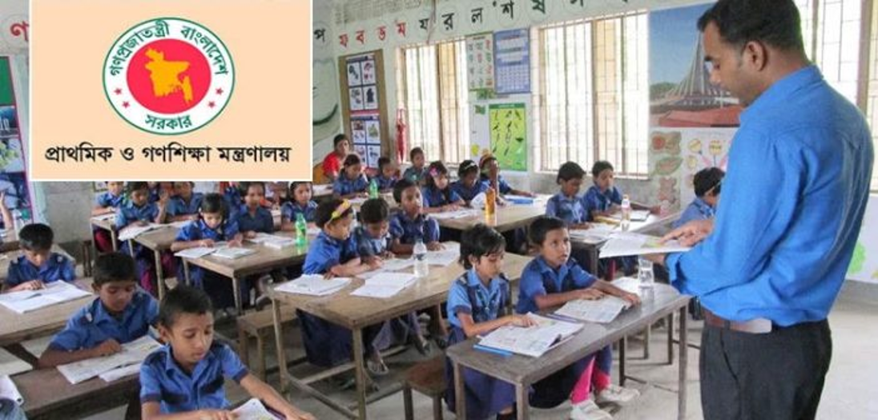
Teacher’s Model Reading

Slide 14

Chorus Reading

Slide 15
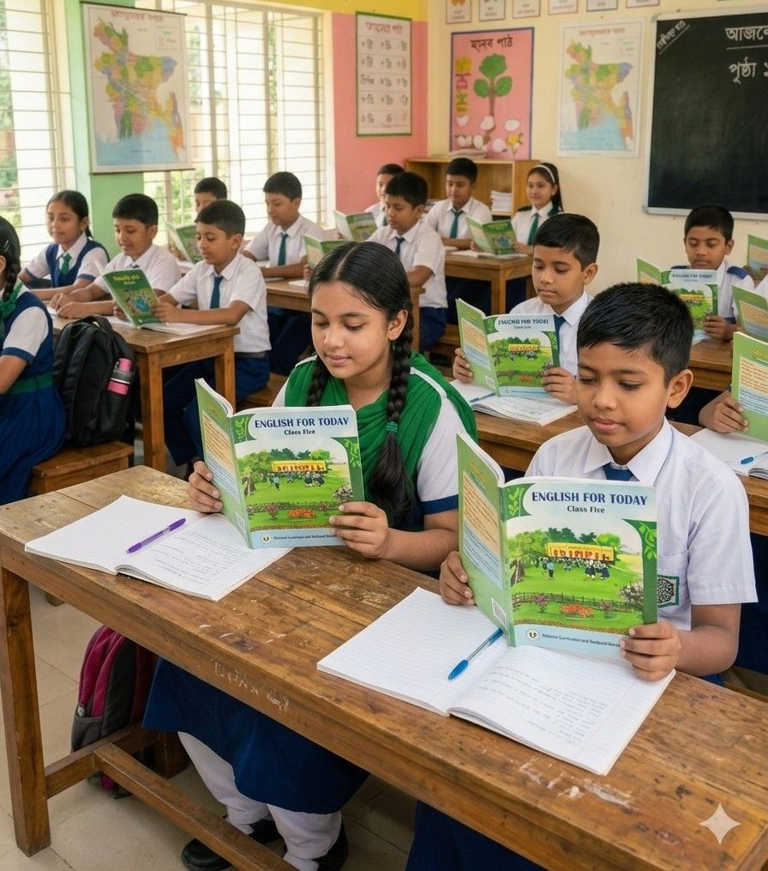
Student’s Reading

Slide 16
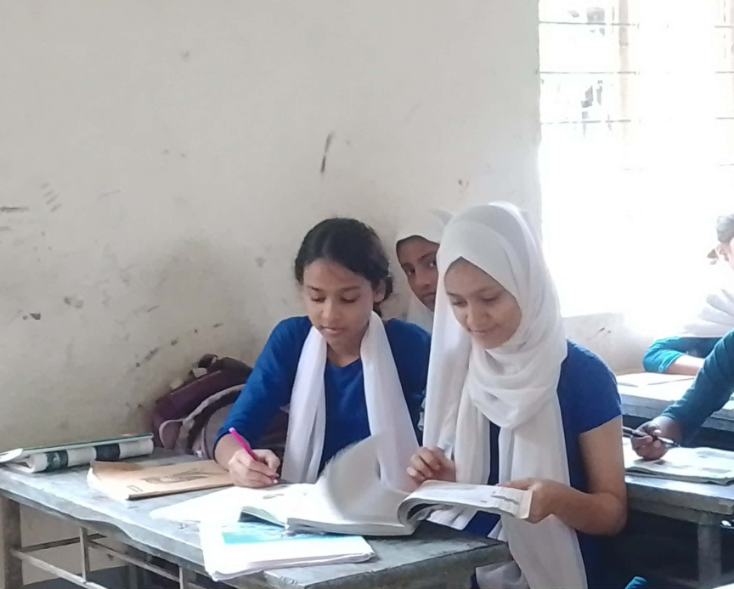
Pair Work
a)What is the poem about?
b) Who is the writer of the poem?
c)How does the speaker feel while swinging?

Slide 17
One day one word
Brown
বাদামী
Read the poem again.

Slide 18

Feedback

Slide 19

Key point of the session
“What have you learnt today?”
We have read the poem and got the main ideas.

Slide 20

Home Work
Do you have a swing at school or home?what do you see from it?

Slide 21


