Slide 1
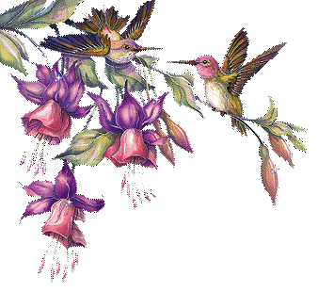

Md Jamal Shah
Head Teacher
Purba Guzara High School
Raozan,Chattogram.
Contact No:01817-780898
E-mail: jamalshahctg24@gmail .com

Slide 2
Class Ten
English 1st Paper
Time:50 minuties

Slide 3
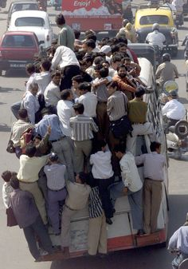
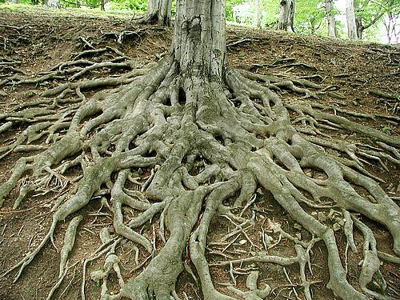
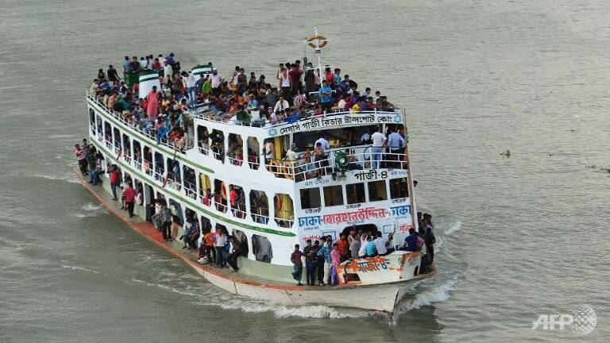
Look at these pictures below:
1
2
11
3
Why do you think people take such risks to
go home to celebrate their festivals?
How do you feel to see this photo?

Slide 4
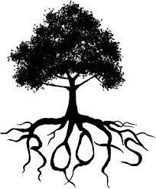
Roots
Unit:Twelve
Lesson :1 (My roots)
Page No:140-143

Slide 5
Learning outcomes
After you have studied the lesson,you will able to-
Parcipate in conversations and debates.
Exchange personal imformation.
Narrate incidents and events in a logical sequence.
Present own ideas,give and ask for imformation.
Write letters to problem pages of newspapers.

Slide 6
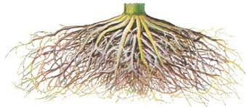
Main Ideas of the topic
Root is the basic cause,source
or origin of something.
Everyone wants to share happiness
and sadness with his near and dear oncs.
In this country like Bangladesh,most of the people Living outside their homes have a strong desire to get back home during several religious festivals for the home-bond people with mad rush in the buses,trains and launches.This the pull of the roots.
Human being have an attraction for his own persons,places, families, cultures,traditions and and where he born and grew up and that’s are our roots.
But some people lose that bond and become rootless.They do not
know where they are from and feel empty and lost.

Slide 7
Read the text carefully from your own textbooks,find out following words:
Desire,hazard,pull,rush, invisible,identity,devod, bond,rootless,non-entity.

Slide 8
Write some words and their meaning according to this text
Humanity=human nature,the quality of human
Empty =not filled,containing nothing
Pull =a force drawing someone or
something in a particular direction
Invisible =unable to be seen,not visible to the eye
Bond =a close connection joining two or more
people
Rootless =having no ties with a particular place or
community

Slide 9
Practising Synonym or Similar words
Social--- -- fimiliar,common,civil,polite
Context— situation,condition,relation
Bond--- - connection,tie in,binding
Religious-- pious,spiritual,holy,moral
Humanity- kindness,humanness,mankind
Desire--- aspiration,passon,ambition,wish
Mad rush- excitement
Home-bound people-old people,people who
are not free to move about

Slide 10
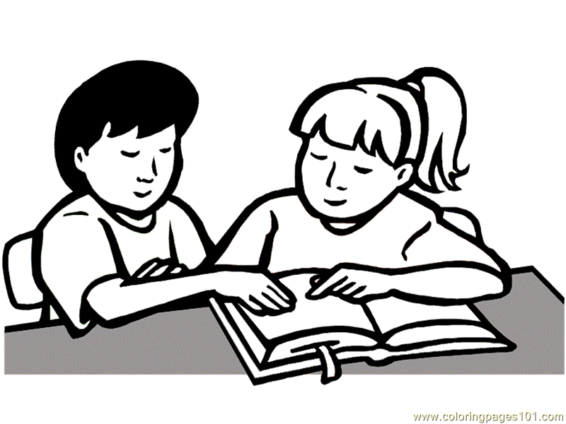
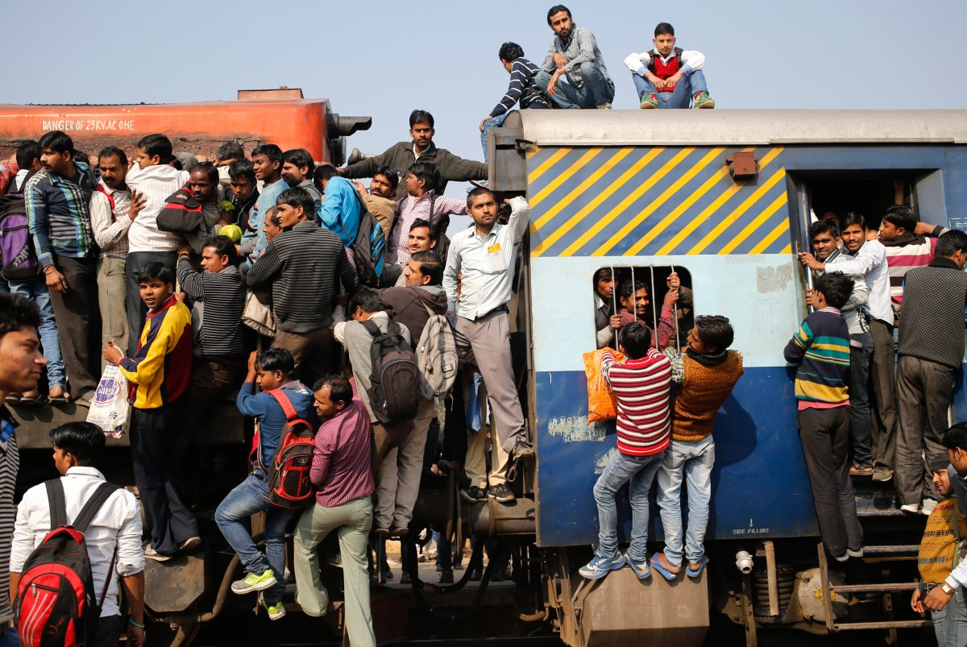
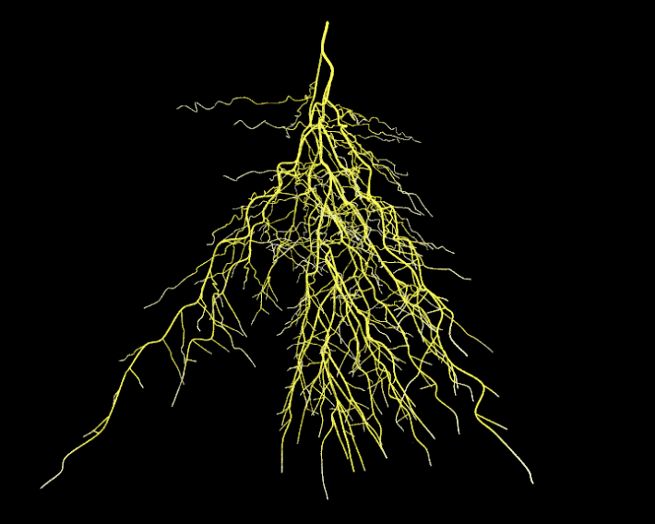
Works in pairs
Why people have strong desire
to get back home during the religious festivals?
Make three sentences about your roots.

Slide 11

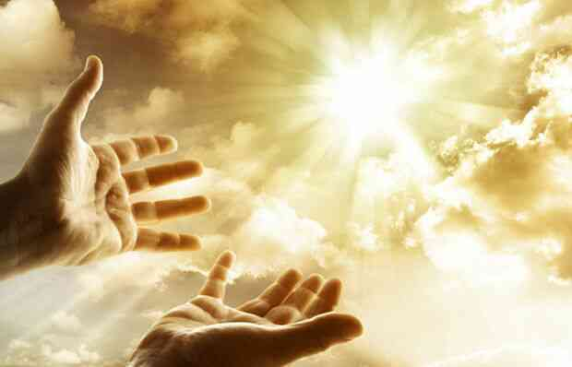
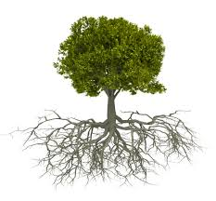
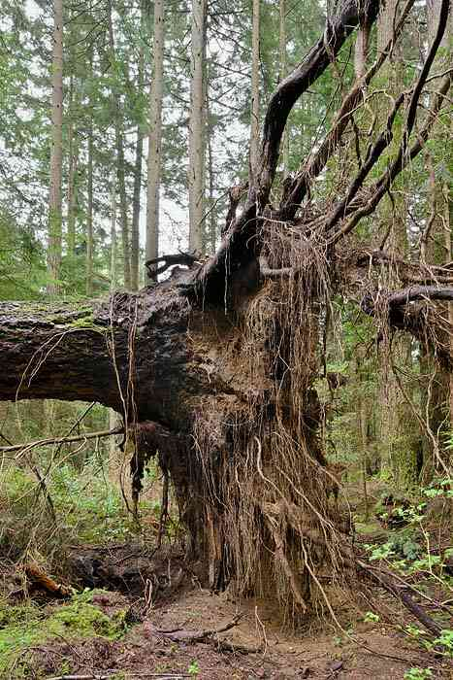
Evaluation
What is the synonym of the word “Religious”?
Do human beings have roots like the trees?Is it visible?
What do you mean by Rootless?

Slide 12
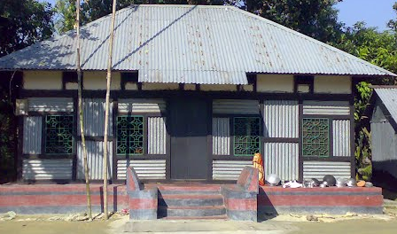

Home work
Why people become
rootless, according to
you?
Write a short Paragraph
about your root.

Slide 13


