Slide 1
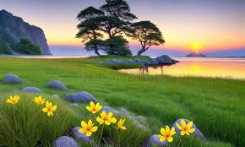
Good Morning Students
Welcome to today’s class

Slide 2
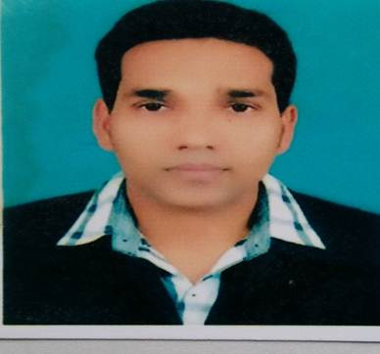
Teacher’s Identity
Md. Azim Uddin. Latifpur Government Primary School .

Slide 3


Lesson Identity
Subject: English
Class: Five
Unit: 8, A Field Trip to Remember
Activity: 1.1, 1.2
Page: 39 – 40

Slide 4
Learning Outcomes
3.4 Participating in conversations for exchanging in formation or ideas about familiar topic.
4.1 Recognising time fractions – half and quarter including time and currency, and read them aloud following proper pronunciation.
4.2 Reading aloud appropriate texts with proper stress, intonation and punctuation.
7.2 Writing numbers in fractions – half and quarter including time and currency correctly to use them in written communication.

Slide 5
Title of the lesson
We will read a text about a historical place
A Field Trip to Remember

Slide 6
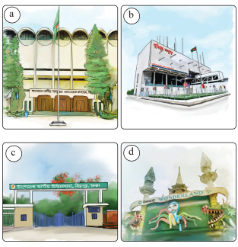
Review of the prior knowledge
What are the pictures about?
Ans: The Bangladesh National Museum, The Liberation War Museum, The National Zoo, and Wonderland Amusement park.
Have you ever visited any of these places?
Ans: Yes, I have. I visited the National Zoo and the Liberation War Museum With my school friends.
How do you feel when you are on a trip?
Ans: I feel very happy and excited. I love seeing new places and learning new things.
Ask Ss

Slide 7
New Words
Museum – যাদুঘর
Chatter – গল্প করা
Explore – অন্বেষণ করা
Patriotism - দেশপ্রেম
Sacrifice – বলিদান
Memorable – স্মরণীয়

Slide 8
Words and meanings
Museum – place to keep old objects
Chatter – quick, light talk
Explore – look around to learn
Patriotism - love for one’s country
Sacrifice – giving up for a good cause
Memorable – easy to remember; special

Slide 9


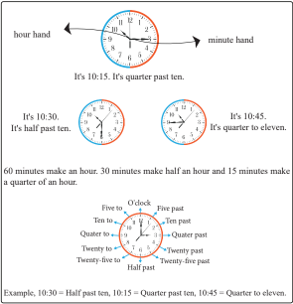
What do you see in the pictures?
Study Tour Bus
Watched a short documentary
Let’s find out

Slide 10
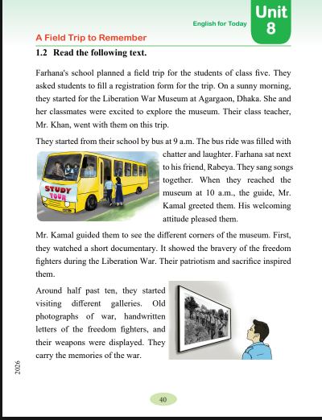
Open the text book at page 40

Slide 11
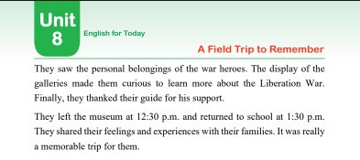

Slide 12

Practice with Chain drill
One will read the text aloud first, and the other will check the reading. Change their roles in turns.

Slide 13
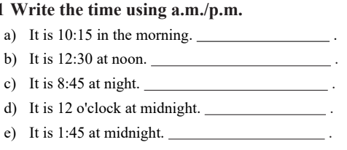
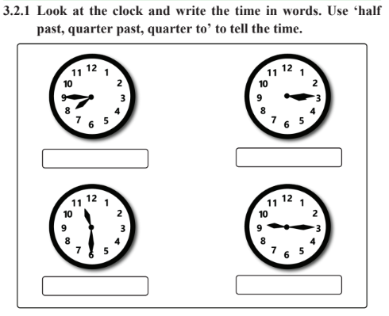
Evaluation
It is 10: 15 a.m.
It is 12: 30 p.m.
It is 8:45 p.m.
It is 12:00 a.m.
It is 1:45 a.m.
Quarter to eight
Quarter past three
Half past eleven
Quarter past nine

Slide 14
