Slide 1
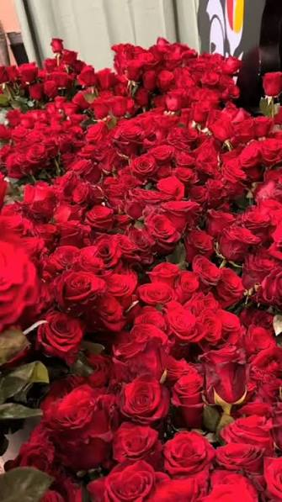
GOOD MORNING

Slide 2

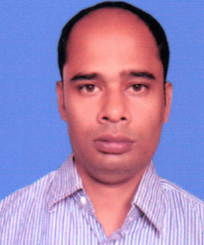
TEACHER’S INFORMATION:
Nittananda Shaha
ASSISTANT TEACHER
SABOIL GOVT. PRIMARY
SCHOOL
MOHADEBPUR, NAOGAON

Slide 3
Lesson Introduction
Class :5
Unit :18
Title : Nakshi Kantha
Page : 97-99 ( Activity : 1.1,1.2, 2.1, 3.1,4.1)

Slide 4
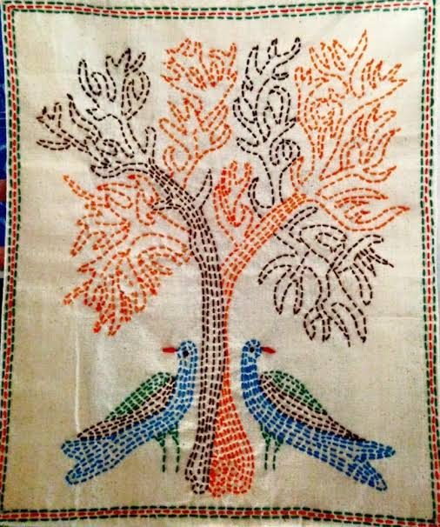
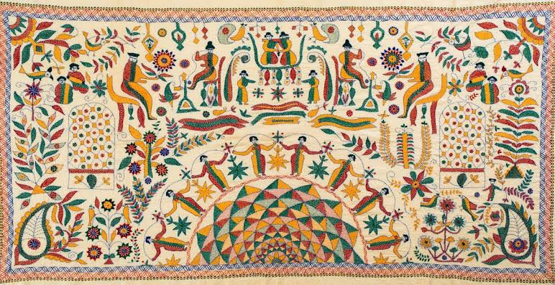
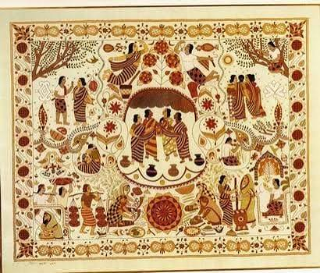
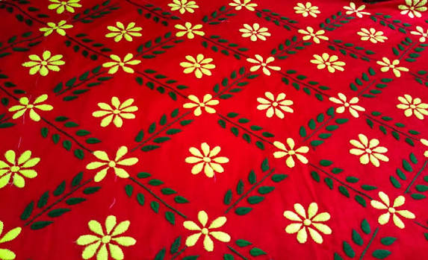
a) Have you seen these things before?
b)Do you know about these?
c) Why do people use these things?

Slide 5
Announcement of the Lesson
Nakshi Kantha
Write out in your khata

Slide 6
1.1 Look up the words of column A in the dictionary. Then , match the words with their meanings in column B.
Column A | Column B
a) stitch | i) a way of doing something that has existed for a long time
b) quilt | ii) to sew pieces of cloth
c) wrap | iii) a warm blanket made by sewing pieces of clothes together
d) pattern | iv) to put cloth over something to cover it
e) tradition | v) a design that repeats shapes, colours, lines etc
a) stitch
ii) to sew pieces of cloth
b) quilt
iii) a warm blanket made by sewing pieces of clothes together
c) wrap
iv) to put cloth over something to cover it
d) pattern
v) a design that repeats shapes, colours, lines etc
e) tradition
i) a way of doing something that has existed for a long time

Slide 7
Vocabulery
Word
Meening
fond
Having affection or love for someone
Decided
Determined; clear and definite.
Traditional
Passed down from generation to generation.
Handmade
Made by hand rather than by machine.
pattern
A repeated design
stitch
To sew or join pieces of cloth with a needle and thread.
symbol
A sign, mark, picture, or object that represents something else.
wrapped
Folded or wound around something.
homeland
The country where a person was born or belongs.

Slide 8
1.2 Read the following passage.
When Adiba was in Class five , she moveto New York with her parents. Her grandmother lives in a village in Bangladesh. She is very fond of her grandmother. Adiba used to visit her grandmother once every year.
Last year, her grandmother wanted to give her something on her birthday. So, she decided to sew a special Nakshi Kantha for her.

Slide 9
It is a traditional handmade quilt. She began by gathering colourful pieces of old sarees. With great care , she stitched them together. She made a beautiful pattern of flowers and birds on it. It took many days and nights to complete the Kantha. Before Adiba’s birthday, her grandmother sent her the Nakshi Kantha.
Adiba was filled with joy after receiving it. Adiba heard from her father that the stitch, colour and pattern of the Kantha had a story to tell. From that day, Adiba wanted to learn more about the Nakshi Kantha. It was more than just a quilt.It was a symbol of her grandmother's love. She felt happy when she wrapped herself with the quilt. It symbolises the rich tradition of her homeland.

Slide 10
2.1 Read the passage again and answer the following questions.
a) What did Adiba’s grandmother gather for sewing the Kantha?
Adiba's grandmother gathered colourful pieces of old sarees for sewing the Kantha.
b) What patterns did she make on the Kantha?
She made beautiful patterns of flowers and birds on the Kantha.
c) How long did it take to complete the Kantha?
It took many days and nights to complete the Kantha.
d) How did the Kantha tell a story?
The Kantha told a story through its stitches, colours and patterns.
e) How did Adiba feel when she wrapped herself in the quilt?
Adiba felt happy when she wrapped herself in the quilt.

Slide 11
3.1 Language Focus: Simple Past Tense
In English, -d/-ed is added to most verbs to tell/show what happened in the past. They are regular verbs.
But irregular verbs do not follow the usual rules for changing tenses.
Present
Past
Present
Past
begin
began
live
lived
make
made
visit
visited
take
took
decide
decided
tell
told
Regular Verbs
Irregular Verbs
stitch
stitched
feel
felt
fill
filled
had
wrap
wrapped
have
cherish
cherished
Is/am
was

Slide 12
4.1 Now, fill in the blanks using correct form of the verbs (present simple/past simple) given below.
use | take | live | give | tell | make | visit
Adiba ________ in New York. She ________her grandmother once a year. Last year, her grandmother ___________a Nakshi Kantha for her. She_________ colourful pieces of old sarees to make it. It ___________ many days to stitch beautiful patterns of flowers and birds. Her grandmother ________ her the quilt on her birthday. Adiba was very happy because the quilt was cozy and warm and it _________ a story through its designs.
lives
visits
made
used
took
gave
told

Slide 13
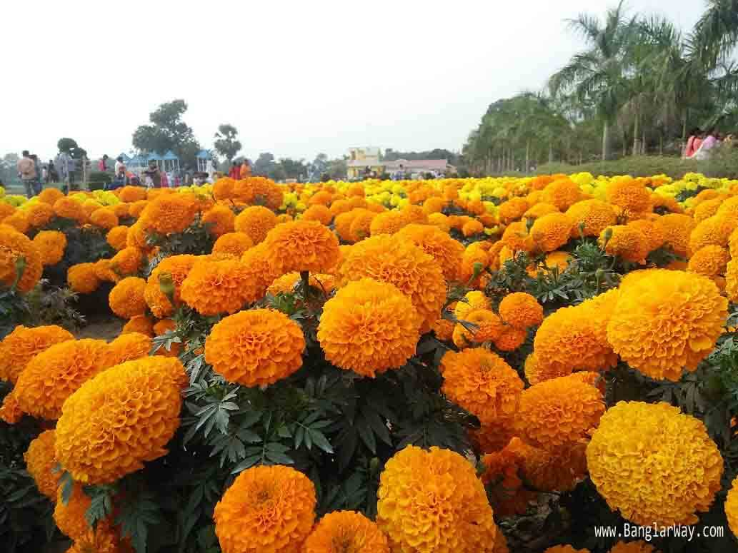
THANK YOU

