Slide 1
English With Anisur Rahman
Warm-up
Add your lesson content here...
Good morning, everyone.
How are you today?
Welcome to our English class.
📚 English With Anisur Rahman | Learn English with Bangla Explanation

Slide 2
English With Anisur Rahman
Cover
Add your lesson content here...
Class: 3
Subject: English
Unit: 4 – Let's Play with Sounds and Numbers
Lesson: 2
Pages: 52–53
Topic: Say the Middle Sounds /ɪ/ and /iː/
📚 English With Anisur Rahman | Learn English with Bangla Explanation

Slide 3
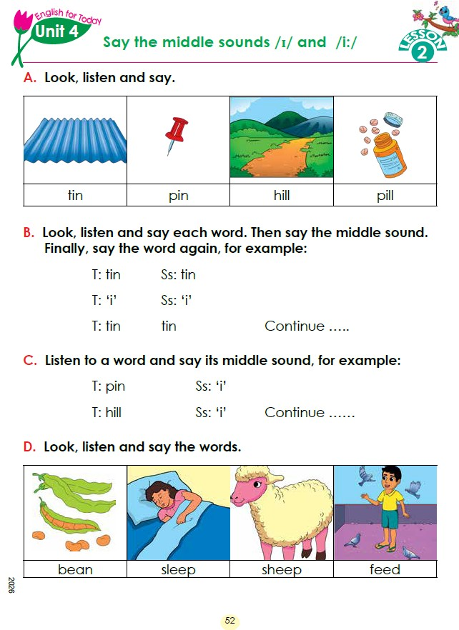
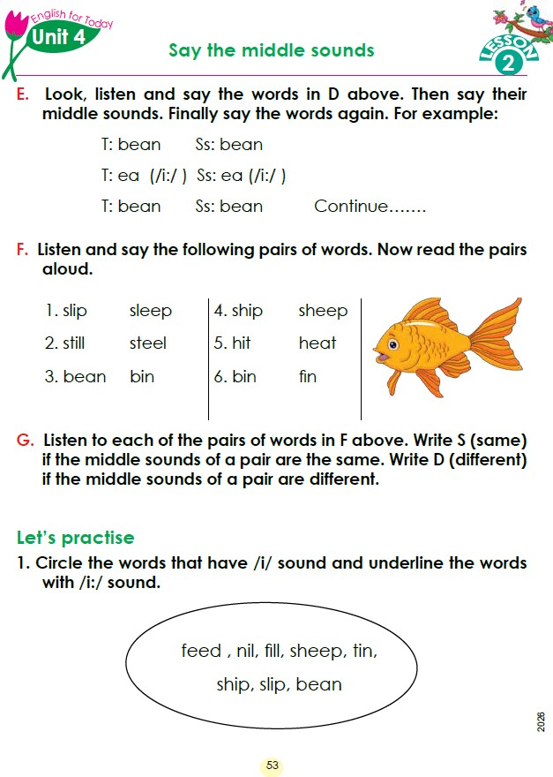
English With Anisur Rahman
Cover
📚 English With Anisur Rahman | Learn English with Bangla Explanation

Slide 4
English With Anisur Rahman
Learning Outcomes
Add your lesson content here...
By the end of the lesson, students will be able to:
Recognise the middle sounds /ɪ/ and /iː/.
Pronounce familiar words correctly.
Distinguish between the short /ɪ/ sound and the long /iː/ sound.
Read and compare words with confidence.
📚 English With Anisur Rahman | Learn English with Bangla Explanation

Slide 5
English With Anisur Rahman
Revision
What sounds did we learn in the previous class?
Expected answer:
/æ/
/e/
Say with me:
bag
cat
pen
hen
Excellent!
Today we shall learn two new sounds.
📚 English With Anisur Rahman | Learn English with Bangla Explanation

Slide 6
English With Anisur Rahman
Activity A
What is this?
📚 English With Anisur Rahman | Learn English with Bangla Explanation

Slide 7
English With Anisur Rahman
Activity B
Repeat with me:
pin
hill
pill
Teacher:
i
/ɪ/
Students:
i
/ɪ/
Teacher:
tin
Students:
tin
📚 English With Anisur Rahman | Learn English with Bangla Explanation

Slide 8
English With Anisur Rahman
Activity C
📚 English With Anisur Rahman | Learn English with Bangla Explanation

Slide 9
English With Anisur Rahman
Activity D
📚 English With Anisur Rahman | Learn English with Bangla Explanation

Slide 10
English With Anisur Rahman
Vocabulary
Word | Bangla Meaning
bean | শিম
sleep | ঘুমানো
Sheep | ভেড়া
feed | খাবার দেওয়া
📚 English With Anisur Rahman | Learn English with Bangla Explanation

Slide 11
English With Anisur Rahman
Activity E
📚 English With Anisur Rahman | Learn English with Bangla Explanation

Slide 12
English With Anisur Rahman
Activity F
📚 English With Anisur Rahman | Learn English with Bangla Explanation

Slide 13
English With Anisur Rahman
Activity G
→ D
→ D
→ D
→ D
→ D
→ S
📚 English With Anisur Rahman | Learn English with Bangla Explanation

Slide 14
English With Anisur Rahman
Activity G
📚 English With Anisur Rahman | Learn English with Bangla Explanation

Slide 15
English With Anisur Rahman
Activity F
📚 English With Anisur Rahman | Learn English with Bangla Explanation

Slide 16
English With Anisur Rahman
Pair Work
Add your lesson content here...
📚 English With Anisur Rahman | Learn English with Bangla Explanation

Slide 17
English With Anisur Rahman
Practice
Add your lesson content here...
📚 English With Anisur Rahman | Learn English with Bangla Explanation

Slide 18
English With Anisur Rahman
🎲 Fun Classroom Activity
Students raise
✋ One hand for /ɪ/
🙌 Two hands for /iː/
Example:
sleep
            Students:
            🙌
Teacher:
tin
            Students:
            ✋
📚 English With Anisur Rahman | Learn English with Bangla Explanation

Slide 19
English With Anisur Rahman
Quiz
Add your lesson content here...
📚 English With Anisur Rahman | Learn English with Bangla Explanation

Slide 20
English With Anisur Rahman
Assessment
Add your lesson content here...
📚 English With Anisur Rahman | Learn English with Bangla Explanation

Slide 21
English With Anisur Rahman
Homework
Add your lesson content here...
Read all the words on Pages 52–53.
Write four words with /ɪ/.
Write four words with /iː/.
Practise reading the word pairs aloud.
📚 English With Anisur Rahman | Learn English with Bangla Explanation

Slide 22
English With Anisur Rahman
Thank You
Add your lesson content here...
Thank You
wish you all the best.
Happy learning.
📚 English With Anisur Rahman | Learn English with Bangla Explanation

