Slide 1


Slide 2


Unit-11
Activity-1.1,1.2
Lesson Title:
Making Requests
Page: 54-55

Slide 3

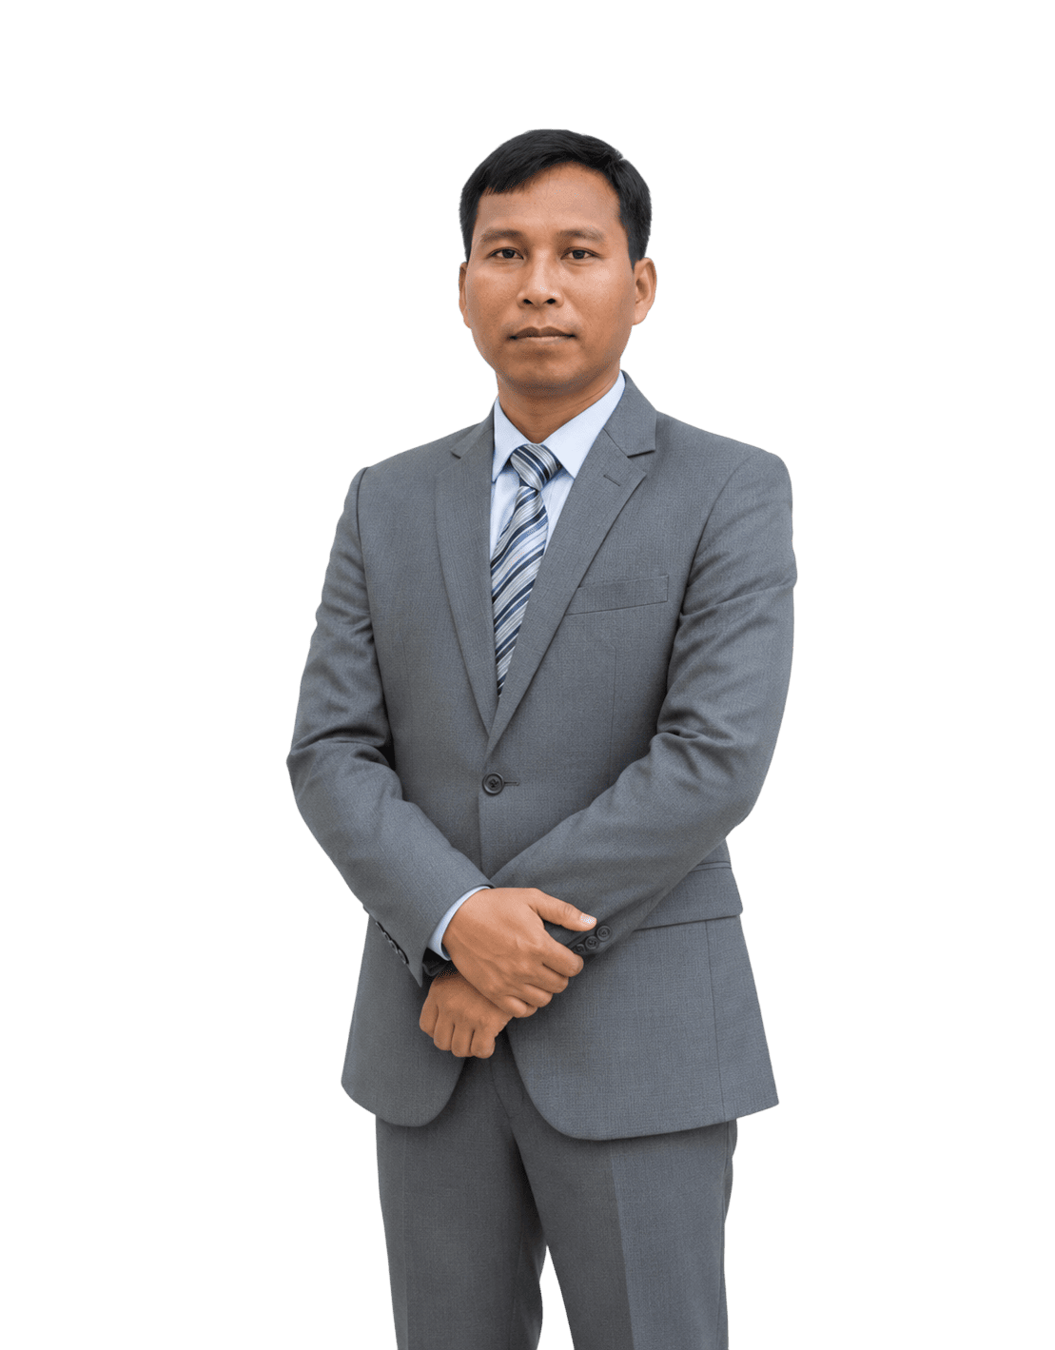
Eman Chakma
Assistant Teacher
Khyangsapara Govt Primary School
Mahalchari, Khagrachari

Slide 4

Learning Outcomes
👉 Students will be able to
4.2.1 Read aloud texts with proper stress, intonation.
8.1.2 Recognize and use a range of words and phrases in written communication.
8.1.2 Recognize and use a range of words and phrases in written communication.

Slide 5
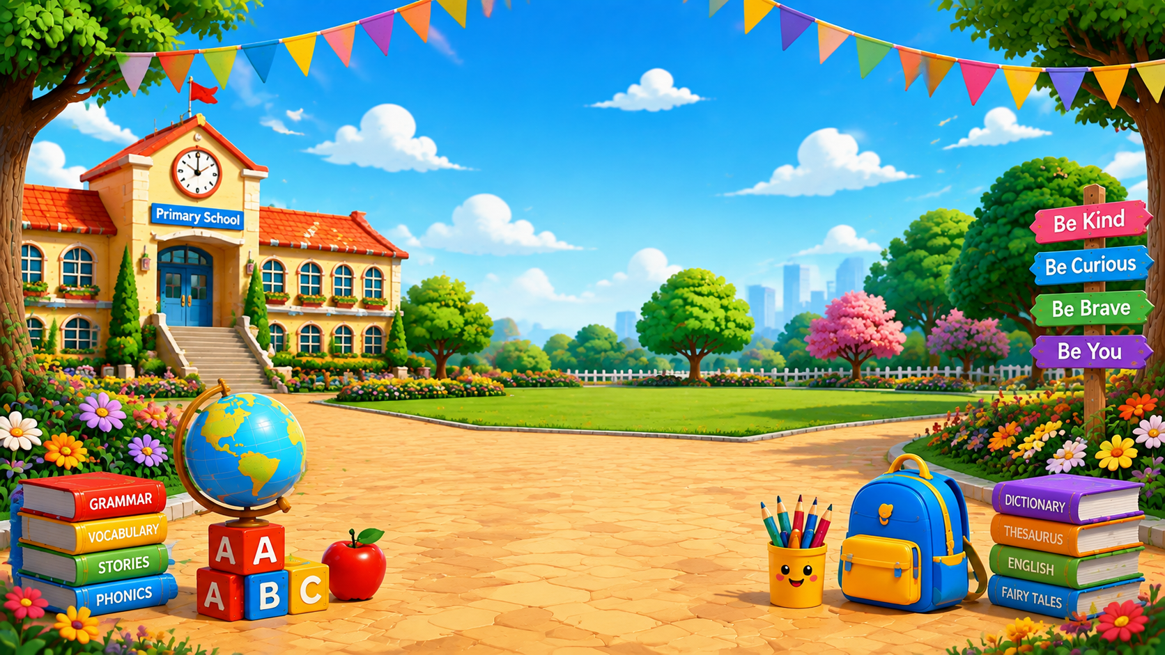
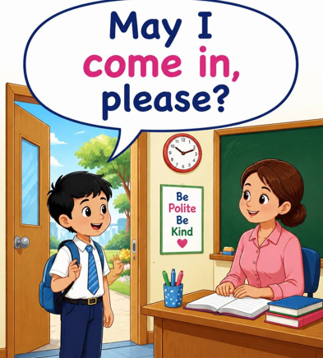
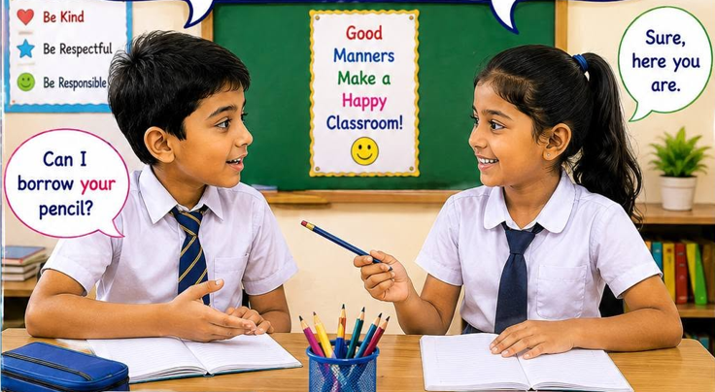
Review of the prior knowledge
  🎯 How do you make requests to others?

Slide 6
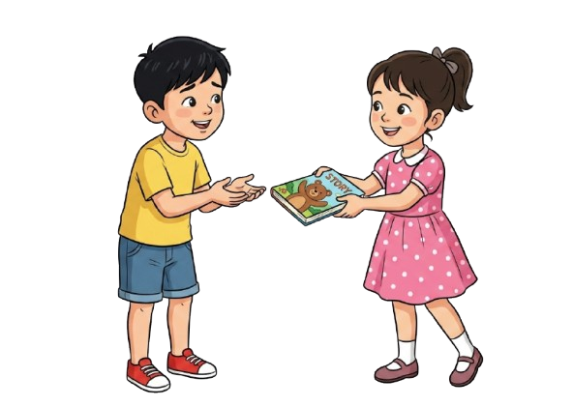
Look at the picture
  📌 What do you see in the picture?
  📌 What do you think they are talking about?
  📌 How do you request someone to get something?

Slide 7
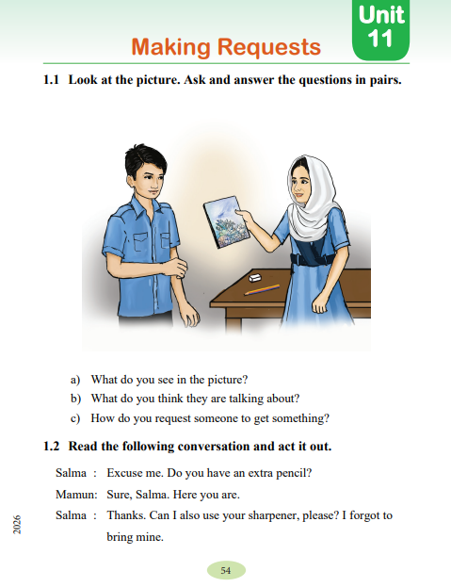
Our Today’s Lesson
Open the textbook page 54
Makng Requests

Slide 8
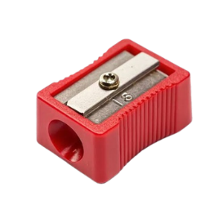
New words
Request
A request is the act of asking for something politely or officially, or the thing that you are asking for.
Sharpener
a tool, device, or machine used to make things sharp
Suggest
to propose an idea, show something without saying it directly, or make someone think of an image or feeling.

Slide 9
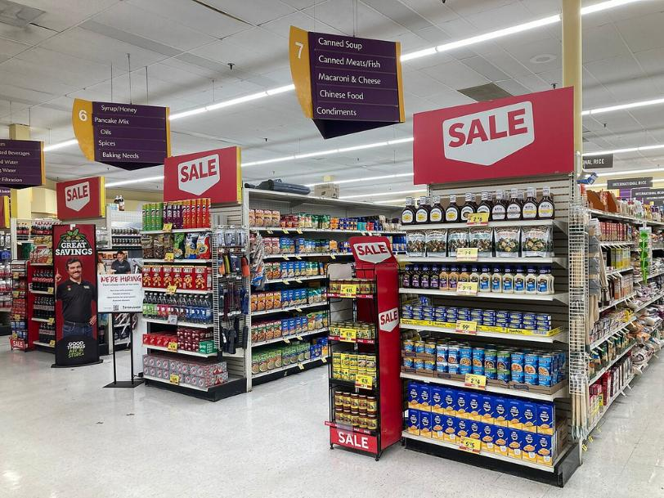
New words
Necessary
something is needed, required, or essential to reach a goal or make something happen
Store
a shop where you buy things, a supply of items kept for later, or the act of keeping things safe until you need them.

Slide 10
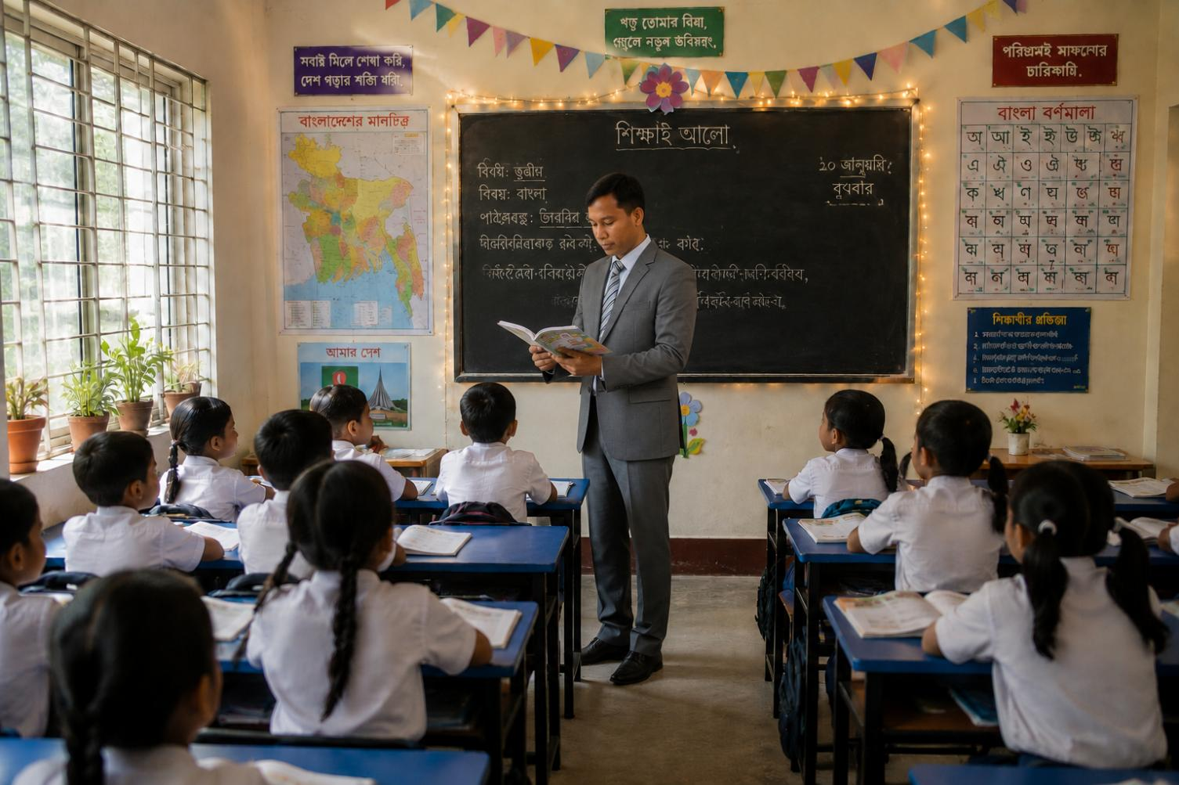

Teacher’s Model Reading

Slide 11
Listen to me and put your finger under the line
Salma: Excuse me. Do you have an extra pencil?
Mamun: Sure, Salma. Here you are.
Salma Thanks. Can I also use your sharpener, please? I forgot to bring mine.
Mamun: I'm sorry. I don't have a sharpener.
Salma That's okay.
Mamun: May I see the pictures you have coloured?
Salma: Why not? Here is my drawing book.
Mamun: Nice drawings, Salma. But you have only two pages left.
Salma Oh, really? Then, I need to buy a new one. Can you suggest
me any store?
Mamun: Sure. You can find your necessary items at the City Library.
Salma: Could you tell me how to get there?
Mamun: Yes, it is on the College Road, next to the government
college. Go straight and then turn left on the College Road. The library will be on your right.
Salma: Thanks for your help, Mamun.
Mamun: You are welcome. Thank you.

Slide 12
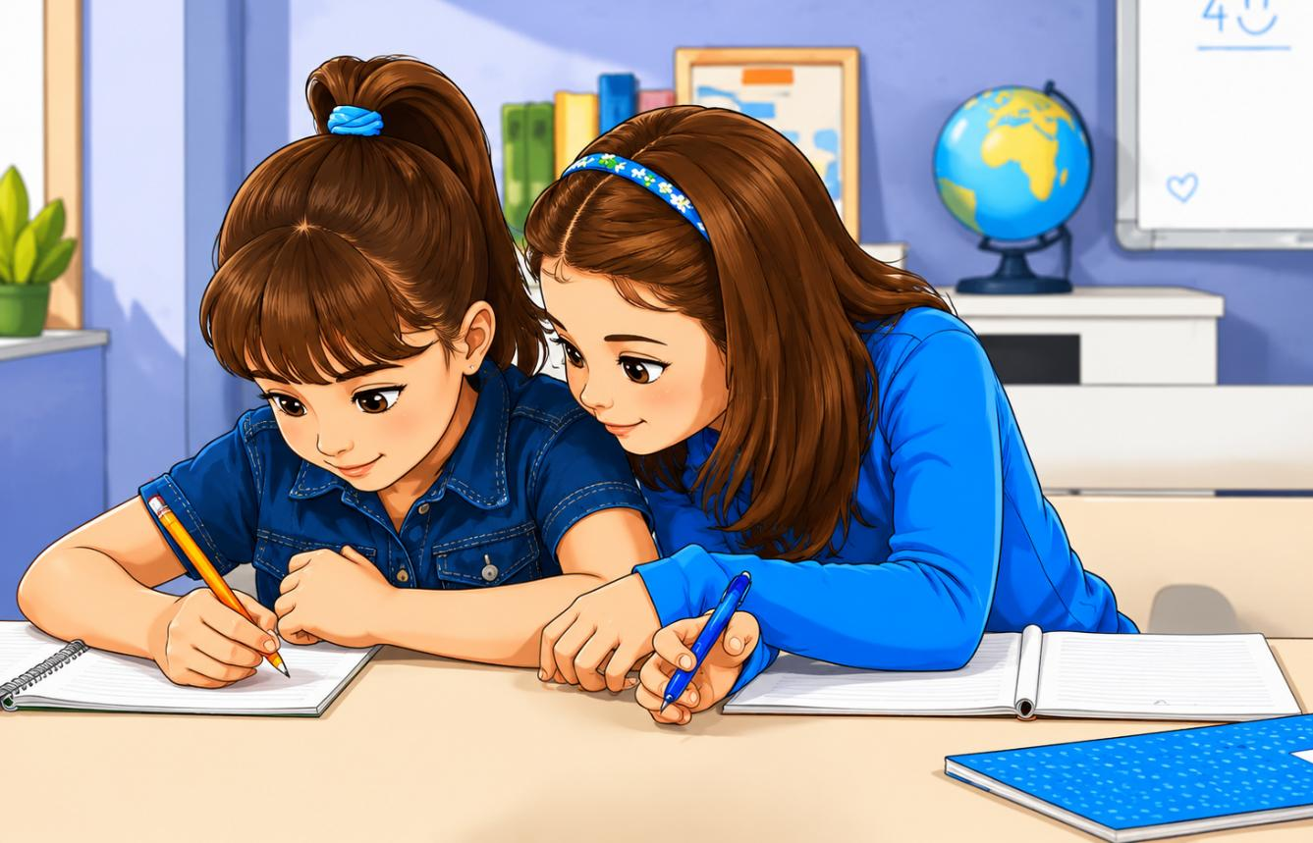
Pair Work
Read the text in pairs and role-play the conversation.

Slide 13
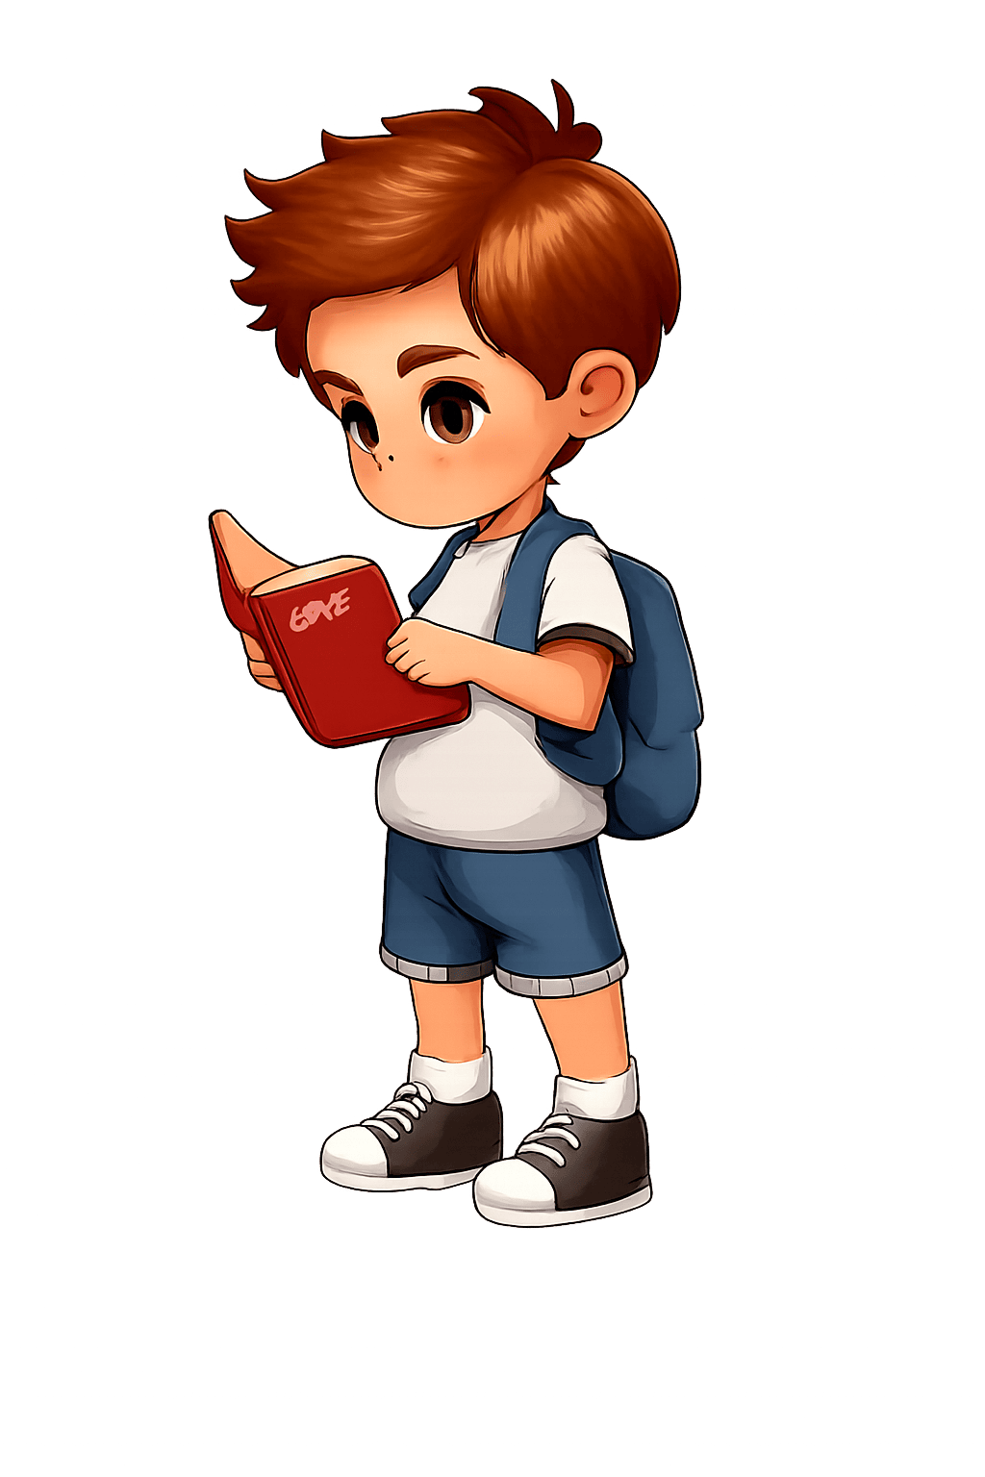
Assessment
Read the conversation individually from activity 1.2 in textbook

Slide 14


