Slide 1
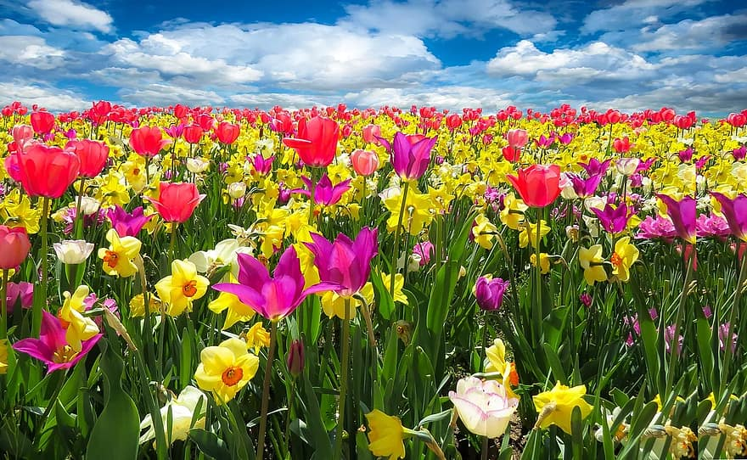
Good morning my lovely students

Slide 2


Introduce
Palash
Assistant Teacher
Shaid Gafur G.P.S.
Paikgaccha,Khulna

Slide 3

Lesson Identity
Class:one
Subject:English For Today
Unit:2
Lesson:17
Time:50 Minute

Slide 4
Learning outcomes
# Recognize the sounds of the alphabet in familiar words
# Read the pictures of familiar objects and events

Slide 5


Lesson Declaration

Slide 6
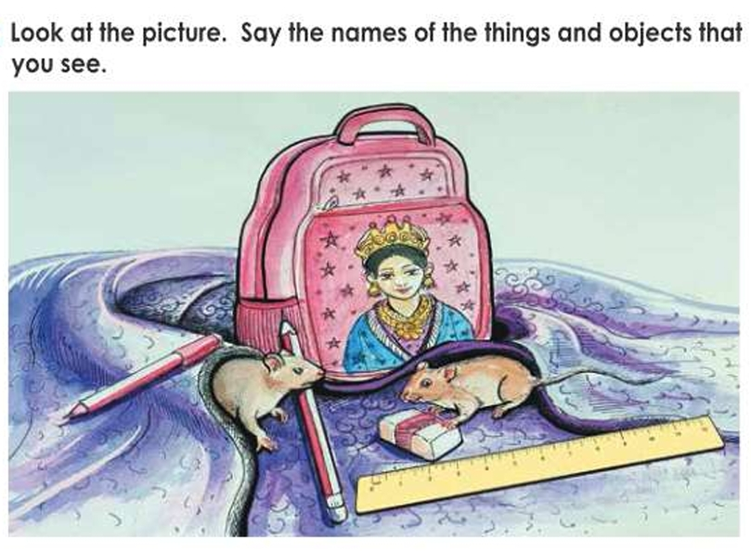

Slide 7
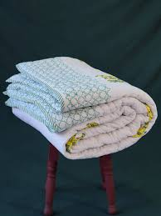
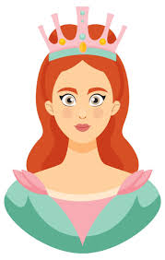
Look, listen and say
quilt q
Quilt Q
লেপ
queen q
Queen Q
রাণী

Slide 8
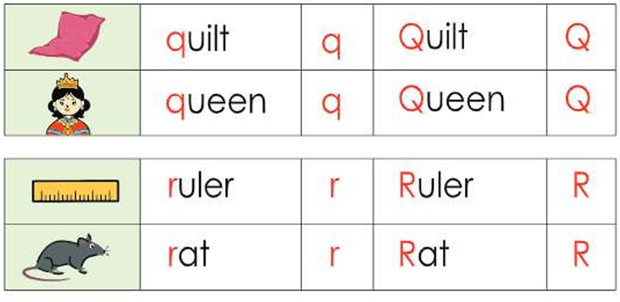

Slide 9

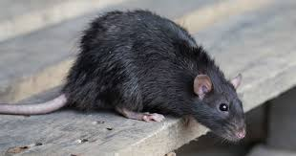
Evaluation
See the picture and write the letter

Slide 10


