Slide 1
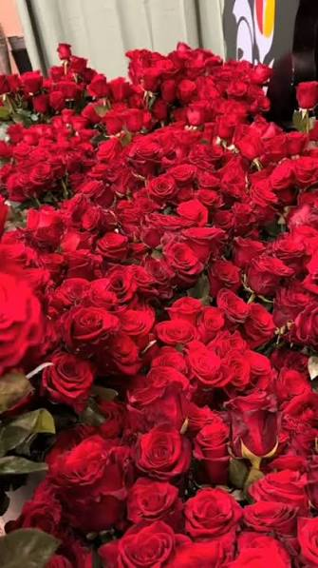
GOOD MORNING

Slide 2
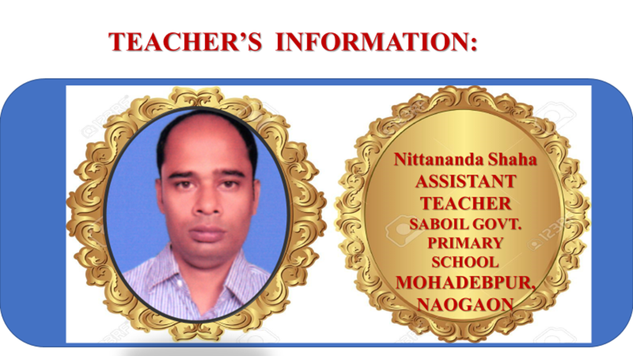

Slide 3
Lesson Introduction
Class :5
Unit :19
Title :The Wind and the Sun
Page : 100-105 ( Activity : 1.1,2.1, 2.2, 3.1,3.1.1,4.1)

Slide 4
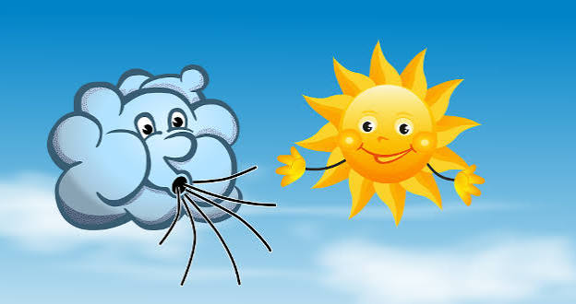
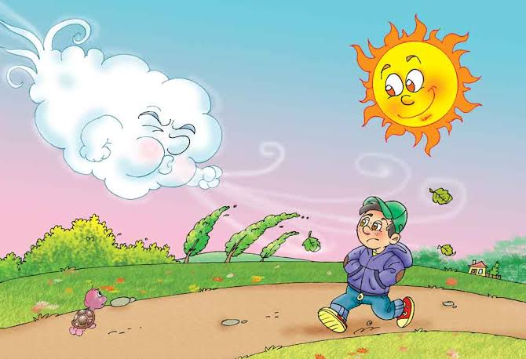
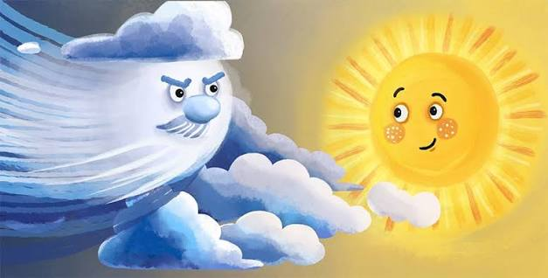
a) Have you seen these things before?
b)Do you know about these?
c) What is our today’s listen?

Slide 5
Announcement of the Lesson
The Wind and the Sun
Write out in your khata

Slide 6
Vokabulery
Word
Meaning
argument
Quarrel, A reason or opinion used to support an idea
powerful
having great power, strength, or influence.
across
on the opposite side.
ocean
a very large body of salt water that covers much of the Earth.
tornadoes
violent, cyclone, tornado, whirlwind, typhoon
A competition in which people try to win.
contest
agreed
had the same opinion, or accepted a plan or idea.
gust
Gust means a sudden, strong burst of wind.
wiggled
moved with small, quick movements from side to side.

Slide 7
1.2 Read the story.
The wind and the sun were having an argument about who was stronger
than the other.
‘I am the most powerful!’ said the wind.
‘No, I am the most powerful!’ said the sun.
‘I can blow trees to the ground!’ said the wind. ‘I can push ships across the
ocean. I can make tornadoes!’
‘Is that right?’ replied the sun. Just then, they saw a man walking along the
road in his winter jacket.

Slide 8
‘Let's have a contest to see who is more powerful,’ said the wind. ‘He who can remove the man’s jacket first will be winter.”
The sun agreed.
The man kept shivering and zipped up his jacket.”Brrr!What a cold and windy day!’

Slide 9
It started raining. The wind blew even harder and turned the rain into a
storm.
“Well, look at that! There’s a happy storm !” said the man.
The wind blew its strongest gust towards the man, but the man's jacket
stayed on. He zipped the jacket higher to cover his nose.
‘Oh! This is impossible,’ said the wind. He stopped blowing.
‘My turn!’ said the sun.
First, the sun was shining enough to stop the rain and storm. The man
unzipped his jacket. Then the sun pulled the clouds apart and gently shone
down on the man. Suddenly, it felt like a beautiful sunny day.
“Wow. The weather is strange around here!” said the man.
The sun gently wiggled its fingers and increased the temperature.

Slide 10
“What strange weather it is! Now, it feels like a hot summer!” the man said.
as he began to sweat. ‘Oh, it's so hot!’
He removed his jacket and headed to a nearby tree. He took a rest for a
while under the shade of the tallest tree.
‘I have made the man remove his jacket. I have won!’ said the sun.

Slide 11
2.1 Fill in the blanks using the words from the box below.
snow, | sweat | arguing, | jacket | trees
arguing
a) The wind and the sun were __________ about who is stronger.
b) The wind claimed that it could blow __________ to the ground.
c) The sun said it could melt all the __________ on the mountains.
d) The contest was to see who could remove the man's __________
e)The man finally removed his jacket because he began to_________.
trees
snow
jacket
sweat

Slide 12
2.2 Write the answers to the following questions.
a)What could the wind do to show its strength?
Ans: The wind could blow trees to the ground, push ships across the ocean and make tornadoes to show its strength.
b) What did the man do when the wind blew strongly?
Ans: The man zipped his jacket higher to cover his nose when the wind blew strongly,
c) What did the sun do first before shining brightly?
Ans: Before shining brightly, the sun first pulled the clouds apart and gently shone down on the man.
d) Why did the man finally take off his jacket?
Ans:The man finally took off his jacket because he began to sweat.
e) If you were the man in the story, how would you feel about the sudden change in weather?
e) If I were the man in the story, I would feel surprised about the sudden change in weather.

Slide 13
3.1 Language Focus: Comparison of Adjective
Look at the following words used in the text.
stronger ,powerful, harder, beautiful , hot , tallest , coold
The above words are used to talk about the qualities or characteristics of a person or thing. These are adjectives.
Adjectives are describing words. They tell us more about people, animals, places and things.
Adjectives can describe the difference between two things. For example,
a tall tree | a taller tree
an interesting story | a more interesting story

Slide 14
Adjectives can also describe something as the best or the greatest among three or more things. For example,
We use -er for one syllable word (tall) We add more for more than one syllable word (in-ter-es-ting
The cheetah is the fastest animal in the jungle.
We use -est for one syllable word (fast) We add mast for more than one syllable word (beau-ti-ful)
This is the most beautiful picture in the gallery.

Slide 15
3.1.1 Now write the forms of adjectives of the following. The first one is done for you.
Adjectives
Positive
Comparative
Superlative
close
closer
closest
strong
stronger
strongest
warm
warmer
warmerest
weak
weaker
weakest
happiest
happy
happier
fast
faster
fastest
good
better
best
careful
more careful
most careful
colourful
more colourful
most colourful
comfortable
more comfortable
most comfortable

Slide 16
4.1 Choose five adjectives from the left column of the table in activity 3.1.1 Write sentences using those adjectives and their comparative and superlative forms. One is done for you.
Sumon is strong.
Strong
Kabir is stronger than Sumon.
Farhan is the strongest boy in the class.

Slide 17
Anisha is a happy girl.
Happy
Nusrat is happier than Anisha.
Nabila is the happiest girl in the class.
Monir is a wehk boy.
Weak
Arafat is weaker than his brother.
Monir is the weakest student in the class.
Be careful while crossing the road.
Careful
Rubi is more careful than Jami
Rumi is the most careful in the family
The cheetah is a fast animal.
Fast
The cheetah is faster than the lion.
The cheetah is the fastest animal in the jungle.
This chair is comfortable.
comfortable
Sofa is more comfortable than chair.
This is the most comfortable chair in the office.

Slide 18
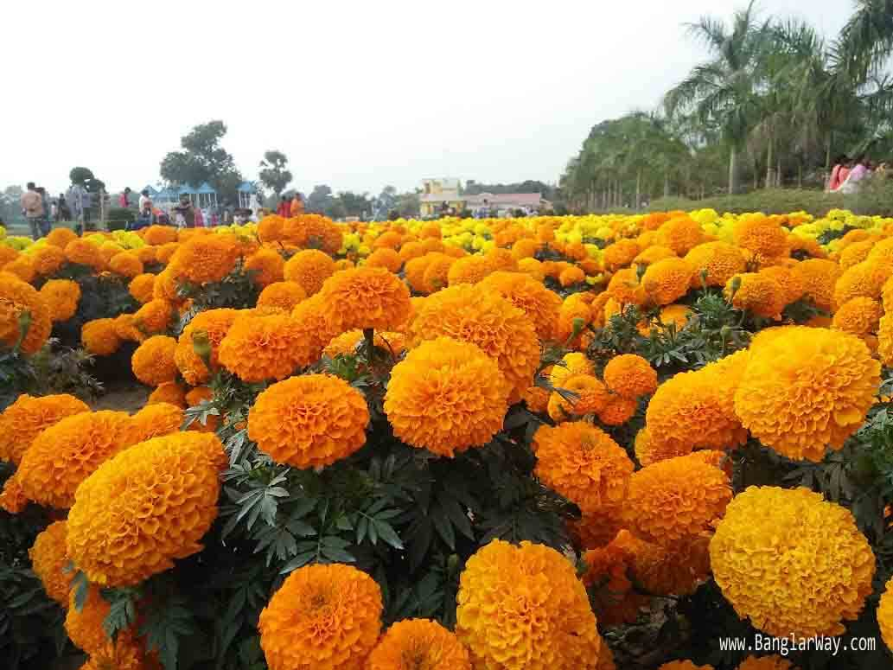
THANK YOU

