Slide 1

Unit – 7
Lesson – 1,2
Page no: 63-66
Colours Shapes and signs
Created by: Manik Hossain
Siddik Mia Govt Primary School
Mohammadpur, Dhaka

Slide 2
Learnig outcomes:
1.1 Students can identify colours.
1.2 Students can say the name of seven colours.

Slide 3
Seven colours
Red - লাল
Green – সবুজ
Blue – নীল
Violet - বেগুনী
Orange – কমলা
Yellow - হলুদ
Indigo – গাঢ় বেগুনী/ গাঢ় নীল

Slide 4
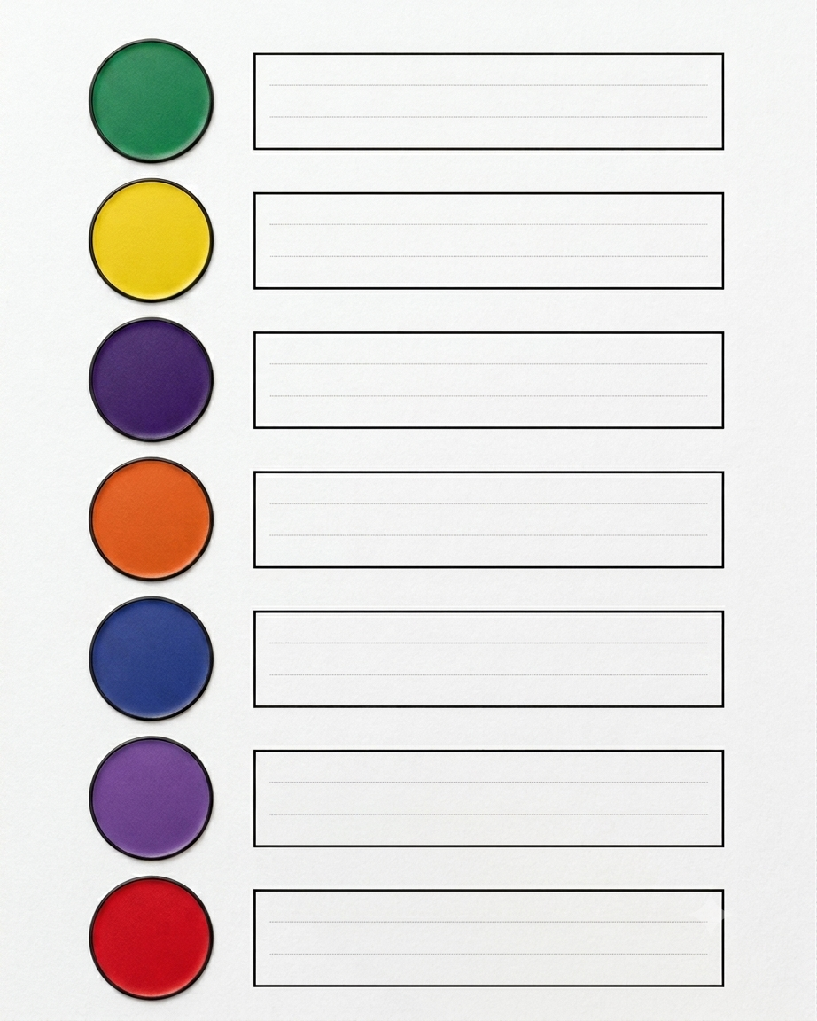
Green – সবুজ
Yellow - হলুদ
Indigo – গাঢ় বেগুনী
Orange – কমলা
Blue – নীল
Violet - বেগুনী
Red - লাল

Slide 5
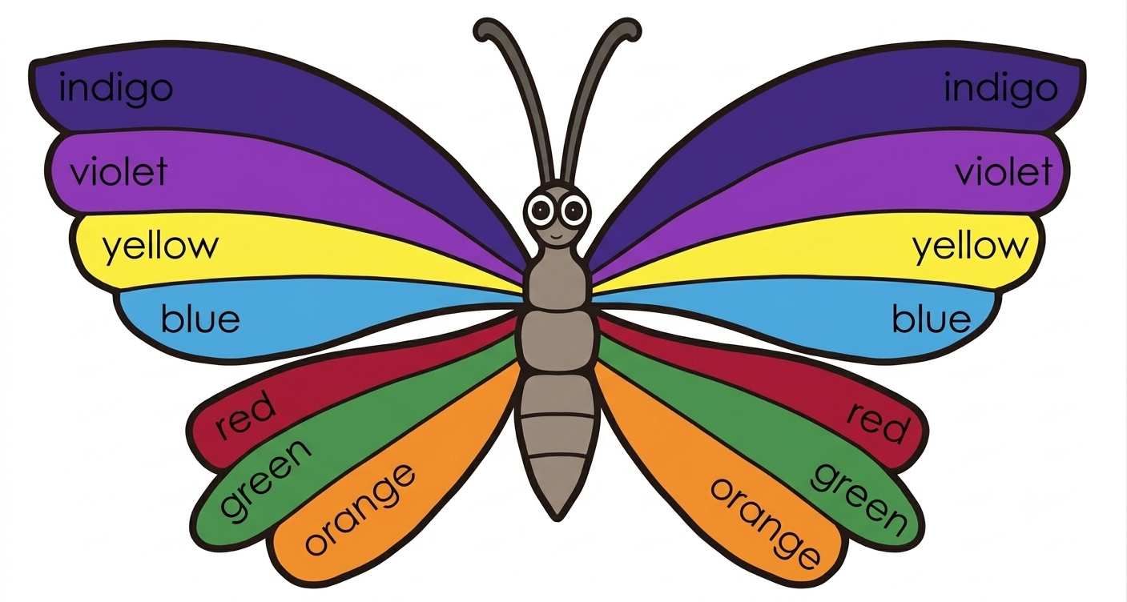

Slide 6

Red ,
red ,
red ,
The rose
is
red .

Slide 7

Green ,
green ,
green ,
The parrot
is
green .

Slide 8

Blue ,
blue ,
blue ,
The sky
is
blue ,

Slide 9

Violet ,
violet ,
violet ,
The ballon
is
violet ,

Slide 10
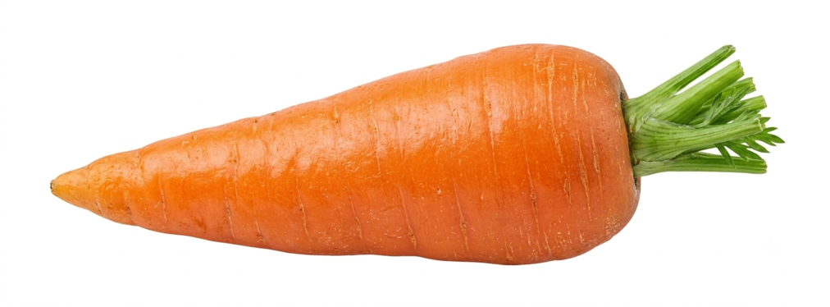
Orange ,
orange ,
orange ,
The carrot
is
orange .

Slide 11
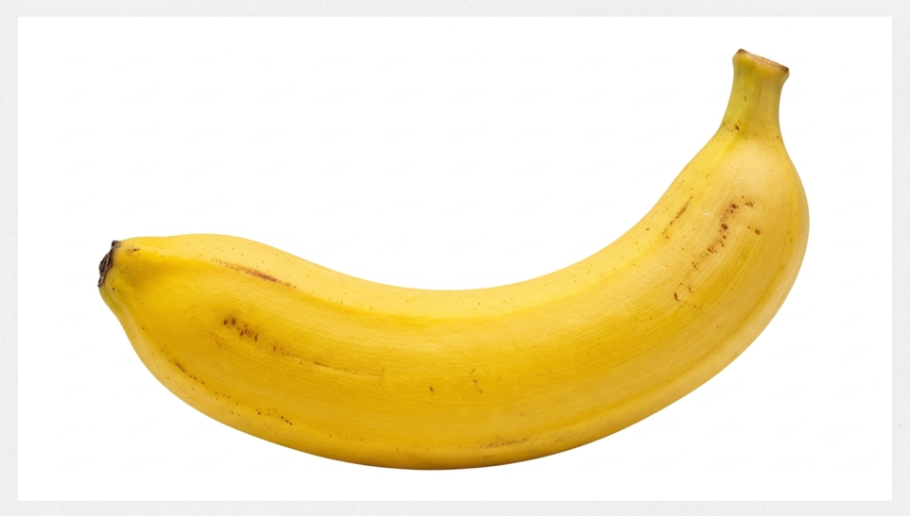
Yellow ,
yellow ,
yellow ,
The banana
is
yellow .

Slide 12
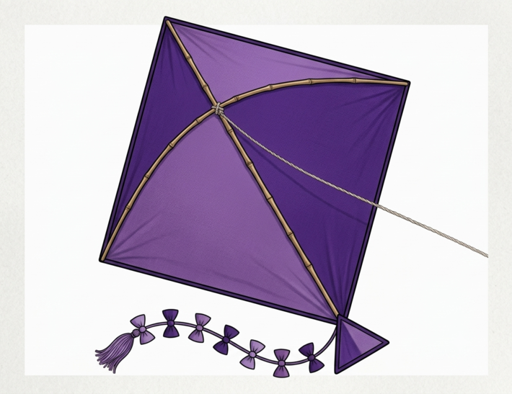
Indigo ,
indigo ,
indigo ,
is
The kite
indigo .

Slide 13
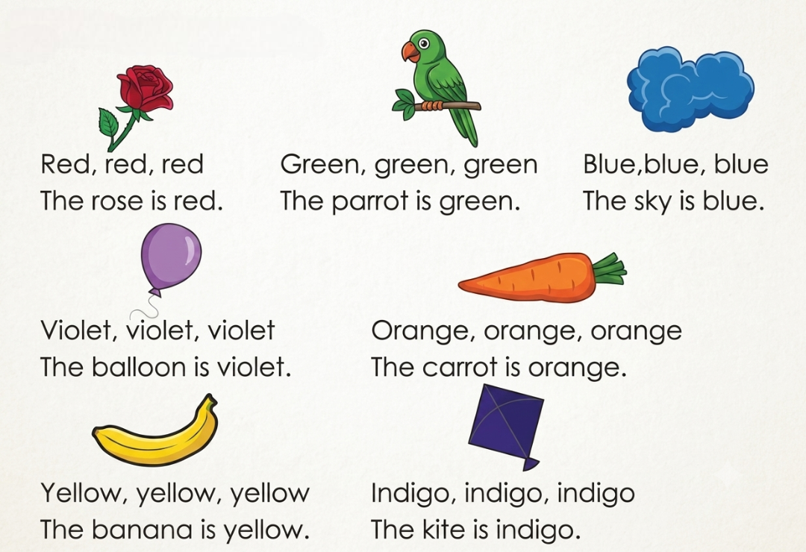


Slide 14
Thank You

