Slide 1

Unit – 7
Lesson – 2,3,4
Page no: 67-69
Shapes and sizes
Created by: Manik Hossain
Siddik Mia Govt Primary School
Mohammadpur, Dhaka

Slide 2
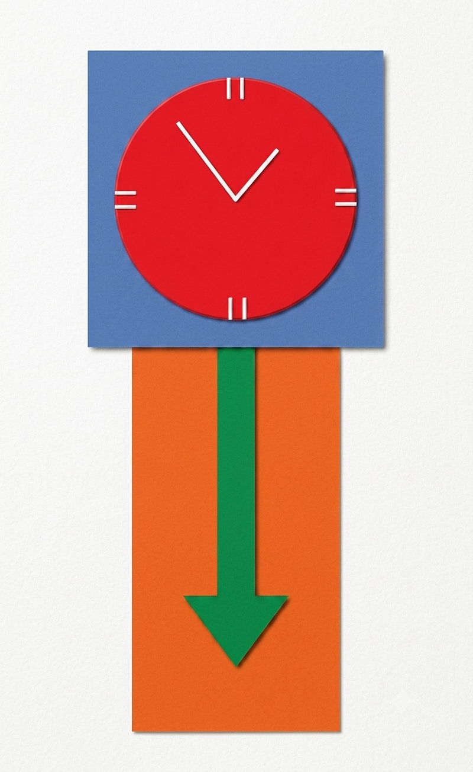
Look at picture and say what you see.

Slide 3
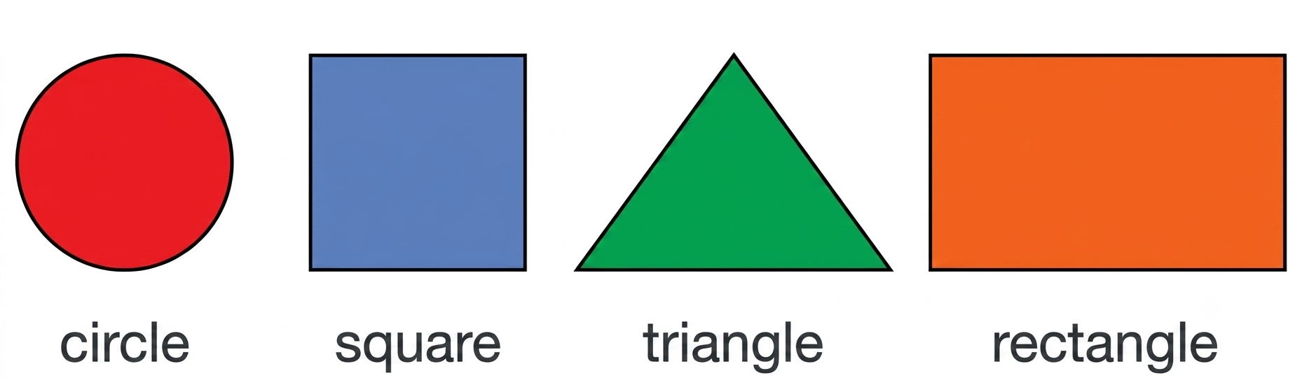
Square

Slide 4
Square
Square
Circle

Slide 5
Square
Circle
Rectangle

Slide 6
Square
Circle
Triangle
Rectangle

Slide 7
Circle
বৃত্ত/গোল
Square
বর্গ/চারকোনা
Triangle ত্রিভুজ/তিনকোনা
Rectangle
চতুর্ভূজ/আয়ত

Slide 8
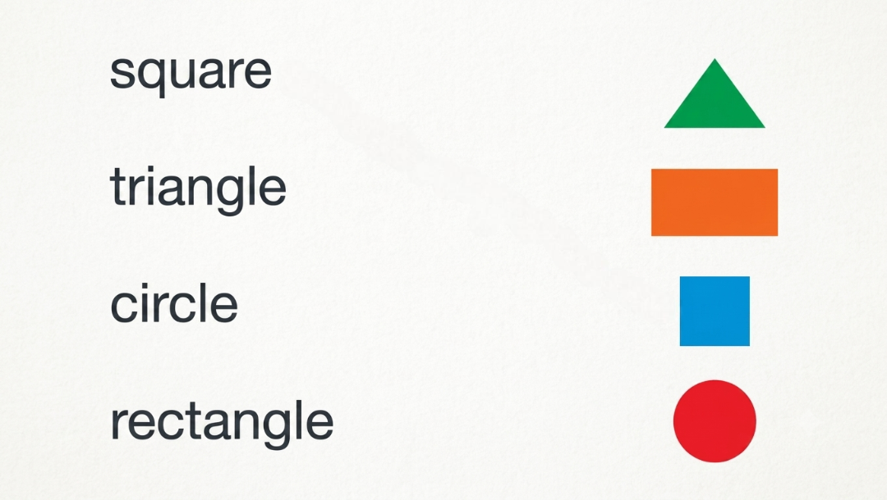

Slide 9
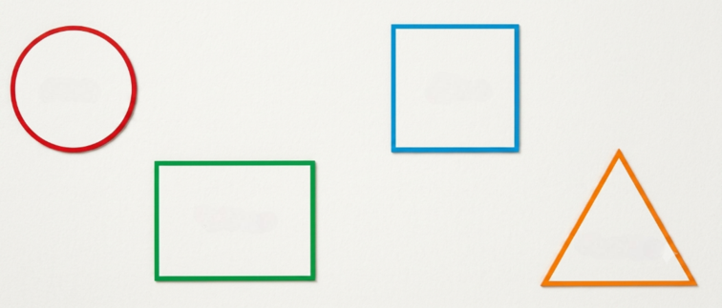
Circle
Square
Rectangle
Triangle

Slide 10
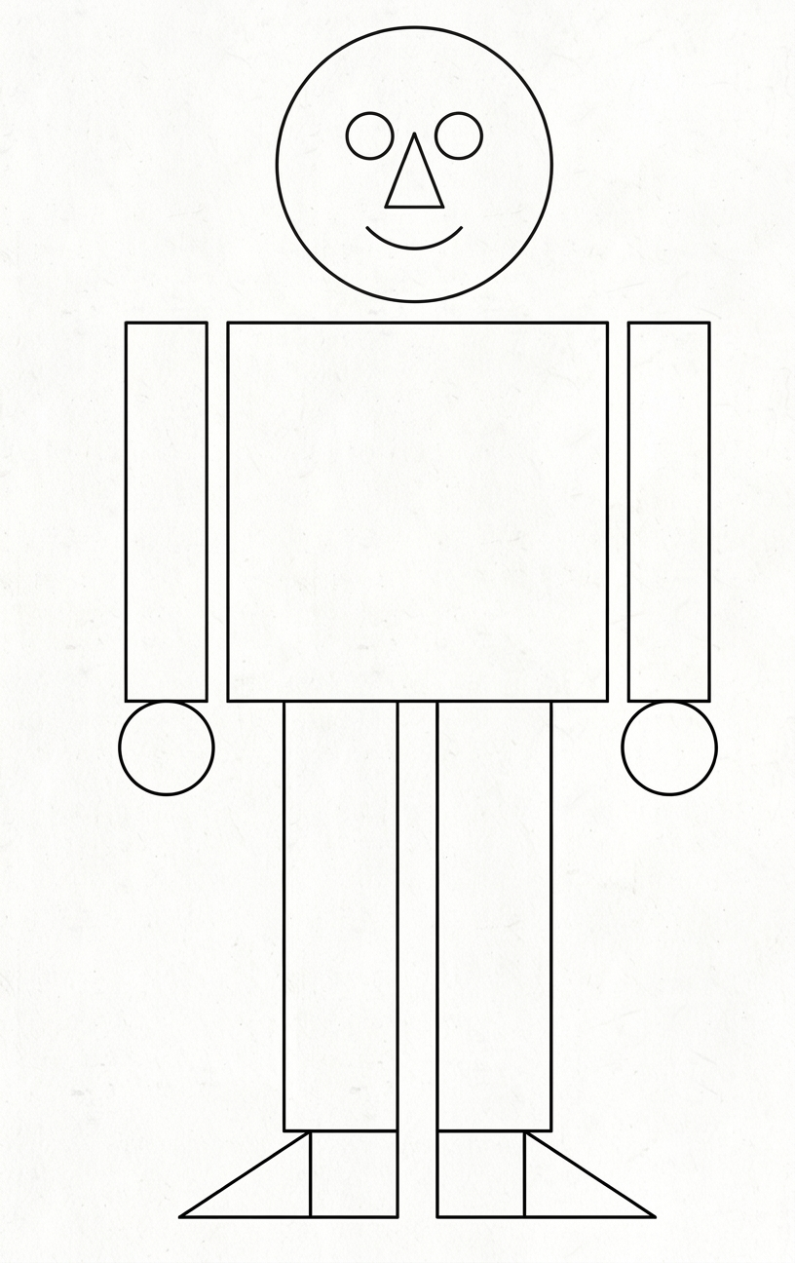
Mr. Shape
Look at Mr. Shape How many shape can you find?
You can colour them to find.

Slide 11
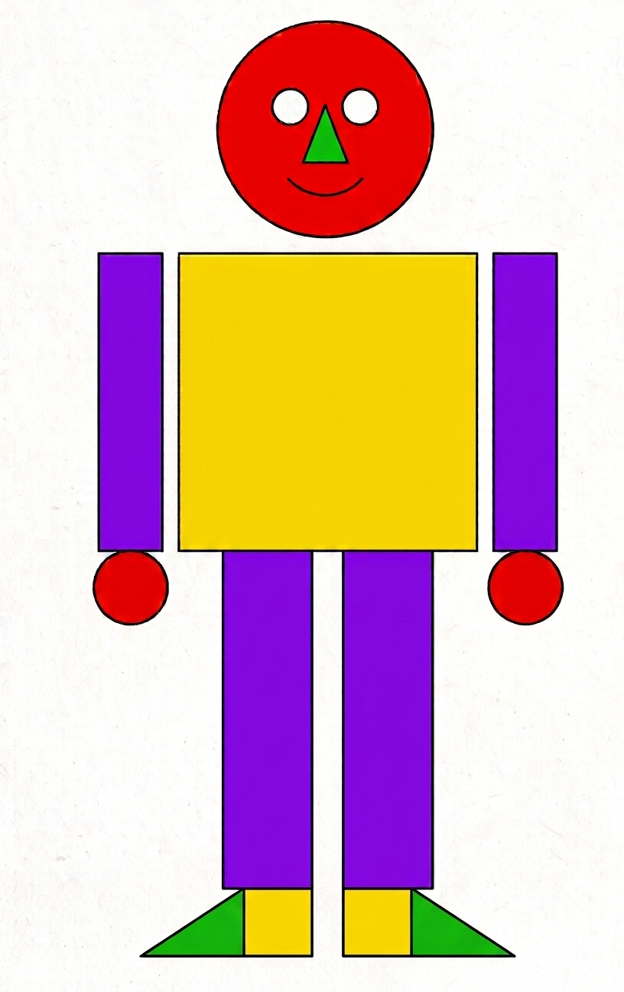
Mr. Shapre has five circles.
Mr. Shapre has three squares.
Mr. Shapre has four rectangles.
Mr. Shapre has three triangles.

Slide 12
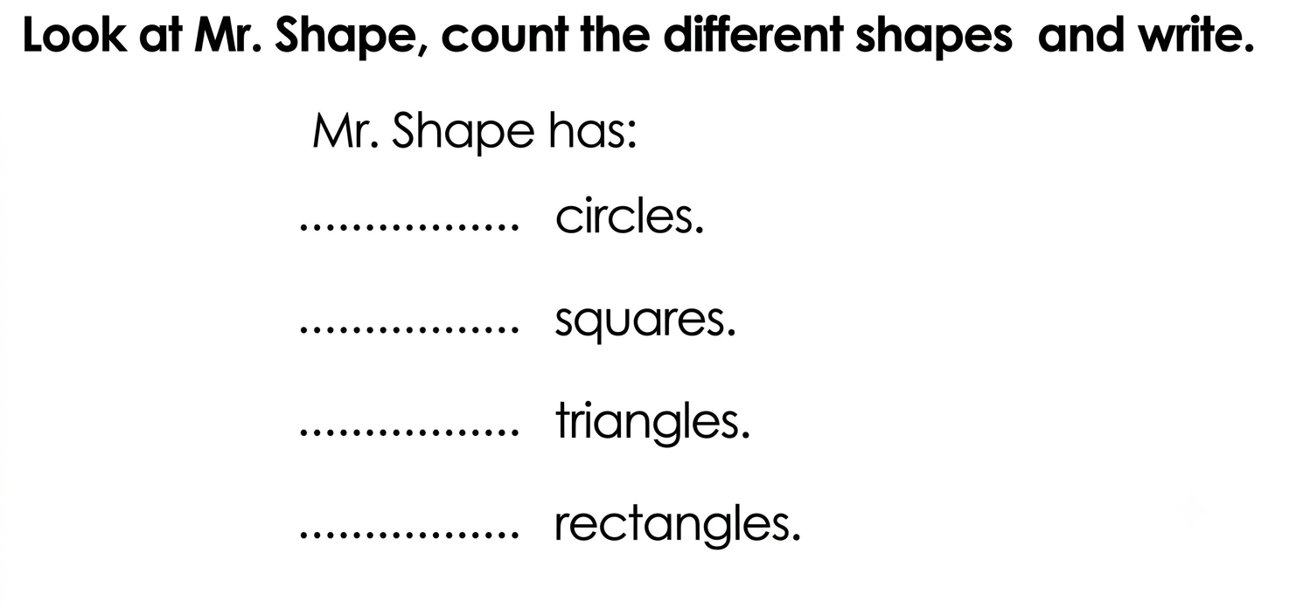
Five
Three
Three
Four

Slide 13

I am Mr. Shape, look at me.
I have circles, squares, triangles and Rectangles.
As many as there could be.
My eyes are round and so is my face,
My body is square if you haven't noticed, in case.
My arms are rectangles and so are my legs.
My hands are circles and my feet are triangles, you see.

Slide 15
Thank You
Mirjam Nilsson
mirjam@contoso.com
www.contoso.com

