Slide 1

Unit – 7
Lesson – 5
Page no: 70-71
Sizes
Created by: Manik Hossain
Siddik Mia Govt Primary School
Mohammadpur, Dhaka

Slide 2
Size
Look, listen and say.
দেখো, শোনো এবং বলো।
tall – লম্বা
short – খাটো
big – বড়
small – ছোট
fat – মোটা
thin – চিকন

Slide 3
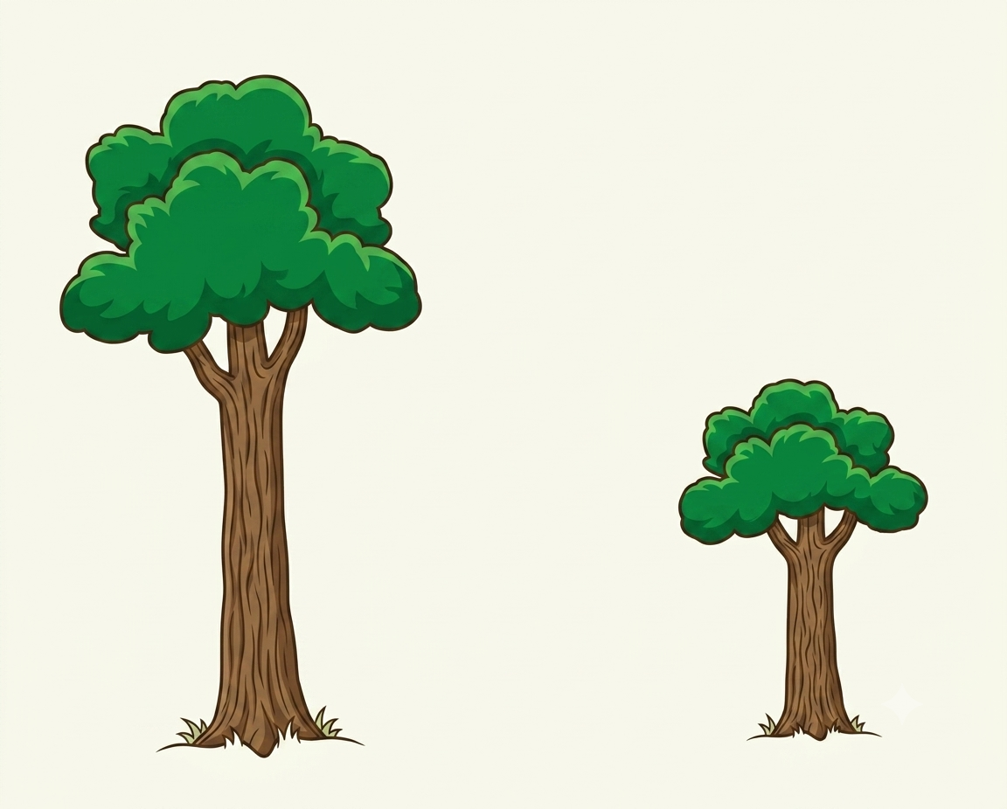
tall
short

Slide 4
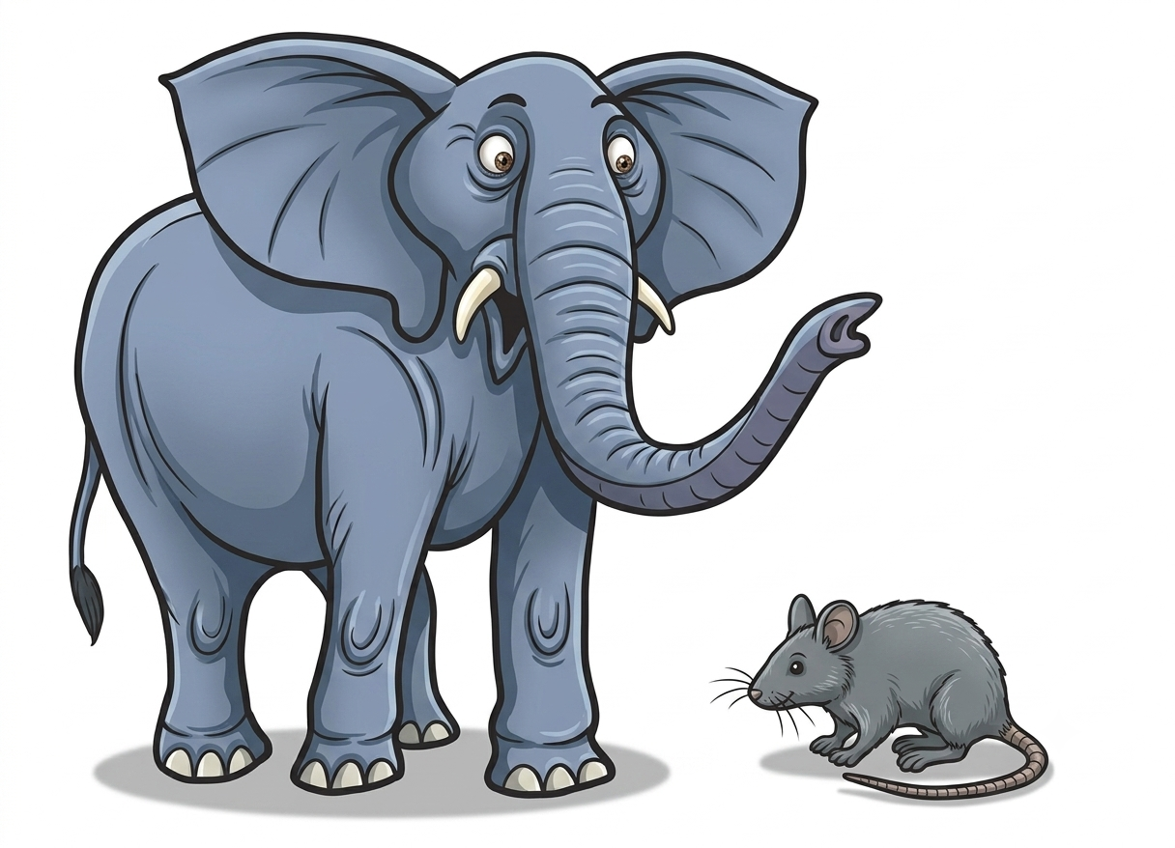
big
small

Slide 5
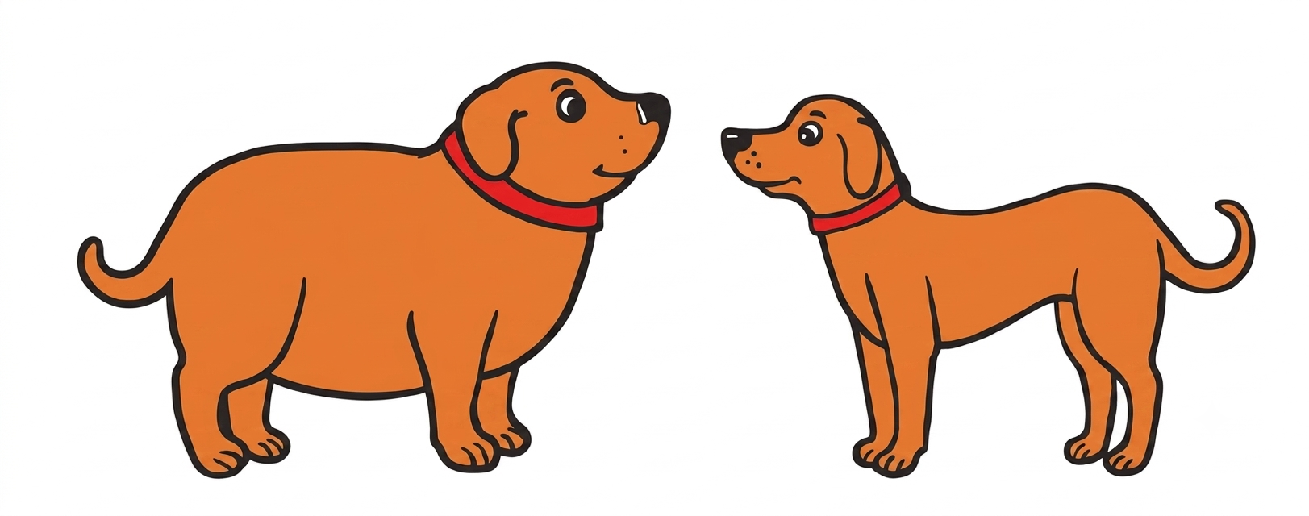
fat
thin

Slide 6
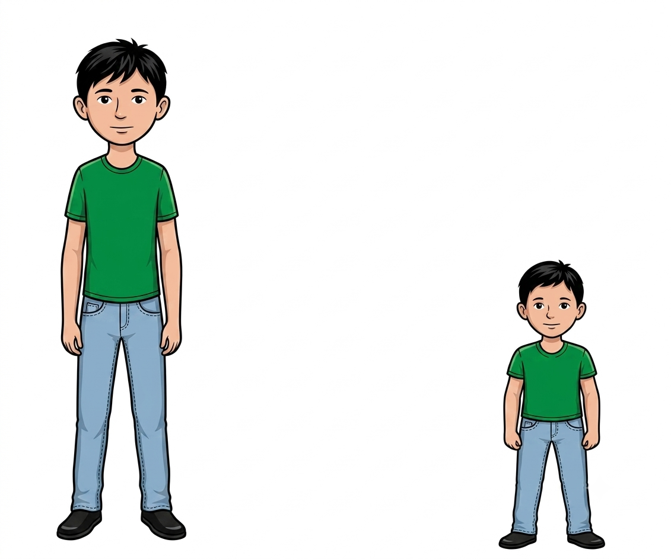
a tall man
a short man

Slide 7

a big pot
a small pot

Slide 8
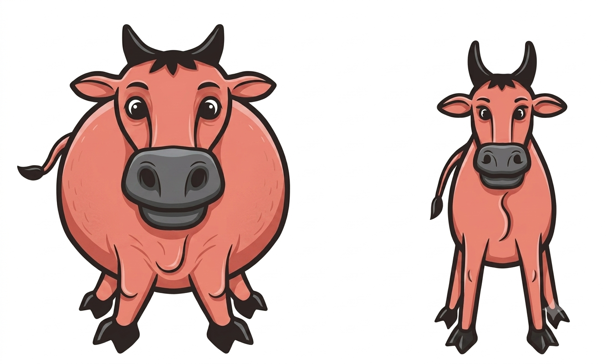
a fat cow
a thin cow

Slide 9
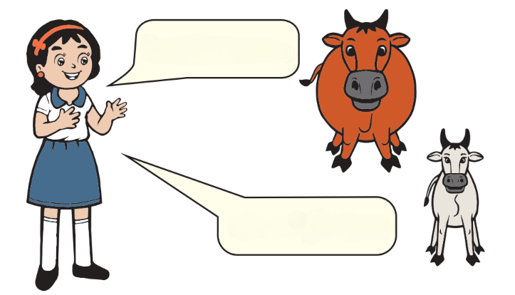
It`s a fat cow.
It`s a thin cow.

Slide 10
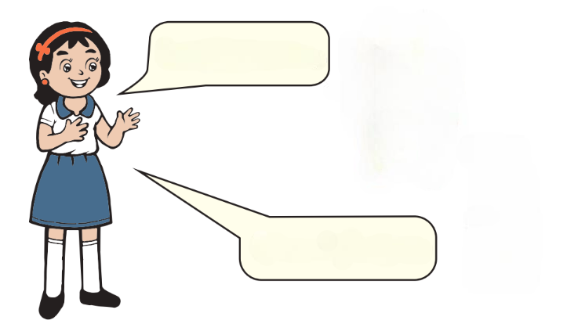
It`s a tall tree.
It`s a short tree.

Slide 11
It`s a big pot.
It`s a small pot.

Slide 12
It`s a fat dog.
It`s a thin dog.

Slide 13
It`s a tall man.
It`s a short man.

Slide 14
Thank You

