Slide 1
Primary English With Anisur Rahman
Cover
📚 Lesson Information
Class: 3
Subject: English
Unit: 4 – Let's Play with Sounds and Numbers
Lesson: 3
Page: 55
Topic: Row, Row, Row Your Boat (Rhyme)
📚 English With Anisur Rahman | Learn English with Bangla Explanation

Slide 2
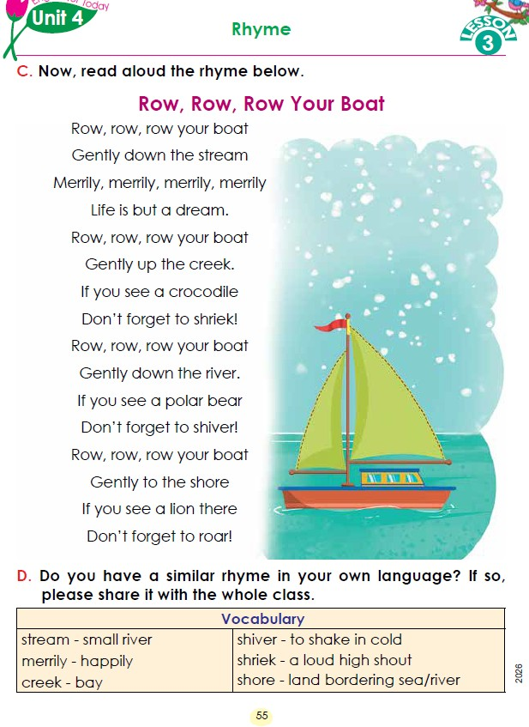
Primary English With Anisur Rahman
Cover
📚 English With Anisur Rahman | Learn English with Bangla Explanation

Slide 3
Primary English With Anisur Rahman
🎯 Learning Outcomes
By the end of the lesson, students will be able to:
2.1.1 Listen to rhymes, cartoons and digital contents and respond with joy.
6.1.1 Read rhymes, cartoons and digital contents and respond with joy.
📚 English With Anisur Rahman | Learn English with Bangla Explanation

Slide 4
Primary English With Anisur Rahman
Warm-up
🌸 Greeting (2 minutes)
Good morning, everyone.
How are you today?
Shoshi, how are you?
Arifa, how are you?
....
📚 English With Anisur Rahman | Learn English with Bangla Explanation

Slide 5
Primary English With Anisur Rahman
Warm-up
Today We are going to read the poem,
“Row, Row, Row Your Boat”
📚 English With Anisur Rahman | Learn English with Bangla Explanation

Slide 6
Primary English With Anisur Rahman
Warm-up
Row, Row, Row Your Boat
Have you ever travelled in a boat?
Possible Answer:
Yes, I have.
📚 English With Anisur Rahman | Learn English with Bangla Explanation

Slide 7
Primary English With Anisur Rahman
Warm-up
Row, Row, Row Your Boat
Have you ever seen a river?
Possible Answer:
Yes, I have.
Haven't you ever seen a river?
Possible Answer:
Yes, I have.
📚 English With Anisur Rahman | Learn English with Bangla Explanation

Slide 8
Primary English With Anisur Rahman
Revision: Teacher’s Reading
📚 English With Anisur Rahman | Learn English with Bangla Explanation

Slide 9
Primary English With Anisur Rahman
Vocabulary
Word | Meaning
stream | ছোট নদী
dream | স্বপ্ন
merrily | আনন্দের সঙ্গে
creek | ছোট খাল/ উপসাগর
shriek | জোরে চিৎকার
river | নদী
shiver | ঠান্ডায় কাঁপা
shore | নদী বা সমুদ্রের তীর
roar | গর্জন করা
📚 English With Anisur Rahman | Learn English with Bangla Explanation

Slide 10
Primary English With Anisur Rahman
Revision: Choral Reading
📚 English With Anisur Rahman | Learn English with Bangla Explanation

Slide 11
Primary English With Anisur Rahman
Activity C
🐊 Crocodile
→ "Shriek!"
📚 English With Anisur Rahman | Learn English with Bangla Explanation

Slide 12
Primary English With Anisur Rahman
Activity C
🐻 Polar bear
→ "Shiver!"
📚 English With Anisur Rahman | Learn English with Bangla Explanation

Slide 13
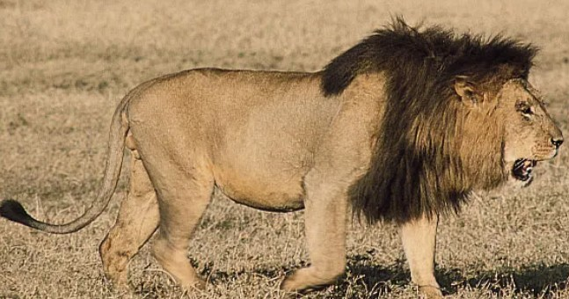
Primary English With Anisur Rahman
Activity C
Lion
→ "Roar!"
📚 English With Anisur Rahman | Learn English with Bangla Explanation

Slide 14
Primary English With Anisur Rahman
Activity C
🐊 Crocodile → "Shriek!"
🐻 Polar bear → "Shiver!"
Lion → "Roar!"
📚 English With Anisur Rahman | Learn English with Bangla Explanation

Slide 15
Primary English With Anisur Rahman
Revision: Pair Reading
📚 English With Anisur Rahman | Learn English with Bangla Explanation

Slide 16
Primary English With Anisur Rahman
Activity C
Explanation of the remaining verses similarly:
creek = ছোট খাল
crocodile = কুমির
shriek = জোরে চিৎকার করা
river = নদী
polar bear = মেরু ভালুক
shiver = ঠান্ডায় কাঁপা
shore = নদী/সমুদ্রের তীর
lion = সিংহ
roar = গর্জন করা
📚 English With Anisur Rahman | Learn English with Bangla Explanation

Slide 17
Primary English With Anisur Rahman
📘 Bangla Meaning (Simple)
Row, row, row your boat
→ নৌকাটি বেয়ে চলো।
Gently down the stream
→ ধীরে ধীরে স্রোতের দিকে এগিয়ে যাও।
Merrily, merrily, merrily, merrily
→ আনন্দের সাথে, আনন্দের সাথে।
Life is but a dream
→ জীবন যেন একটি স্বপ্ন।
📚 English With Anisur Rahman | Learn English with Bangla Explanation

Slide 18
Primary English With Anisur Rahman
Revision: Individual Reading
📚 English With Anisur Rahman | Learn English with Bangla Explanation

Slide 19
Primary English With Anisur Rahman
Pair Work
📚 English With Anisur Rahman | Learn English with Bangla Explanation

Slide 20
Primary English With Anisur Rahman
Practice
📚 English With Anisur Rahman | Learn English with Bangla Explanation

Slide 21
Primary English With Anisur Rahman
Quiz
🐊 Crocodile
→ "Shriek!"
📚 English With Anisur Rahman | Learn English with Bangla Explanation

Slide 22
Primary English With Anisur Rahman
Quiz
🐻 Polar bear
→ "Shiver!"
📚 English With Anisur Rahman | Learn English with Bangla Explanation

Slide 23
Primary English With Anisur Rahman
Quiz
Lion
→ "Roar!"
📚 English With Anisur Rahman | Learn English with Bangla Explanation

Slide 24
Primary English With Anisur Rahman
Practice
📚 English With Anisur Rahman | Learn English with Bangla Explanation

Slide 25
Primary English With Anisur Rahman
💬 Activity D – Speaking
Do you know a similar rhyme in Bangla?
Possible answers:
আয় আয় চাঁদ মামা
হাতি মা হাতি
খোকন খোকন ডাক পাড়ি
Recite a Bangla Rhyme:
📚 English With Anisur Rahman | Learn English with Bangla Explanation

Slide 26
Primary English With Anisur Rahman
📝 Assessment
What is a stream?
What should you do if you see a crocodile?
What does "merrily" mean?
Read the first four lines of the rhyme.
What does a lion do?
📚 English With Anisur Rahman | Learn English with Bangla Explanation

Slide 27
Primary English With Anisur Rahman
📝 Assessment
1. What is a stream?
Answer: A stream is a small river.
2. What should you do if you see a crocodile?
Answer: I should not forget to shriek.
I should shriek.
3. What does "merrily" mean?
Answer: Merrily means happily.
📚 English With Anisur Rahman | Learn English with Bangla Explanation

Slide 28
Primary English With Anisur Rahman
📝 Assessment
4. Read the first four lines of the rhyme.
Row, row, row your boat
Gently down the stream
Merrily, merrily, merrily, merrily
Life is but a dream.
5. What does a lion do?
Answer: A lion roars.
📚 English With Anisur Rahman | Learn English with Bangla Explanation

Slide 29
Primary English With Anisur Rahman
Homework
📚 English With Anisur Rahman | Learn English with Bangla Explanation

Slide 30
Primary English With Anisur Rahman
Thank You
Thank You
Wish you all the best.
📚 English With Anisur Rahman | Learn English with Bangla Explanation

