Slide 1


Slide 2
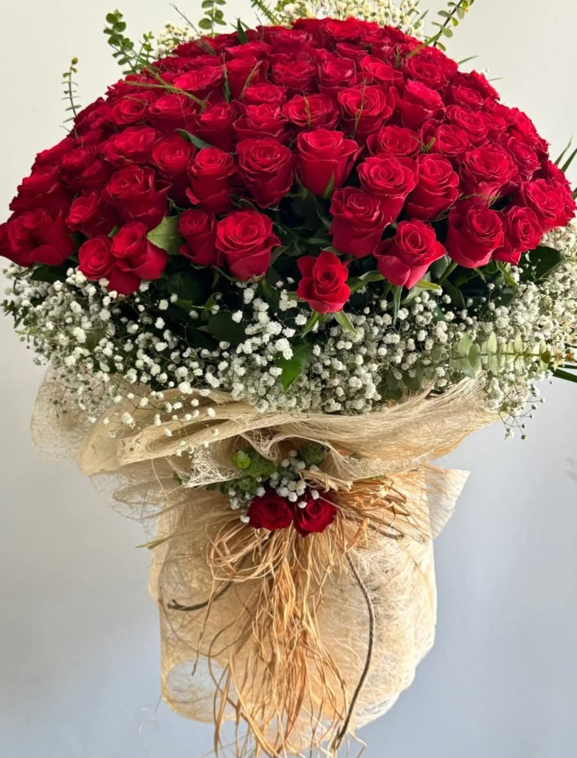
WELCOME

Slide 3
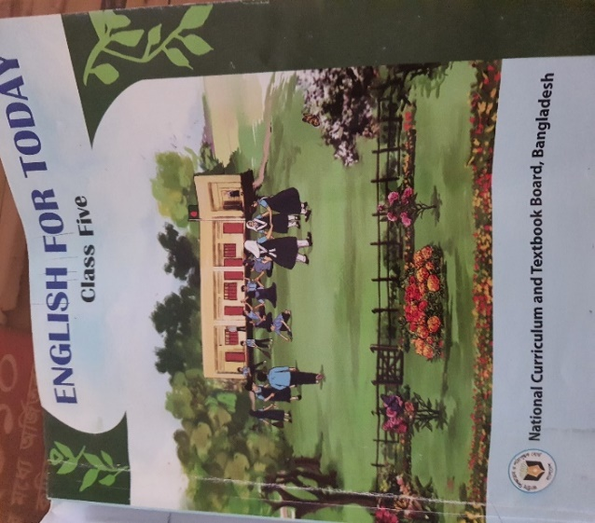
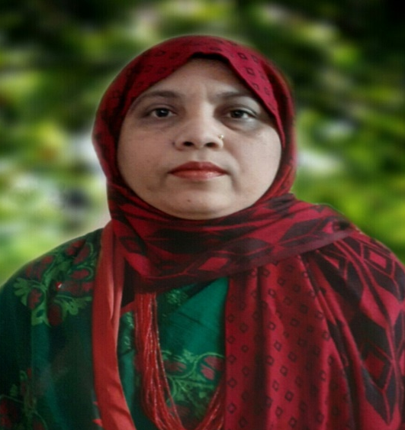

IDENTITY
Muktamony
Head teacher
Atashia Government Primary School
Shibpur , Narsingdi.
Title –Quality Time Together
Class - Five
Subject- English
Unit-13 , Page -69
Lesson- 1, (1.1 Naima….play.)
Time-40 minutes
Date---/08/2026

Slide 4
Learning Outcomes
Learning Outcomes:
4.2.1 Read aloud texts with proper stress , intonation.
5.1.1 Comprehend and express the meaning and uses of familiar words.
5.1.4 Get the general ideas from simple texts.

Slide 5
Review of the prior knowledge
Review of prior knowledge :
Do your parents have mobile or laptop at your home ?
When do you use it ?
How long do you use it?
Does it disturb your sleep or keep you away from your friend ?
(Conduct a brief discussion regarding overuse of mobile phone .)

Slide 6
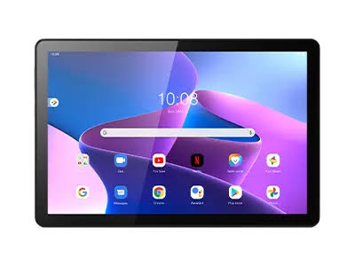
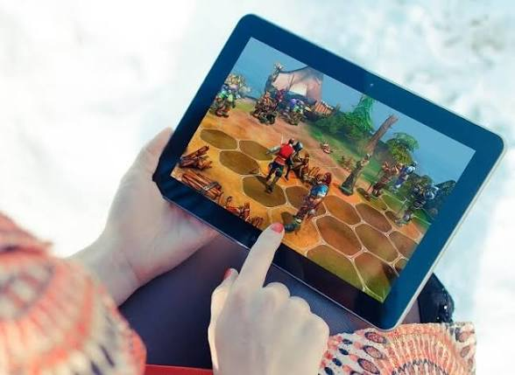
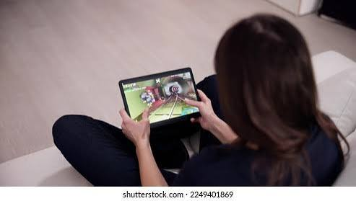
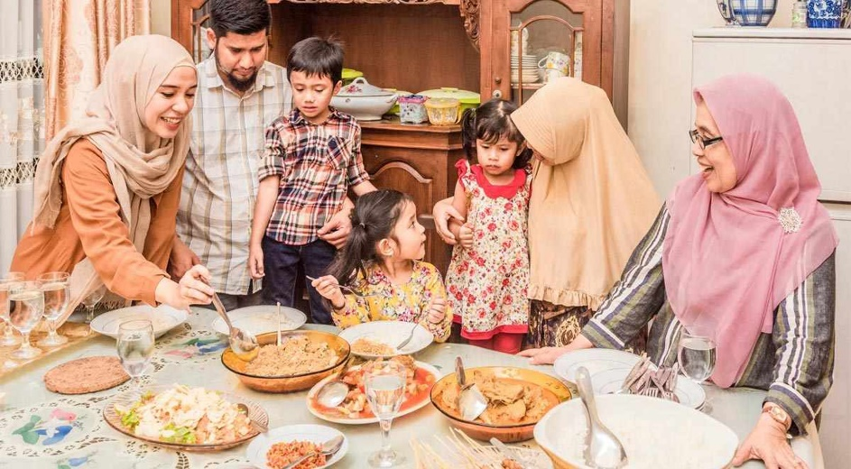
a

Slide 7
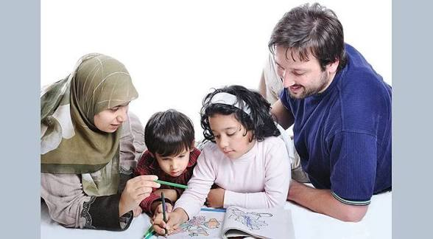
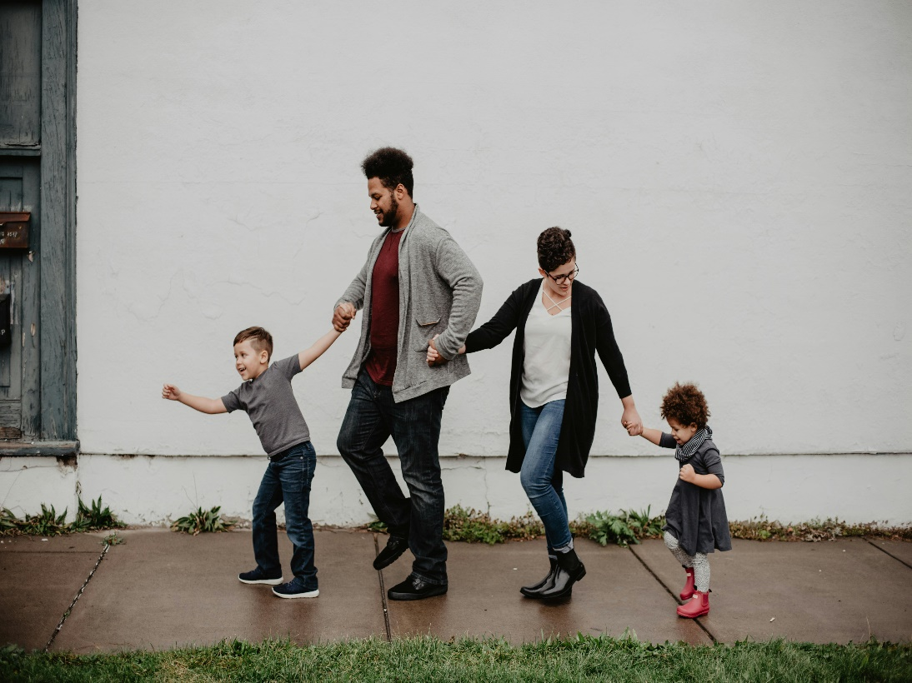
What are they doing ? Are they spending quality time together?

Slide 8
Our today’s topic is-
Quality Time Together

Slide 9
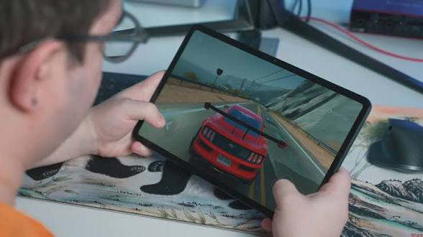
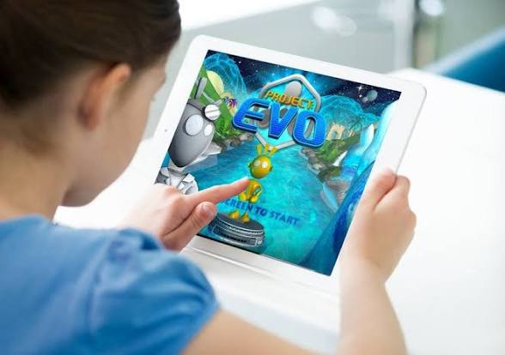
Look at the picture . What do you see in the picture ? What are they doing?

Slide 10
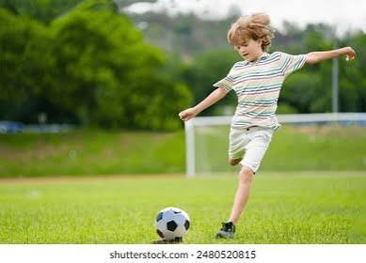
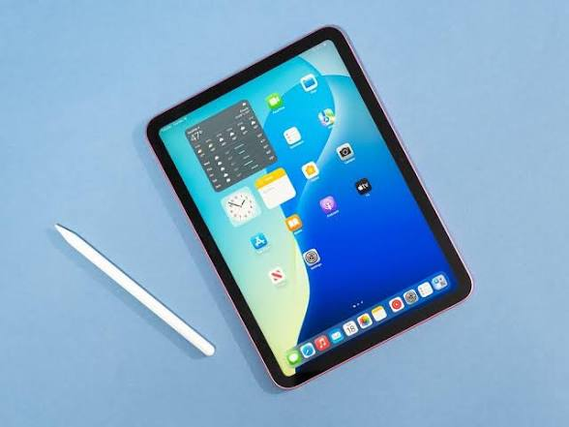
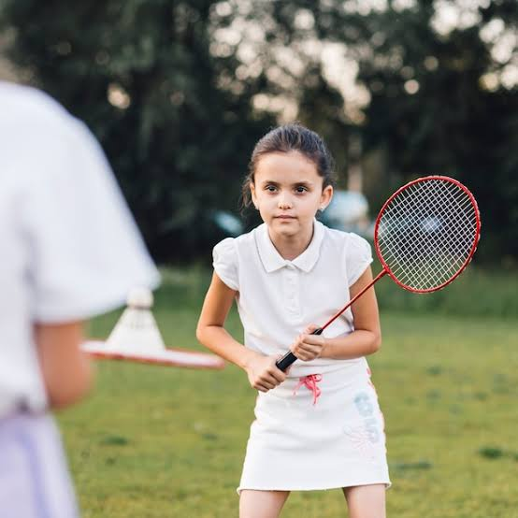
Naima and Masuk were twins . They were in class five . Naima loved to play badminton and Masuk loved to play football.They were also very good students at school.

Slide 11
Their parents , Naeem Hasan and Mina Begum, loved them very much. Naima and Masuk often played with their parents when they had free time . Their home was always full of happiness !

Slide 12

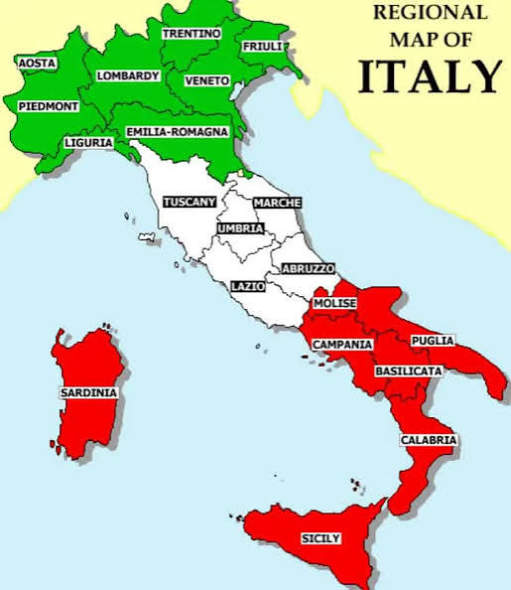
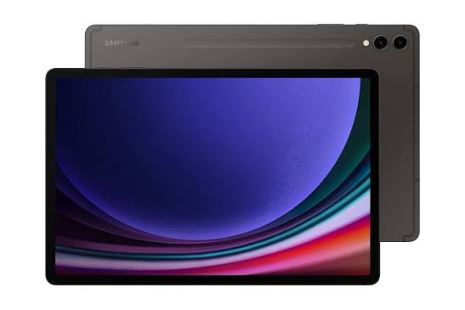
One day a special box arrived. It was from their close relative, Mr. Rakib , who lived in Italy . There was a black tablet inside the box.

Slide 13
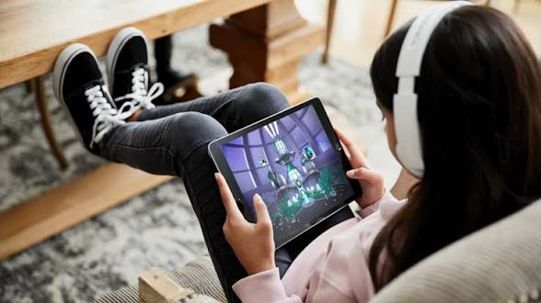
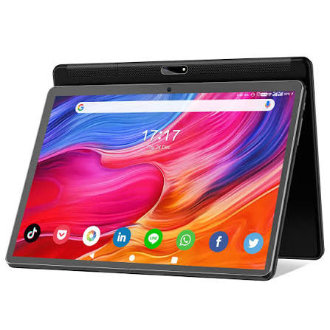
When they turned it on , the screen showed many bright colours.’Wow!’ They were both surprised.

Slide 14
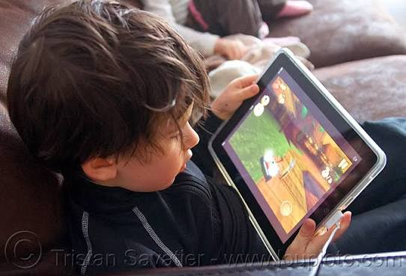
At first ,the tablet was so much fun . They played video games after finishing the study . And soon , the tablet became more exciting than playing outside . ’Naima! Masuk ! Their friend Rana called from the gate. ’ let’s play!’

Slide 15
New Words
Twin-জমজ-Two children born at the same birth a person’s father or mother
Happiness- সুখ- the stste of being happy
Special-বিশেষ- exclusive,particular
Arrive-পৌঁছা-reach
Tablet-ট্যাবলেট-a tablet is a small flat computer
Screen- পর্দা- display
Bright-উজ্জ্বল-reflecting much light
Change-পরিবর্তন করা-make something different
Grumpy-বদমেজাজি-bad – tempered
Angry-রাগান্বিত- furious,irate

Slide 16
Open your book at page 69 .
Model reading
Silent reading
Individual reading

Slide 17
Assessing Learing
I will ask students randomly to come to the front and read the passage.

Slide 18
Ask and answer the questions
i. Where did Mr. Rakib live?
Answer: Mr. Rakib lived in Italy.
ii. What Class Naima and Masuk were in?
Answer: Naima and Masuk were in class Five.
iii. What was their father’s name?
Answer: Their father’s name is Naeem Hasan.
iv. What was inside the box?
Answer: There was a tablet inside the box.
v. Why were Naima and Masuk surprised when they turned on the tablet ?
Answer: Naima and Masuk were surprised when they turned on the tablet because it showed many bright colours .
vi. Who are the twins in the text?
Answer; Naima and Masuk were twins.
vi. What did Masuk like to play ?
Answer : Masuk liked to play football.
vii. How was their home ?
Answer: Their home was full of happiness.

Slide 19

Choose the best answer
What did Masuk love to play?
Table tennis b. cricket c. football d. Badminton
Ii . Who loved to play badminton ?
a. Naima b. Masuk c. Neem Hasan d. Mina Begum
iii. How was their home ?
Full of noise b. calm and quiet c. Full of quarrelsome d. full of happiness
iv. Where was from the special box ?
Italy b. Spain c. India d. Indonesia
v. What was inside the box ?
Chocolate ii. Medicine iii. a black tablet iv. A smart phone

Slide 20
Make sentences:
Twins - Sima and Rima are twins.
Football - Masuk loved to play football.
Happiness - Their home was always full of happiness.
Special - One day , a special box arrived.
Relative - Mr. Rakib is their close relative.

Slide 21
Rewrite the following text using capital letters and punctuation marks where necessary.
naima and masuk were twins
it was from their close relative mr. rakib.
wow they were both surprised
his father’s name is Naeem hasan.
lets play

Slide 22
Group work
Group - Adjective
Group - Preposition
Find out five adjective from the story. Make sentences.
Find out five preposition from the story . Make sentences.

Slide 23
Feedback: I will support the students during the class who cannot read aloud the conversation properly.
Summary of the session : Recap the main points of the lesson.
What have we learnt today ?
We have learnt about the tablet.
We have also learnt that we should not use it all day long.

Slide 24

Home Work
Write at least five sentences about a Tablet.

Slide 25
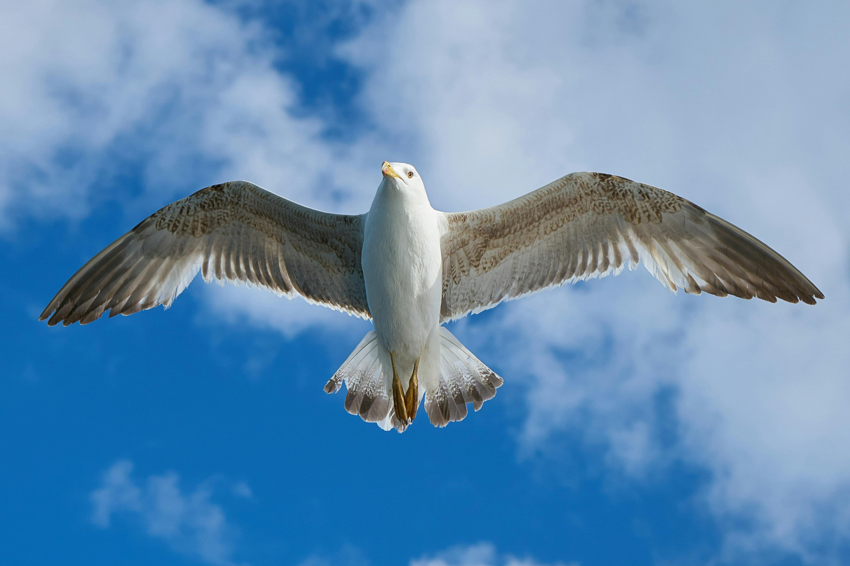
GOODBYE

