Slide 1
Primary English With Anisur Rahman
Welcome
Good morning, students.
How are you today?
Welcome to our English class.
📚 English With Anisur Rahman | Learn English with Bangla Explanation

Slide 2
Primary English With Anisur Rahman
Cover
Class: 5
Subject: English
Unit: 12 – Eating Healthy
Pages: 63–65
Activities:
2.2
2.3
2.4
3.1
3.1.1
3.1.2
📚 English With Anisur Rahman | Learn English with Bangla Explanation

Slide 3
Primary English With Anisur Rahman
Warm-up
Today we shall learn—
describing foods
adjectives
words showing frequency
making sentences
📚 English With Anisur Rahman | Learn English with Bangla Explanation

Slide 4
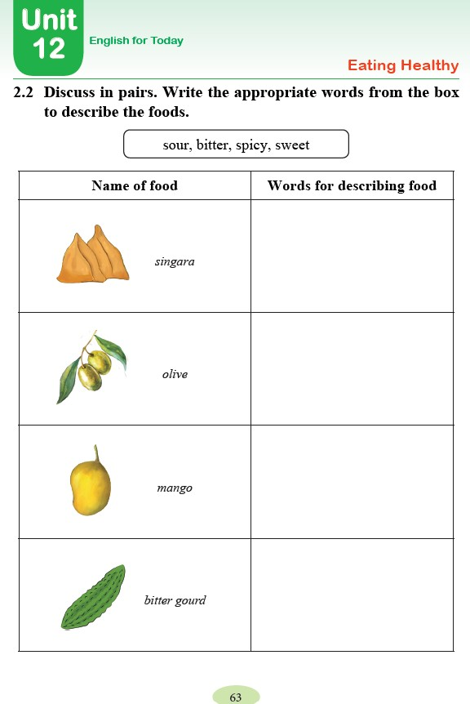
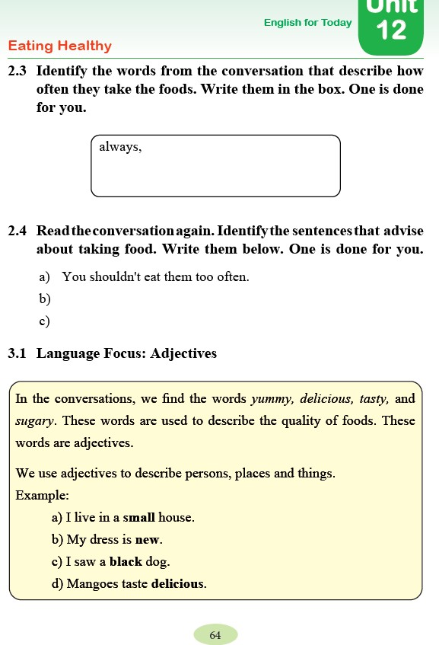
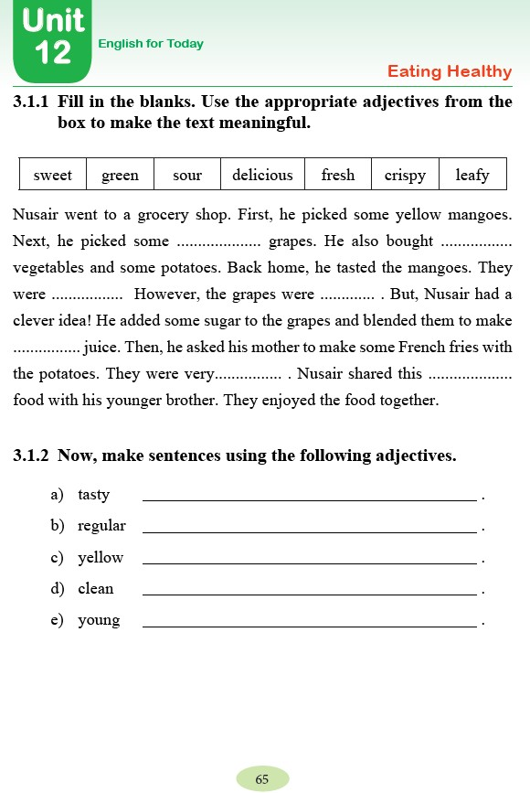
Primary English With Anisur Rahman
Cover
Class: 5
Subject: English
Unit: 12 – Eating Healthy
Pages: 63–65
Activities:
2.2
2.3
2.4
3.1
3.1.1
3.1.2
📚 English With Anisur Rahman | Learn English with Bangla Explanation

Slide 5
Primary English With Anisur Rahman
Learning Outcomes
By the end of the lesson, students will be able to—
describe foods using adjectives.
identify words showing frequency.
find advice from a conversation.
understand adjectives.
fill in blanks using suitable adjectives.
make simple sentences with adjectives.
📚 English With Anisur Rahman | Learn English with Bangla Explanation

Slide 6
Primary English With Anisur Rahman
Warm-up
1. What is your favourite fruit?
Sample Answer
My favourite fruit is mango.
বাংলা: আমার প্রিয় ফল আম।
📚 English With Anisur Rahman | Learn English with Bangla Explanation

Slide 7
Primary English With Anisur Rahman
Warm-up
2. Do you like spicy food?
Sample Answer
Yes, I do.
বাংলা: হ্যাঁ, আমি ঝাল খাবার পছন্দ করি।
📚 English With Anisur Rahman | Learn English with Bangla Explanation

Slide 8
Primary English With Anisur Rahman
Warm-up
4. Which vegetable is bitter?
Sample Answer
Bitter gourd is bitter.
বাংলা: করলা তিতা।
📚 English With Anisur Rahman | Learn English with Bangla Explanation

Slide 9
Primary English With Anisur Rahman
Revision
📚 English With Anisur Rahman | Learn English with Bangla Explanation

Slide 10
Primary English With Anisur Rahman
Vocabulary
Word | Bangla
sweet | মিষ্টি
sour | টক
Spicy | ঝাল
Bitter | তিতা
Adjective | বিশেষণ
Delicious | সুস্বাদু
Crispy | মুচমুচে
Leafy | পাতাযুক্ত
Fresh | টাটকা
Green | সবুজ
Regular | নিয়মিত
📚 English With Anisur Rahman | Learn English with Bangla Explanation

Slide 11
Primary English With Anisur Rahman
📖 Activity 2.2
→ spicy
সিঙ্গারা ঝাল।
→ sour
জলপাই টক।
→ sweet
আম মিষ্টি।
→ bitter
করলা তিতা।
📚 English With Anisur Rahman | Learn English with Bangla Explanation

Slide 12
Primary English With Anisur Rahman
Activity 2.3
regularly,
usually,
sometimes,
often
Words Showing Frequency:
These words tell us how often we do something.
এই শব্দগুলো বলে কোনো কাজ কতবার করা হয়।
📚 English With Anisur Rahman | Learn English with Bangla Explanation

Slide 13
Primary English With Anisur Rahman
Activity 2.3
Words Showing Frequency:
always = সর্বদা
regularly = নিয়মিতভাবে
usually = সাধারণত
sometimes = কখনো কখনো
often = প্রায়শই / প্রায়ই
📚 English With Anisur Rahman | Learn English with Bangla Explanation

Slide 14
Primary English With Anisur Rahman
Activity 2.4
You also should try.
We should take time and eat slowly.
📚 English With Anisur Rahman | Learn English with Bangla Explanation

Slide 15
Primary English With Anisur Rahman
Activity 3.1
Adjective ব্যক্তি, প্রাণী, স্থান ও বস্তুর গুণ বোঝায়।
📚 English With Anisur Rahman | Learn English with Bangla Explanation

Slide 16
Primary English With Anisur Rahman
Activity B
মিষ্টি
সবুজ
টক
সুস্বাদু
টাটকা
মুচমুচে
পাতাযুক্ত
green
leafy
delicious
sour
sweet
crispy
fresh
The mango is tasty.
He is a regular student.
The banana is yellow.
Our classroom is clean.
The boy is young.
📚 English With Anisur Rahman | Learn English with Bangla Explanation

Slide 17
Primary English With Anisur Rahman
Pair Work
Arifa:
What is the taste of mango?
Shoshi:
It is sweet.
Arifa:
What is the taste of olive?
Shoshi:
It is sour.
Arifa:
What is the taste of bitter gourd?
Shoshi:
It is bitter.
Arifa:
Is singara spicy?
Shoshi:
Yes, it is.
📚 English With Anisur Rahman | Learn English with Bangla Explanation

Slide 18
Primary English With Anisur Rahman
Pair Work
Alif:
What is the taste of mango?
Arafat:
It is sweet.
Alif:
What is the taste of olive?
Arafat:
It is sour.
Alif:
What is the taste of bitter gourd?
Arafat:
It is bitter.
Alif:
Is singara spicy?
Arafat:
Yes, it is.
📚 English With Anisur Rahman | Learn English with Bangla Explanation

Slide 19
Primary English With Anisur Rahman
Practice
📚 English With Anisur Rahman | Learn English with Bangla Explanation

Slide 20
Primary English With Anisur Rahman
Quiz
📚 English With Anisur Rahman | Learn English with Bangla Explanation

Slide 21
Primary English With Anisur Rahman
Assessment
📚 English With Anisur Rahman | Learn English with Bangla Explanation

Slide 22
Primary English With Anisur Rahman
Homework
📝 Homework
Write five adjectives.
Write five sentences using adjectives.
Write the names of five healthy foods and describe them.
📚 English With Anisur Rahman | Learn English with Bangla Explanation

Slide 23
Primary English With Anisur Rahman
Thank You
Thank You
wish you all the best.
📚 English With Anisur Rahman | Learn English with Bangla Explanation

