Slide 1
C
M
W
L
E
O
E

Slide 2
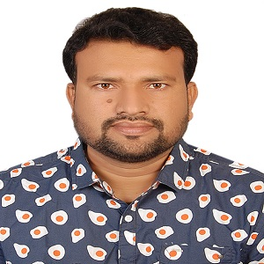
Presented By
Ahsanul Haque
Assistant Teacher
Bhaishar patherhati Government Primary School
Sarail, Brahmanbaria

Slide 3
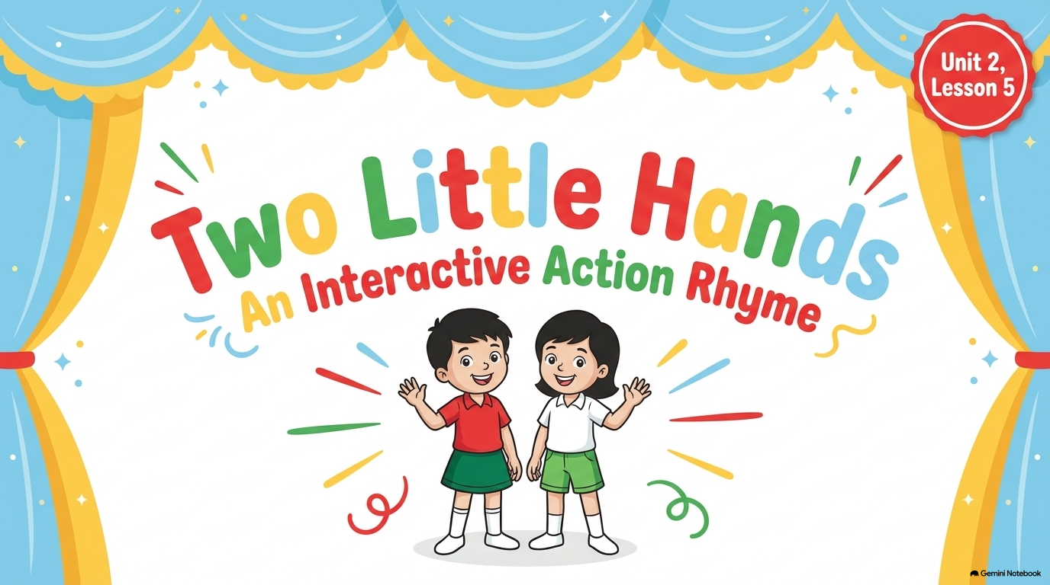
Class: Two
Sub: English

Slide 4
Learning Outcomes
2.1.1 Listen to rhymes and respond with joy.

Slide 5
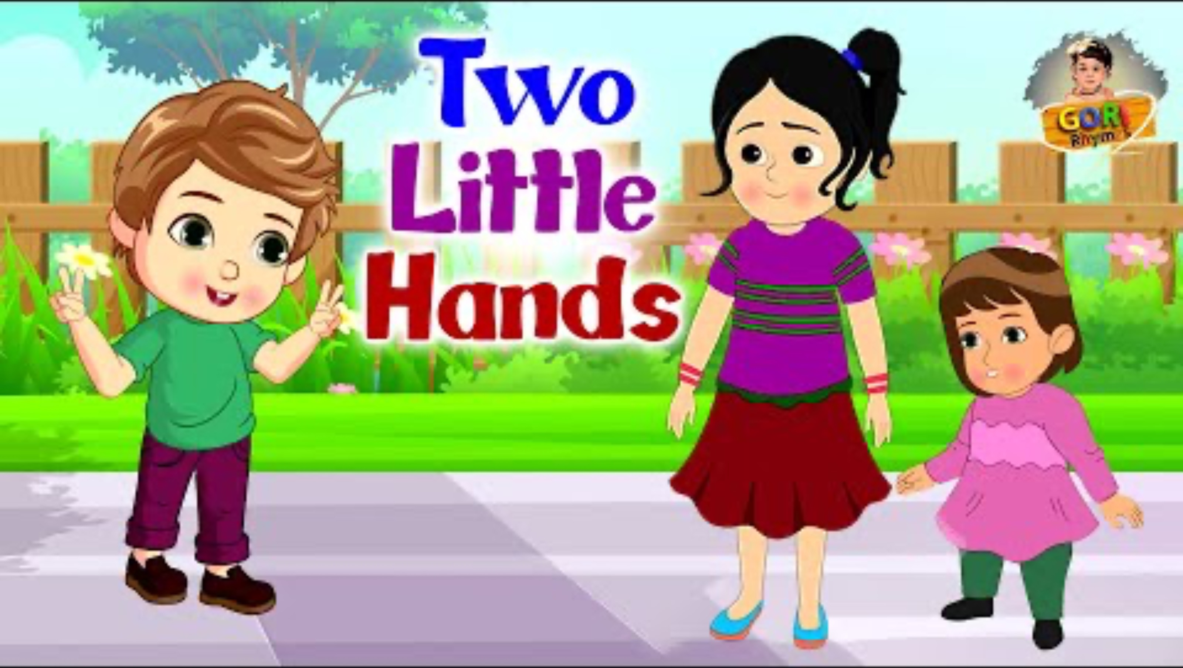
video

Slide 6
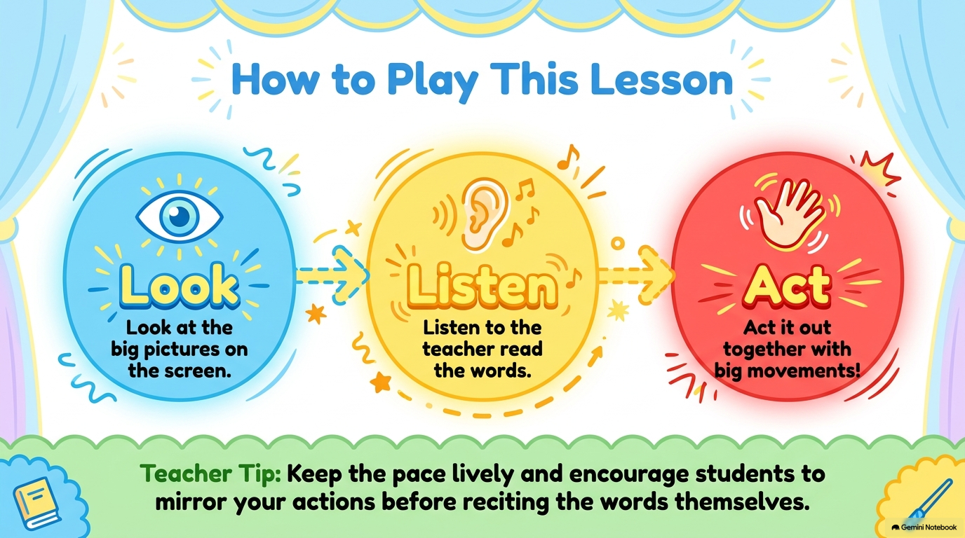

Slide 7
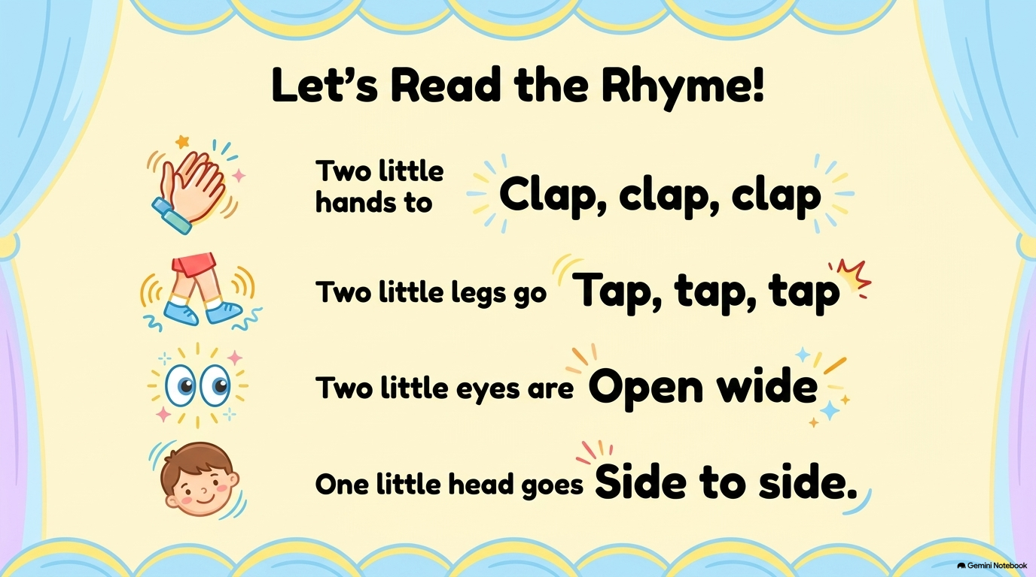

Slide 8
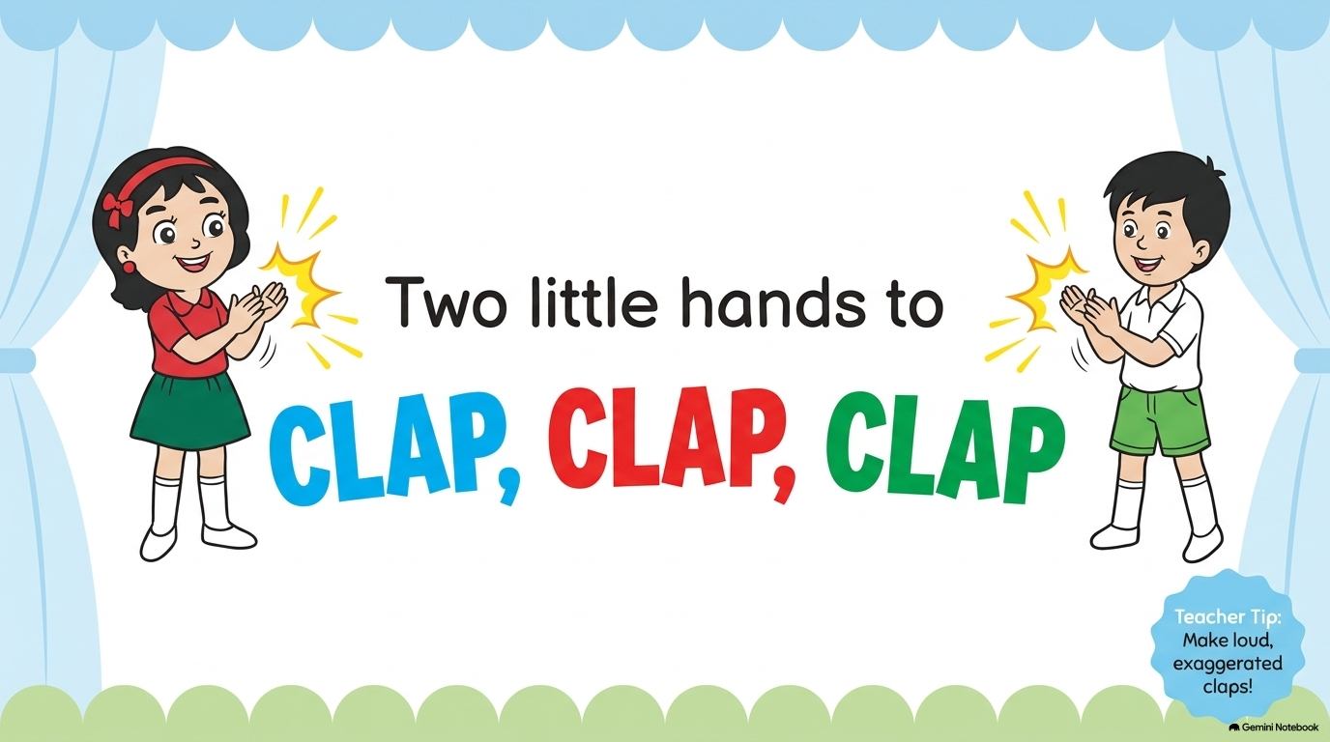

Slide 9
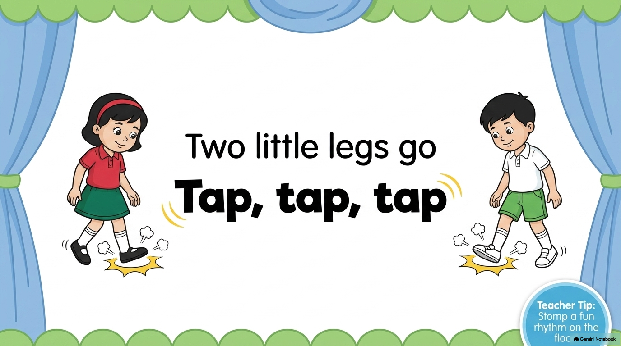

Slide 10
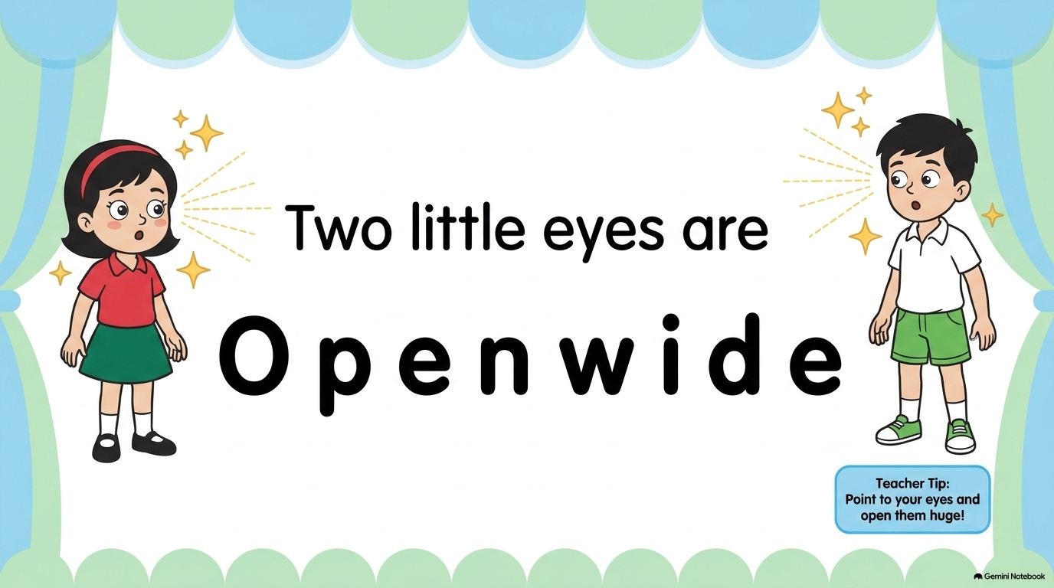

Slide 11
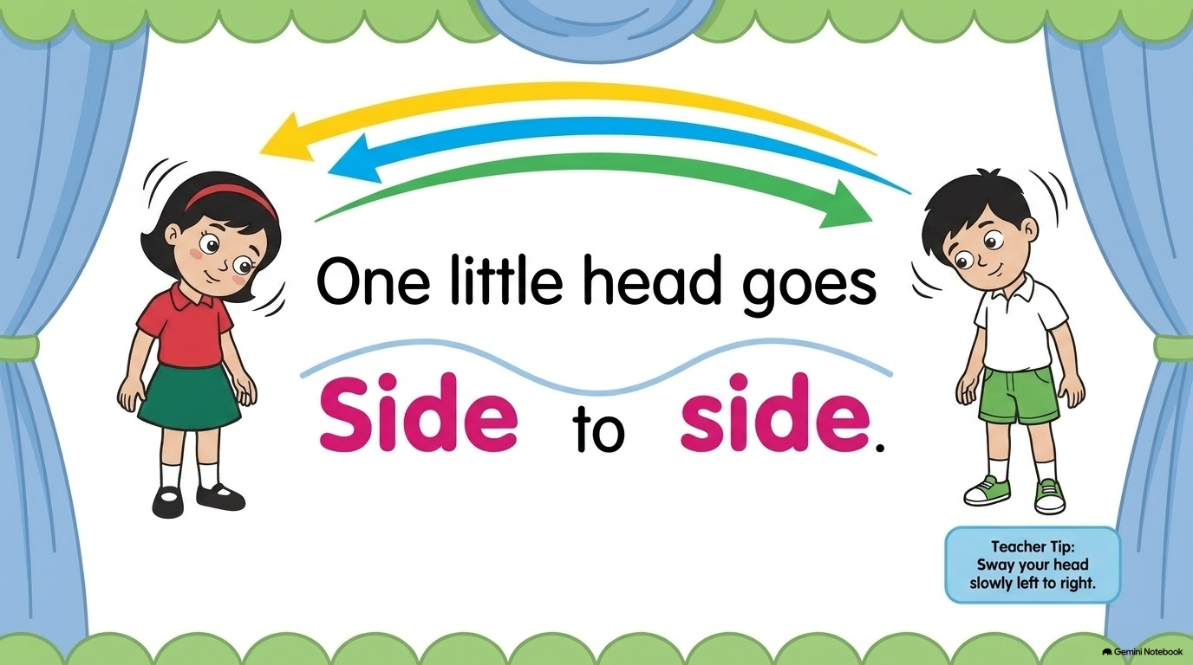

Slide 12
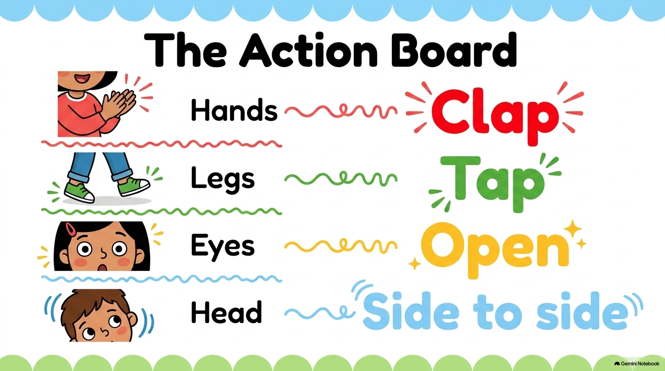

Slide 13
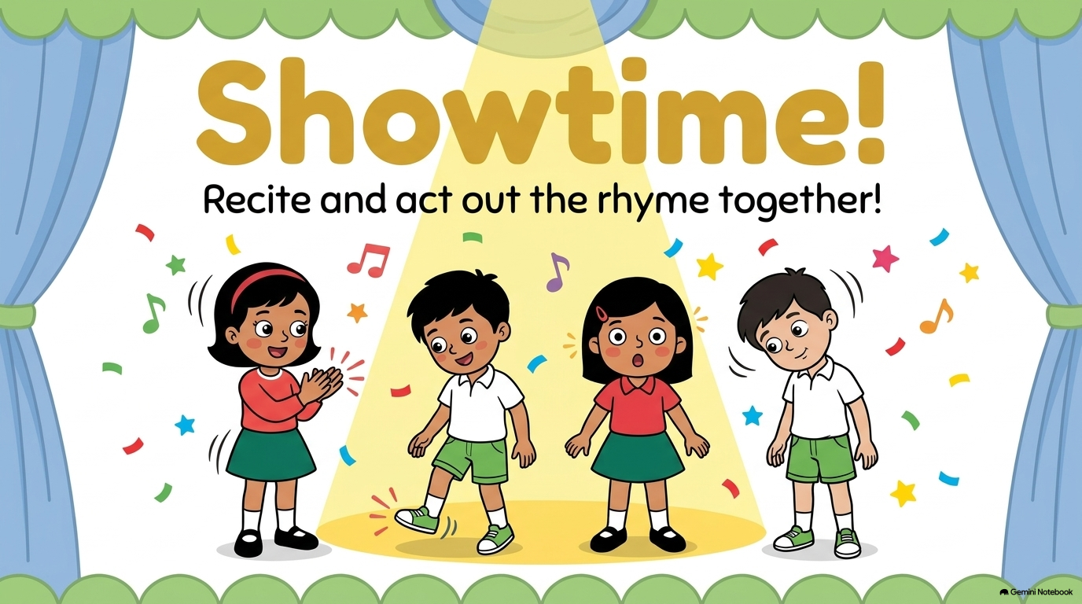

Slide 14


