Slide 1
Primary English With Anisur Rahman
Warm-up
Assalamu Alaikum everyone.
Good morning students.
How are you today?
I hope all of you are fine.
Let's start today's English class.
📚 English With Anisur Rahman | Learn English with Bangla Explanation

Slide 2
Primary English With Anisur Rahman
Cover
Class 5 English
Unit 12: Eating Healthy
Page 66–67
Activities:
3.2 Language Focus: Adverb
3.2.1 Fill in the blanks
3.3 Language Focus: Modal Verbs (should, shouldn't, must)
Duration: 30–35 minutes
📚 English With Anisur Rahman | Learn English with Bangla Explanation

Slide 3
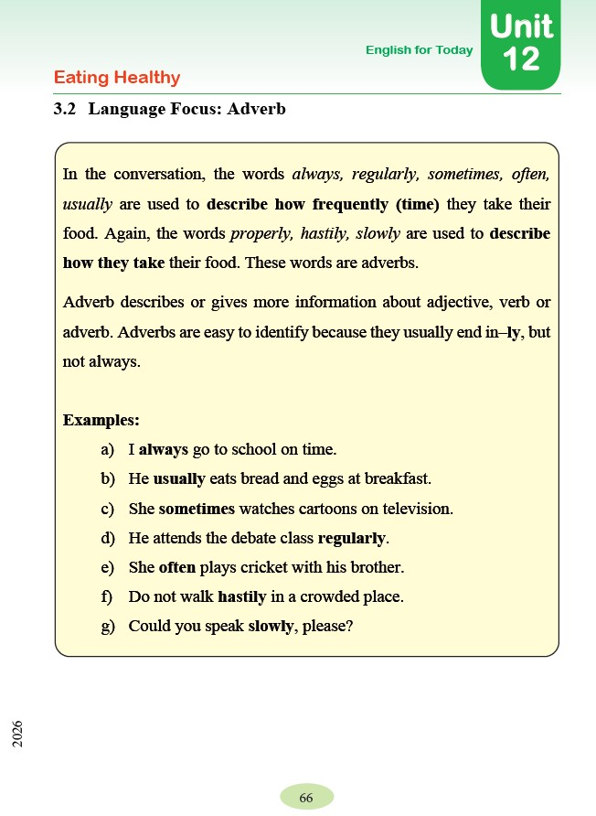
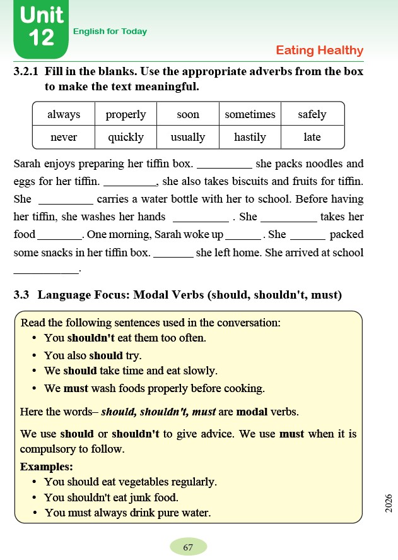
Primary English With Anisur Rahman
Cover
📚 English With Anisur Rahman | Learn English with Bangla Explanation

Slide 4
Primary English With Anisur Rahman
Welcome
Welcome
Class 5 English
Unit 12 – Eating Healthy
Page 66–67
Topic
Adverbs
Modal Verbs
📚 English With Anisur Rahman | Learn English with Bangla Explanation

Slide 5
Primary English With Anisur Rahman
Learning Outcomes
After this lesson, students will be able to—
✅ identify adverbs
✅ use adverbs correctly
✅ complete the paragraph using suitable adverbs
✅ understand should, shouldn't and must
✅ make their own sentences.
📚 English With Anisur Rahman | Learn English with Bangla Explanation

Slide 6
Primary English With Anisur Rahman
Revision
Do you eat breakfast every day?
Sample answer
Yes, I do.
Do you wash your hands before eating?
Sample answer
Yes, I do.
📚 English With Anisur Rahman | Learn English with Bangla Explanation

Slide 7
Primary English With Anisur Rahman
Revision
Do you eat vegetables regularly?
Sample answer
Yes, I do.
Should we eat junk food every day?
Sample answer
No, we shouldn't.
📚 English With Anisur Rahman | Learn English with Bangla Explanation

Slide 8
Primary English With Anisur Rahman
Today's Grammar
Today we shall learn
Adverbs
and
Modal Verbs
📚 English With Anisur Rahman | Learn English with Bangla Explanation

Slide 9
Primary English With Anisur Rahman
Activity 3.2
📚 English With Anisur Rahman | Learn English with Bangla Explanation

Slide 10
Primary English With Anisur Rahman
Today's Grammar
What is an Adverb?
Definition
An adverb tells us—
how
when
how often an action happens.
📚 English With Anisur Rahman | Learn English with Bangla Explanation

Slide 11
Primary English With Anisur Rahman
Today's Grammar
বাংলা
Adverb এমন শব্দ যা বলে—
কাজটি
✔ কীভাবে
✔ কখন
✔ কতবার
ঘটে।
📚 English With Anisur Rahman | Learn English with Bangla Explanation

Slide 12
Primary English With Anisur Rahman
Today's Grammar
Adverbs in the Book
always = সবসময়
regularly = নিয়মিত
sometimes = মাঝে মাঝে
often = প্রায়ই
usually = সাধারণত
properly = সঠিকভাবে
hastily = তাড়াহুড়ো করে
slowly = ধীরে ধীরে
📚 English With Anisur Rahman | Learn English with Bangla Explanation

Slide 13
Primary English With Anisur Rahman
Today's Grammar
I always go to school on time. আমি সবসময় সময়মতো স্কুলে যাই।
He usually eats bread and eggs at breakfast. সে সাধারণত নাশতায় রুটি ও ডিম খায়।
She sometimes watches cartoons. সে মাঝে মাঝে কার্টুন দেখে।
He attends the debate class regularly. সে নিয়মিত বিতর্ক ক্লাসে যায়।
She often plays cricket. সে প্রায়ই ক্রিকেট খেলে।
Do not walk hastily. তাড়াহুড়ো করে হাঁটবে না।
Could you speak slowly? আপনি কি ধীরে ধীরে কথা বলতে পারেন?
📚 English With Anisur Rahman | Learn English with Bangla Explanation

Slide 14
Primary English With Anisur Rahman
Practice
Choose the correct word.
I ______ go to school.
a) always
b) tree
c) banana
always
📚 English With Anisur Rahman | Learn English with Bangla Explanation

Slide 15
Primary English With Anisur Rahman
Practice
Choose the correct word.
She eats fruits ______.
regularly
📚 English With Anisur Rahman | Learn English with Bangla Explanation

Slide 16
Primary English With Anisur Rahman
Practice
Choose the correct word.
Walk ______.
slowly
📚 English With Anisur Rahman | Learn English with Bangla Explanation

Slide 17
Primary English With Anisur Rahman
Vocabulary
📚 English With Anisur Rahman | Learn English with Bangla Explanation

Slide 18
Primary English With Anisur Rahman
Quickly
Activity 3.2.1
Usually
Sometimes
Always
Properly
never
hastily
Late
quickly
Soon
Safely
📚 English With Anisur Rahman | Learn English with Bangla Explanation

Slide 19
Primary English With Anisur Rahman
Activity 3.3
📚 English With Anisur Rahman | Learn English with Bangla Explanation

Slide 20
Primary English With Anisur Rahman
Activity 3.3
What are Modal Verbs?
Today's modal verbs
✔ should
✔ shouldn't
✔ must
📚 English With Anisur Rahman | Learn English with Bangla Explanation

Slide 21
Primary English With Anisur Rahman
Activity 3.3
should
উচিত
Example
You should eat vegetables.
তোমার সবজি খাওয়া উচিত।
📚 English With Anisur Rahman | Learn English with Bangla Explanation

Slide 22
Primary English With Anisur Rahman
Activity 3.3
shouldn't
উচিত নয়
You shouldn't eat junk food.
তোমার জাঙ্ক ফুড খাওয়া উচিত নয়।
📚 English With Anisur Rahman | Learn English with Bangla Explanation

Slide 23
Primary English With Anisur Rahman
Activity 3.3
must
অবশ্যই
You must wash your hands.
তোমার অবশ্যই হাত ধুতে হবে।
📚 English With Anisur Rahman | Learn English with Bangla Explanation

Slide 24
Primary English With Anisur Rahman
Activity 3.3
Examples
You should eat healthy food.
তোমার স্বাস্থ্যকর খাবার খাওয়া উচিত।
You shouldn't eat too much chocolate.
তোমার বেশি চকলেট খাওয়া উচিত নয়।
📚 English With Anisur Rahman | Learn English with Bangla Explanation

Slide 25
Primary English With Anisur Rahman
Activity 3.3
Examples
You must drink clean water.
তোমার অবশ্যই বিশুদ্ধ পানি পান করতে হবে।
📚 English With Anisur Rahman | Learn English with Bangla Explanation

Slide 26
Primary English With Anisur Rahman
Pair Work
Student A
Should we eat vegetables?
Student B
Yes, we should.
📚 English With Anisur Rahman | Learn English with Bangla Explanation

Slide 27
Primary English With Anisur Rahman
Pair Work
Student A
Must we wash our hands?
Student B
Yes, we must.
📚 English With Anisur Rahman | Learn English with Bangla Explanation

Slide 28
Primary English With Anisur Rahman
Practice
📚 English With Anisur Rahman | Learn English with Bangla Explanation

Slide 29
Primary English With Anisur Rahman
Quiz
Classroom Quiz
Choose the correct answer.
We ______ wash our hands before eating.
a) must
b) banana
c) mango
must
📚 English With Anisur Rahman | Learn English with Bangla Explanation

Slide 30
Primary English With Anisur Rahman
Quiz
Classroom Quiz
Choose the correct answer.
You ______ eat too much junk food.
shouldn't
📚 English With Anisur Rahman | Learn English with Bangla Explanation

Slide 31
Primary English With Anisur Rahman
Quiz
Classroom Quiz
Choose the correct answer.
You ______ exercise every day.
should
📚 English With Anisur Rahman | Learn English with Bangla Explanation

Slide 32
Primary English With Anisur Rahman
Summary
Summary
Today we learned—
✅ Adverbs
✅ always
✅ usually
✅ sometimes
✅ regularly
✅ properly
✅ slowly
✅ should
✅ shouldn't
✅ must
📚 English With Anisur Rahman | Learn English with Bangla Explanation

Slide 33
Primary English With Anisur Rahman
Assessment
📚 English With Anisur Rahman | Learn English with Bangla Explanation

Slide 34
Primary English With Anisur Rahman
Homework
Homework
Write five sentences using
always
usually
sometimes
should
must
📚 English With Anisur Rahman | Learn English with Bangla Explanation

Slide 35
Primary English With Anisur Rahman
Thank You
Thank You
Wish you all the best.
📚 English With Anisur Rahman | Learn English with Bangla Explanation

