Slide 1
Primary English With Anisur Rahman
Cover
Class 5 English
Unit 12: Eating Healthy
Page 68 | Modal Verbs & Letter Writing
👨‍🏫 Md. Anisur Rahman
Primary School Teacher
📚 English With Anisur Rahman | Learn English with Bangla Explanation

Slide 2
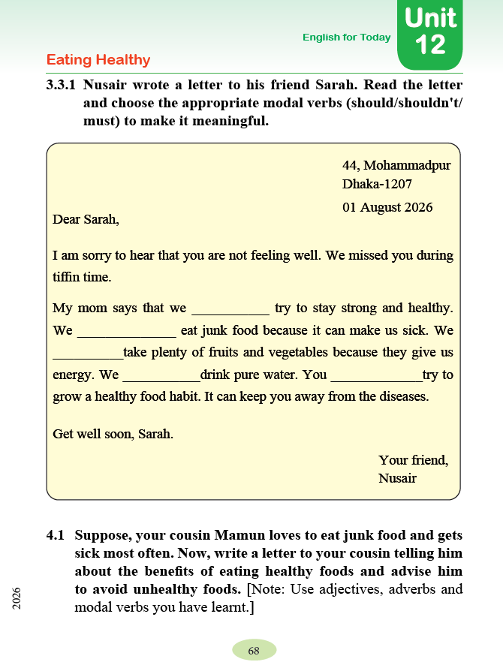
Primary English With Anisur Rahman
Cover
Class 5 English
Unit 12: Eating Healthy
Page 68 | Modal Verbs & Letter Writing
👨‍🏫 Md. Anisur Rahman
Primary School Teacher
📚 English With Anisur Rahman | Learn English with Bangla Explanation

Slide 3
Primary English With Anisur Rahman
Learning Outcomes
At the end of this lesson, students will be able to—
✔ Use should, shouldn't, must correctly.
✔ Complete the letter.
✔ Write a simple letter about healthy food.
✔ Give advice using modal verbs.
📚 English With Anisur Rahman | Learn English with Bangla Explanation

Slide 4
Primary English With Anisur Rahman
Warm-up
1. What is your favourite healthy food?
👉 My favourite healthy food is mango.
2. Do you eat junk food every day?
👉 No, I don't.
3. Why should we drink pure water?
👉 Because it keeps us healthy.
📚 English With Anisur Rahman | Learn English with Bangla Explanation

Slide 5
Primary English With Anisur Rahman
Revision
Modal | Use | Bangla
should | advice | উচিত
shouldn't | negative advice | উচিত নয়
must | strong obligation | অবশ্যই
You should eat vegetables.
তোমার শাকসবজি খাওয়া উচিত।
📚 English With Anisur Rahman | Learn English with Bangla Explanation

Slide 6
Primary English With Anisur Rahman
Revision
Modal | Use | Bangla
should | advice | উচিত
shouldn't | negative advice | উচিত নয়
must | strong obligation | অবশ্যই
You shouldn't eat junk food.
তোমার জাঙ্ক ফুড খাওয়া উচিত নয়।
📚 English With Anisur Rahman | Learn English with Bangla Explanation

Slide 7
Primary English With Anisur Rahman
Revision
Modal | Use | Bangla
should | advice | উচিত
shouldn't | negative advice | উচিত নয়
must | strong obligation | অবশ্যই
You must drink pure water.
তোমার অবশ্যই বিশুদ্ধ পানি পান করতে হবে।
📚 English With Anisur Rahman | Learn English with Bangla Explanation

Slide 8
Primary English With Anisur Rahman
Vocabulary
Word | Meaning
healthy | স্বাস্থ্যকর
junk food | জাঙ্ক ফুড
disease | রোগ
energy | শক্তি
habit | অভ্যাস
vegetables | শাকসবজি
fruits | ফলমূল
pure water | বিশুদ্ধ পানি
advice | পরামর্শ
📚 English With Anisur Rahman | Learn English with Bangla Explanation

Slide 9
Primary English With Anisur Rahman
Activity 3.3.1
should
shouldn't
should
must
should
📚 English With Anisur Rahman | Learn English with Bangla Explanation

Slide 10
Primary English With Anisur Rahman
Activity 3.3.1
Bangla Meaning
Dear Sarah,
প্রিয় সারাহ,
I am sorry to hear that you are not feeling well.
তুমি অসুস্থ শুনে আমি দুঃখিত।
We missed you during tiffin time.
টিফিনের সময় আমরা তোমাকে খুব মিস করেছি।
My mom says that we should try to stay strong and healthy.
আমার মা বলেন আমাদের সুস্থ ও শক্তিশালী থাকার চেষ্টা করা উচিত।
We shouldn't eat junk food because it can make us sick.
আমাদের জাঙ্ক ফুড খাওয়া উচিত নয়, কারণ এটি আমাদের অসুস্থ করতে পারে।
📚 English With Anisur Rahman | Learn English with Bangla Explanation

Slide 11
Primary English With Anisur Rahman
Activity 3.3.1
Bangla Meaning
We should take plenty of fruits and vegetables because they give us energy.
আমাদের বেশি করে ফলমূল ও শাকসবজি খাওয়া উচিত, কারণ এগুলো আমাদের শক্তি দেয়।
We must drink pure water.
আমাদের অবশ্যই বিশুদ্ধ পানি পান করতে হবে।
You should try to grow a healthy food habit.
তোমার স্বাস্থ্যকর খাদ্যাভ্যাস গড়ে তোলার চেষ্টা করা উচিত।
Get well soon.
দ্রুত সুস্থ হয়ে ওঠো।
Your friend,
তোমার বন্ধু,
Nusair
📚 English With Anisur Rahman | Learn English with Bangla Explanation

Slide 12
Primary English With Anisur Rahman
Activity 4.1
📚 English With Anisur Rahman | Learn English with Bangla Explanation

Slide 13
Primary English With Anisur Rahman
Activity 4.1
Write a Letter
Imagine—
Your cousin Mamun loves junk food.
Write a letter advising him to—
✅ Eat healthy food
✅ Avoid junk food
Use
✔ should
✔ shouldn't
✔ must
📚 English With Anisur Rahman | Learn English with Bangla Explanation

Slide 14
Primary English With Anisur Rahman
Sample Letter
                Ullapara,
                Sirajganj.
                01 August 2026
Dear Mamun,
How are you?
I hope you are well.
I heard that you eat junk food very often.
You should eat fruits and vegetables every day.
You shouldn't eat too much junk food because it is unhealthy.
You must drink pure water and wash your hands before eating.
Healthy food gives us energy and keeps us fit.
Take care of your health.
Your loving cousin,
Rahim
📚 English With Anisur Rahman | Learn English with Bangla Explanation

Slide 15
Primary English With Anisur Rahman
Pair Work
📚 English With Anisur Rahman | Learn English with Bangla Explanation

Slide 16
Primary English With Anisur Rahman
Practice
📚 English With Anisur Rahman | Learn English with Bangla Explanation

Slide 17
Primary English With Anisur Rahman
Quiz
Choose the correct answer.
We ______ drink pure water.
a) should
b) must
c) shouldn't
✅
📚 English With Anisur Rahman | Learn English with Bangla Explanation

Slide 18
Primary English With Anisur Rahman
Quiz
Choose the correct answer.
We ______ eat junk food every day.
a) should
b) shouldn't
c) must
✅
📚 English With Anisur Rahman | Learn English with Bangla Explanation

Slide 19
Primary English With Anisur Rahman
Quiz
Choose the correct answer.
Fruits give us ______.
a) disease
b) energy
c) homework
✅
📚 English With Anisur Rahman | Learn English with Bangla Explanation

Slide 20
Primary English With Anisur Rahman
Assessment
📚 English With Anisur Rahman | Learn English with Bangla Explanation

Slide 21
Primary English With Anisur Rahman
Homework
✍ Write 5 sentences about healthy food using—
should
shouldn't
must
Example:
I should eat vegetables every day.
📚 English With Anisur Rahman | Learn English with Bangla Explanation

Slide 22
Primary English With Anisur Rahman
Thank You
Thank You
🌟 Thanks for Cooperating!
📚 English With Anisur Rahman | Learn English with Bangla Explanation

