Slide 1
Primary English With Anisur Rahman
Cover
Subject: English
Class: 2
Unit: 7 – Colours, Shapes and Signs
Lesson: 1
Page: 63
Topic: Colours
👨‍🏫 Teacher:
Anisur Rahman
📚 English With Anisur Rahman | Learn English with Bangla Explanation

Slide 2
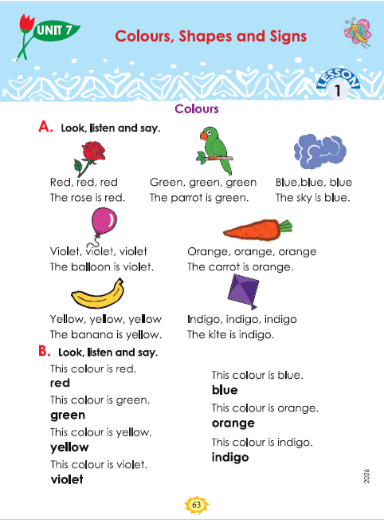
Primary English With Anisur Rahman
Cover
Subject: English
Class: 2
Unit: 7 – Colours, Shapes and Signs
Lesson: 1
Page: 63
Topic: Colours
📚 English With Anisur Rahman | Learn English with Bangla Explanation

Slide 3
Primary English With Anisur Rahman
🎯 Learning Outcomes
At the end of the lesson, students will be able to:
✅ identify six colours
✅ say the names of colours in English
✅ make simple sentences using colours
📚 English With Anisur Rahman | Learn English with Bangla Explanation

Slide 4
Primary English With Anisur Rahman
Warm-up
Let's Talk!
"আজ আমরা ইংরেজিতে বিভিন্ন রঙের নাম শিখব।"
Show some classroom objects.
What colour is your bag?
What colour is your pencil?
What colour is the board?
📚 English With Anisur Rahman | Learn English with Bangla Explanation

Slide 5
Primary English With Anisur Rahman
Revision
📚 English With Anisur Rahman | Learn English with Bangla Explanation

Slide 6
Primary English With Anisur Rahman
Activity A
Read together.
টিয়াপাখি সবুজ।
গোলাপটি লাল।
আকাশ নীল।
বেলুনটি বেগুনি।
গাজরটি কমলা রঙের।
ঘুড়িটি নীলচে-বেগুনি (ইন্ডিগো) রঙের।
কলাটি হলুদ।
📚 English With Anisur Rahman | Learn English with Bangla Explanation

Slide 7
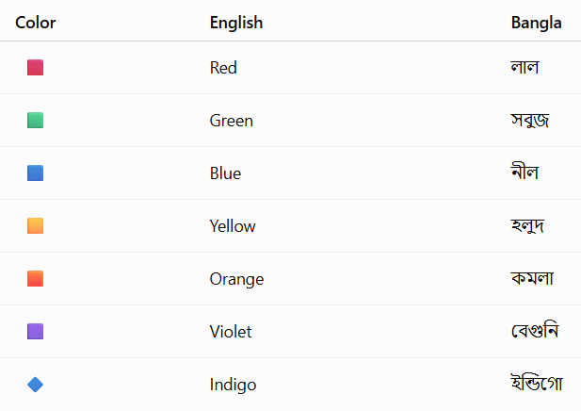
Primary English With Anisur Rahman
Vocabulary
📚 English With Anisur Rahman | Learn English with Bangla Explanation

Slide 8
Primary English With Anisur Rahman
Activity B
📚 English With Anisur Rahman | Learn English with Bangla Explanation

Slide 9
Primary English With Anisur Rahman
Activity B
This colour is green. 👉
This colour is blue. 👉
This colour is red. 👉
This colour is violet. 👉
This colour is orange. 👉
This colour is yellow. 👉
This colour is indigo. 👉
📚 English With Anisur Rahman | Learn English with Bangla Explanation

Slide 10
Primary English With Anisur Rahman
Pair Work
Ask your friend.
A: What colour is the banana?
B: The banana is yellow.
A: What colour is the rose?
B: The rose is red.
A: What colour is the sky?
B: The sky is blue.
📚 English With Anisur Rahman | Learn English with Bangla Explanation

Slide 11
Primary English With Anisur Rahman
Practice
Fill in the blanks.
The rose is ______.
The carrot is ______.
The banana is ______.
The sky is ______.
The balloon is ______.
red
green
yellow
blue
violet
📚 English With Anisur Rahman | Learn English with Bangla Explanation

Slide 12
Primary English With Anisur Rahman
Quiz
Answer orally.
What colour is the parrot?
✅ Green.
What colour is the kite?
✅ Indigo.
What colour is the banana?
✅ Yellow.
What colour is the carrot?
✅ Orange.
What colour is the rose?
✅ Red.
📚 English With Anisur Rahman | Learn English with Bangla Explanation

Slide 13
Primary English With Anisur Rahman
Assessment
📚 English With Anisur Rahman | Learn English with Bangla Explanation

Slide 14
Primary English With Anisur Rahman
Homework
Write five sentences.
Example:
The rose is red.
The banana is yellow.
The sky is blue.
The carrot is orange.
The parrot is green.
📚 English With Anisur Rahman | Learn English with Bangla Explanation

Slide 15
Primary English With Anisur Rahman
Thank You
Thank You
Wish you all the best
📚 English With Anisur Rahman | Learn English with Bangla Explanation

