Slide 1
Primary English With Anisur Rahman
Cover
English for Today
Class 3 English
Unit 4 | Lesson 5
Numbers 91–100
Pages 59–60
👨‍🏫 Md. Anisur Rahman
📚 English With Anisur Rahman | Learn English with Bangla Explanation

Slide 2
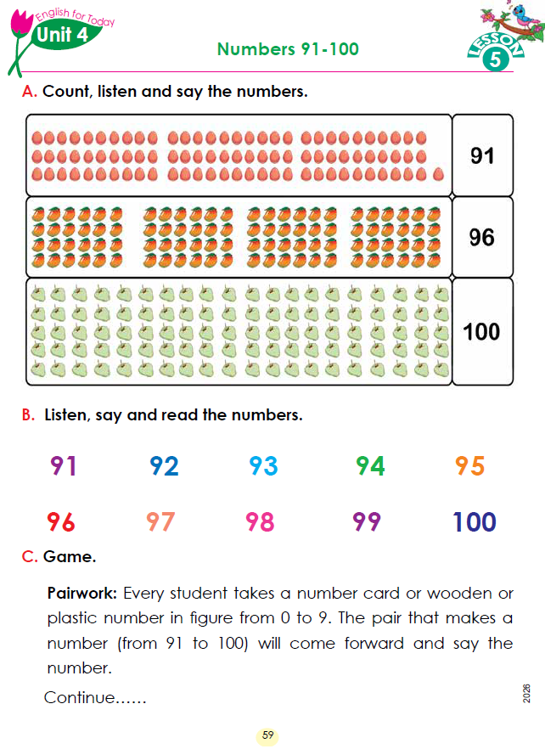
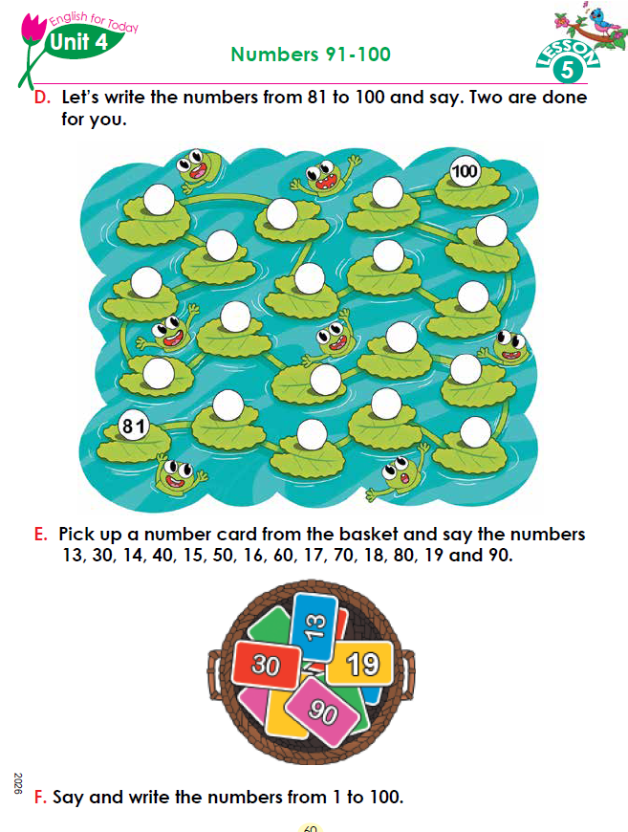
Primary English With Anisur Rahman
Cover
📚 English With Anisur Rahman | Learn English with Bangla Explanation

Slide 3
Primary English With Anisur Rahman
🎯 Learning Outcomes
By the end of the lesson, students will be able to:
Count objects from 91 to 100.
Read and pronounce numbers 91–100 correctly.
Write numbers from 81 to 100.
Recognize missing numbers.
Participate in pair work and number games.
📚 English With Anisur Rahman | Learn English with Bangla Explanation

Slide 4
Primary English With Anisur Rahman
Warm-up
Let's count together!
81
82
83
84
85
86
87
88
89
90
What comes after 90?
Expected answer: 91
📚 English With Anisur Rahman | Learn English with Bangla Explanation

Slide 5
Primary English With Anisur Rahman
Revision
Let's revise:71–80
71
72
73
74
75
76
77
78
79
80
Let's revise:81–90
81
82
83
84
85
86
87
88
89
90
📚 English With Anisur Rahman | Learn English with Bangla Explanation

Slide 6
Primary English With Anisur Rahman
Revision
What comes after 89?
Expected answer: 90
What comes after 90?
Expected answer: 91
Which is bigger: 88 or 91?
Expected answer: 91
📚 English With Anisur Rahman | Learn English with Bangla Explanation

Slide 7
Primary English With Anisur Rahman
Vocabulary
📚 English With Anisur Rahman | Learn English with Bangla Explanation

Slide 8
Primary English With Anisur Rahman
Activity A
📚 English With Anisur Rahman | Learn English with Bangla Explanation

Slide 9
Primary English With Anisur Rahman
Activity B
📚 English With Anisur Rahman | Learn English with Bangla Explanation
Notes:
Students count aloud.

Slide 10
Primary English With Anisur Rahman
Activity B
Read the Numbers
91 – Ninety-one
92 – Ninety-two
93 – Ninety-three
94 – Ninety-four
95 – Ninety-five
96 – Ninety-six
97 – Ninety-seven
98 – Ninety-eight
99 – Ninety-nine
100 – One hundred
📚 English With Anisur Rahman | Learn English with Bangla Explanation
Notes:
Students count aloud.

Slide 11
Primary English With Anisur Rahman
Pair Work
📚 English With Anisur Rahman | Learn English with Bangla Explanation

Slide 12
Primary English With Anisur Rahman
Activity D
93
99
94
98
92
96
91
95
97
89
87
90
88
86
82
84
83
85
📚 English With Anisur Rahman | Learn English with Bangla Explanation

Slide 13
Primary English With Anisur Rahman
Activity E
📚 English With Anisur Rahman | Learn English with Bangla Explanation

Slide 14
Primary English With Anisur Rahman
Activity F
Examples:
25
47
68
91
100
📚 English With Anisur Rahman | Learn English with Bangla Explanation

Slide 15
Primary English With Anisur Rahman
Practice
Fill in the blanks.
91 __ 93
95 __ 97
98 __ 100
92
96
99
📚 English With Anisur Rahman | Learn English with Bangla Explanation

Slide 16
Primary English With Anisur Rahman
Quiz
Answer orally.
What comes after 96?
What comes before 100?
Read 98.
Which is bigger? 97 or 92?
What comes after 99?
📚 English With Anisur Rahman | Learn English with Bangla Explanation

Slide 17
Primary English With Anisur Rahman
Assessment
Can the student...
✅ Read 91–100?
✅ Count correctly?
✅ Write numbers?
✅ Identify missing numbers?
📚 English With Anisur Rahman | Learn English with Bangla Explanation

Slide 18
Primary English With Anisur Rahman
Homework
Write numbers: 91–100
Practice reading them three times.
📚 English With Anisur Rahman | Learn English with Bangla Explanation

Slide 19
Primary English With Anisur Rahman
Thank You
🎉 Thank You!
See you in the next class.
Keep practising English every day.
📚 English With Anisur Rahman | Learn English with Bangla Explanation

