Slide 1

Good morning
Prepared by: Md. Saifuddin-Ass. Teacher , Afzal Nagar GPS. Satkania, Chattogram.

Slide 2
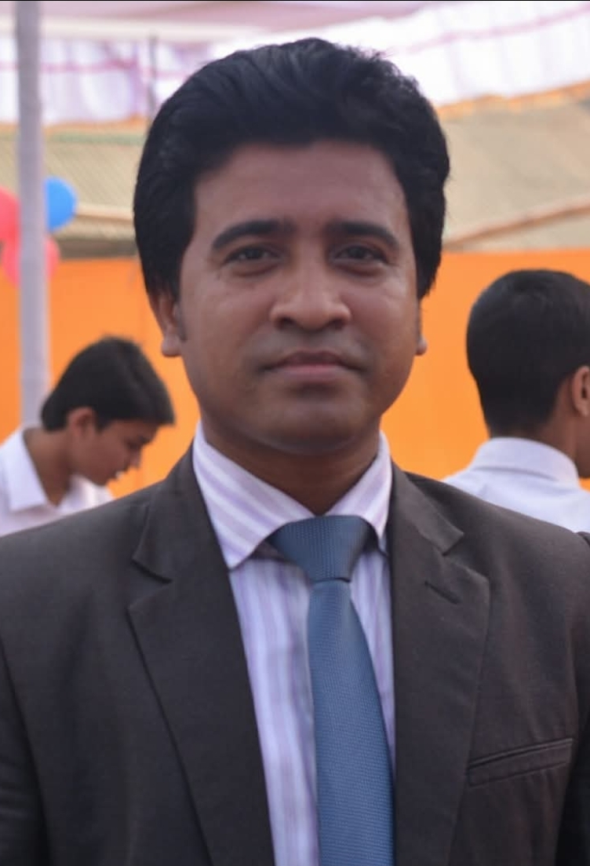
Teacher Profile
Md. Saifuddin
Ass. Teacher of Afzalnagar GPS.
Satkania, CTG.

Slide 3

Let's see a picture!
Prepared by: Md. Saifuddin-Ass. Teacher , Afzal Nagar GPS. Satkania, Chattogram.

Slide 4
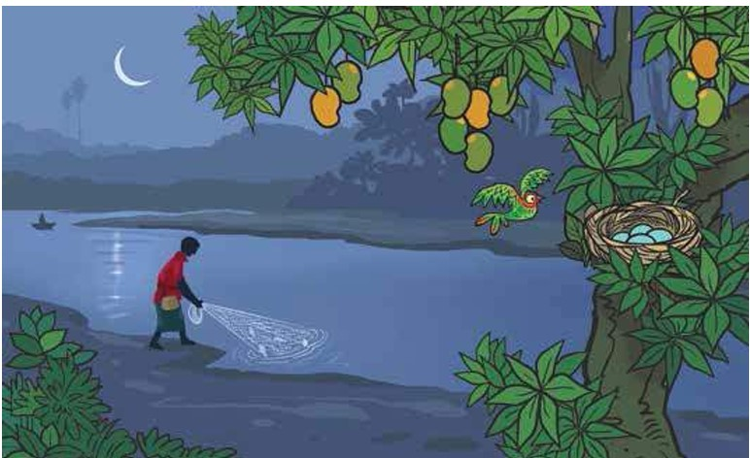
Prepared by: Md. Saifuddin-Ass. Teacher , Afzal Nagar GPS. Satkania, Chattogram.

Slide 5

Prepared by: Md. Saifuddin-Ass. Teacher , Afzal Nagar GPS. Satkania, Chattogram.

Slide 6
moon
Moon
Prepared by: Md. Saifuddin-Ass. Teacher , Afzal Nagar GPS. Satkania, Chattogram.

Slide 7


Slide 8
mango
Mango

Slide 9
https://www.youtube.com/watch?v=WFMI-cV9sq8&list=RDWFMI-cV9sq8&start_radio=1
Prepared by: Md. Saifuddin-Ass. Teacher , Afzal Nagar GPS. Satkania, Chattogram.

Slide 10


Prepared by: Md. Saifuddin-Ass. Teacher , Afzal Nagar GPS. Satkania, Chattogram.

Slide 11

Thank you
for staying with me.
Prepared by: Md. Saifuddin-Ass. Teacher , Afzal Nagar GPS. Satkania, Chattogram.

