Slide 1
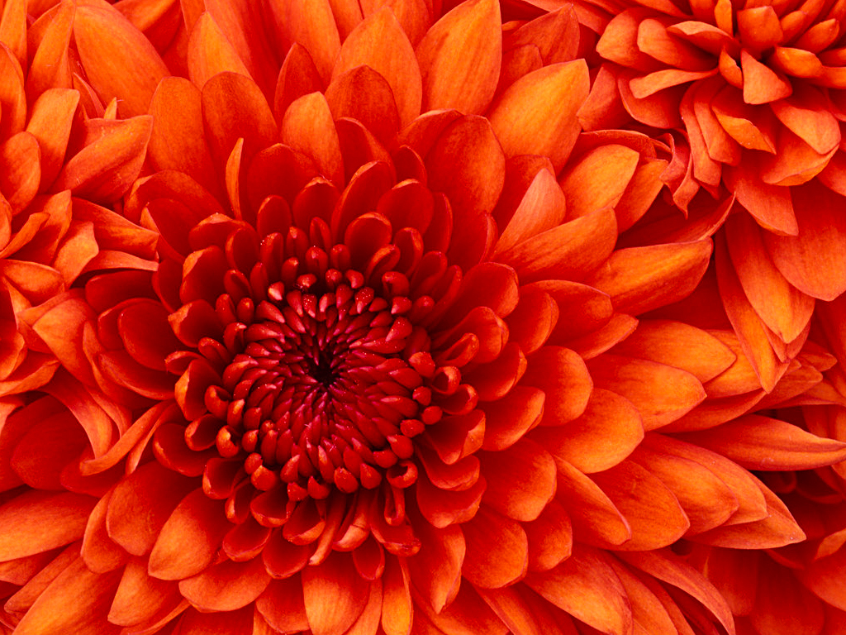
Good morning to All

Slide 2

Introduction
Students:
Class –Ten
English First Paper
Md. Monirul Haque
Assistant Teacher (English)
Amlabari Secondary School
Khoksa, Kushtia
01722 273272

Slide 3
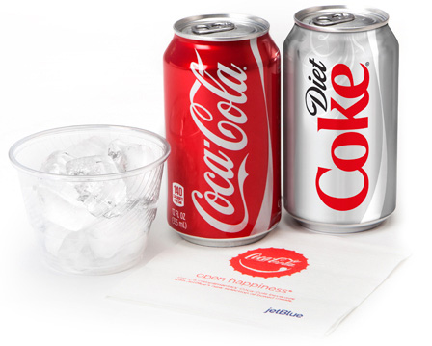
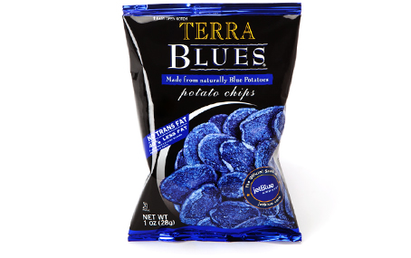
What do you see in the picture ?
What kind of food is these?

Slide 4
Topic
JUNK FOOD

Slide 5
Learning Outcomes
By the end of the lesson you’ll have-
Matched food ingredients with the picture
Read an Article about Junk Food & Answered questions
Read the Statements about Junk Food & make similar Statements
Designed a poster Describing the bad feature of Junk Food

Slide 6
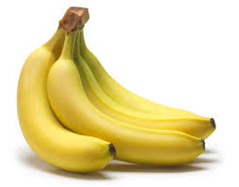
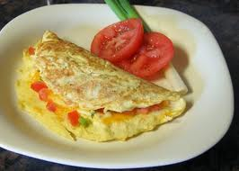
A . Look at the following food items and fill in the appopriate boxes in the table in groups. 10 min
Homemade | Expensive | Fresh | Natural
 |  | Banana | Banana

Slide 7
Filling the Table
Homemade | Expensive | Fresh | Natural
Egg omlet | chips | banana | banana
burger | apple | egg | egg
 |  | apple | apple

Slide 8
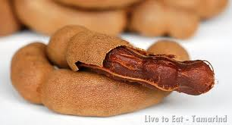

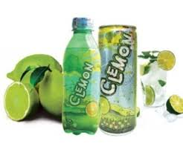
Vocabulary
Pungent : a spicy taste.
The chicken curry tasted pungent with a lot of chilly in it.
fizzy : sparking.
If you open a bottle of fizziy drink you will see a lot of bubbles coming out.
lemonade : a kind of lemon drink.
He used to take a bottle of lemonade after lunch.

Slide 9
Read the text and answer the questions:
‘Junk food’ is food that has been produced for its pungent taste rather than for its healthvalue.It is great fun to eat and it can look very appealing ,but it is not good for the body. It often contains added chemicals which make it taste soothing but are unhealthy. It usually contains a lot of animal fat or sugar.
Foods like chips,burgers,crips,cakes,buiscuits are high in animal fats. Sweeets and fizzi drinks like cola and lemonade are high in sugar.When we eat a large amount of fat our bodies turn into fatty tissue, and a large amout of sugar can damage our teeth and skin.Junk food lakes the vitamins we need. Although people occasionally eat junk food,the body does best when it is given a healthy balance of nutrients from freshly garden homemade foods.

Slide 10
Pair Work 15 min
.
Questions
1 What is Junk Food?
2 What does it contain ?
3 How does it harm teeth and skin ?
4 Wha does it lack ?
5What tdoes homemade food contain ?
Notes:
Questions:
1 What is Junk Food?
2 What does it contain ?
3 How does it harm teeth and skin ?
4 What does it lack ?
5 What does homemade food contain ?
Answers
Junk food is a kind of food that we eat for their taste but not for the food value.
J F usually contains animal fat and sugar.
3. The sugar in Junk Food harms teeth and skin.
4. J F lacks vitamins and minerals.
5. Homemade food contains a healthy balance of nutrients.

Slide 11
Feedback
MCQ 1. Which one is a Junk Food……..
A) Banana, b) Drinks, c) Guava, d)Rice
2.True Or False? If false give correct Ans.
a) Junk Food contains animal fat.
3. Fill in the gaps with the clues.
damage, lack, sugar, Junk Food
a)………. Our teeth and skin.
B) It contains high in …………It
c)……….vitamin and mineral we need.

Slide 12
Home Task
“Design a poster pointing out why one should not eat junk food.”

Slide 13
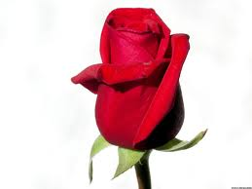
THANK YOU

