Slide 1
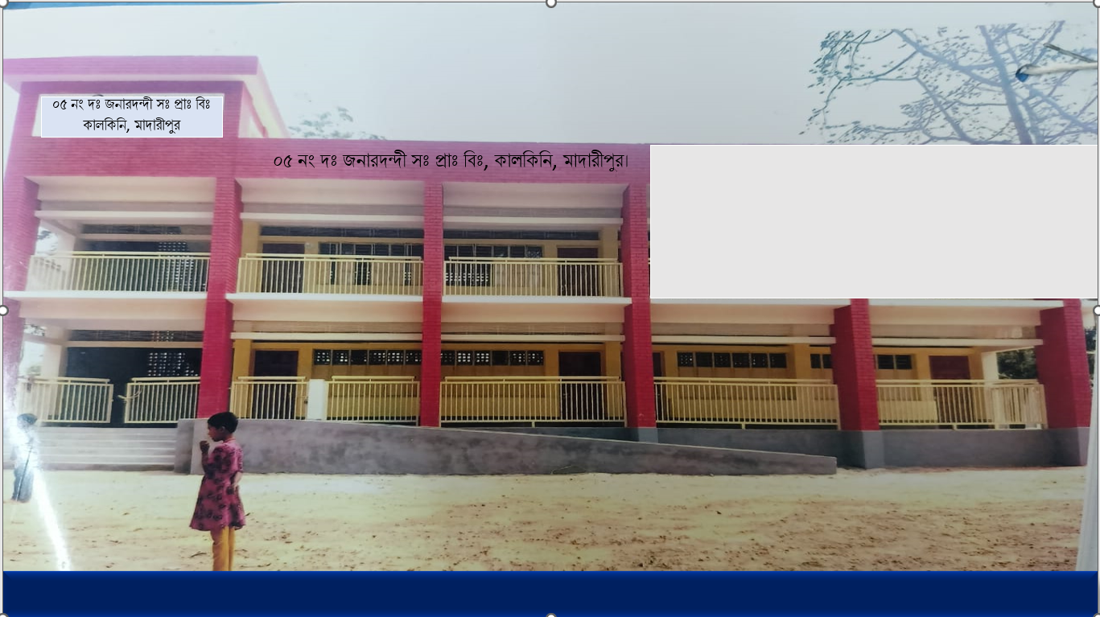
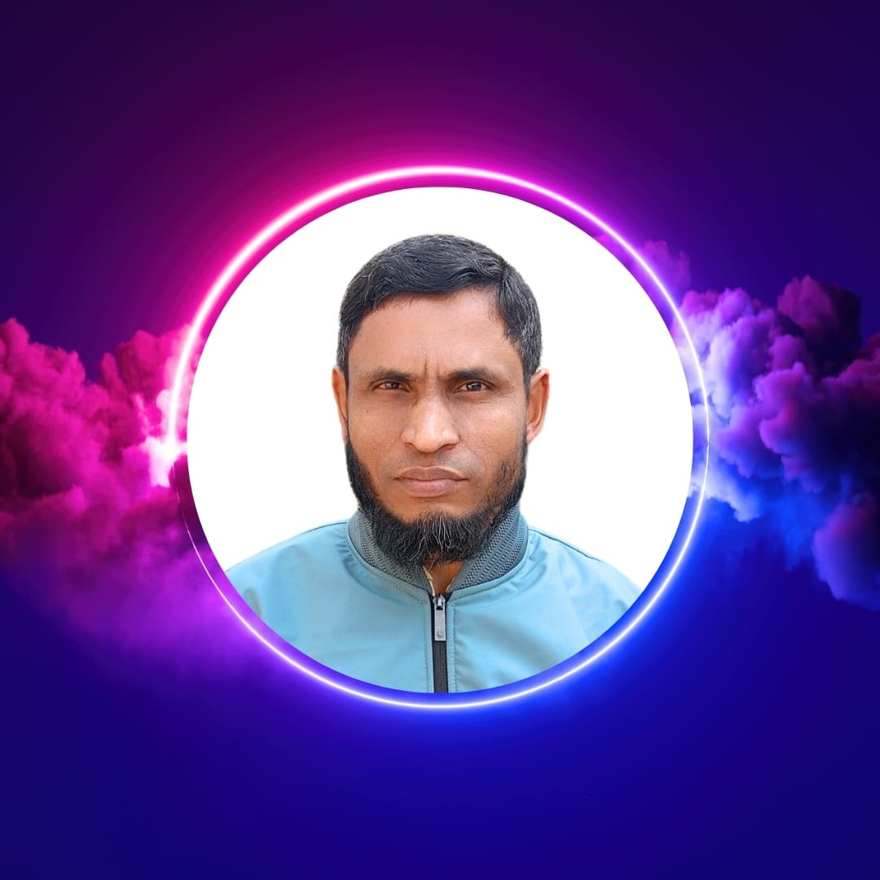

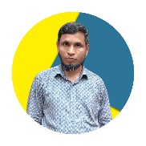
WEL COME
Class - Three
Subject - English
Unit - 7
I want
to join
English class
*05 No South Jonardondi GPS* * Kalkini, Madaripur. *

Slide 2
Introducing
Belayet Hossain
Assistant Teacher
05 No South Jonardondi GPS
Kalkini, Madaripur.
Gmail : belayet01715205765@gmail.com

Slide 3

INTRODUCING
Class : Three
Subject : English
Unit : 7, Lesson 3
Saving water
Activity : A, B, C, D
Page : 104 & 105.
Time : 45 minutes

Slide 4
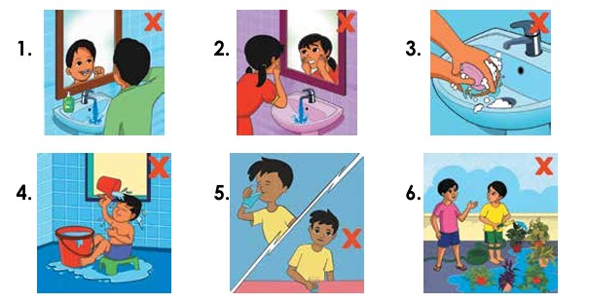
Can you guess what is our today's lesson?
What is the relationship between them?

Slide 5
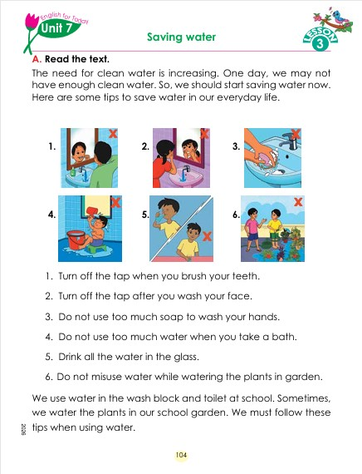
Today's Our Lesson
Saving water
Unit - 7.
Lesson 3

Slide 6
Learning Outcomes
Students will be able to:-
Listening:-
4.3.1 - enjoy and understand simple stories.
Speaking:-
3.1.1 - ask and answer Wh questions.
Reading:-
5.1.1 - read simple paragraphs.
Writing:-
8.1.3 - write sentence from the text book or model.
10.1.1 - write short and simple paragraphs answering a
set of questions.

Slide 7
Who can you see in the picture?
New Words
Water
Opposite name of life.
The need for clean water is increasing. One day, we may not have enough clean water. So, we should start saving water now. Here are some tips to save water in our everyday life.

Slide 8
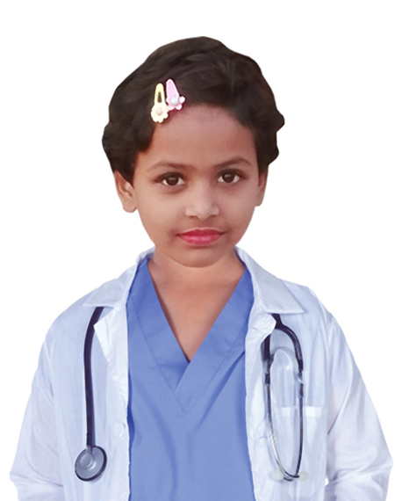
The need for clean water is increasing. One day, we may not have enough clean water. So, we should start saving water now. Here are some tips to save water in our everyday life.

Slide 9
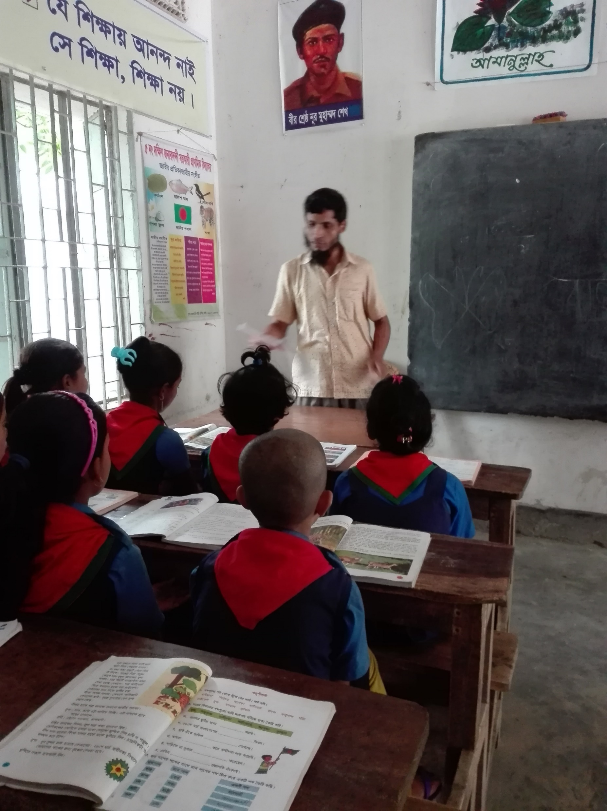
Teacher’s reading

Slide 10

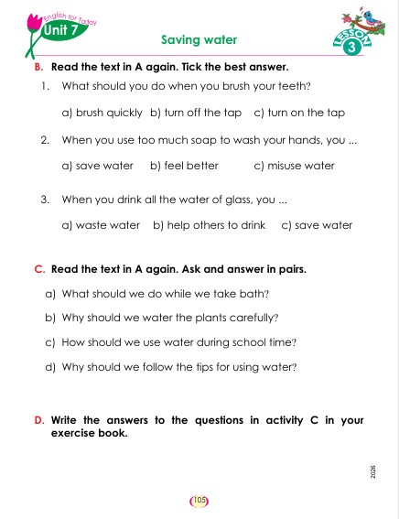
Open your English book at page-104-105

Slide 11
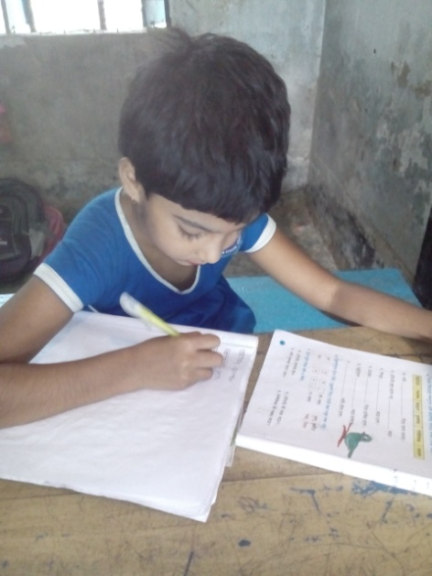
Individual Work
Make sentence by the words:
Need
Clean
Life

Slide 12
The need for clean water is increasing. One day, we may not have enough clean water. So, we should start saving water now. Here are some tips to save water in our everyday life.
How kind of water is increasing?
When we have not enough clean water?
What we have not enough?
What we should start?
How much tips to save water?
Answer
Please click answer button for answer
Pair Work
Answer
Time: 5 minute's
Answer
Answer
Answer

Slide 13
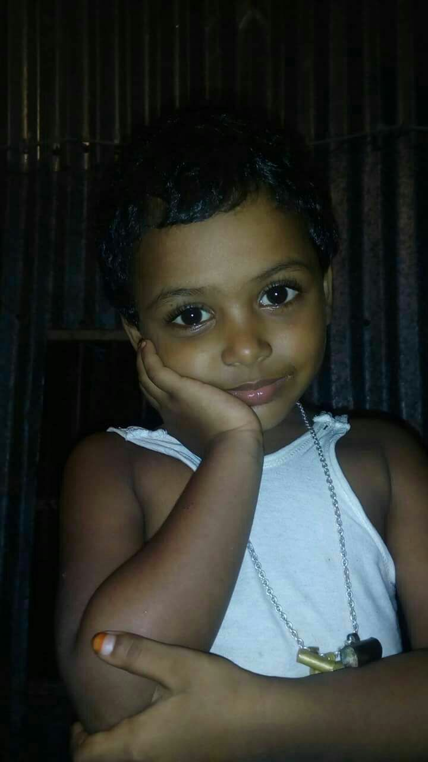
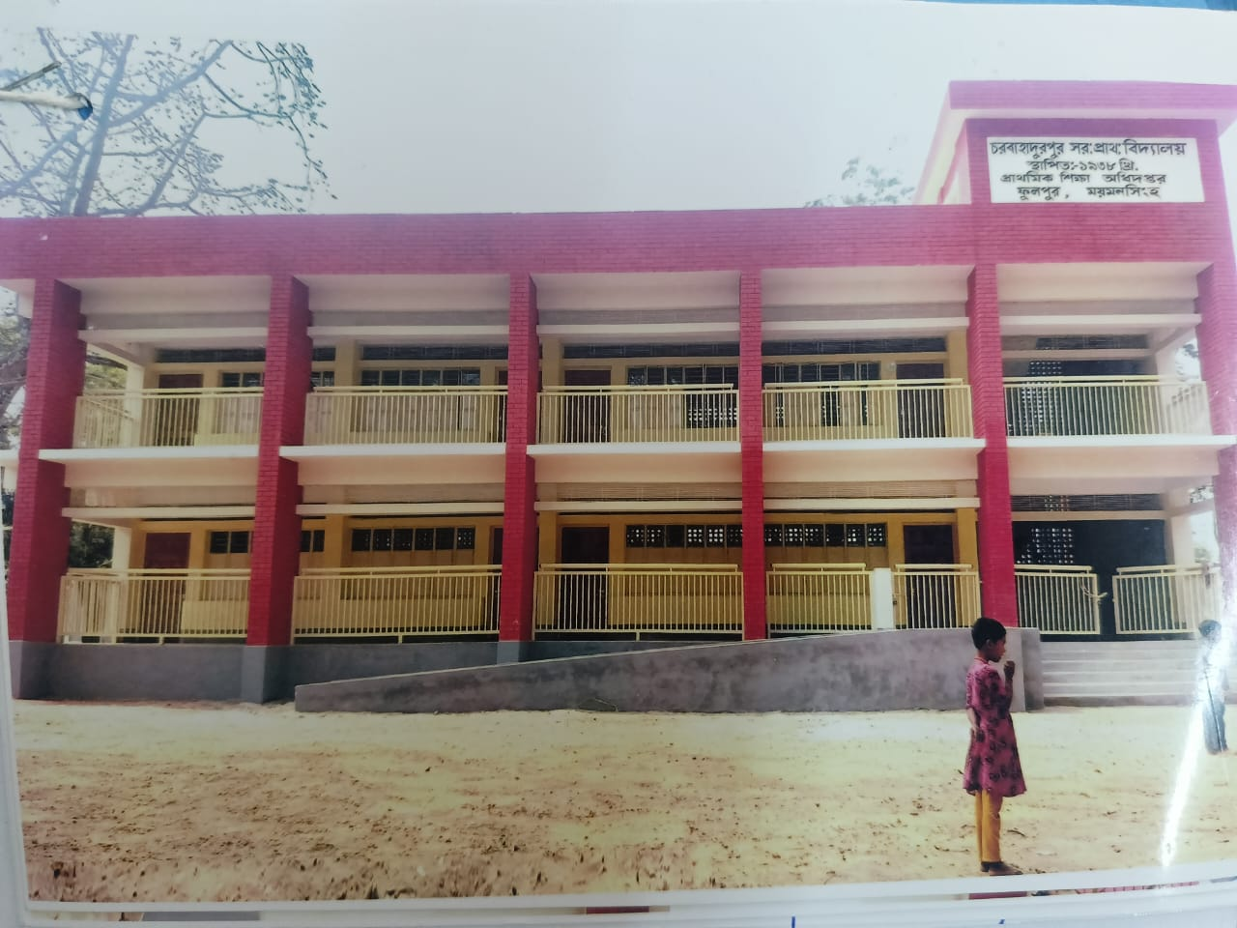
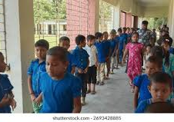
Group Work
Time: 10 minute's
Saving water

Slide 14
Individual Work
Read the sentences. Write T for True and F for False.
The need for clean water is increasing.____
We may not have enough dirty water.____
We should finish saving water._____
Here are some tips.____
Here are some tips to save water in our everyday life.___
T
F
F
T
T

Slide 15
Choose the correct answer.
1. The need for clean water is .....

(a) decreasing
(b) increasing
Match them
(c) dropping
(d) falling
2. We have not enough clean .........
(a) sugar
(b) butter
Match them

(c) milk
(d) water

Slide 16
Pair Work
Ask and answer.
What is the story about?
What should we do while we take bath?
Why should we water the plants carefully?
How should we use water during school time?
Why should we follow the tips for using water?

Slide 17
Pair Work
Match the words in column A with the words of
similar meaning in column B. One is done for you.
A | B
need clean start tips save | protects begining fresh school methods

Slide 18
Pair Work
Let’s read the text in section A again. List the nouns, pronouns and verbs in the following table.
Noun | Pronoun | Verb
Water | We | Save

Slide 19
Evaluation
Look attentively. Now we play a game. Everybody close your eyes.
Which word is missing?
Open your eyes.
Clean
Water
Life

Slide 20
Evaluation
Write three sentences about Clean water.

Slide 21
Thanks to All

