Slide 1
Welcome
to
Class -IX
English For Today

Slide 2
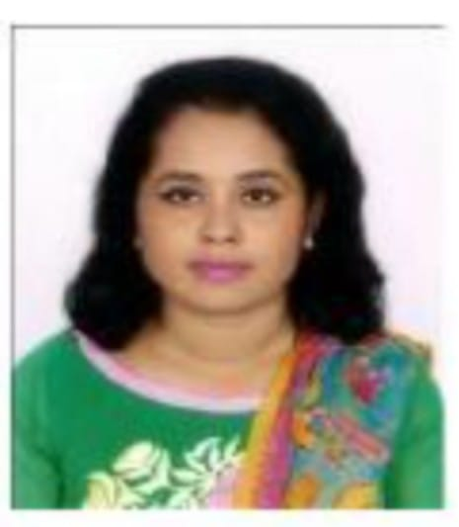
Introducing
Sirazum Munira
Assistant Teacher, English
Kalukhali Dakhil Madrasha
Kalukhali Rajbari

Slide 3

Unit -12
Roots
Lesson-3
The Return of the Native

Slide 4
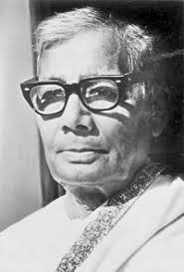
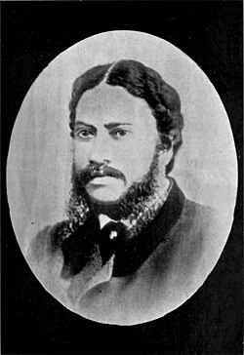
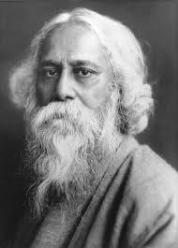
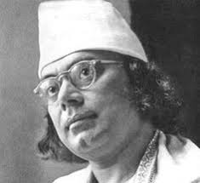
(Jasim Uddin :1903-1976)
(Michael Madhusudan Dutt :1824 – 1873)
(Rabindranath Tagore:1861-1941)
Kazi Nazrul Islam: 1306 -1976)

Slide 5
কপোতাক্ষ নদ (চতুর্দশপদী কবিতাবলী)
মাইকেল মধুসূদন দত্ত
সতত, হে নদ, তুমি পড় মোর মনে |
সতত তোমার কথা ভাবি এ বিরলে ;
সতত ( যেমতি লোক নিশার স্বপনে
শোনে মায়া-যন্ত্রধ্বনি) তব কলকলে
জুড়াই এ কান আমি ভ্রান্তির ছলনে!---
বহু দেশে দেখিয়াছি বহু নদ-দলে,
কিন্তু এ স্নেহের তৃষ্ণা মিটে কার জলে?
দুগ্ধ-স্রোতোরূপী তুমি জন্ম-ভূমি-স্তনে!

Slide 6
*Introducing the poet:
Michael Madhusudan Dutt ; 25 January 1824 – 29 June 1873) was a Bengali poet and playwright. He is considered one of the pioneers of Bengali literature.
Madhusudan was born in Sagardari, a village in Keshabpur Upazila, Jessore District of Bengal to a Hindui family. His father was Rajnarayan Dutt and his mother was Jahnabi Devi. He wants to be a Englishman from his early age in form and manner.
* Read the passage from the book.

Slide 7
vocabulary
Words | Bengali meaning | Meaning | Synonym
Dramatist | নাট্যকার | a person who writes plays. | playwright
Aspire | আকাঙ্খা | direct one's hopes | hope
Sophisticated | অত্যাধুনিক | involving a great deal of worldly experience and knowledge of fashion and culture. | cultured
Adopted | গৃহীত | choose to take up | chosen

Slide 8
Home Work
Learn vocabulary with synonyms.
Read the passage with spelling.

Slide 9
Thank You very Much
for watching

