Slide 1


WELCOME

Slide 2
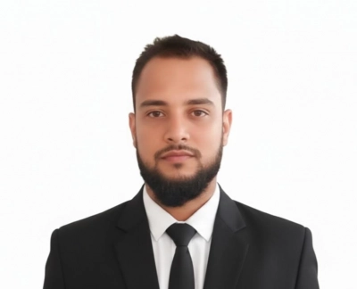
Introduction of the Teacher
ABU BOKUR SEDDIK
ASSISTANT TEACHER (ENGLISH) B.S.D GIRLS ALIM MADRASAH BANIACHONG,HOBIGONG
Mobile: 01917673360

Slide 3

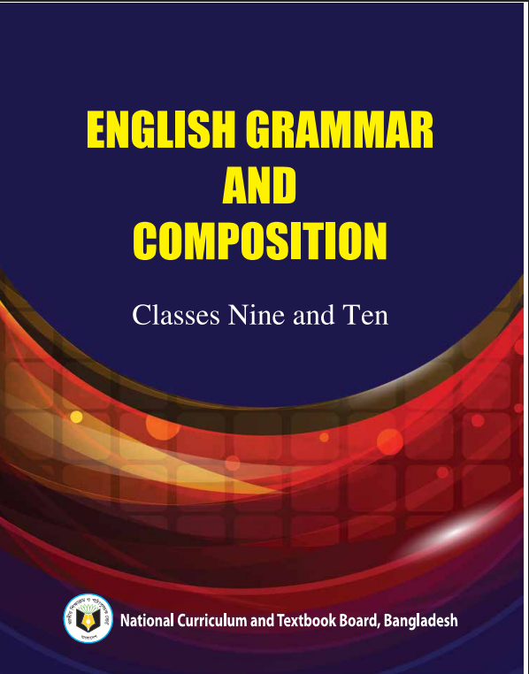
Introduction of Lesson
Class : Ten
Subject : English 2nd Paper
Unit : One
Lesson : 1
Time : 50 Minutes

Slide 4

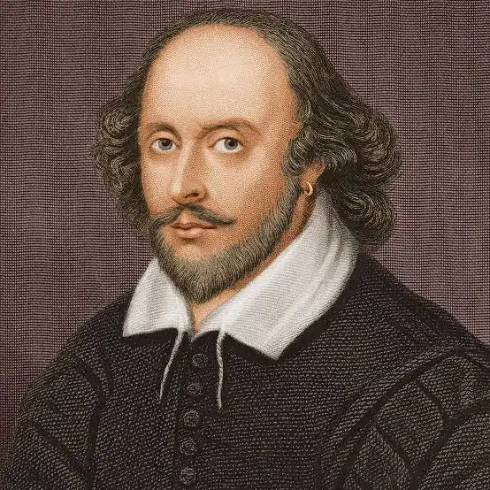
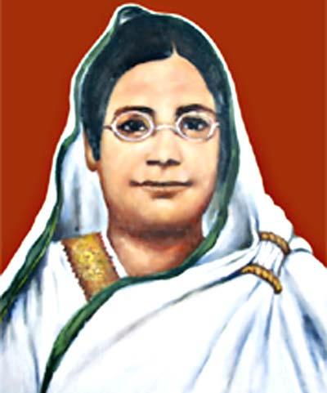
Look at the underlined words.
# Shakespeare was a greatest dramatist in
the world.
# Begum Rokeya was a famous writer and
a social worker.

Slide 5
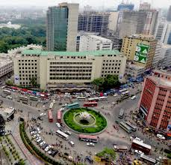
Look at the underlined words.
# Motijhil is the busiest city in Dhaka.
What do the underlined words refer to?
Name of different person or things

Slide 6

Today’s Lesson
Kinds of Noun

Slide 7
Learning Outcomes
-By the end of the lesson students will be able to…
say what a noun is.
identify noun in sentences.
-make sentences using nouns.

Slide 8
Activity: A
Read the following passage and notice the underlined words.
Shakespeare was born in1564 at Startfort-
upon-Avon in England. He was a poet,
playwright and actor. He is widely regarded
as one of the greatest writers in English and
the most prominent dramatists of the world.
He enjoys enormous popularity even in the
modern age for his plays and poems.

Slide 9
What the underline words?
Noun
A noun is a word that names a person, place, thing, idea, quality, or action.

Slide 10
Kinds of Noun
There are five kinds of Nouns in English. They are-
a) Proper noun
b) Common noun
c) Collective noun
d) Material noun
e) Abstract noun

Slide 11
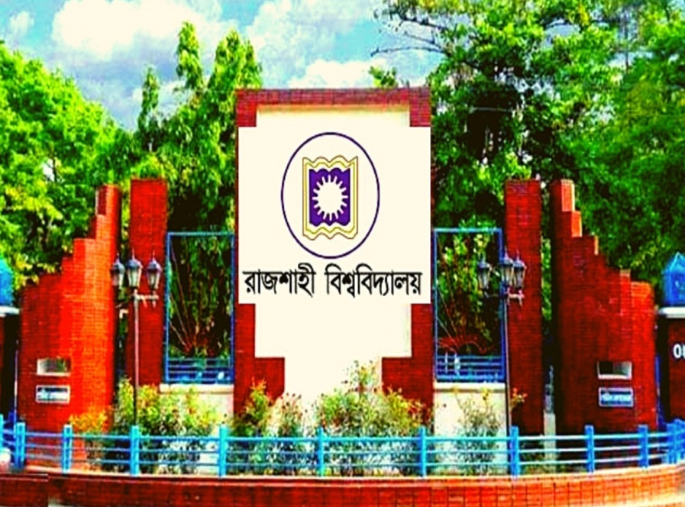
Activity: A1
Read the following passage and notice the underlined words.
Rajshahi is a divisional city in Bangladesh.
It is in the western part of the country.
It stands on the river Padma. My friend
Alamgir lives in this city. He is a professor
of History. I often visit him. He speaks good
English.

Slide 12

What do the underlined words refer to?
Proper Noun

Slide 13
Definition of Proper Noun
A proper noun is the name of a particular person, place or thing.
Example- ‘Rajshahi’ is the name of a particular city.

Slide 14

Students’ pair work
Now make sentences with the proper noun.

Slide 15
Check your answers.
a) Rajshahi is a beautiful city.
b) We love our motherland Bangladesh very much.
c) The Padma is one of the biggest rivers in Bangladesh.
d) My friend Alamgir is a nice person.
e) We all should know the history of our Liberation war.
f) More than 400 million people speak English as a native
language.

Slide 16
Home Work
Make a list of Proper nouns and make sentences with those noun.

Slide 17

Thank you Everybody

