Slide 1


Slide 2
পরিচিতি
শিক্ষক পরিচিতি
নামঃ শারমিন সুলতানা
পদবীঃসহকারী ইংরেজী শিক্ষক
প্রতিষ্ঠানঃ দক্ষিন ঘাটলাবাগ মহিলা দাখিল মাদ্রাসা
উপজেলাঃ চাটখিল
জেলাঃ নোয়াখালী
ফোন নাম্বারঃ01869966439
শ্রেণি পরিচিতি
শ্রেণিঃ ৭ম
বিষয় ঃইংরেজি
অধ্যায়ঃ ৫ম
পর্রিচ্ছেদঃ ১ম
সময়ঃ ৪০ মিনিট

Slide 3


Slide 4
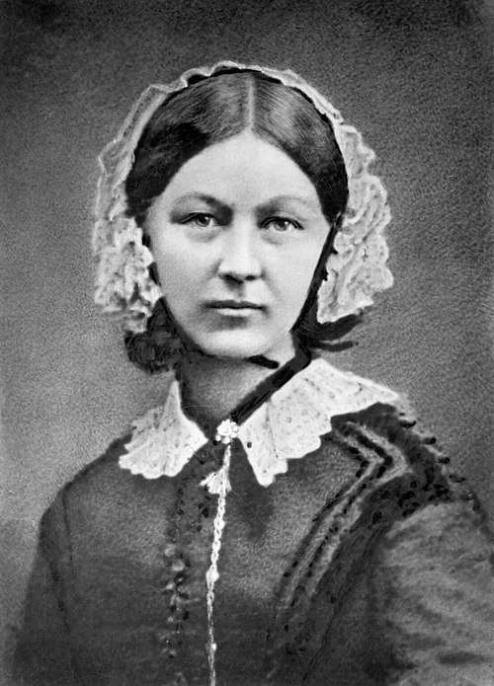
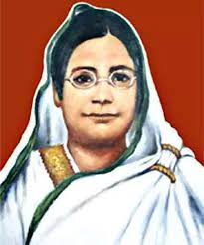
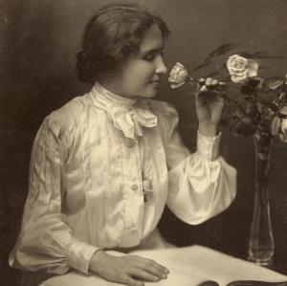
Some picture of greatest Women

Slide 5
Learning Outcomes
After we have studied this unit , we will be able to
.Tell the meaning of new words
Read and understand texts correctly.
Write short paragraphs and compositions on Begum Rokeya.

Slide 6
Synonyms
Village= Rural
2. Encourage = Support
3.Communication=Exchange
4. Famous= well known
5. Cooperative=Helpful

Slide 7
Great Women to Remember
Look at the picture . Ask and answer these questions.
1.who is the women?
Ans : Begum Rokeya
Born;1880
Birthplace; Pairabond,
Rangpur
b

Slide 8
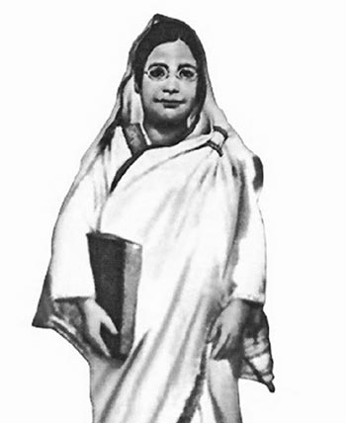
Education : She had no institutional education
She learnt Bangla and English from her elder brother Ibrahim

Slide 9
She got married in 1896 to Khan Bahadur Sakhawat Hussain

Slide 10
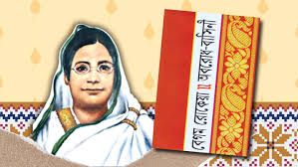
She is a great writer.

Slide 11
Died
She was died in 1932 and buried in Pairabondh ,Rangpur.

Slide 12
Group work
Group A: Complete the chart given in the text section ,D
Group B:Write about her education

Slide 13
EVALUATION
1.What is the name of Begum Rokeyas birth place?
2.How did she learn Bangla and English?
3.

Slide 14


