Slide 1

Welcome to the Class

Slide 2

Introduction
Jakirul Islam
Assistant Teacher, English
Karakhanda Dakhil Madrasha
Bagmara, Rajshahi
Contact: 01763908832
Subject: English Second Paper
Class: Ten
Topic: Tense
Time: 10 AM to 11 AM
Date: 17/01/2026

Slide 3
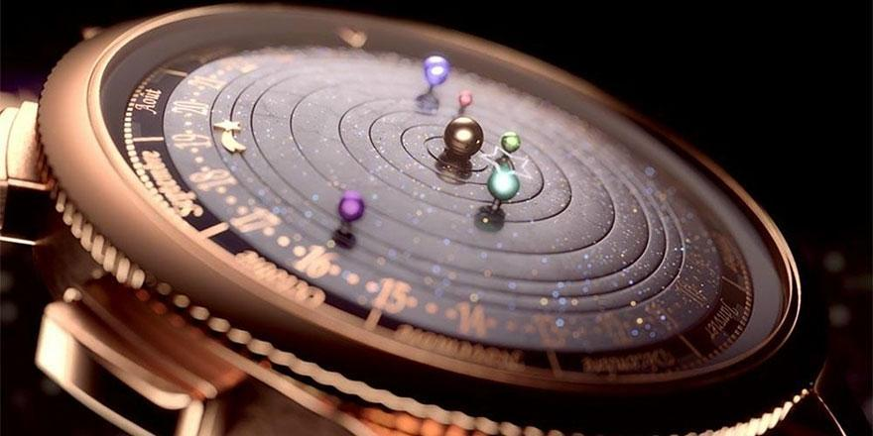

Time

Slide 4


Tense and It’s Classification

Slide 5

Learning Outcomes
Students will be able to know what Tense is.
Students will be able to know how many types of tense there are.

Slide 6
Tense
In English Grammar Tense is used to refer to time of an action or event.
Tense is the concept of time which may be present, past or future.
কোন কাজ সম্পাদনের সময়কে tense বা কাল বলে। Tense দ্বারা সময়কে উল্লেখ করা হয় এবং যা বর্তমান, অতীত কিংবা ভবিষ্যত হতে পারে।
Example:- I eat rice. (present)
- I ate rice. (past)
- I will eat rice. (future)
এখানে উপরের বাক্য গুলোতে যথাক্রমে বর্তমান, অতীত ও ভবিষ্যৎ কাজের কথা নির্দেশ করে।

Slide 7
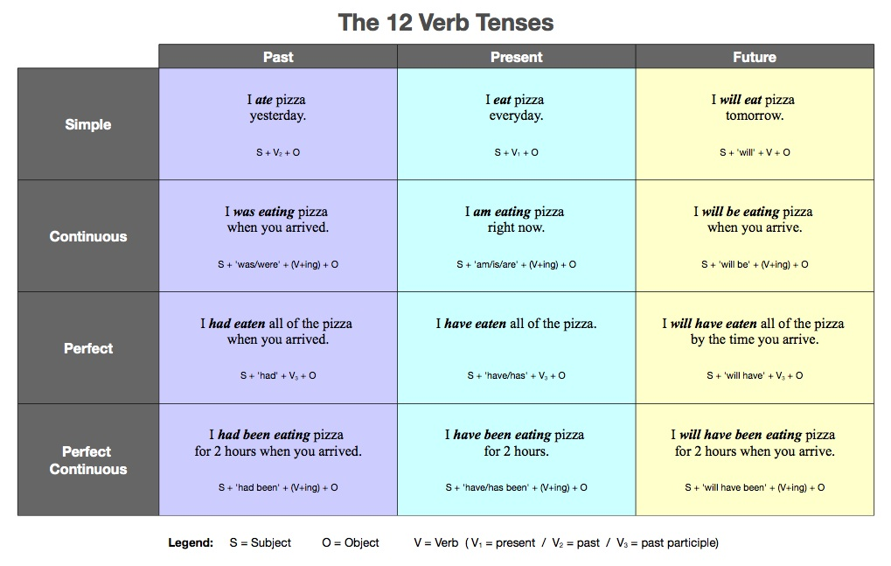


Slide 8
Group Work
Find out at least four Examples of Every Tense

Slide 9
Evaluation
*What is Tense?
*What are the Tenses?
*Give Example

Slide 10

Find out at least three examples of every tense
Other Example

Slide 11


