Slide 1

Well come

Slide 2
পরিচিতি
নামঃআব্দুল মোতালেব
পদবিঃসহকারি শিক্ষক
প্রতিষ্ঠানঃদক্ষিন ঘাটলাবাগ মহিলা মাদ্রাসা
উপজেলাঃচাটখিল
জেলাঃনোয়াখালি
মোবাইলঃ০১৭৯৪১১০১২৮
ইমেইলঃabdulmotaleb550@gamil.com
শ্রেণীঃ৭ম
বিষয়ঃইংরেজি
অধ্যায়ঃ১
পরিচ্ছেদঃ১
সময়ঃ৪০

Slide 3

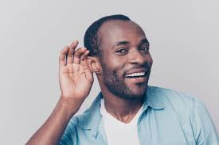
Hear the voice
mike

Slide 4
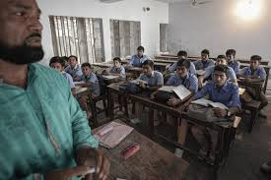
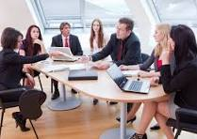
Attention, please
Class room
Metting place

Slide 5
Learning outcomes
At the end of this lesson students……..
1.can tell about attention
2.Can write about attention
3.description and explanation of attention
4.Can analyze

Slide 6
Class room
Hear of voice
mike
The teacher is teacheing in the classroom and all the students are listening to the teacher
A preson is listenting to something with interesting
Announcing with a microphone

Slide 7
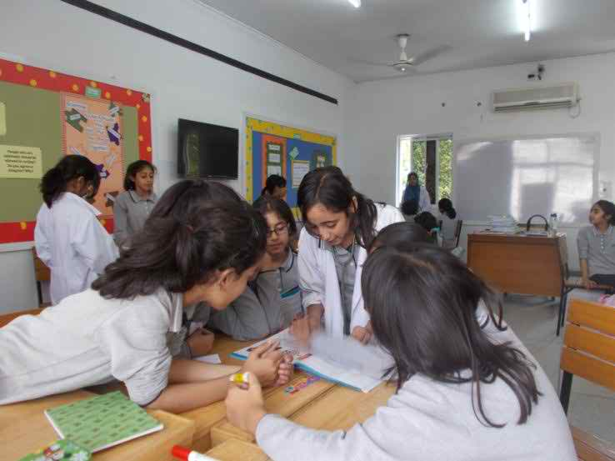
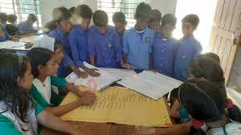
1.What are the specific responsibilities of each of us in this work?
2.What steps do we need to achieve it?

Slide 8
Evaluation
1.To build a peaceful and tidy atomosphere for improving ateention?
2.Need to improve our relationship with each other ?
3.You need to pay more attention to what the teacher says?

Slide 9

1.What is attention?
2.Class attention means?
3.Group work means?

Slide 10
Thank you all of my students

