Slide 1


WELCOME

Slide 2



IN TRODUCE
BANBIS
DEEN ISLAM (ASSISTANT TEACHER)
ENGLISH
WAZUDDIN FOUNDATION TRUST DAKHRIL MADARASAH.
GOURIPUR, DAUDKANDI,CUMILLA
EMAIL-DEEN6079@GMAIL.COM
MOBILE -01568439793

Slide 3

Today’s teaching topic
sentence
What is sentence ?
How many types of sentece?

Slide 4
A sentence is a group of words giving a complete thought. A sentence must contain a subject and a verb (although one may be implied). For example
There are five types of sentence
Assertive sentence
Interrogative sentence
Imperative sentence
Optative sentence
Exclaimatory sentence

Slide 5
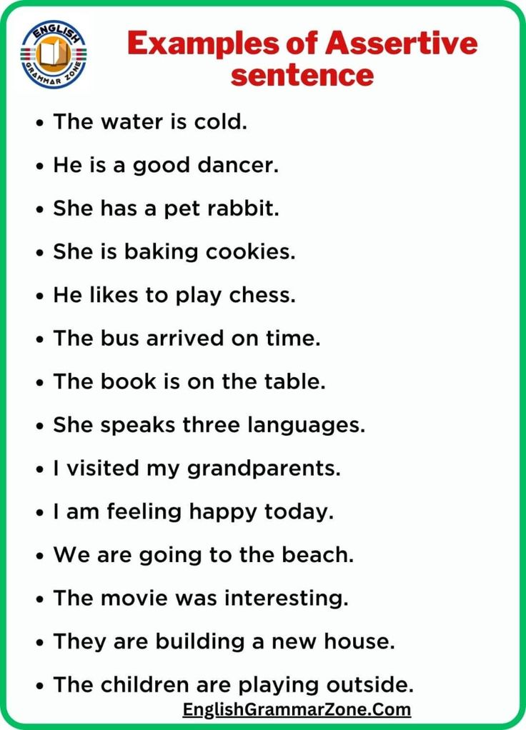
Definition of Assertive sentence.
- An assertive sentence is a sentence that makes a statement or that will describe something to be true or we can say an assertive sentence is a statement or an opinion with confidence and certainty

Slide 6
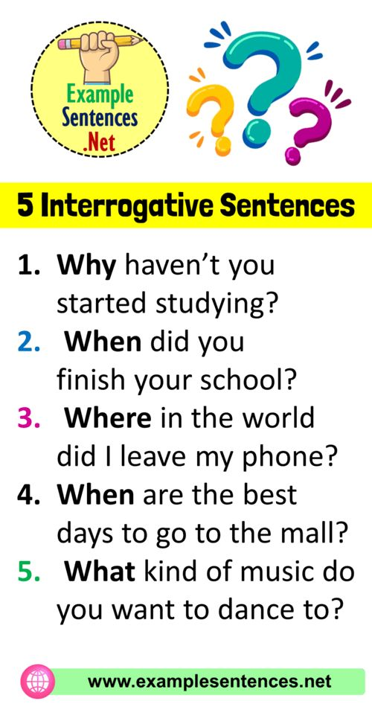
DEFINITION OF INTERROGATIVE SENTENCE
An interrogative sentence is a type of sentence that asks a direct question and requests information. It always concludes with a question mark (?) rather than a period

Slide 7
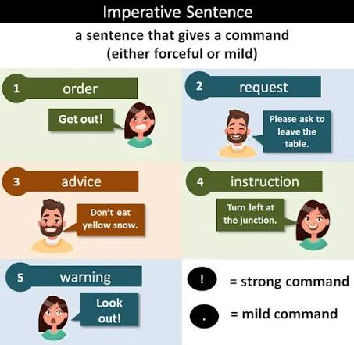
Definition of imperative Sentence
An imperative sentence gives a command, makes a request, offers advice, or issues an instruction. It typically omits the subject "you," which is implied, and starts directly with the base form of a verb.

Slide 8
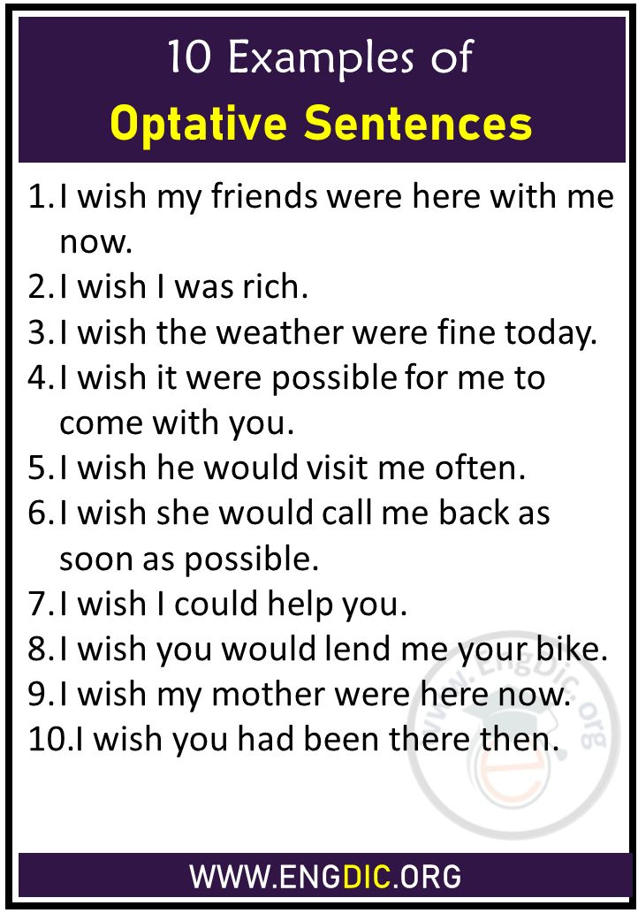
Definition of Optative Sentence
An optative sentence is a type of sentence that expresses a wish, hope, desire, prayer, blessing, or curse. According to Merriam-Webster, it is a sentence structure expressive of a wish or hope

Slide 9
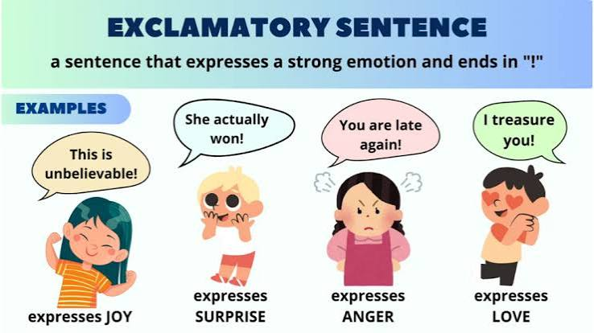
Last one Exclaimatory Sentence
An exclamatory sentence is a statement that expresses strong emotion—such as surprise, joy, anger, or excitement—and always ends with an exclamation mark (!) rather than a period. It is one of the four main types of sentences in English

Slide 10
Home work
Sentence in details write and commit to memory

Slide 11
Thanks all
Take care yourselves

