Slide 1


Good Morning

Slide 2

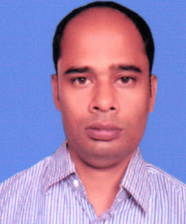
TEACHER’S INFORMATION:
Nittananda Shaha
ASSISTANT TEACHER
SABOIL GOVT. PRIMARY
SCHOOL
MOHADEBPUR, NAOGAON

Slide 3
Lesson Introduction
Class :5
Unit :13
Title : Quality Time Together
Page : 69-73 ( Activity : 1.1, 2.1, 2.2,2.3,3.1,3.1.1,4.1)

Slide 4
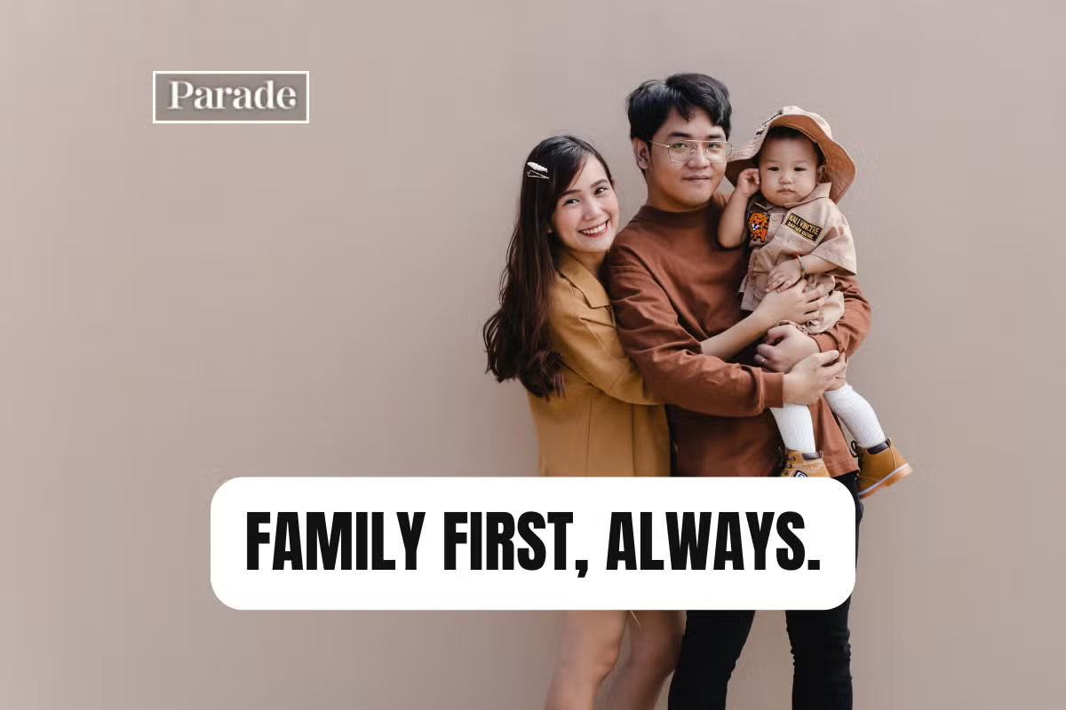
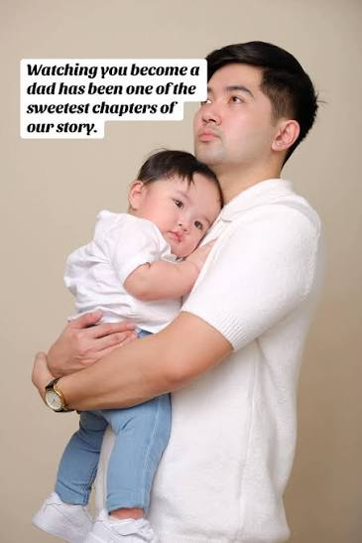

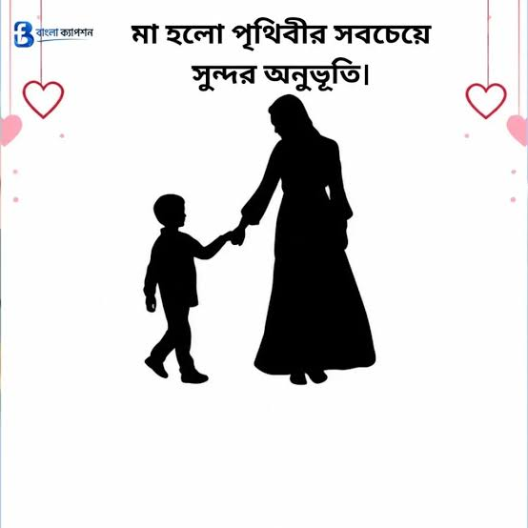

Slide 5
I will ask some questions like:
1)What do you see in these picturs?
2) Can you say aboyt your family?

Slide 6
Announcement of the Lesson
Quality Time Together
Write out in your khata

Slide 7
Vocabulery
Word
Meening
twins
two children born at the same time to the same mother
parents
Father and mother
special
something is distinct, exceptional, or designed for a specific purpose
relative
Who belongs to your family
Turned it on
Switched it on
surprised
Feeling unexpected wonder
exciting
Making you very happy

Slide 8
replied
To give answar
grumpy
easily annoyed or unhappy
angry
Feeling mad or upset

Slide 9
1.1 Read the following story.
Naima and Masuk were twins . They were in Class Five. Naima loved to play badminton and Masuk loved to play football . They were also very good students at school. Their parents, Naeem Hasan and Mina Begum, loved them very much. Naima and Masuk often played with their parents when they had free time. Their home was always full of happiness!

Slide 10
One day, a special box arrived. It was from their close relative, Mr. Rakib, who lived in Italy. There was a black tablet inside the box . When they turned it on , the screen showed many bright coloures .”Wow!” They were both surprised.
At first, the tablet was so much fun. They played video games after finishing their study. And soon, the tablet became more exciting than playing outside. ‘Naima ! Masuk !’ their friend Rana called from the gate. ‘Let's play!’

Slide 11
‘Not now!’ Naima replied. Her eyes were stuck to a YouTube video. Masuk was also watching the video with his sister.
The twins slowly started to change. Often they became grumpy and got angry. “Time for dinner!” their mom called one evening. “Just five more minutes, Ma!’ Masuk shouted. His voice was sharp and annoying. Mother noticed it and took the tablet away. Then, Masuk started to cry. ‘You're so unfair!’ he screamed.

Slide 12
The situation became worse. At night, they couldn't sleep properly. Naima rubbed her eyes all the time, and Masuk felt sleepy all day long. Their parents, Naeem Hasan and Mina Begum were very worried and unhappy.They understood that their children were spending too much time on screens. So, they decided to talk to Naima and Masuk.

Slide 13
‘This tablet is wasting your precious time,’ their dad said softly. ‘It's taking away your sleep , affecting your school work and keeping you away from your friends.’ The twins saw the sadness in their parents' eyes. They felt ashamed. They realised that they were using the tablet too much and became tired and grumpy.

Slide 14
Then, they promised not to use the tablet without their parents’ permission. Every weekend, the family members used to sit together and shared funny stories. Naima and Masuk also started playing outside with their friends again . Their home became full of joy!

Slide 15
2.1 Match the words from Column A with their meanings in
Column B.
Words | Meanings
i) twins | a) to feel bad or embarrassed about something
ii) tablet | b) To tell someone that you will definitely do something
iii) grumpy | c) two children born at the same time to the same mother
iv) ashamed | d) a device with a screen used for connecting to the internet, watching videos, reading books etc.
v) promise | e) easily annoyed or unhappy
i) twins
c) two children born at the same time to the same mother
ii) tablet
d) a device with a screen used for connecting to the internet, watching videos, reading books etc.
iii) grumpy
e) easily annoyed or unhappy
iv) ashamed
a) to feel bad or embarrassed about something
v) promise
b) To tell someone that you will definitely do something

Slide 16
2.2 Resd the story carefully and fill in the blanks with the correct words.
grumpy, YouTube, screen, stories, ashamed
YouTube
a) When their friend Rana called, Naima’s eyes were stuck to a_________ video.
grumpy
b) The twins became _________ and angry very easily because of their addiction to the tablet.
screen
c) Their parents realised that their children were spending too much time on the _________ .
ashamed
d) Naima and Masuk felt _________ when their dad talked to them.
stories
e) The family members sat together, shared funny _________.

Slide 17
2.3 Ask and answer the following questions. Then write the
answers in the exercise book.
a) Where did Mr.Rakib live?
Mr.Rakib lived in Italy.
b) Why were Naima and Masuk surprised when they turned on the tablet?
They were both surprised because of it’s bright colours .
c) How did the twin's behaviour change after they started using the tablet?
The twin's behaviour changed slowly after they started using the tablet . They became grumpy and angry.

Slide 18
d)What were the main problems faced by Naima and Masuk using the tablet too much?
The main problems faced by Naima and Masuk using the tablet too much were wasting their precious time, taking away their sleep , affecting their school work and keeping them away from their friends.’
e)Imagine , you are what you Naima and Masuk. Write tow sentences about what would like to do in your free time now.
If I were Naima and Masuk ,I would like to spend my free time playing outside with my friends.

Slide 19
3.1 Language Focus : Prefix and Suffix
Prefix
Root word with meaning
Suffix
Newly formed word with meaning
un
Happy(joyful)
Unhappy(sad)
Singer
(who sing)
Sing(to sing)
er
Agree
(accept)
Disagreement
(difference of opinion)
dis
ment
More examples: Using Prefix: dislike, upload, rewrite, incomplete
Using Suffix: sadness, sleepy, helpful, quickly

Slide 20
3.1.1 Choose prefixes and suffixes from the box . And make new words from the words below. The first one is done for you.
prefixes | suffixes
Un,re,ir,dis | Al , cal , ly ,ment , tion, ed, er , ier , est , ness
a) happy : unhappy, happily, happiness
b) magic
c) agree
d) create
e) appear
f) act

Slide 21
4.1 Work in groups. Search for the word with prefixes and suffixes in your English for Today textbook. Now , make a list and discuss their meanings.

Slide 22

T
H
A
N
K
Y
O
u

