Slide 1
ASSALAMU ALAIKUM
WELCOME EVERYONE

Slide 2

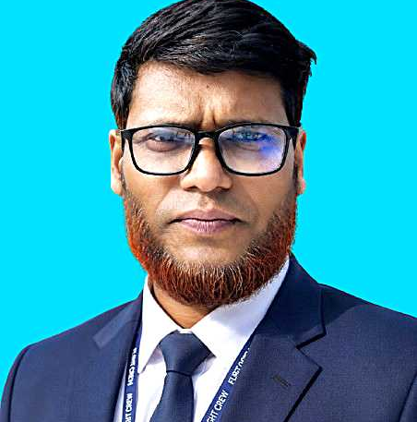
TEACHER’S IDENTITY
ABU ISHAQUE M.A. MED. (ENGLISH)
ASSISTANT TEACHER
ID NO-25, ENGLISH 1st BATCH CTG. DIVISION

Slide 3

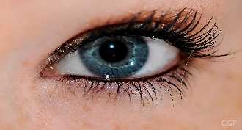
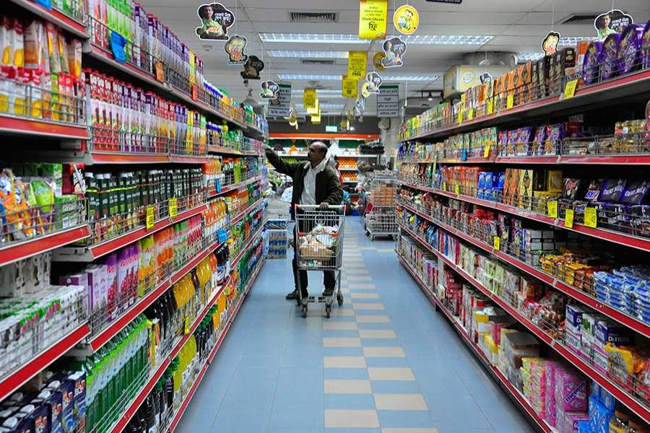
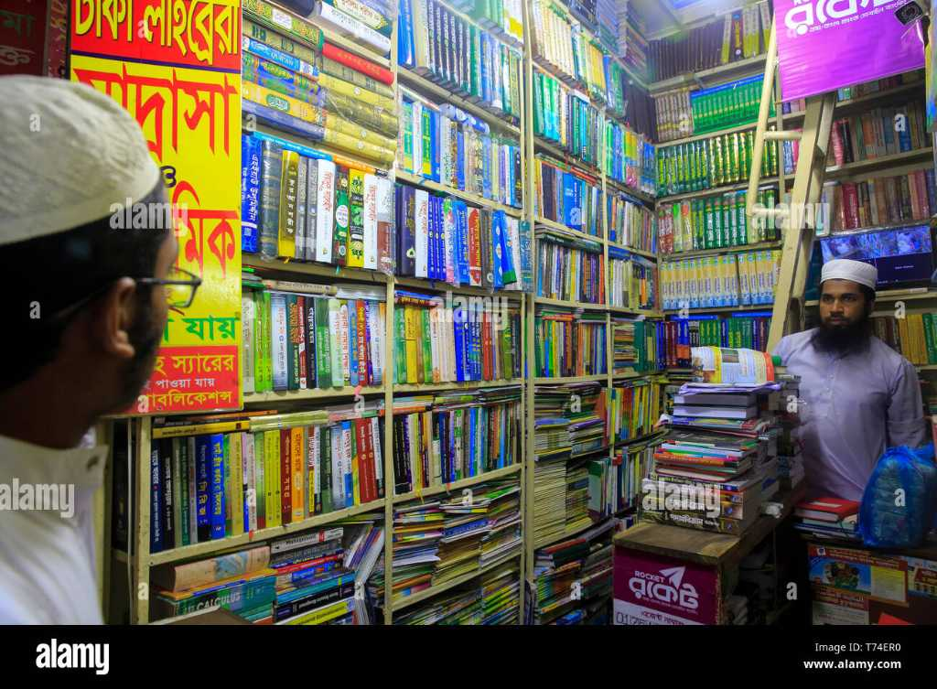
LOOK AT THE PICTURES
1.
2.
A SUPER SHOP
A BOOK SHOP

Slide 4
THE LESSON OF THE DAY.
A BOOK SHOP
SUBJECT- ENGLISH FOR TODAY
CLASS- SEVEN UNIT- ONE LESSON- 05
PAGE- 07

Slide 5

LEARNING OUTCOMES
By the end of the lesson, the learners will be able to…`
1
talk about the pictures.
2
Know the meaning of some new words.
3
listen audio and choose the correct answer.
4
play a role for conversation with a shop keeper.

Slide 6

Dictionary
Meaning:
a book giving the meaning and usually the pronunciation of words listed in alphabetical order .
I have a Oxford Dictionary.

Slide 7

Out of stock
It’s not in the store more.
That mobile phone is out of stock.

Slide 8

In stock
It’s avaiable in the store.
Or
It is not finished.
That phone is in stock.
The book is in the stock.

Slide 9


Listen to the audio and choose the best option ..

Slide 10
01. Which book did the boy want?
ABC
MATH
NOVEL
LEARNER’S

Slide 11
02. Which one is equally good?
WRITER DICTIONARY
ABC DICTIONARY
DICTIONARY
LEARNER’S DICTIONARY

Slide 12
03. Which one is equally good?
WRITER
LEARNER’S
NOVEL
ABC

Slide 13
03. Who told sure?
RAFIQ
RONEY
SELLSMAN
AZAD

Slide 14
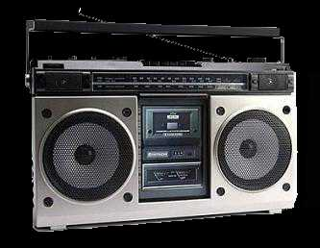

Listen to the audio again and play a role with your friend who is beside you to buy a pen from a sells man ..

Slide 15
Homework
Write a conversation between you and your mother to buy a new shirt..
Notes:
Tommorow you will submit a conversation copy with your mother to buy a new shirt for the Eid Ul Azha.

Slide 16
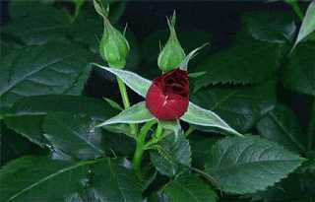
THAT’S ALL FOR TODAY.
Notes:
I would like to end here with advance greetings on Eid-ul-Azha, may Allah bless you .

