Slide 1


Slide 2


Slide 3
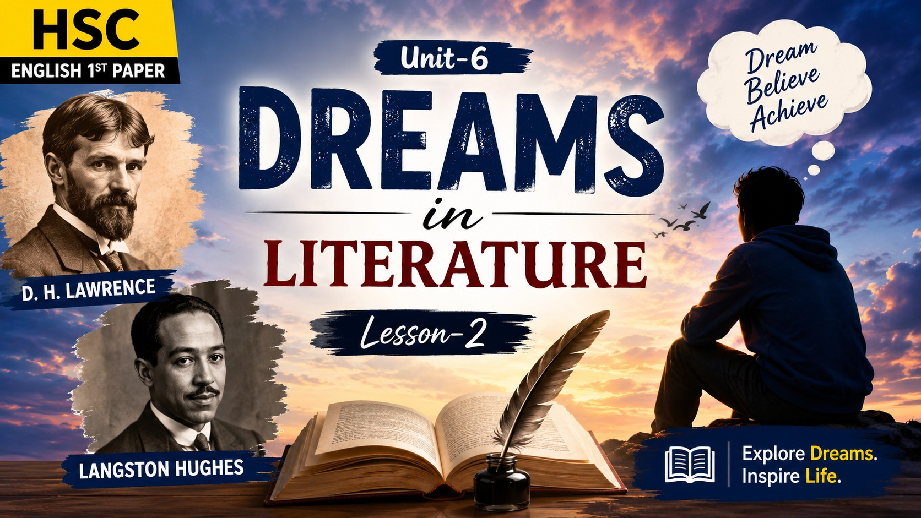

Slide 4

Lesson-2:
Dreams in Literature

Slide 5
Learning Outcomes
Identify the main ideas and themes of the poems Dreams by D. H. Lawrence and Langston Hughes.
Explain how dreams inspire hope, purpose, creativity, and success in human life.
Compare and contrast the messages, imagery, and literary techniques used by the two poets.
Develop critical thinking by participating in discussions and expressing personal opinions about the importance of dreams.

Slide 6
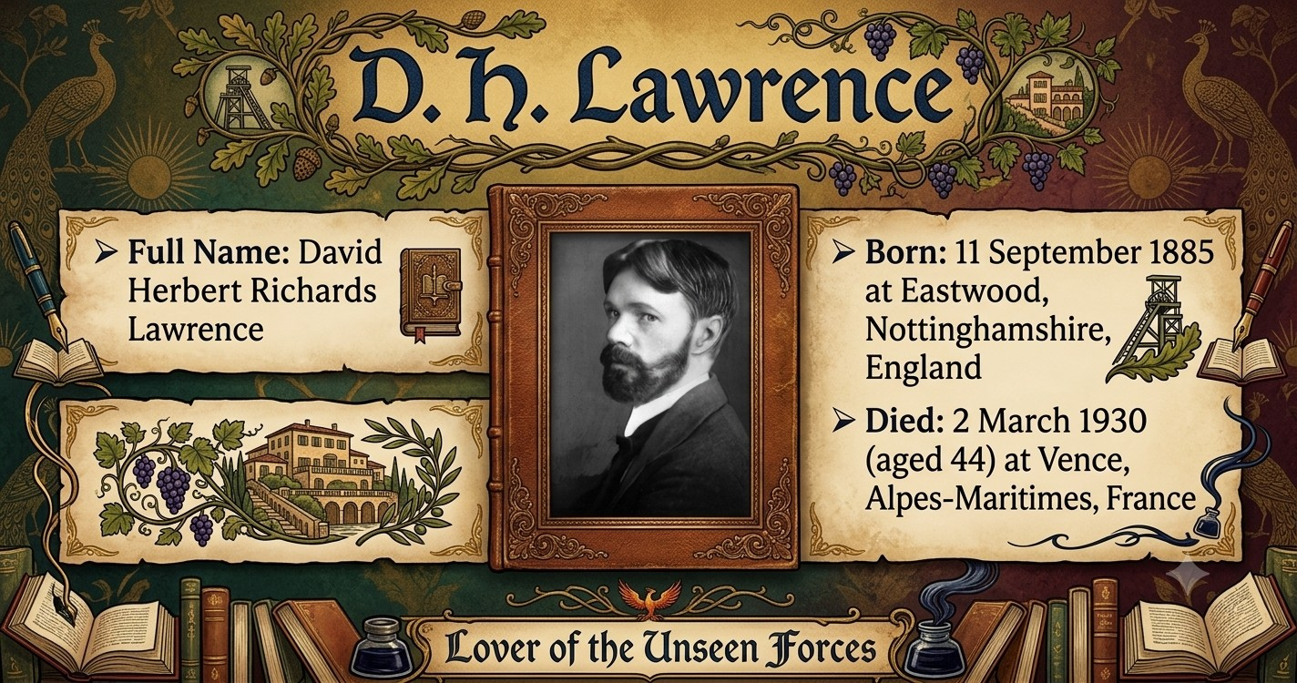

Slide 7
Dreams
- D. H. Lawrence
All people dream, but not equally.
Those who dream by night in the dusty recesses of their mind,
Wake in the morning to find that it was vanity.
But the dreamers of the day are dangerous people,
For they dream their dreams with open eyes,
And make them come true.

Slide 8
Theme
The poem “Dreams” by D. H. Lawrence highlights the essential role of dreams in giving direction, energy, and meaning to human life. Lawrence suggests that dreams lift us beyond the limitations of ordinary reality and help us rise above fear, sadness, and uncertainty. Without dreams, life becomes dull, empty, and mechanical. Dreams inspire hope, encourage creativity, and nourish the inner spirit. They act as a powerful force that keeps us moving forward and makes life worthwhile.

Slide 9
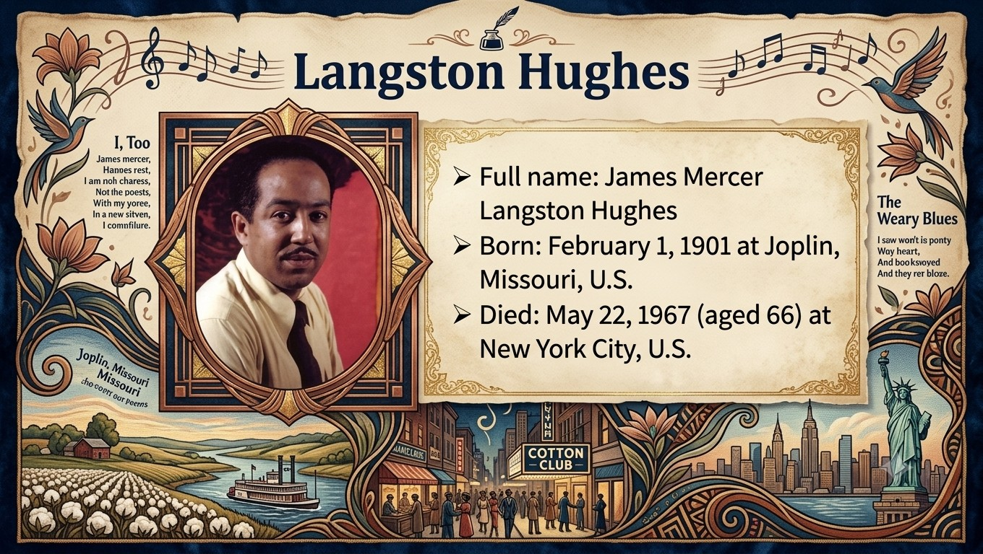

Slide 10
Dreams
- Langston Hughes
Hold fast to dreams
For if dreams die
Life is a broken-winged bird
That cannot fly.
For when dreams go
Life is a barren field
Frozen with snow.
Hold fast to dreams

Slide 11
Theme
The poem “Dreams” by Langston Hughes emphasizes the necessity of holding onto dreams because they give life purpose, hope, and direction. Hughes warns that when dreams die, life becomes empty, broken, and without movement—like a “broken-winged bird” or a “barren field.” Dreams represent aspirations, goals, and the inner motivation that makes life meaningful. By urging readers to cling to their dreams, the poem highlights how dreams shape our future and keep our spirits alive.

Slide 12
GROUP DISCUSSION
Discuss critical analysis of the poem

Slide 13

Write a paragraph on “Dream”

Slide 14


