Slide 1


Good Morning

Slide 2
Teacher Information
Sonnashe kumer pall
Head Teacher
Goraitupi Govt Primary School.
Chuadanga sadar, chuadanga
Sonnashe kumer pall
I am yourEnglish Teacher

Slide 3
LESSON INTRODUCTION
Class: Five
Subject: English
Title of the lesson: Unit- 11
Part of the lesson : 3.1
Date: 05.07.2026

Slide 4
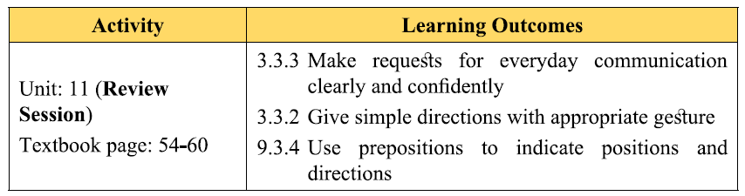
Learning outcomes:
After this lesson the students will be able -

Slide 5

Dear students, look at the picture

Slide 6
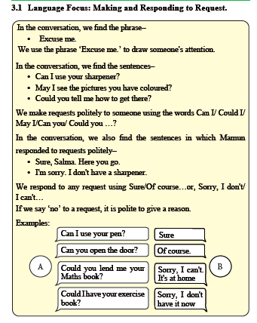
PRESENTATION

Slide 7

Can I use your pen?
Sure.
Can you open the door?
Of course.
Could you lendme your maths book?
Sorry, I can`t It`s at home.
Could I have your exercise book?
Sorry, I don`t have it now.

Slide 8
You want a glass of water from someone.
Could you give me a glass of water please?
Request
Sure here it is .
Respond
You want someone to open the door.
Could you open the door please?
Request
Sorry I can no`t it`s too high.
Respond
You want someone to open the door.

Slide 9
You want someone to close the window.
Could you colse the window please?
Sorry I can`t I am too busy tp do that.
Could you give me toy please?
Sure here it is .
Could you give me your phone number please?

Slide 10
Introduce
পরিচয় করানো
ছুটি
Holiday
দেখা হওয়া
Meeting
leaving
ছেড়ে যাবে
Journey
ভ্রমন
Really
সত্যি

Slide 11
Student Reading GW
Student Reading PW

Slide 12
Student Reading PW
Where is Jessica going?
Where is sima from?

Slide 13
Students group reading
Hi I’m…..
Hello I’m…… and I’m from…..

Slide 14
SS` pair and individual reading
Nice meeting you. Take Care .See you
Bye! Nice Meeting you”
Bye! Nice Meeting you,too”

Slide 15
Silent Reading

Slide 16
Evaluation
Where is Jessica going?
Where is sima from?

Slide 17
One day one word
Across
আড়াআড়ি/ অপরপাড়ে
The cat run across the road

Slide 18

Good bye

