Slide 1

Good Morning

Slide 2
Teachers’ Identity
Sonnashe kumer Pal
Head Teacher
Goraitupi Govt. Primary School.
Chuadanga sadar, Chuadanga.

Slide 3
Lesson Introduction
Class :5
Unit :12
Title : Eating Healthy
Page : 61,62 ( Activity : 1.1, 1.2, 2.1)

Slide 4
Learning Outcome
3.4.1 Ask simple questions on familiar topics.
3.4.2 Answer simple questions appropriately and confidently.
4.2.1 Read aloud texts with proper stress intonation.

Slide 5
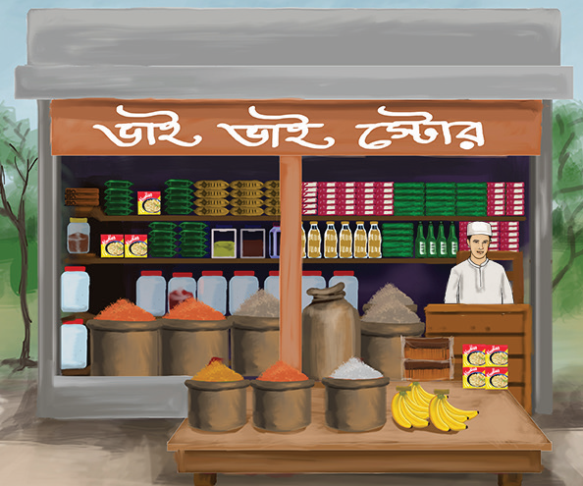

Slide 6
I will ask some questions like:
1)Have you ever bought anything from a store?
2) What did you buy from a store?

Slide 7
Announcement of the Lesson
Eating Healthy

Slide 8
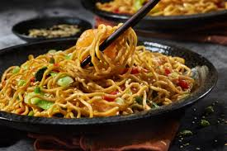
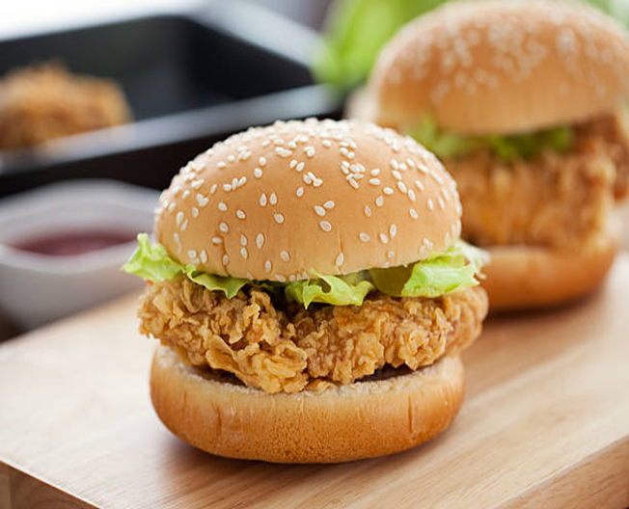
1.2 Read the following conversation.
Shihab : It’s tiffin time. Let’s eat together.
Sarah: Sure. Who else like to join us ?
Mong : Let’s sit over there to enjoy our tiffin.
Sarah : Noodles again ! I wish to have a chicken burger for tiffin everyday.

Slide 9
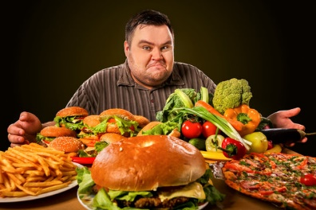
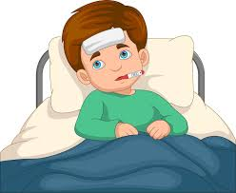
Mong : If you eat them regularly you’ll get fat and sick.
Shihab: Mong is quite reasonable. You shouldn’t eat them too often, Sarah.

Slide 10
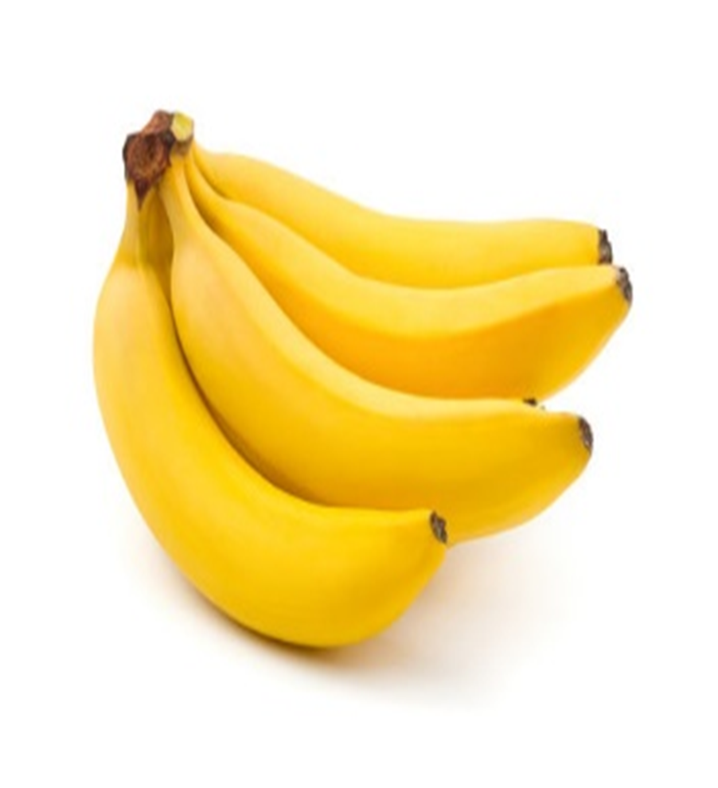
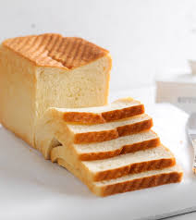
Mong : I have bread and banana today. My mother sometimes prepares new items for me.
Sarah : Oh ! This banana looks fresh. It has vitamins to give you energy.

Slide 11
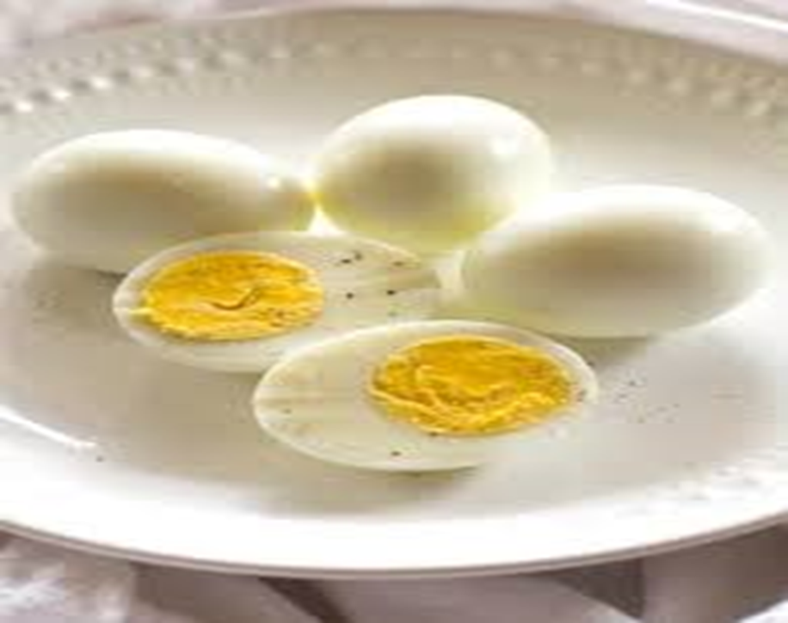
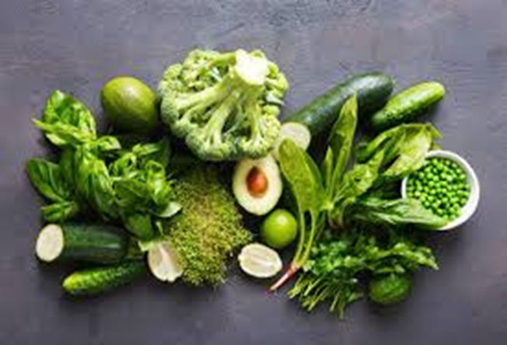
Mong : That’s right. By the way , your noodles with sliced eggs and green vegetables looks delicious .

Slide 12

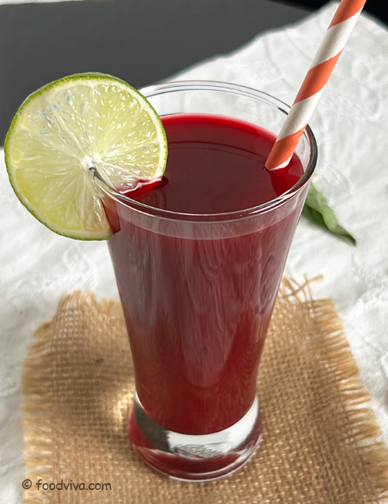
Shihab: Look ! I have sweet cake and juice for my tiffin.
Sarah: Don’t you think those sugary foods are harmful for our healthy?
Mong: Yes, I usually avoid junk food. You also should try.
Shihab: I know. But healthy foods are not always tasty.

Slide 13
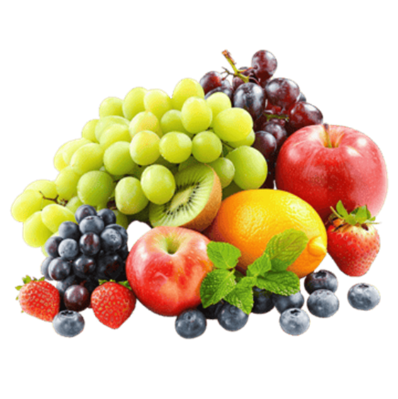

Mong : Really? I find fruits and vegetables tasty. You can also try them regularly.
Sarah: Yes, besides, we must wash foods properly before cooking.

Slide 14
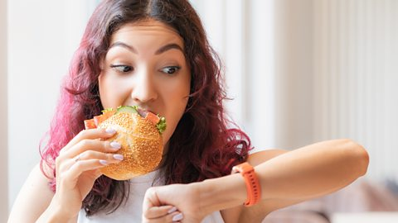
Mong : Oh, our tiffin break will be over soon. Let’s eat quickly.
Shihab: No, Mong, my mom says that eating hastily can cause digestion problems.
Mong: Yes. You are right. We should take time and eat slowly.
Sarah: Let’s finish and go back to the class.

Slide 15
Regularly
নিয়মিত
যৌক্তিক
Reasonable
সুস্বাদু
Delicious
Harmful
ক্ষতিকর
Properly
সঠিকভাবে
Digestion
পরিপাক

Slide 16
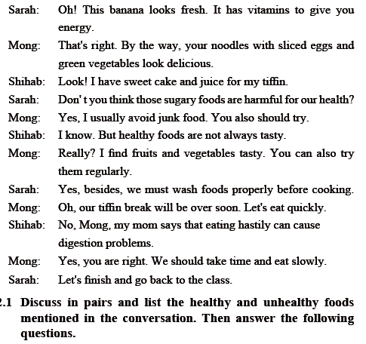

Slide 17
Discuss in pairs and list the healthy and unhealthy foods mentioned in the conversation.
Healthy foods | Unhealthy foods
Bread | Noodles
Banana | Chicken burger
Fruits | Sweet
Vegetables | Juice
Eggs | Cake
 | Sugary

Slide 18


