Slide 1
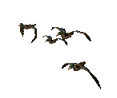


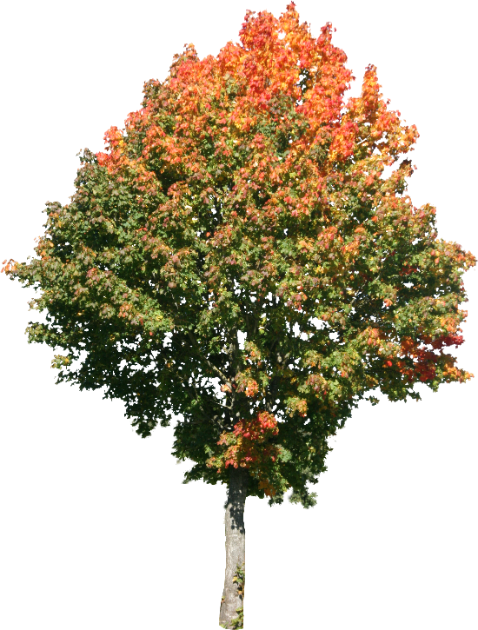
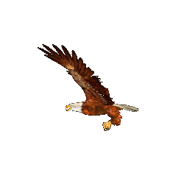
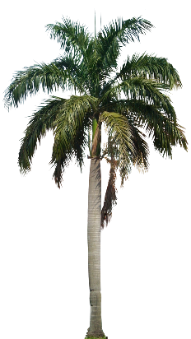


Good morning

Slide 2
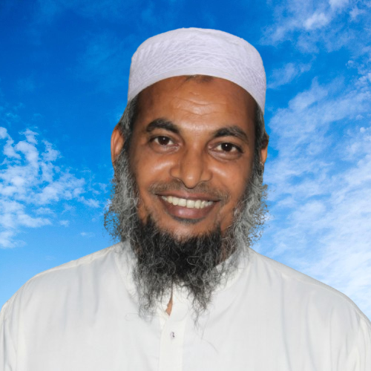
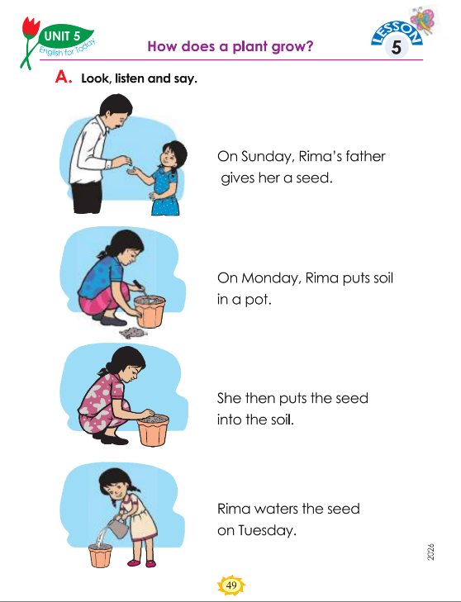

Identity
Teacher
Lesson
Dewan Rezaul Hassan
(Assistant Teacher)
Baropakhia Rothindrapara GPS
Delduar, Tangail.
E-mail:drezaulhassan@gmail.com
Class: Two
Subject: English
Unit:5:: Days in a Week
Lesson:5.How does a plant grow?, Session:48
Period:70, Activity: A, Page: 49
Heading: (How does a plant grow?)
Session 48: A

Slide 3
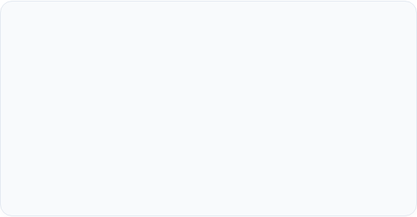
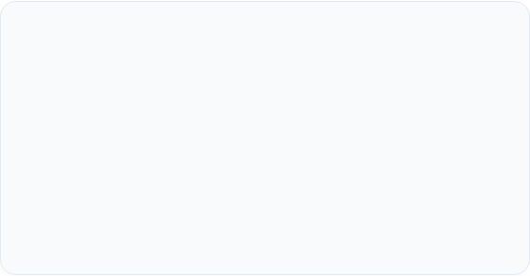
Learning & Session Overview
Key Learning Outcome
Teaching Materials & Aids
Lesson 5: How does a plant grow?
Page: 50
Session 48: A
Learning Outcomes:
8.1.1 Recognize familiar words in everyday conversations.
8.1.2 Use familiar words in everyday conversations.
Teaching aids: Pictures of activity A/audio/video clip, picture flashcards, text cards.
To deliver an engaging and interactive session
A colorful classroom calendar
English For Today Class 2 Textbook (Page 49)
Audio player/video clips (where possible)
Days of the Week visual cards
Baropakhia Rothindrapara GPS
Slide 2

Slide 4

Let’s listen and act with the rhyme “good morning”

Slide 5
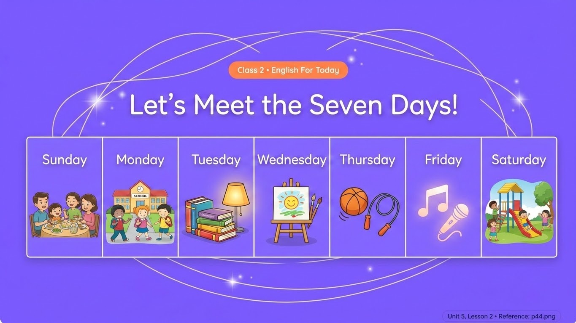
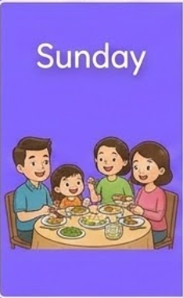







Slide 6
How Does a Plant Grow? 🌱
Let's learn Rima's planting story together!

Slide 7







Let's Warm Up: Action Mime! 🎭
Watch and Act! 👋
The Magic Garden Words 🪴
Look at your teacher! Can you mime these action words with proper gestures?
Read these everyday words out loud with your partner:
Give: Hand over an imaginary seed!
Put: Place something carefully inside a pot!
Water: Pour water from a watering can!

Slide 8








Rima's Storyboard: Step by Step! 📖
Point with your finger and track each word as we read!
Rima waters the seed on Tuesday.
Rima's father gives her a seed.
Rima puts soil into a pot.
She puts the seed into the soil.

Slide 9
Story Match Challenge! 🎯
Tap on the red "Reveal Word" buttons to finish each sentence together!
1. On Sunday, Rima's father gives her a ...
2. On Monday, Rima puts soil into a ...
3. Rima waters the seed on ...

Slide 10



Classroom Role-Play Time! 🎙️
Form teams of three! Grab your role card and speak with a confident smile!
Your lines:
Your lines:
Your lines:
"On Sunday, Rima's father gives her a seed..."
"Rima, here is a small seed for you. Plant it carefully!"
"Thank you, Father! I will put soil in a pot, plant it, and water it!"
"On Monday, Rima puts soil in a pot..."

Slide 11

Today's Star Board! ⭐
Awesome Goals | What I Can Do Cleanly! | My Star Level!
Retell Rima's Story | I can say the days of the week and tell how a plant grows! | 😊 😊 😊 Three Smiles!
Say Key Words | I can confidently recognize and name "soil", "seed", "pot", and "water"! | ⭐ ⭐ ⭐ Super Star!
Team Play | I proudly acted out the story during my classroom roleplay activity! | 🤝 🤝 🤝 Great Friend!

Slide 12



Let's Think Together! 🌳
Look Around You! 🏡
How Do Trees Grow? 🤔
Turn to your friend and talk about these questions:
What do plants need to grow up big, healthy, and strong?
Water from a can?
Have you seen trees around your house? What kind of trees are they?
Warm golden sunlight?
Good soil in a flower pot?

Slide 13










Meet Our Garden Friends! ☀️
Tap on each garden object to practice saying its name out loud!
a seed
a flower pot
the sun
a water can
a plant

Slide 14
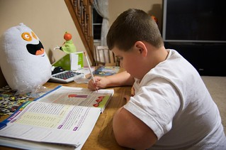
Home work
You will write five plants’ name in your khata.

Slide 15





Brilliant Job, Gardeners!
Thanks
for
watching?
You did an amazing job speaking, sequencing, and matching your English garden words today! See you next class! 👋🌿

