Slide 1


Slide 2


Slide 3

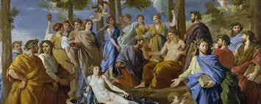
Unit 3:
Myths and Literature

Slide 4

Lesson-4
Khona

Slide 5
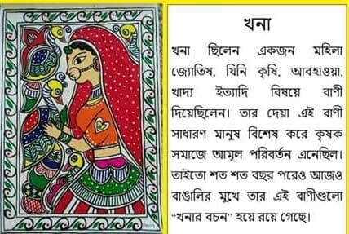

Slide 6
Khona
Jodi borshe magher shesh, dhonyi rajar punyi desh.
If it rains at the end of Magh (last month of Winter), the kingdom will prosper. The mystery (রহস্য) that connects seasons with soil and crops (ফসল) with rain was no secret to her. She realized the interdependence (পারস্পরিক নির্ভরতা) that links people and climate in myriad (অগণিত) ways. She was Khona.

Slide 7


Slide 8
The mythical (পৌরাণিক) story of Khona is deeply rooted (মূলীকৃত) in Bangla folklore (লোককাহিনী). Khona, originally named Lila, was an incredible woman with a gift for predicting (ভবিষ্যদ্বাণী করা) weather and understanding the ways of farming. Her wisdom was shared through memorable, rhyming verses known as "Khona's Words" or "Khonar Bochon." These sayings, though simple and easy to remember, were filled with deep knowledge and practical advice for farmers.

Slide 9
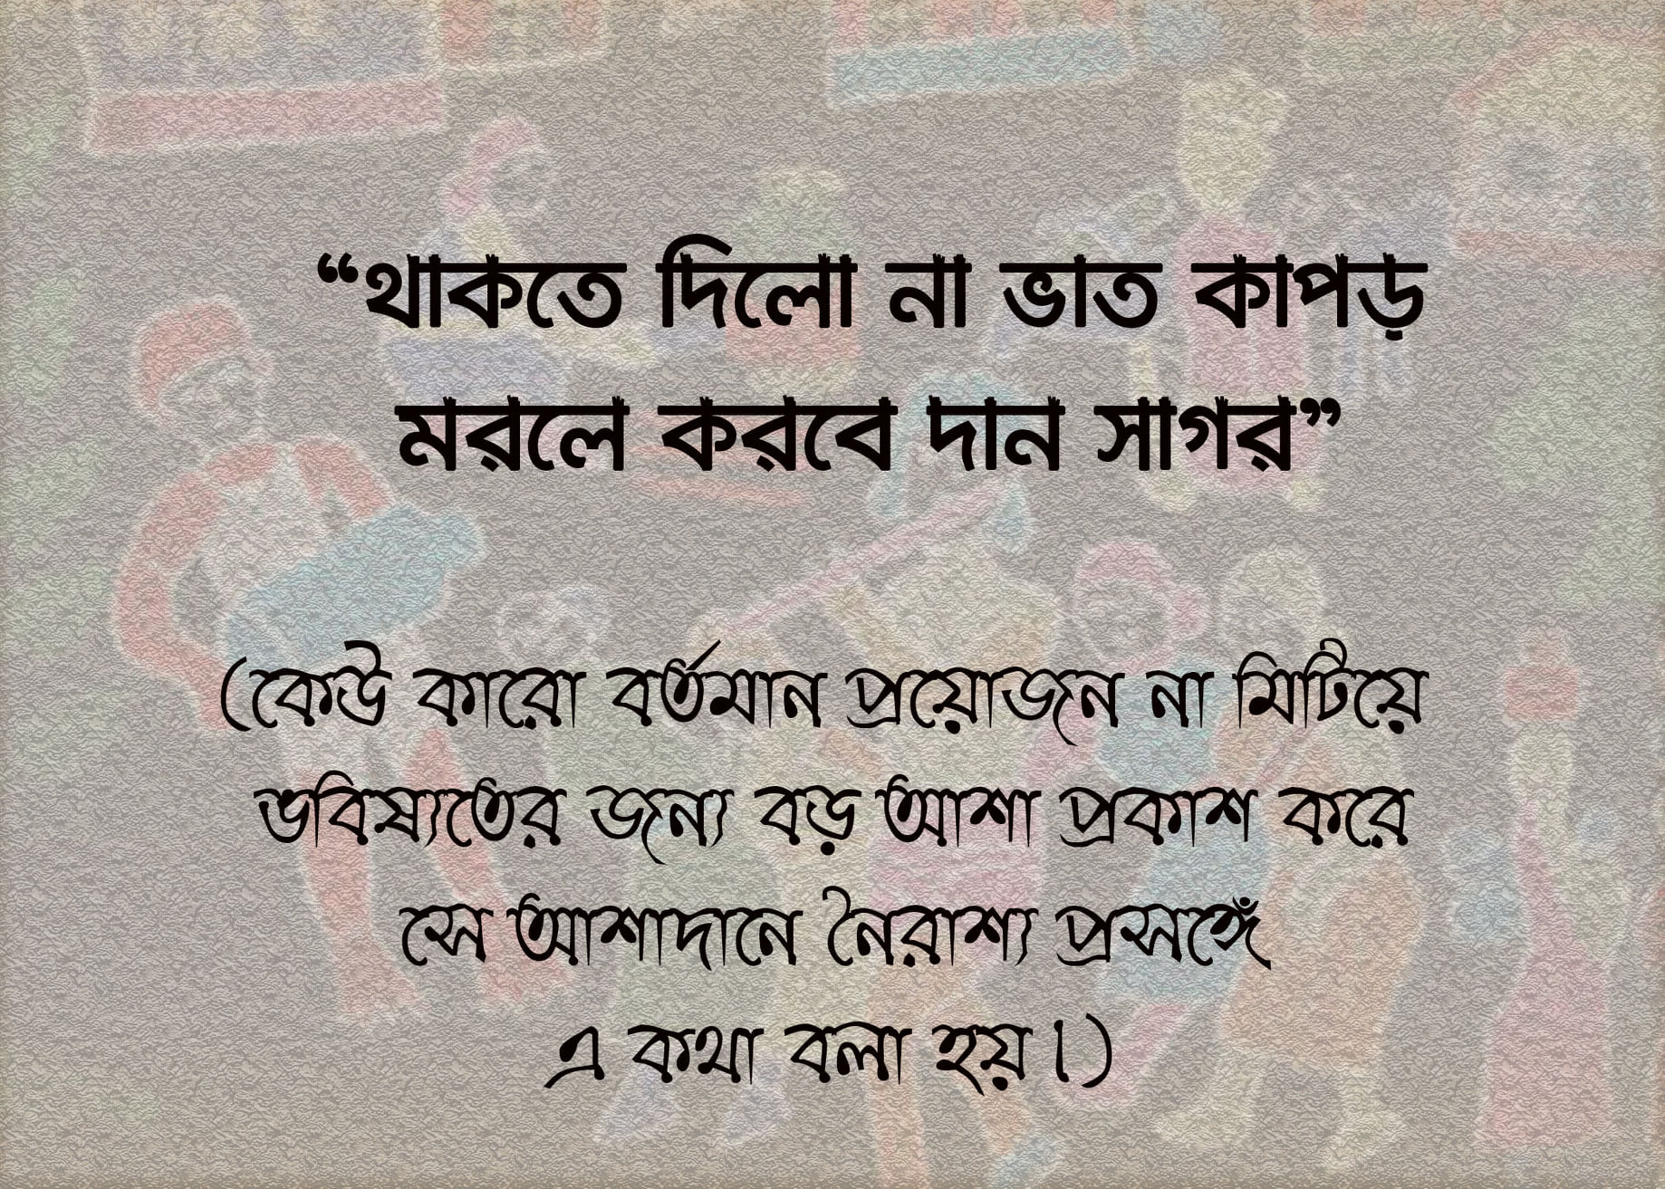

Slide 10
Khona used her knowledge to help the peasants (কৃষক), but her actions often challenged the ruling class. The rulers, not pleased with her defiance (অবাধ্যতা), punished her cruelly by cutting out her tongue. Thus, she became known as Khona, which means "someone who cannot speak." Despite this harsh (কঠোর) punishment, her wisdom lived on through her sayings, which have been passed down for over 1500 years.

Slide 11
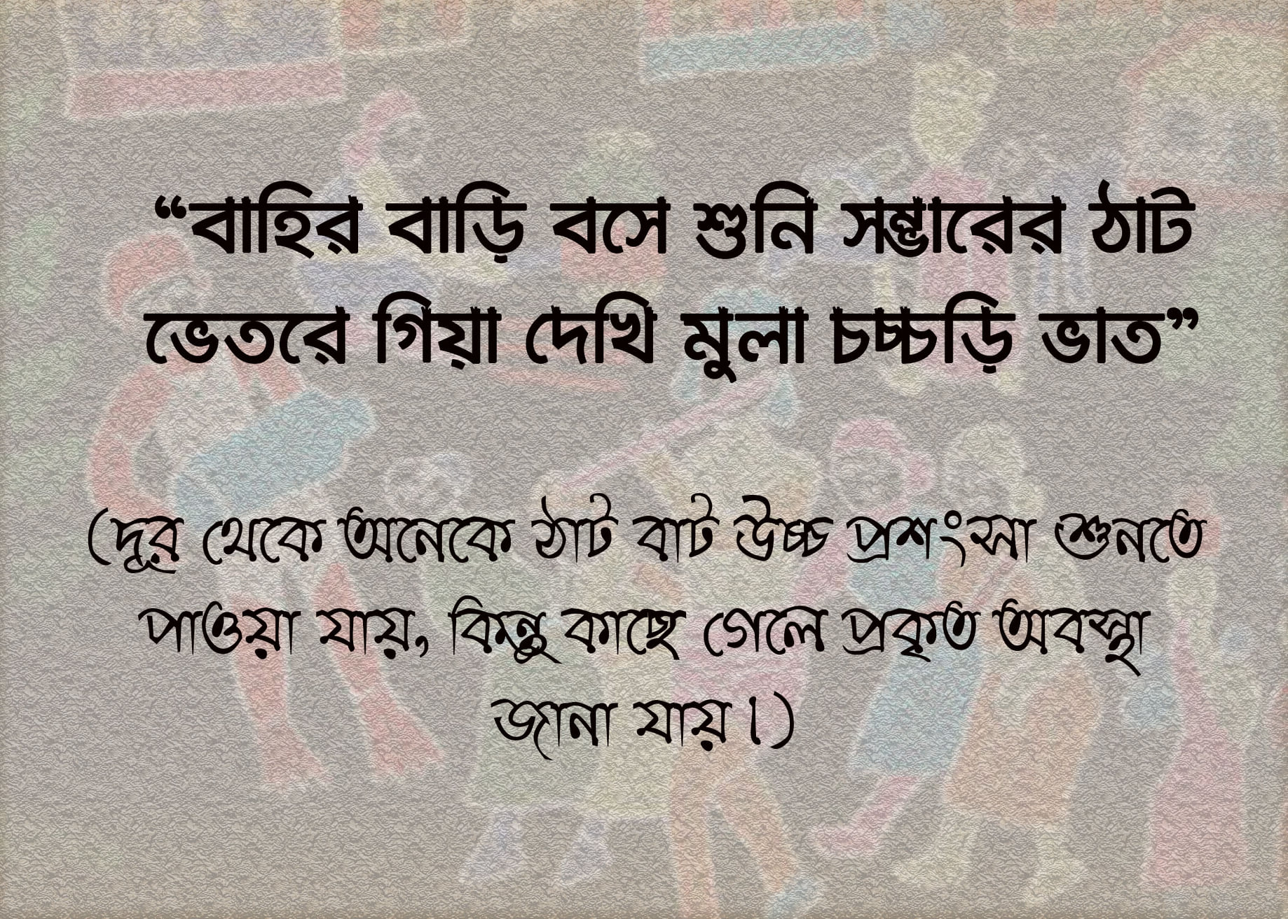

Slide 12
There are many versions of Khona's story. One retelling (পুনঃবক্তব্য) goes like this: in the kingdom of Deyulnagar, there was a royal astrologer named Varaha who served King Dharmaketu. Sadly, Varaha's wife died while giving birth to their son, Mihir. Worried about his son's future, Varaha saw in the stars that Mihir was destined for a life of trouble and death.

Slide 13


Slide 14
Heartbroken, Varaha decided to save Mihir by placing him in a copper (তামা) pot and setting the pot afloat (ভেসে থাকা) on the river Viddyadhory. The baby was found and rescued in Sri Lanka, where he was raised by the king. As he grew up in the royal court, he married the king's daughter, an astrologer herself, named Lila.

Slide 15
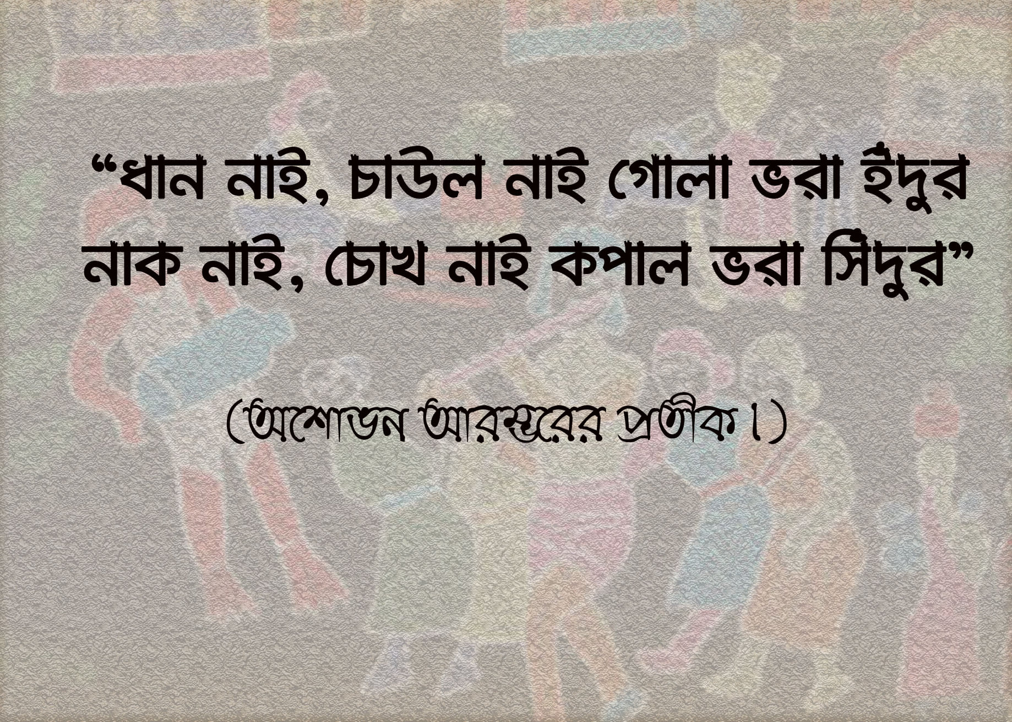

Slide 16
Lila and Mihir managed to find Varaha and prove that his predictions (ভবিষ্যদ্বাণী) about Mihir's future had been wrong. Varaha, though surprised by his mistake, was thrilled (রোমাঞ্চিত) to see his son again and welcomed both Mihir and Lila warmly. They were soon introduced to the royal court and became royal astrologers themselves.

Slide 17
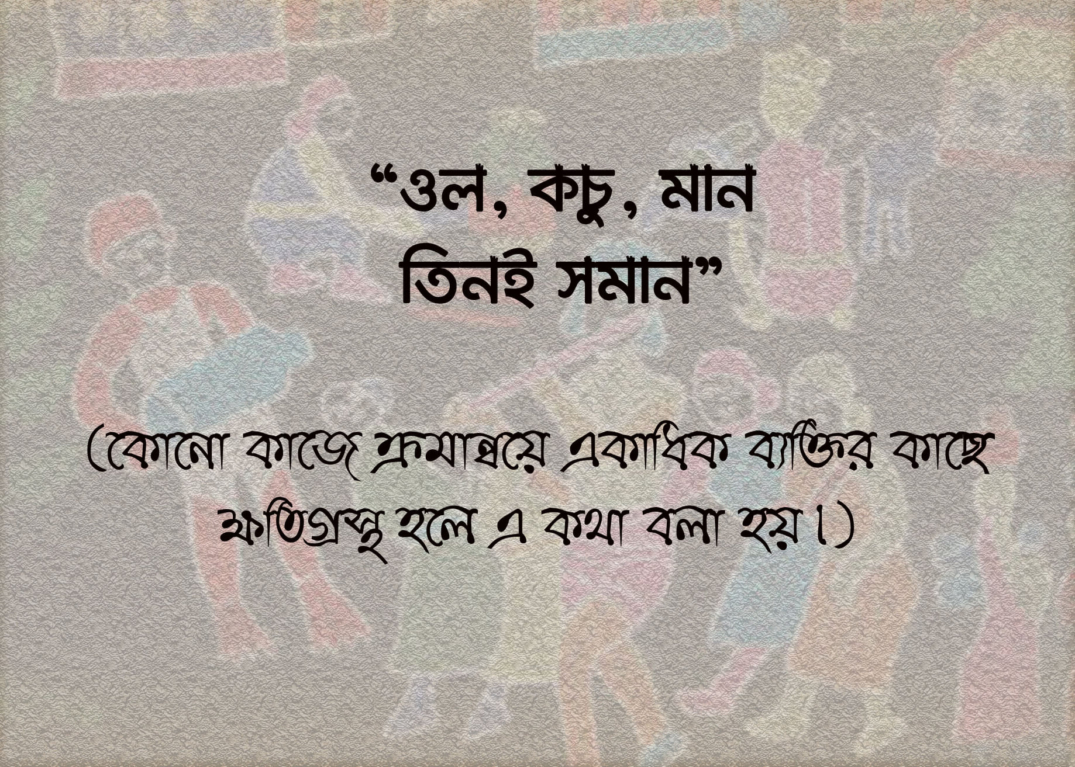

Slide 18
Even though Lila was now a royal astrologer (জ্যোতিষী), she kept in touch with the local farmers. She learned a lot from them and found that they shared valuable knowledge through short, easy-to-remember verses (পদ). Lila began to use these simple verses to explain her own complex astrological (জ্যোতিষশাস্ত্র সংক্রান্ত) knowledge.

Slide 19
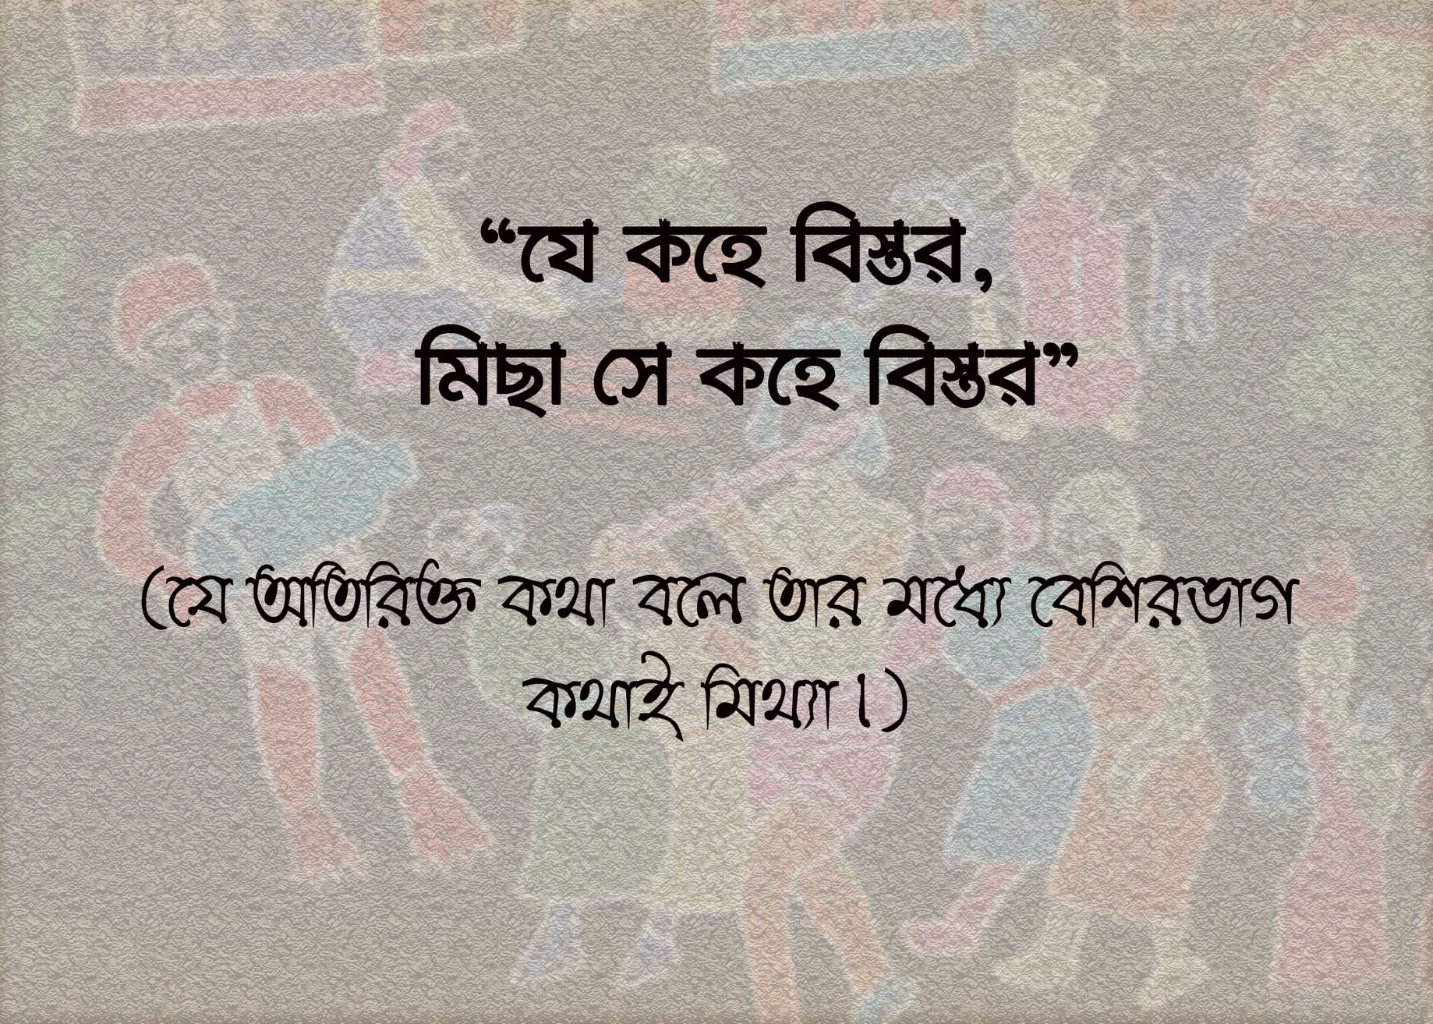

Slide 20
Varaha, feeling jealous and angry, ordered his son to punish Lila by cutting out her tongue, hoping to silence her. However, Khona's story and her knowledge remained alive. Her wisdom about nature-oriented (প্রকৃতি-ভিত্তিক) farming continued to benefit the people of the land.

Slide 21
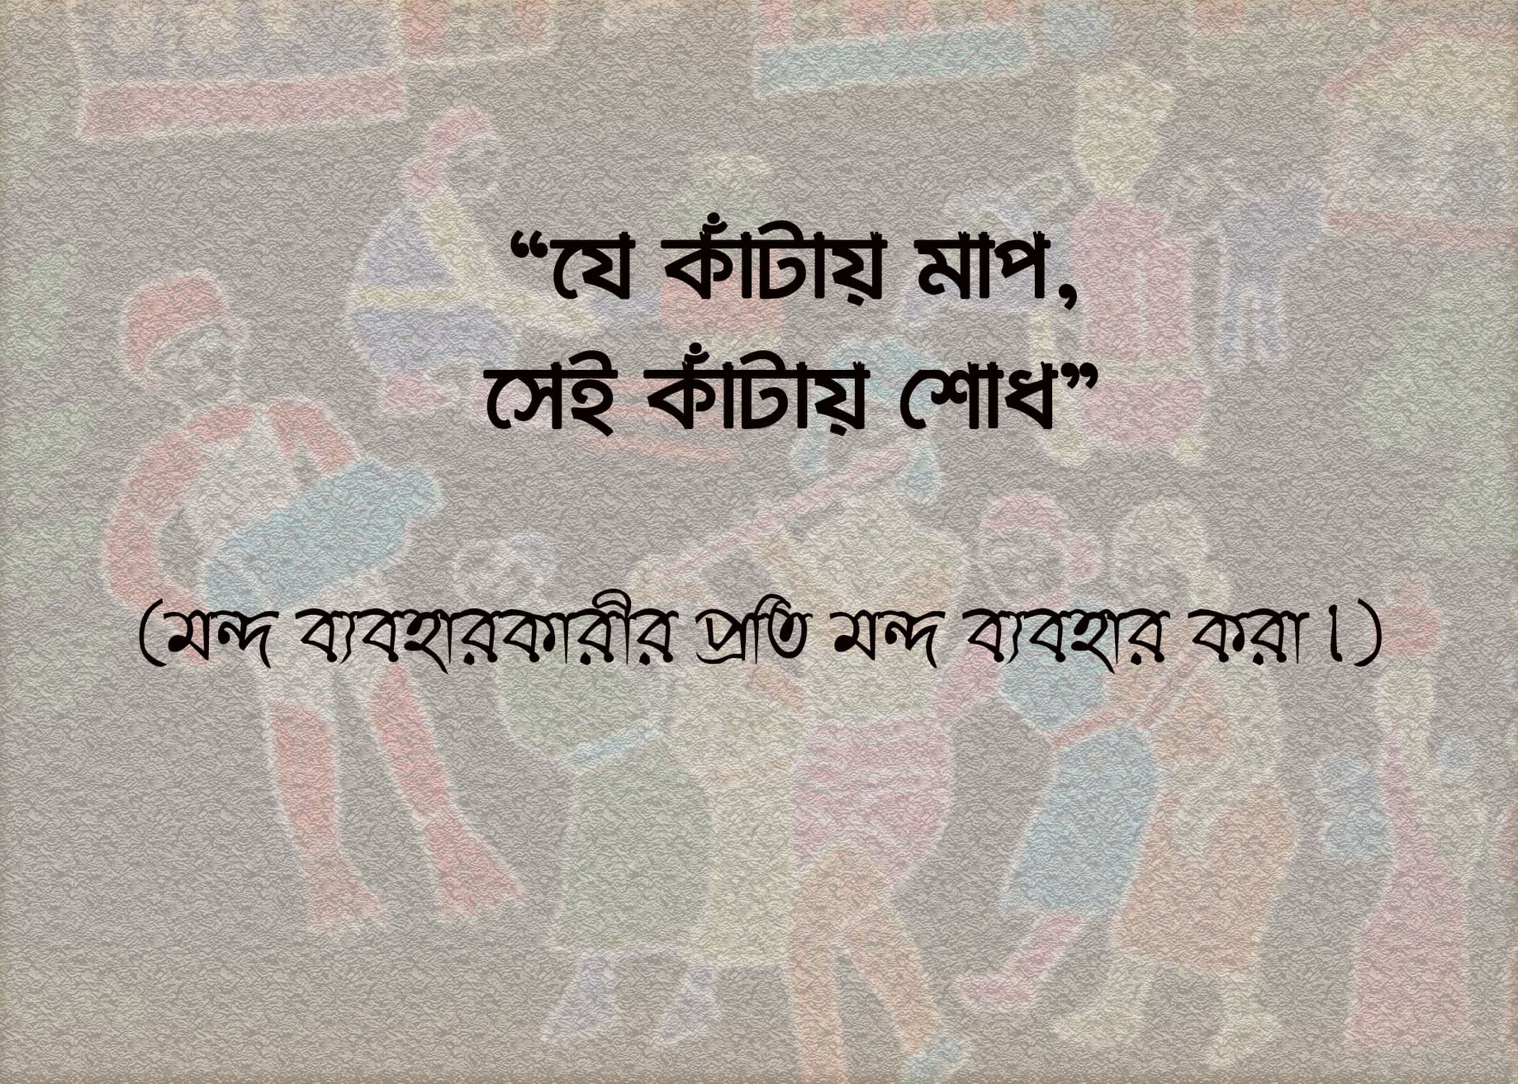

Slide 22


