Slide 1


Good Morning Dear Learners

Slide 2

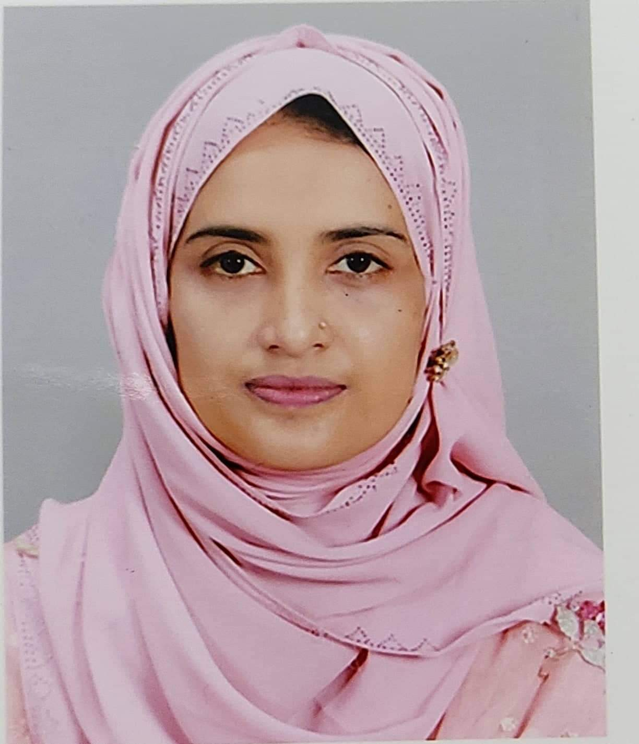
Mst Mowsumi Akter
Assistant Teacher
Mashora GPS,Burichong,Cumilla
Email:Mowsumi.akter342@gmail.com
Presented by

Slide 3

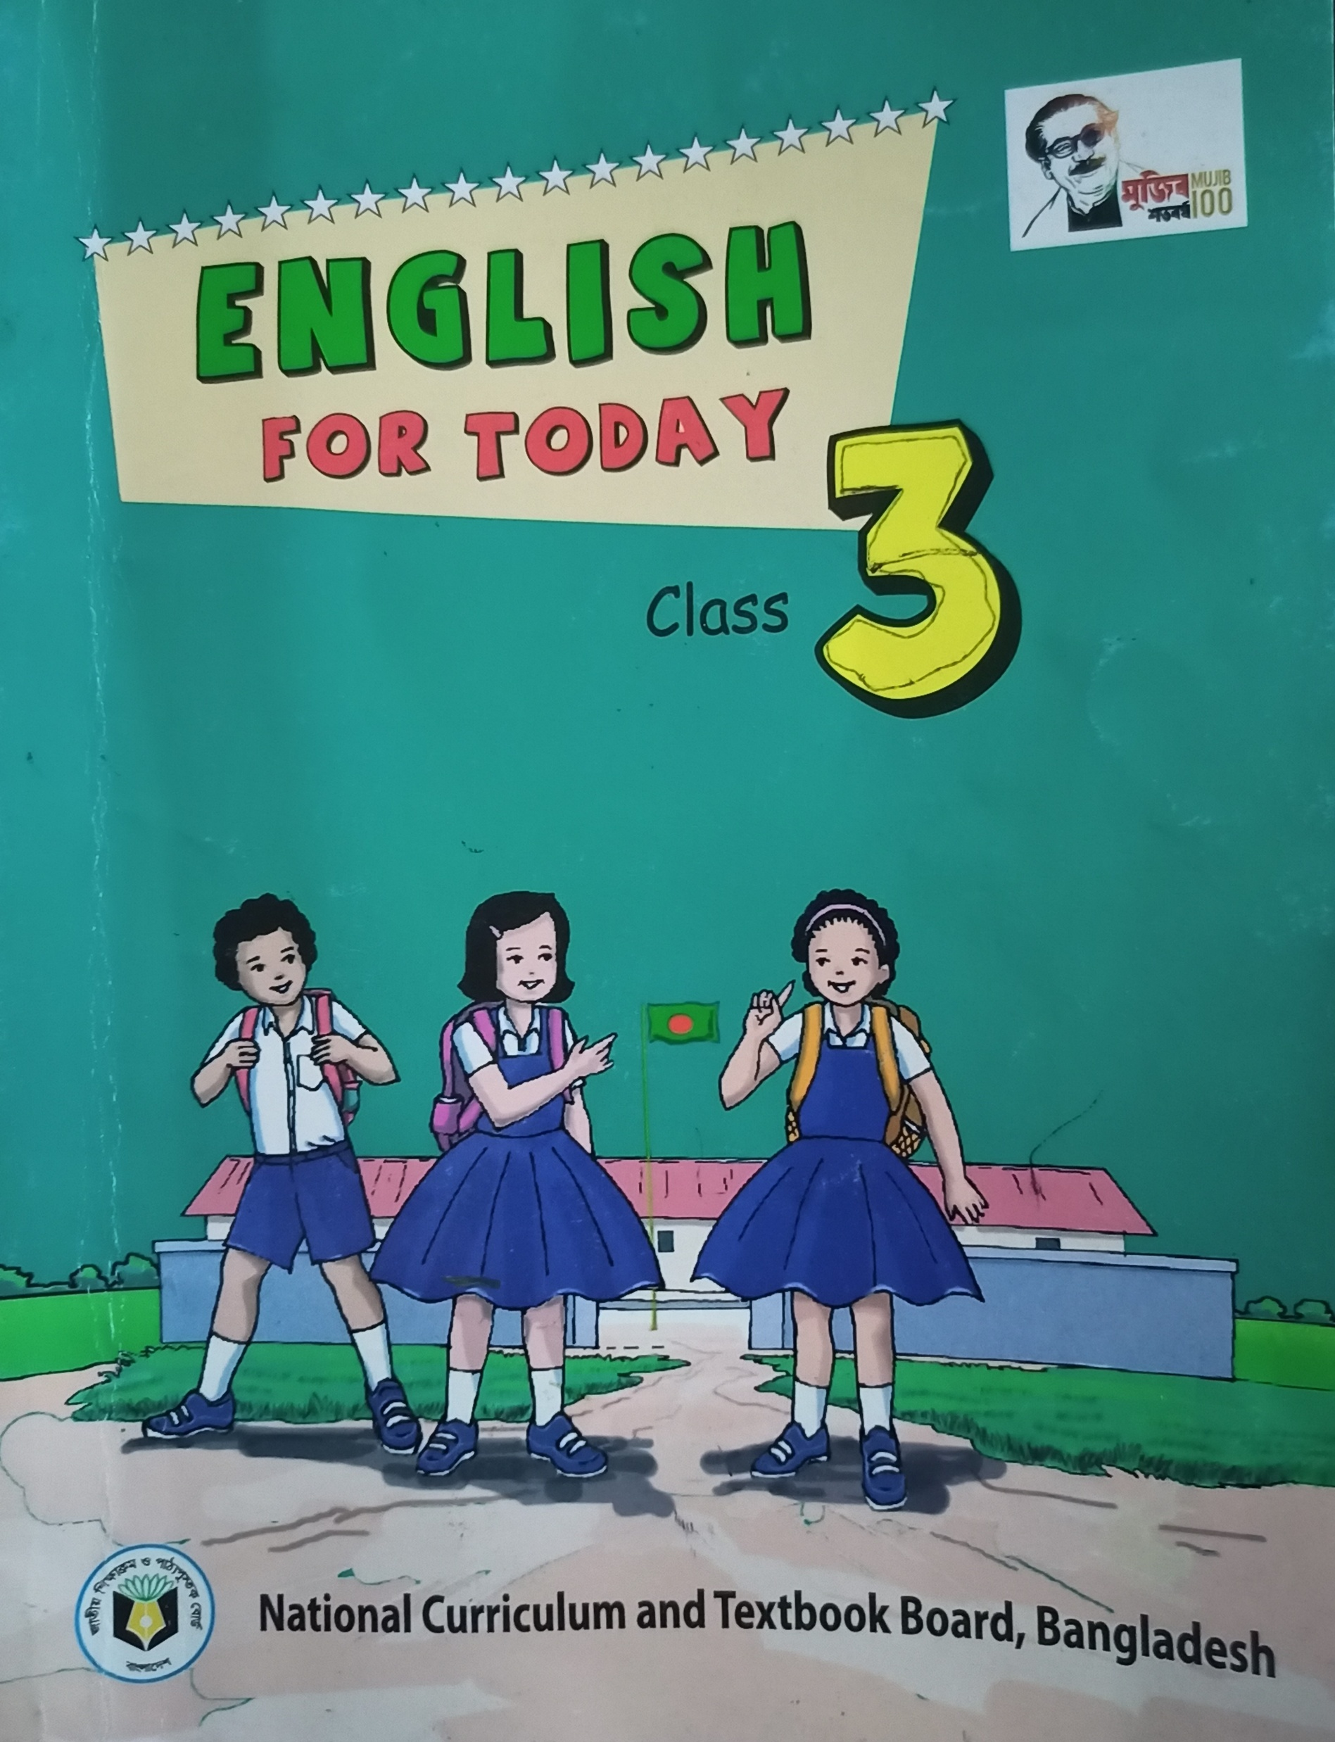
Subject Identity
Subject :English
Unit:2
Lesson:5
Time:45 minutes

Slide 4

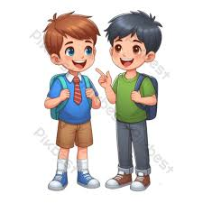

Warm up activities

Slide 5

Learning outcomes:By the end of the lesson students will be better understand to:
4.2.Reading aloud simple sentences with proper stress,intonation and punctuation.
5.1. Understanding simple texts for specific information.

Slide 6
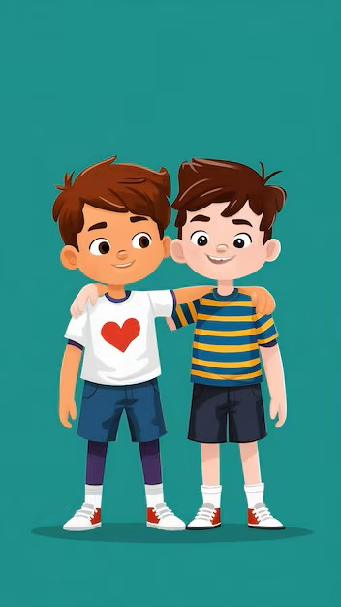

Let’s see the picture and say who are they?

Slide 7
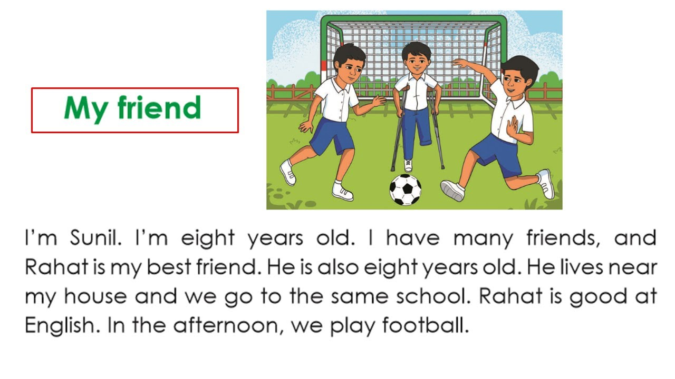
Lesson Declaration
My friend
Activity:A,B
Page:29

Slide 8
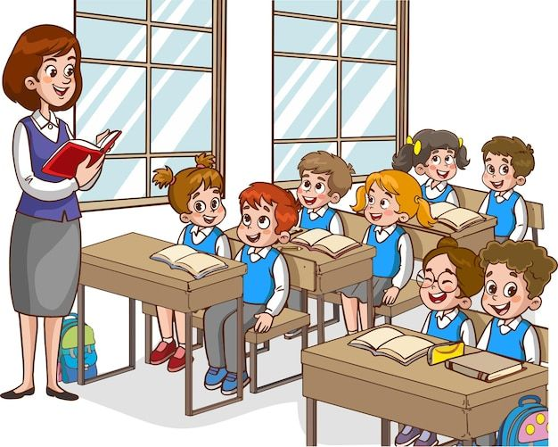
Let’s read the text
I am Sunil.I am eight years old.I have many friends,but Sunil is my best friend.He is also eight years old.He lives near my house and we go to the same school.Rahat is good at English.In the afternoon,we play football.

Slide 9

Pair work
Read the text practise in pairs and explain the questions from 1 to 4.

Slide 10

Group work
Read the text practise in groups and explain the questions from 1 to 4.

Slide 11

Practise activities
Let’s a spotting mistake game.

Slide 12

Individual work
Ask students answer the questions one by one in front of the class.

Slide 13

Home work
Write four sentences about your friend in your exercise book.

Slide 14


Goodbye.See you in the next class.

